Slide 1


[AHG19] Response to the questionnaire on VVC hardware encoder implementation challenges
(JVET-AO0053)
Muxuan Wu, Jianhua Yu (HiSilicon)
Yin Zhao, Elena Alshina (Huawei)

Slide 2
Organization of the presentation:
Section 1: An example of hardware encoder architecture
Section 2: Response to the AHG19 questionnaire

Slide 3
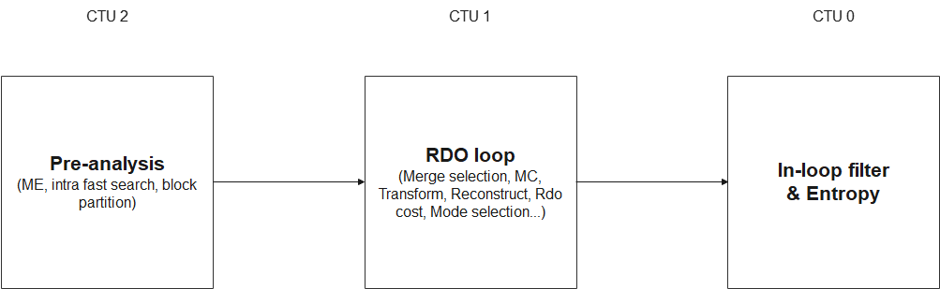
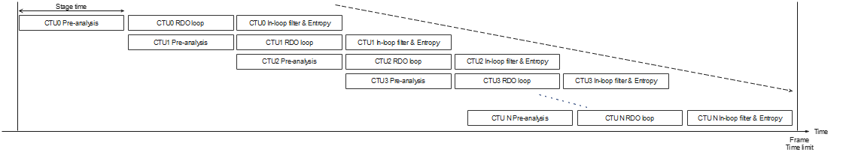
3-stage encoding pipeline & frame latency
Parallel processing at the same time

Slide 4
3-stage encoding pipeline (cont.)
Stage 2 – RDO Loop
Main and the most complex stage of the encoder
Similar to VTM’s compressCtu() function
Heavy recursive process with many operations:
  Motion compensation
  Intra Prediction
  Transform
  Quantization
  RDO cost evaluation
  Reconstruction
Determines final coding mode and reconstructed pixels
Extremely high complexity → motivates adding a pre‑analysis stage

Slide 5
3-stage encoding pipeline (cont.)
Stage 1 – Pre‑Analysis Stage
Reduces computational load of the RDO loop
Uses intra fast search to reduce intra mode candidates
RDO loop evaluates fewer options → lower complexity
Moves tasks out of RDO loop, such as:
  Motion estimation for all CU sizes
Allows RDO to focus on essential operations
Improves overall pipeline efficiency

Slide 6
3-stage encoding pipeline (cont.)
Stage 3 – Loop Filters & Entropy Coding
Handles loop filters and entropy coding
Applies filters to reconstructed pixels from the RDO loop
Produces the final reconstructed result
Encodes syntax elements of the current CTU
Generates the output bitstream
Completes the CTU processing pipeline

Slide 7
More details on Stage 1
Pre‑Analysis Stage
Main purpose: reduce RDO loop computational complexity
Keeps CU dependencies low to avoid recursive CU processing
Pipeline has not processed the left CTU yet
  Cannot use left CTU‘s final modes
  Cannot use left CTU‘s motion vectors
  Cannot use left CTU‘s reconstructed pixels
Neighbor CU information must be estimated, not taken from actual coded results
Uses simplified algorithms for estimation to maintain pipeline parallelism
Ensures pre‑analysis remains lightweight and hardware‑friendly

Slide 8
More details on Stage 2
RDO Loop Stage
Determines final coding mode
Generates reconstructed pixels (before filtering)
Evaluates all CU modes and all CU sizes
Computes RDO cost to select the best mode
Hardware uses parallel architecture to shorten processing time
  Reference software processes sequentially → too slow for hardware
  Parallelism ensures that stage‑time requirement is met

Slide 9
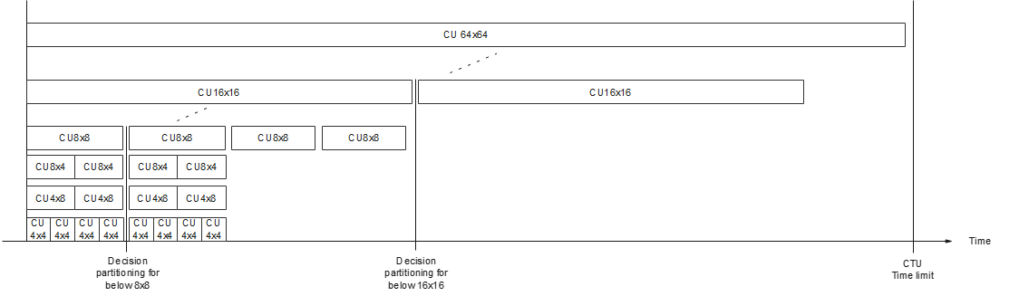
Parallel Computation Across CU Sizes
Hardware supports parallel processing across different CU sizes
Same‑size CUs must still be processed sequentially due to dependencies
Example dependency rule:
  All CUs below 8×8 must be processed first
  Their partitions must be finalized
  Only then can the hardware start processing the next 8×8 CU and its sub‑CUs
Ensures correctness while maximizing parallelism across CU sizes

Slide 10
CU Size Complexity & Pre‑Analysis Optimization
Disable CU64x64
Disable one BT
Complexity mainly comes from the large number of CU sizes
More CU sizes → more parallel processing required → higher area and power
Pre‑analysis algorithms used to reduce peak computational load
Possible optimization strategies:
  Adaptively disable RDO for CU64×64 or CU4×4
  Limit BT partitioning to test only one of the horizontal and vertical BT splits
Reduces unnecessary computation and keeps hardware cost manageable

Slide 11
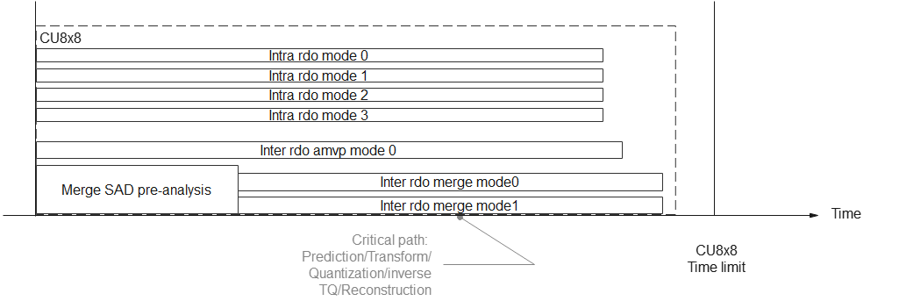
RDO Mode Evaluation & Parallel Architecture
For each CU size, multiple coding modes must be evaluated
  Intra, Inter AMVP, Inter Merge, …
RDO cost is used to select the final coding mode
Many RDO paths are processed in parallel
  To meet the stage‑time requirement, hardware relies on parallel processing
  Number of parallel paths depends on how many modes require RDO evaluation

Slide 12
RDO Path Operations & Merge Mode Pre‑Decision
Extends the overall CU processing time
Each RDO path must execute a full sequence:
  Prediction, Transform, Quantization, Inverse TQ, Reconstruction, RDO cost calculation
This forms a critical path and is time‑consuming
Hardware improves timing by optimizing parallelism at each step
Merge mode evaluation depends on neighboring reconstructed MVs
  Therefore, merge decisions cannot be made outside the RDO loop
  Use SAD‑based pre‑decision before RDO to reduce unnecessary computation
  This dependency and pre‑decision process extends overall CU processing time

Slide 13
Parallelism vs. Hardware Utilization in RDO Architecture
Hardware architecture aims to maximize parallelism to meet timing requirements
Parallel execution does NOT mean giving each coding mode or CU size its own dedicated circuit
Fully dedicated circuits → extremely low hardware utilization
Designers instead adopt pixel‑level pipeline architectures
  Different RDO operations share the same computational resources
Trade‑off:
  Shared pipelines increase per‑CU processing time
Key challenge:
  Design an RDO loop that meets worst‑case timing constraints
  While keeping hardware cost and resource usage under control

Slide 14
More details on Stage 3: Entropy Coding & In‑Loop Filtering
Entropy Coding
  Encodes syntax elements
  Generates the final output bitstream
In‑Loop Filtering
  Applies filtering to reconstructed pixels
  Determines filter parameters
Adaptive Loop Filtering (ALF)
  ALF uses frame‑level parameters
  Parameter estimation normally requires the entire reconstructed frame
  To avoid storing a full frame:
    Do not use ALF parameters calculated from the current frame
    Apply ALF parameters from the previous frame
ALF Two‑Part Operation
  Parameter estimation using the current frame
  Filtering decisions + filtering using previous frame’s parameters

Slide 15
Organization of the presentation:
Section 1: An example of hardware encoder architecture
Section 2: Response to the AHG19 questionnaire

Slide 16
Target Application & Performance Goal
Target application: smartphones
Under design a VVC hardware encoder
Performance goal:
  Support 4K resolution
  Up to 120 fps encoding

Slide 17
VVC Tools difficult for HW encoder implementation
Block Partitioning
  MTT with depth ≥ 2
  Dual‑tree structure
  Large CTU size increases control complexity
Intra Prediction
  MRL (Multiple Reference Lines)
  ISP (Intra Subpartition mode)
  MIP (Matrix‑based Intra Prediction)
Inter Prediction
  MMVD (Merge Mode with Motion Vector Difference)
  GPM (Geometric Partitioning Mode)
  CIIP (Combined Intra-Inter Prediction)
Transform Stage
  Explicit MTS for inter blocks
  LFNST (Low-Frequency Non-separable Secondary Transform)
  SBT (Sub‑Block Transform)
Quantization & Residual Coding
  DQ (Dependent Quantization)
  JCCR (Joint Coding of Chroma Residuals)
Loop Filtering
  Comparatively less difficult than other tools

Slide 18
Why are they difficult for HW encoder Implementation?
1. Coding Gain Issues
  Some tools offer small coding gain
  Hard to implement on encoder, even if decoder side is easy
  Reference software lacks hardware‑friendly fast algorithms
  Hardware engineers must design fast algorithms from scratch
2. RDO Requirements
  RDO consumes large hardware resources
  Chip area is limited
  Tools with poor area vs. coding‑gain trade‑off may be excluded
  Examples: MRL, ISP, MMVD, GPM, CIIP, eMTS for inter blocks, SBT.
3. Hardware Complexity
  Some tools significantly increase structural complexity
  Require large hardware area
  Examples: MTT, 128×128 CTU
4. Critical Path Impact
  RDO is a critical path in the encoder architecture
  Adding complexity here has high cost
  Examples: LFNST, DQ
5. Data Dependence
  Some tools depend on neighbor CU decisions
  Cannot perform pre‑analysis outside the RDO loop
  Even tools not requiring RDO may still incur extra cost due to dependencies

Slide 19
Helpful VVC coding tools for HW encoder design
Parallel Merge
  Merge mode normally creates data dependence between neighboring CUs
  These dependencies can slow down the RDO loop
  Parallel merge allows pre‑computing merge candidates for multiple CUs
  Different CUs can run merge evaluation simultaneously
  Provides engineers with greater flexibility to optimize RDO resource allocation
  Helps improve throughput and pipeline efficiency in hardware encoder design

Slide 20
Encoding algorithms are difficult for hardware
RDOQ
  Adds significant complexity to the RDO loop
  Very hard to parallelize within a CU
  Requires coefficient scanning
  Each coefficient depends on previous decisions
  Strong sequential dependency → limits parallel hardware design
Deblocking in RDO
  Increases RDO loop complexity
  Adds extra filtering operations inside RDO

Slide 21
Main challenges in designing VVC HW Encoder
1. CU Partitioning
  Many CU sizes → more RDO paths → higher hardware resource cost
  Reference software fast algorithms not hardware‑friendly
  MTT becomes difficult until hardware‑optimized fast algorithms are developed
2. RDO Cost
  RDO is the most expensive part of the encoder
  Each additional RDO path increases area and latency
  A coding tool should provide ≥ 1% coding gain per extra RDO path to justify implementation
3. Data Dependency Between CUs
  New coding tools create stronger CU‑to‑CU dependencies
  Must know neighbor CU results before deciding current CU mode
  Prevents pre‑analysis and parallel decision‑making
  Even with skipped RDO paths, dependencies still slow down the RDO loop
4. Luma–Chroma Dependency
  Tools like CCLM introduce cross‑component dependencies
  Luma and chroma cannot be processed in parallel
  Increases intra‑mode computation path
  Reduces achievable parallelism
5. Loop Filtering (ALF)
  ALF depends on frame‑level parameters
  Requires the entire reconstructed frame to compute parameters
  To avoid extra frame storage, must use previous‑frame parameters
  Leads to less coding gain

Slide 22
Comments & Suggestions for new standard design
Develop coding tools that achieve good coding gain with less reliance on RDO
Reduce and control dependencies between CU mode decisions
Further optimize VVC coding tools for better trade‑offs and hardware encoding friendliness
Design in‑loop filters that provide good coding gain without frame‑level decisions
Consider hardware design limitations when designing/proposing new coding tools
Separately evaluate the complexity of RDO‑loop vs. non‑RDO‑loop operations
Test coding tools under realistic hardware‑encoding configurations
  e.g., two reference frames, GOP size ≤ 8, Constrained RDO complexity

Slide 23
Conclusions and suggestions
Differences between HW encoder and VTM
  Hardware encoder must consider critical path and coding‑gain–to‑area ratio
  Parallelism is essential for easier hardware implementation
  Coding tools that do not rely on RDO are generally more friendly for hardware encoder
  Additional RDO is worthwhile only if it provides ≥ 1% coding gain per RDO
Recommend JVET to consider the 3‑stage pipeline architecture as one of reference hardware encoder architectures during the development of the next-generation standard
Recommend AHG19 to consider developing hardware‑encoding-mimicking simulation framework similar to the 3-stage pipeline architecture on VTM

Slide 24
Thank you.

