Slide 1
AHG17: Report on CfE testing
JVET-AN0361
M. Wien, F. Bossen, Ch. Lehmann, V. Baroncini

Slide 2
Overview on CfE testing activity
Compression efficiency test case (CP)
  ECM + 4 submissions + anchor
  All but one submissions in all test categories
Runtime test case (RT)
  ECM_2x + 15 submission variants + anchor
  All submissions responded to all test categories
  Evaluated on subset of test sequences
Functionality test (FC) (error concealment)
  One submission with subset of test sequences
  TBD

Slide 3
Overview
Compression efficiency Test Case
Session allocation |  | 741
S01 | HDR_HLG | 69
S02 | HDR_PQ a | 57
S03 | HDR_PQ b | 59
S04 | SDR_UHD a | 47
S05 | SDR_UHD b | 46
S06 | HD50 1 | 71
S07 | HD50 2 | 68
S08 | HD60 1 a | 51
S09 | HD60 1 b | 51
S10 | HD60 2 | 77
S11 | HD60 3 | 72
S12 | HD60 4 | 73
Runtime Test Case
Session allocation |  | 1189
S13 | HDR_PQ 1 a | 59
S14 | HDR_PQ 1 b | 58
S15 | HDR_PQ 2 a | 53
S16 | HDR_PQ 2 b | 52
S17 | HDR_HLG 1 a | 60
S18 | HDR_HLG 1 b | 57
S19 | HDR_HLG 2 a | 53
S20 | HDR_HLG 2 b | 52
S21 | SDR_HD50 1 a | 59
S22 | SDR_HD50 1 b | 58
S23 | SDR_HD50 2 a | 53
S24 | SDR_HD50 2 b | 52
S25 | SDR_HD60 1 a | 59
S26 | SDR_HD60 1 b | 58
S27 | SDR_HD60 2 a | 53
S28 | SDR_HD60 2 b | 52
S29 | SDR_HD60 3 a | 50
S30 | SDR_HD60 3 b | 50
S31 | SDR_HD60 4 | 87
S32 | SDR_HD60 5 | 60
S33 | SDR_HD60 6 | 54
CP | Start time | duration
Sat | 09:00 | 137 | CP1
Sat | 11:30 | 125 | CP2
Sat | 14:00 | 129 | CP3
Sat | 16:30 | 157 | CP4
RT | Start time | duration
Sun | 09:00 | 129 | RT1
Sun | 11:30 | 127 | RT2
Sun | 14:00 | 125 | RT3
Sun | 16:30 | 125 | RT4
Mon | 09:00 | 129 | RT5
Mon | 11:30 | 119 | RT6
Mon | 13:30 | 145 | RT7
FC | Start time | duration
Mon | 09:00 | 129 | FC1
Functionality test
Session allocation |  | 184
S34 | P09_UHD | 39
S35 | P09_HD_a | 49
S36 | P09_HD_b | 49
S37 | P09_HD_c | 47

Slide 4
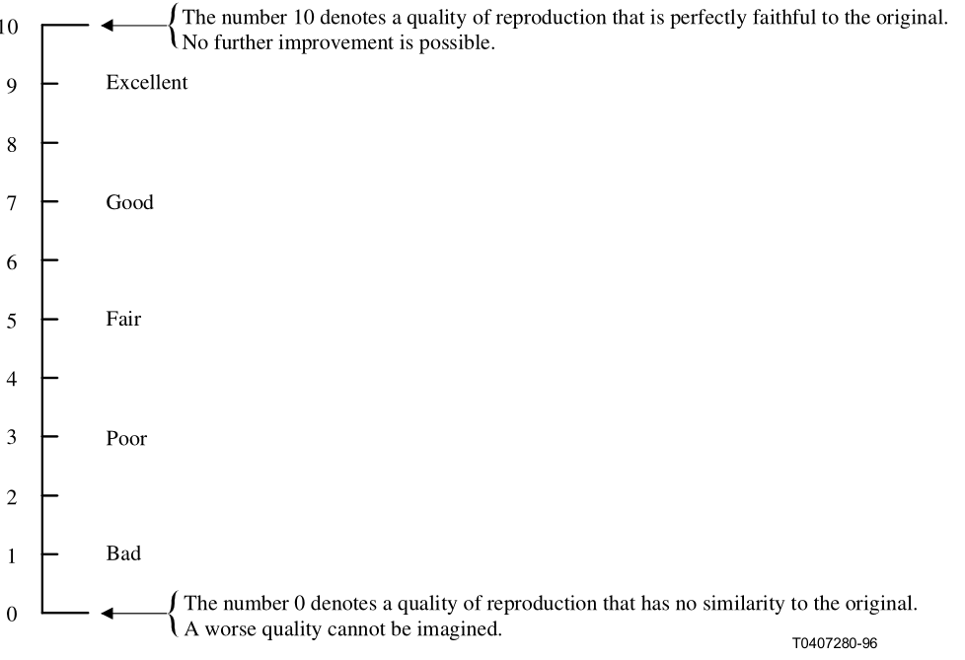
Overview on testing activity
Test method:
Absolute category rating with hidden reference (ACR-HR)
  Rate PVS on absolute quality scale
  BTC of 16sec
  “PVS”– <video> - “Vote x”
  (1sec) (10 sec) (5 sec)
PVS = processed video sequence | BTC = basic test cell

Slide 5
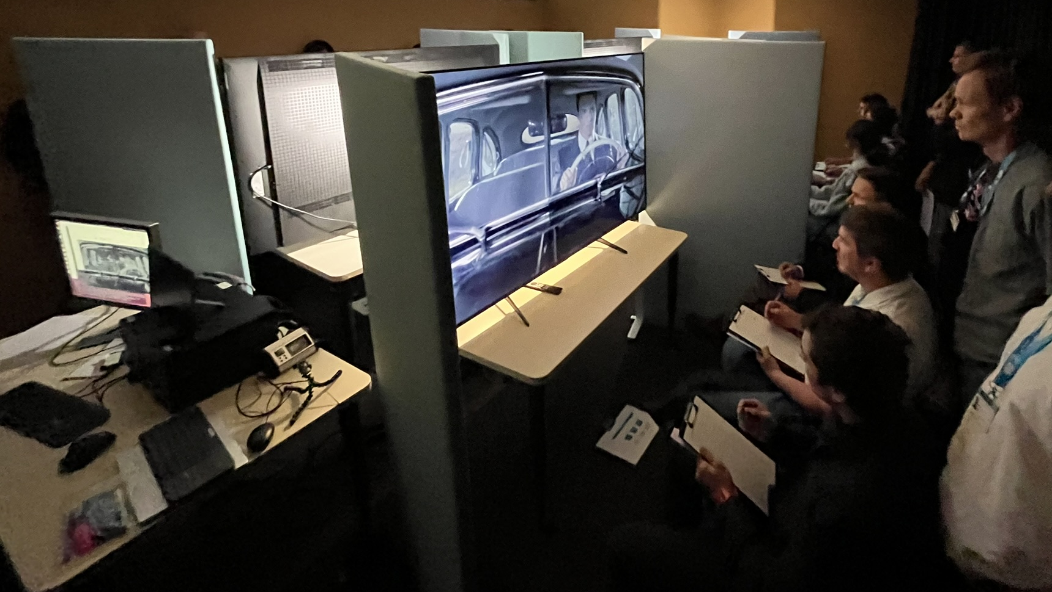
Test statistics
873 Viewers
2131 Test Cases
50146 Votes
(picture from training session)

Slide 6
Data processing
Application of the BT.500 method implemented in the Sureal software package (https://github.com/Netflix/sureal)
  Outlier detection based on ‘noisiness’ of scores per viewer
  No further viewer correlation check
Additional check (performed by Vittorio Baroncini)
  Scan for outliers using non-normalized z-score method (threshold 2), applied to a subset of data so far (HD sequences)
  Very few outliers observed
  Impression: results should be stable.

Slide 7
1st Impression on Results

Slide 8
CfE Results Overview
Presentation:
  Overview: Percentage of rate points where with at least one proposal being better than the anchor
    over all categories
    over all per rate point
    per category
  Examples for cases with significant benefit
  Examples for cases with less benefit

Slide 9
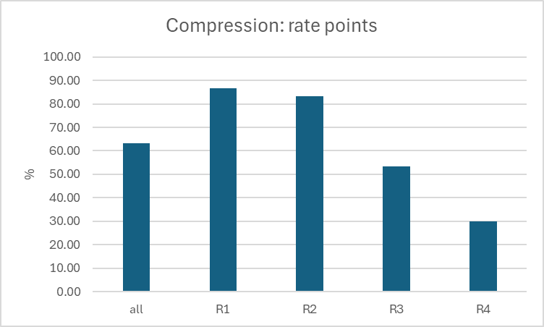
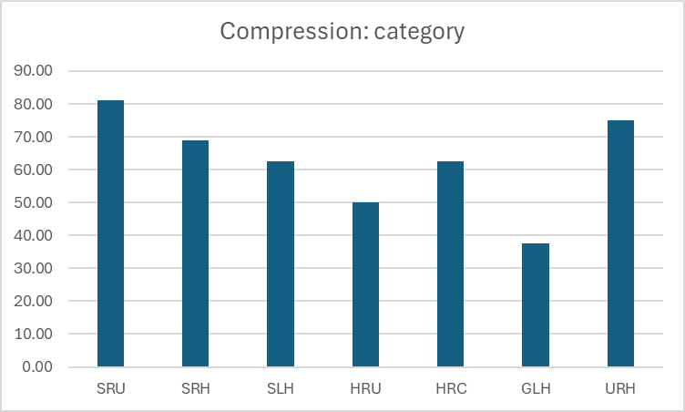
Compression efficiency test case

Slide 10
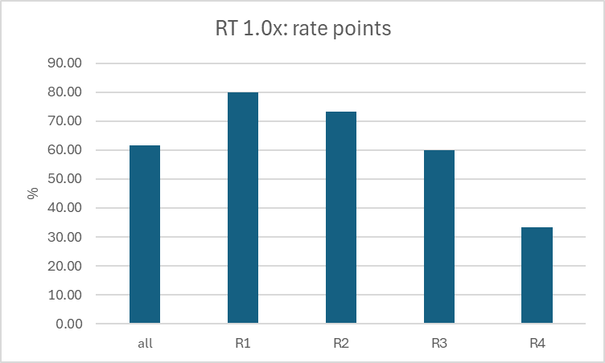
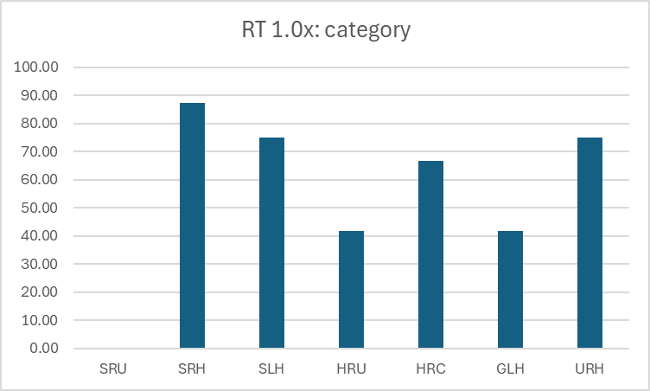
Runtime: 1x test case

Slide 11
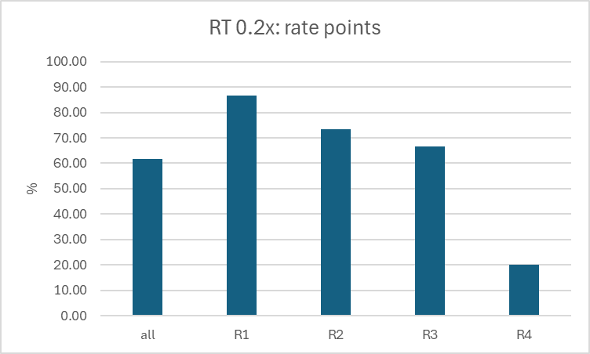
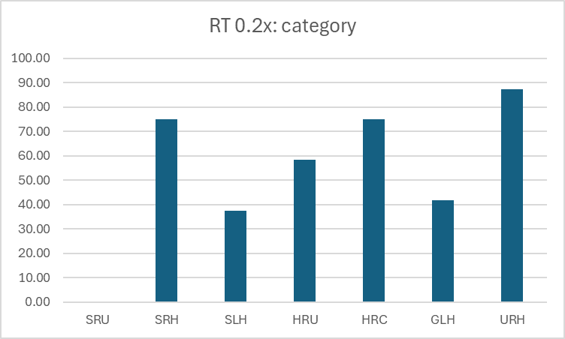
Runtime: 0.2x test case

Slide 12
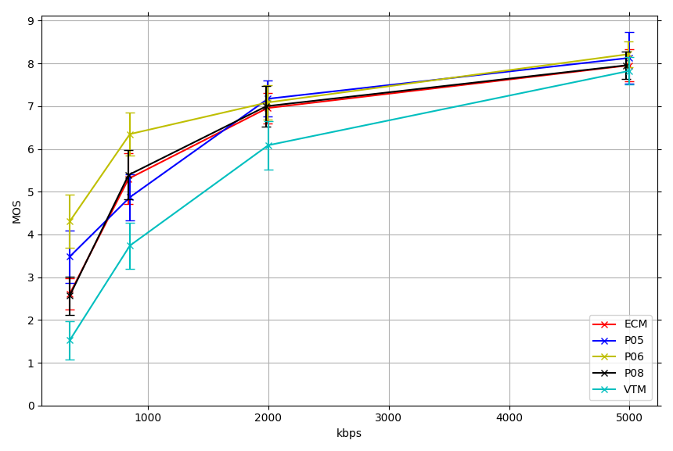
Example MOS-over-Rate plots
HDR PQ UHD
Random access
NeptunFountain
(HRU3)

Slide 13
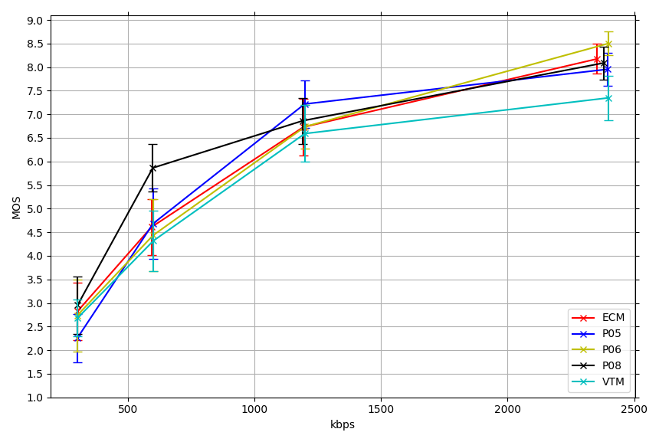
Example MOS-over-Rate plots
Gaming HD Low-delay
Minecraft
(GLH4)

Slide 14
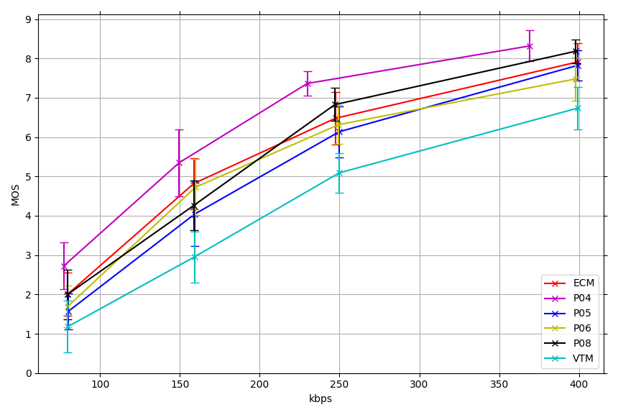
Example MOS-over-Rate plots
UGC Random access
Sports Iceball
(URH4)

Slide 15
Conclusions

Slide 16
Conclusions
CfE is considered successful
For most of the categories, significant compression improvement can be observed when comparing proposals to the anchor
Study of material not completed yet
  Some data points missing in sessions
  Consolidation of results

Slide 17
Thanks
to the ITU for the excellent facilities
to TCL for providing four calibrated 75” miniLED displays for the tests
to Fraunhofer HHI for providing the playout PC
To the viewers scoring all the PVS
to Christian Lehmann and Vittorio Baroncini for running most of the sessions
+ to Christian Lehmann for preparations and technical support!

