Slide 1

JVET-AN0257-v1: [AHG11] CPU and GPU time comparison for NNVC models
Image and Video codec standardization team in Huawei
A. Karabutov, E. Alshina (Huawei)
Franck Galpin (InterDigital)

Slide 2
Goal
Investigate the dependency between an execution time of NN model on different devices and come up with an approach that allows to estimate the inference time on different NPU/GPU bases on an execution time on CPU.

Slide 3
Description of the setup
The model under investigation: LOP6 from NNVC
SW frameworks:
  Simple Ad-hoc Deep-Learning Library (SADL), pure CPU inference.
  PyTorch framework, for CPU and GPU inference.
  Snapdragon Neural Processing Engine (SNPE) library for inference on CPU and NPU of a mobile device.
Devices:
  Huawei Mate50 pro:
    Processor: Snapdragon 8+ Gen 1 4G Mobile Platform.
    NPU: 7th Gen Qualcomm AI Engine.
    RAM: 8 GB.
  High-end PC with GPU:
    Processor: AMD Ryzen 9 5950X 16-Core Processor.
    GPU: Nvidia Geforce RTX 3090, 24 GB.
    RAM: 64 GB DDR4 2133 MHz.

Slide 4
Methodology
Inferencing multiple times the model with a set of input shapes: 144x144, 272x272, 528x528 and 1040x1040. The execution time was averaged among all runs.
Multiply the execution time on number of tiles in the target frame:
Filters input shape | 144x144 | 272x272 | 528x528 | 1040x1040
Image shape \ Tile size | 128x128 | 256x256 | 512x512 | 1024x1024
1920x1080 (HD) | 127 | 32 | 8 | 2
3840x2160 (4k) | 507 | 127 | 32 | 8
Command line to run experiments with SADL library is:
./sadl/sample/sample_simd256 models/nnlf_lop6_model_int16.sadl 144

Slide 5
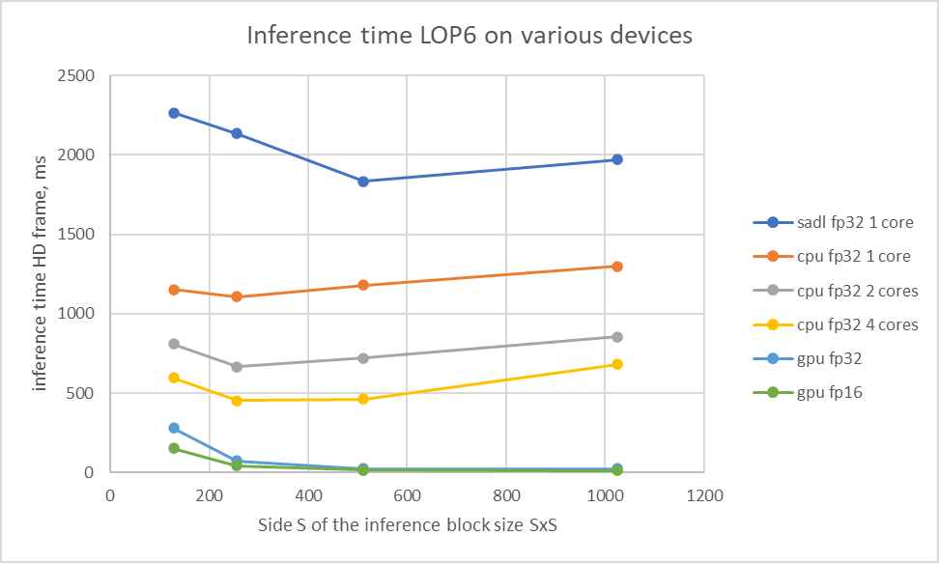

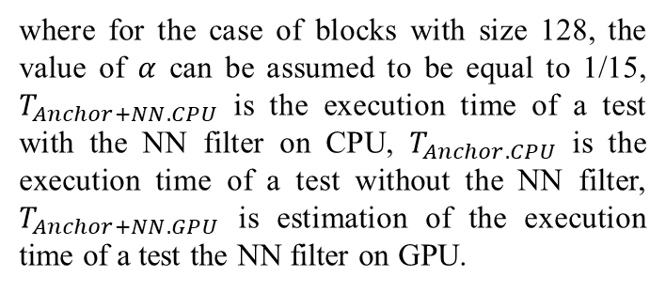
Results
Based on the results we can use the following formula to estimate complexity of tests with the filter on GPU:
$$T_{Anchor+NN.GPU}=T_{Anchor.CPU}+$$
$$α∙\left(T_{Anchor+NN. CPU}−T_{Anchor. CPU}\right)$$
where for the case of blocks with size 128, the value of $α$ can be assumed to be equal to 1/15, $T_{Anchor+NN. CPU}$ is the execution time of a test with the NN filter on CPU, $T_{Anchor. CPU}$ is the execution time of a test without the NN filter, $T_{Anchor+NN.GPU}$ is estimation of the execution time of a test the NN filter on GPU.
Tile size | sadl fp32 1 core | cpu fp32 1 core | cpu fp32 2 cores | cpu fp32 4 cores | gpu fp32 | gpu fp16 | Ratio sadl fp32/gpu fp32 | Ratio sadl fp32/gpu fp16
128 | 18 | 9 | 6 | 5 | 2.2 | 1.2 | 8 | 15
256 | 68 | 35 | 21 | 14 | 2.3 | 1.3 | 29 | 52
512 | 232 | 149 | 91 | 59 | 3.1 | 1.9 | 75 | 122
1024 | 997 | 657 | 432 | 345 | 12.5 | 5.6 | 80 | 178
Model execution time on a single tile in milliseconds.

Slide 6
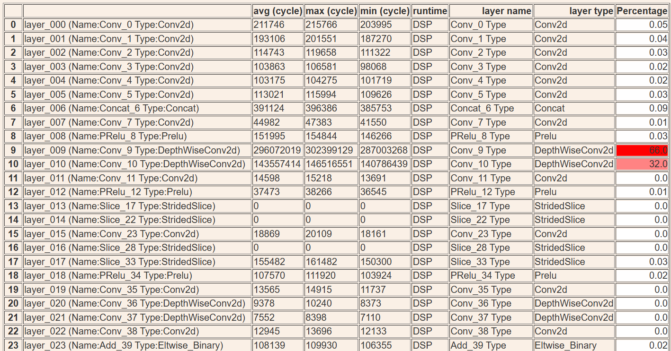
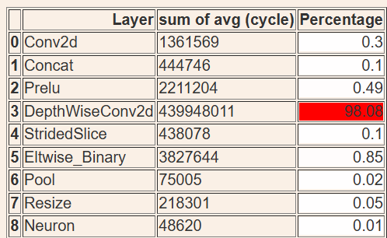
Experiments on the mobile device
 |  | Execution time, ms
AXwY | Platform | Avg | Max | Min
a8w8 | CPU | 81.1 | 83.6 | 77.5
 | NPU | 153.9 | 156.3 | 150.8
a16w8 | CPU | 79.4 | 87.4 | 68.3
 | NPU | 142.6 | 145.8 | 137.9
where X is a number of bits for activations and Y is a number of bits for weights

Slide 7
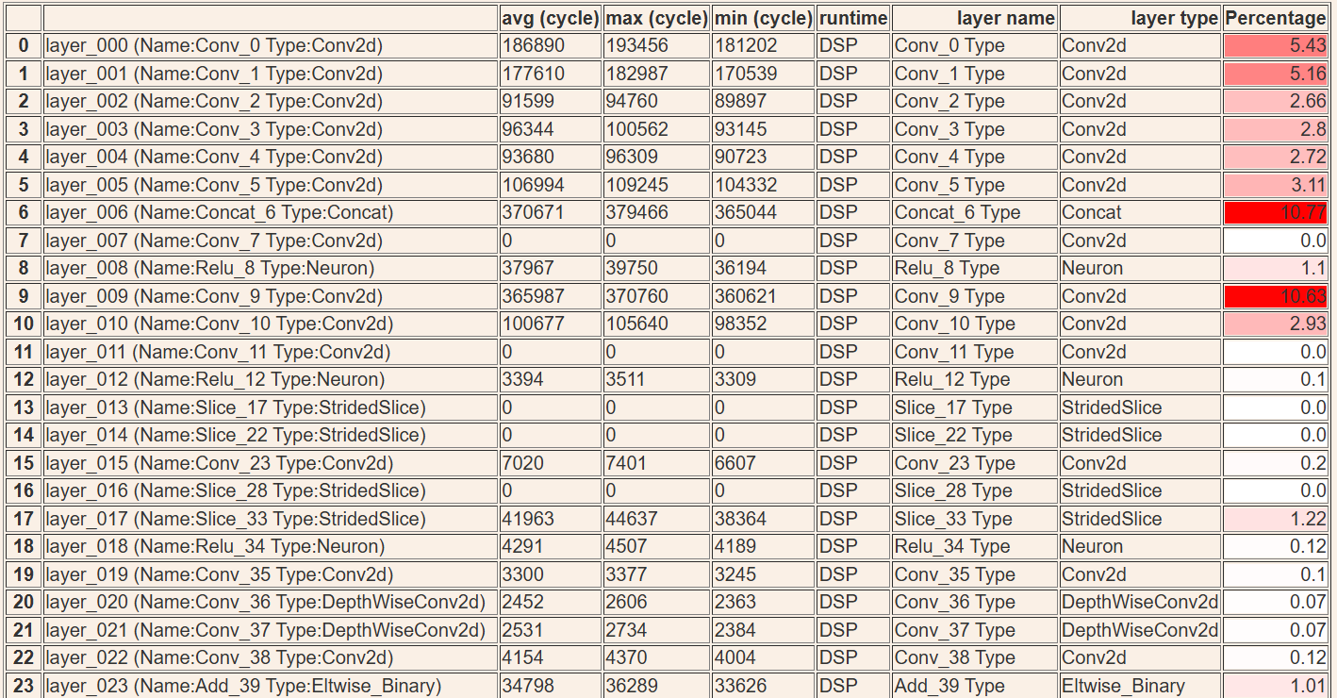
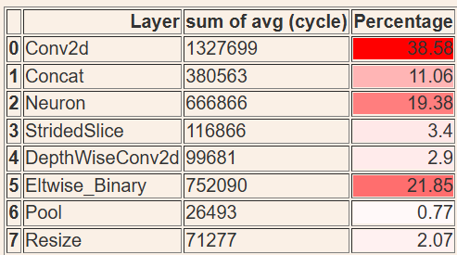
Experiments on the mobile device
DepthWise convolution was changed on Conv2D. PReLU was replaced by ReLU because of a problem with convertion of the model
 |  | Execution time, ms
aXwY | Platform | Avg | Max | Min
a8w8 | CPU | 28.0 | 28.9 | 26.9
 | NPU | 6.1 | 6.4 | 5.7
a16w8 | CPU | 29.7 | 39.3 | 26.2
 | NPU | 6.5 | 6.7 | 6.3

Slide 8
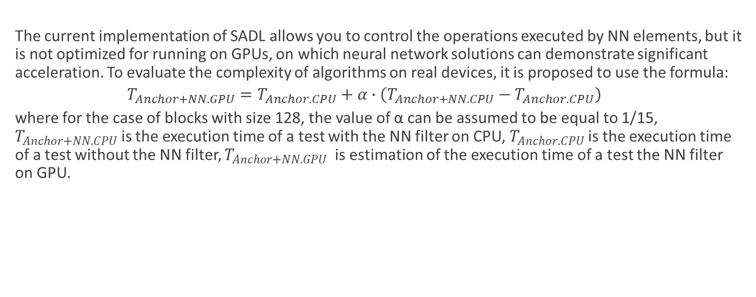
Conclusions
  The current implementation of SADL allows you to control the operations executed by NN elements, but it is not optimized for running on GPUs, on which neural network solutions can demonstrate significant acceleration. To evaluate the complexity of algorithms on real devices, it is proposed to use the formula:
  $$T_{Anchor+NN.GPU}=T_{Anchor.CPU}+α∙\left(T_{Anchor+NN. CPU}−T_{Anchor. CPU}\right)$$
  where for the case of blocks with size 128, the value of α can be assumed to be equal to 1/15, $T_{Anchor+NN. CPU}$ is the execution time of a test with the NN filter on CPU, $T_{Anchor. CPU}$is the execution time of a test without the NN filter, $T_{Anchor+NN.GPU}$ is estimation of the execution time of a test the NN filter on GPU.

Slide 9
