Slide 1

JVET-AN0200
Non-EE2: On improving CIIP Fusion
Yonghua Wang, Xing Zeng, Menghu Jia, Zhengang Li, Cheng Huang
(ZTE)

Slide 2
Introduction
In CIIP, the TIMD derivation method is used to derive the intra prediction mode.
The weights (wIntra, wInter)are fixed segment:
For near-horizontal modes (2 <= angular mode index < 34), the current block is vertically divided as shown in Figure 1(a);
For near-vertical modes (34 <= angular mode index <= 66), the current block is horizontally divided as shown in Figure 1(b).
The (wIntra, wInter) for different sub-blocks are shown in Table 1.
Table 1. The modified weights used for angular modes.
0 | 1 | 2 | 3
0
1
2
3
The sub-block index | (wIntra, wInter)
0 | (6, 2)
1 | (5, 3)
2 | (3, 5)
3 | (2, 6)
(a)
(b)
Figure 1 The division method for angular modes.

Slide 3
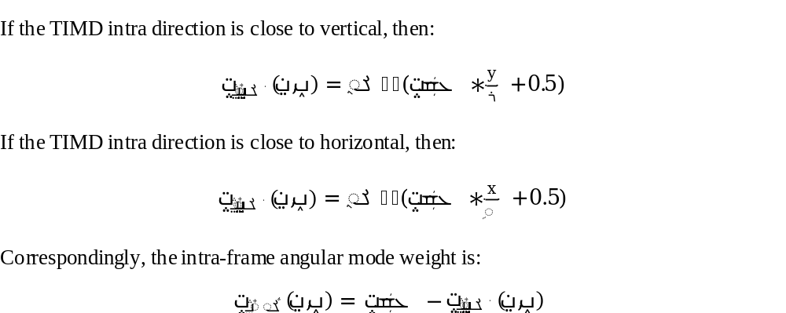
Proposed
Position-dependent linear weight adjustment, the inter-frame mode weight calculation formula has been modified as follows:

Slide 4
Proposed
Applying it only to TIMD mode close to the horizontal or vertical directions, making the weight adjustment more relevant to position.
This method is only applied to the luma.
For other intra-frame angle directions, the original CIIP weighting method is still used.

Slide 5
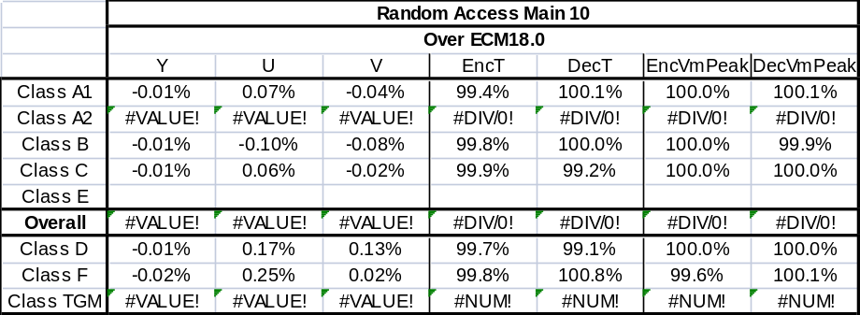
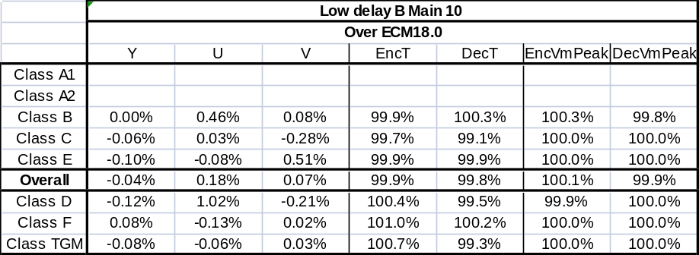
Simulation results
The proposed method is implemented on top of ECM-18.0.

Slide 6
Conclusions
The proposed methods can improve the coding efficiency of ECM with good tradoff.
It is suggested to further study in EE2.
Thanks to Alibaba for cross-checking!

Slide 7
Thank you！

