Slide 1
JVET-AN0142
Non-EE2: GPM without blending for Screen Content
J. Kim(Jade), J. Son, K. Kim, J. Kwak
October 2025
WILUS Inc.

Slide 2
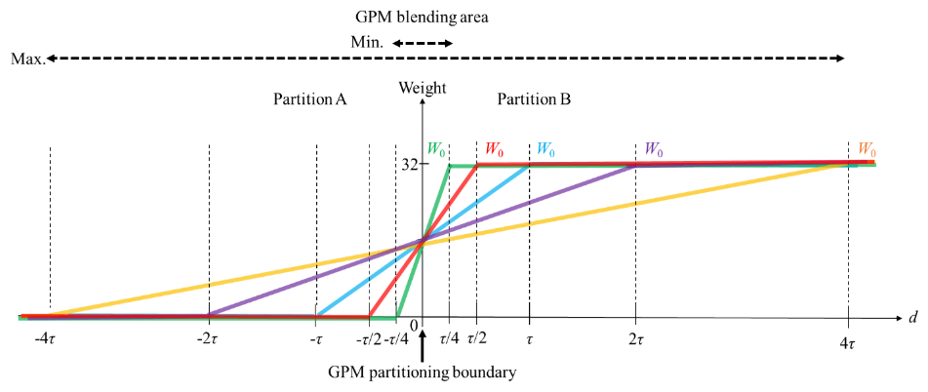
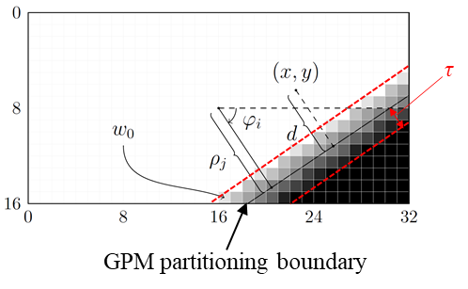
Motivation
In ECM-18.0, the GPM employs five predefined blending widths.
  If min(block width, block height) < 32, use List 1: {1/4τ, 1/2τ, τ, 2τ, 4τ}
  Otherwise, use List 2: {1/2τ, τ, 2τ, 4τ, 8τ}
  Among the five candidates, the index of the selected blending width is signaled.
  For screen content, various blending widths may not always be effective.

Slide 3
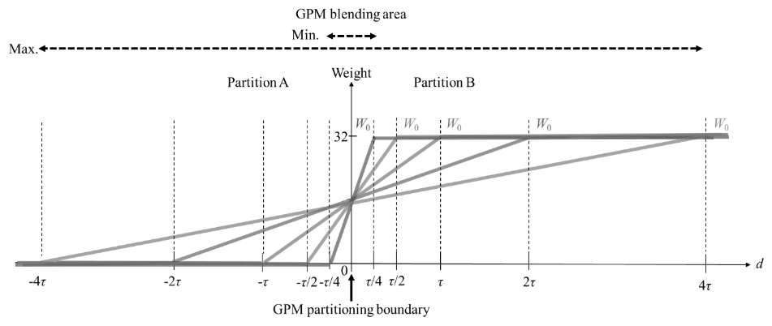
Proposed method
In the proposal, GPM blending width is restricted to a single value for screen content.
  If min(block width, block height) < 32, use 1/4τ
  Otherwise, use 1/2τ
  Eliminate the signaling of the blending width in the bitstream.
  An SPS-level flag to indicate whether the GPM without blending is applied.

Slide 4
Experimental results
On top of ECM-18.0, the simulation results are reported as follows:
 | Random Access Main 10
 | Over ECM-18.0
 | Y | U | V | EncT | DecT | EncVmPeak | DecVmPeak
Class F | -0.02% | 0.04% | 0.05% | 99.7% | 99.9% | 99.5% | 100.1%
Class TGM | -0.12% | -0.12% | -0.08% | 99.2% | 100.0% | 100.0% | 100.2%
 | Low Delay B Main 10
 | Over ECM-18.0
 | Y | U | V | EncT | DecT | EncVmPeak | DecVmPeak
Class F | -0.18% | -0.03% | 0.04% | 99.9% | 100.2% | 100.0% | 100.2%
Class TGM | -0.20% | -0.30% | -0.02% | 99.2% | 98.7% | 100.0% | 99.7%

Slide 5
Conclusion
This contribution proposes GPM without blending for screen content.
Experimental results (Over ECM-18.0)
  RA configuration:
    Class F: -0.02%, 0.04%, 0.05%; 99.7% enc time, 100.0% dec time
    Class TGM: -0.12%, -0.12%, -0.08%; 99.2% enc time, 100.1% dec time
  LDB configuration:
    Class F: -0.18%, -0.03%, 0.04%; 99.9% enc time, 100.2% dec time
    Class TGM: -0.20%, -0.30%, -0.02%; 99.2% enc time, 98.7% dec time
It is recommended to adopt the proposed methods into the next ECM.

Slide 6

THANK YOU
5th Fl., 216 Hwangsaeul-ro, Bundang-gu, Seongnam-si, Gyeonggi-do 13595, Korea, +82-31-712-0523, info@wilusgroup.com, www.wilusgroup.com

