Slide 1
Software fixes for robust decoding in unicast scenario
JVET-AN0081
Kirill Malyshev, Vyacheslav Khamidullin, Sychev Maxim, Sergey Ikonin, Elena Alshina (Huawei)

Slide 2
Introduction
Problems in anchor were found during the preparation for CfE that caused long frames freezes in the unicast scenario.
The more extensive testing with feedback helped to discover another corner case which requires an additional mechanism to improve decoding robustness.
The contribution proposes several fixes of specific logic to ensure a continual decoding process even if the referenced APS NAL unit is unavailable under ultra-low latency test.
The described modifications were used in CfE response JVET-AN0080.

Slide 3
Problems description
The APS NAL and any VCL NAL units can be lost while transmittion through channel under ultra-low latency scenario.
The following problems are happened due to lost of this type NAL units:
  Aspect 1: CTU-level syntax elements parsing depends on APS level syntax elements and could be interrupted
  Aspect 2: Referencing on unavailable APS, such kind of ALF parameter leads to unexpected behavior or interruption of decoding process
  Aspect 3: Standalone APS cannot be decoded without following VCL NAL unit and leads to decoder crush
And one more Aspect 4: Freezing time could be more than 128 frames, and exceed 8 bit limits on POC value.

Slide 4
Aspect 1
Problem
CTU-level syntax elements parsing depends on APS level syntax elements:
alf_chroma_num_alts_minus1, alf_cc_cb_filters_signalled_minus1, and alf_cc_cr_filters_signalled_minus1
Solution
Additional signaling these parameters in Slice header was added in proposed solution.
xWriteUvlc( alfParam.numAlternativesChroma - 1, ”sh_alf_chroma_num_alts_minus1" );
xWriteUvlc(filterParam.ccAlfFilterCount[COMPONENT_Cb - 1] -1, ”sh_alf_cc_cb_filters_signalled_minus1");
xWriteUvlc(filterParam.ccAlfFilterCount[COMPONENT_Cr - 1] -1, ”sh_alf_cc_cr_filters_signalled_minus1");
filterParam.ccAlfFilterCount[COMPONENT_Cb-1]= aps->getCcAlfAPSParam().ccAlfFilterCount[COMPONENT_Cb-1];
filterParam.ccAlfFilterCount[COMPONENT_Cr-1]= aps->getCcAlfAPSParam().ccAlfFilterCount[COMPONENT_Cr-1];
sh_alf_chroma_num_alts_minus1 writes into new slice field m_alfParamNumAlternativesChroma.

Slide 5
Aspect 2
Problem
Referencing on unavailable APS ALF parameter leads to unexpected behavior or interruption of decoding process
Solution
Skip ALF processing if the referenced APS is unavailable.
reconstructCoeffAPSs
int apsIdx = cs.slice->getAlfApsIdsLuma()[i];
curAPS = aps[apsIdx];
if (curAPS == nullptr) {
return false;
}
ALFProcess
bool success = reconstructCoeffAPSs(cs, true, cu->slice->getAlfEnabledFlag(COMPONENT_Cb) || cu->slice->getAlfEnabledFlag(COMPONENT_Cr), false);
if (!success) {
ctuIdx++;
continue;
}
int apsIdxChroma = cs.slice->getAlfApsIdChroma()[i];
curAPS = aps[apsIdxChroma];
if (curAPS == nullptr) {
return false;
}

Slide 6
Aspect 3
Problem
A standalone APS cannot be decoded with non-VCL NAL unit. VVC requires that there is at least one VCL NAL unit in a picture unit and that no VCL NAL unit can appear before NAL_UNIT_PREFIX_APS.
Solution
Allow decoder to accept standalone APS NAL unit for processing. Apply explicit VCL NAL unit receipt check before NAL_UNIT_PREFIX_APS..
case NAL_UNIT_PREFIX_APS:
if (m_pictureUnitNals contains any VCL NAL unit)
{
ret = true;
finished = true;
}
break;
*pseudo code condition

Slide 7
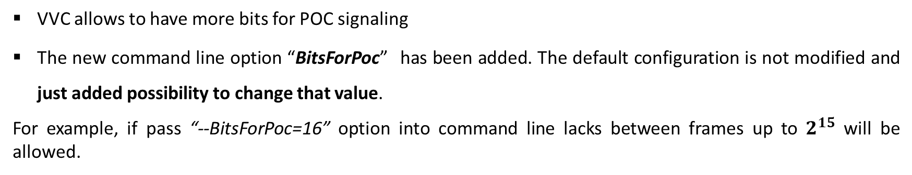
Aspect 4
Problem
The current software implementation has limit on maximum distance between current and referenced frames. It restricted by 8 bits with 1 bit for sign (128 – maximum number of distance). In the event of high network losses, it is possible to experience a gap between sequential POCs that exceeds more than 128 frame. It may result in the decoder crashing.
Solution
VVC allows to have more bits for POC signaling
The new command line option “BitsForPoc” has been added. The default configuration is not modified and just added possibility to change that value.
For example, if pass “--BitsForPoc=16” option into command line lacks between frames up to $2^{15}$ will be allowed.
("BitsForPoc", m_bitsForPoc, 8, "Number of bits that is used in the decoding process for picture order count")

Slide 8
Conclusion
This contribution proposes improvement of AHG18 simulation software towards robust decoding in the unicast scenario. The four aspects are considered and specific modifications are proposed:
  Aspect 1: Specific signaling in the slice header is added to provide a robust CTU-level decoding process.
  Aspect 2: Skip the ALF processing when the referenced APS NAL unit is unavailable is implemented.
  Aspect 3: The decoder is now allowed to obtain standalone APS NAL units for parsing and storing their parameters to ensure more stable APS availability.
  Aspect 4: The new command line option BitsForPoc for encoder to manage MaxPicOrderCntLsb has been added.
All these four modifications increase stability of VTM under packet loss conditions.
It is proposed to adopt described modifications to AHG18 simulation software.
The described modifications were used in CfE response JVET-AN0080.

Slide 9
Thank you.

