Slide 1
[AHG17] On HDR coding and metrics, JVET-AM0287.
Dmytro Rusanovskyy (Nokia), Edouard Francois (InterDigital)

Slide 2
JVET-AM0287: Summary
Contribution reviews JVET-AL2026 (Draft CfE) text’s aspects related to coding efficiency evaluation for HDR content.
  [1] Draft Joint Call for Evidence on video compression with capability beyond VVC, JVET-AL2026.
  [2] VTM and HM common test conditions and evaluation procedures for HDR/WCG video, JVET-AC2021
Contributions proposes:
  Change HDR tests categorization from resolution (4K/8K) to transfer characteristics (BT.2100 PQ/HLG).
  Incorporate in CfE clarification text on compile and run-time settings for deriving of HDR metrics.
  Evaluate need for PSNRL100/DeltaE100 HDR metrics reporting in the view of observed redundancy in additional to the weighted PSNR.
  Document in CfE document the HDR metrics used for CfE

Slide 3
HDR Test Categories of JVET-AL2026
Draft CfE defines 2 HDR test categories: HDR RA 4K (HRU) and HDR RA 8K cropped (HRC), 3840x2160.
  Mixed HLG and PQ with different peak brightness in each category.
  TFs distinct codewords allocations characteristics and tone mapping.
  Objective metrics (JVET-AC2021): PSNR for HLG, wPSNR and PSNRL100/DeltaE100 for PQ.
Proposal: Split HDR test categories to HLG and PQ for viewing and objective metrics reporting.
 | Sequence ID | Sequence name | Transfer fct. | PSNR | wPSNR | L100/DE100
HRU | HRU1 | AMS06 | HLG10 | Yes | N/A | N/A
 | HRU2 | MeridianHDR2 | P3 PQ 4Knits | Yes | Yes | Yes
 | HRU3 | NeptuneFountain3R1 | HDR10 PQ | Yes | Yes | Yes
 | HRU4 | SparksWelding | HDR10 PQ 1Knits | Yes | Yes | Yes
HRC | HRC1 | ChandelierCropBR | HDR10 PQ | Yes | Yes | Yes
 | HRC2 | FashionLadyCrop1 | HDR10 PQ | Yes | Yes | Yes
 | HRC3 | WaterfallForest | HLG10 | Yes | N/A | N/A
 | HRC4 | WomenFootball | HLG10 | Yes | N/A | N/A

Slide 4
HDR-related compile and run-time settings
JVET-AL2026 (Draft CfE) specifies that compile and run-time configurations for VTM and ECM anchors to follow CTC for HDR/WCG JVET-AC2011 [1].
  Compile and run-time configurations of ECM are not defined in JVET-AC2011.
For HDR metrics calculations, JVET-AL2026 (Draft CfE) refers to JVET-AC2011.
  HDR extension of VTM and ECM SW were used to report anchor’s results.
  Reporting of HDR Metrics for other proposals are expected to be aligned to HDRTools implementation.
  HDR metrics derivation remained an active topic of discussion during the AhG17 Calls.
Proposal:
  Update CfE document with self-contained instructions on VTM and ECM compile/run-time configurations and metrics derivation.
  Document in CfE document the HDR metrics used for CfE.

Slide 5
Observed redundancy in HDR Metrics
For HDR metrics calculations, JVET-AL2026 (Draft CfE) refers to JVET-AC2011.
    PSNR to be reported for content with BT.2100/PQ and BT.2100/HLG.
    wPSNR and PSNRL100 and DeltaE100 to be reported for BT.2100/PQ.
    For metrics derivation JVET-AC2011 is referenced.
wPSNR is straightforward LUT-based method aligned with conventional PSNR, integer implementation.
PSNRL100 and DeltaE metrics are computationally and resource demanding, floating point implementations.
There are observations on correlation of PSNRL100 and DeltaE100 with wPSNR for PQ data.
Proposal: Assess correlation of PSNRL100 and DeltaE100 in addition to wPSNR from the results of visual quality assessment conducted during CfE evaluation.

Slide 6
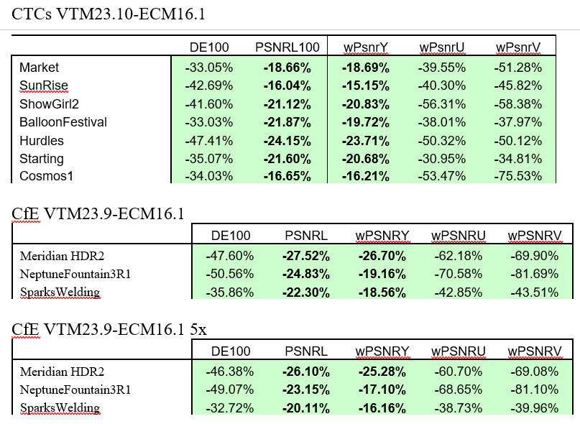
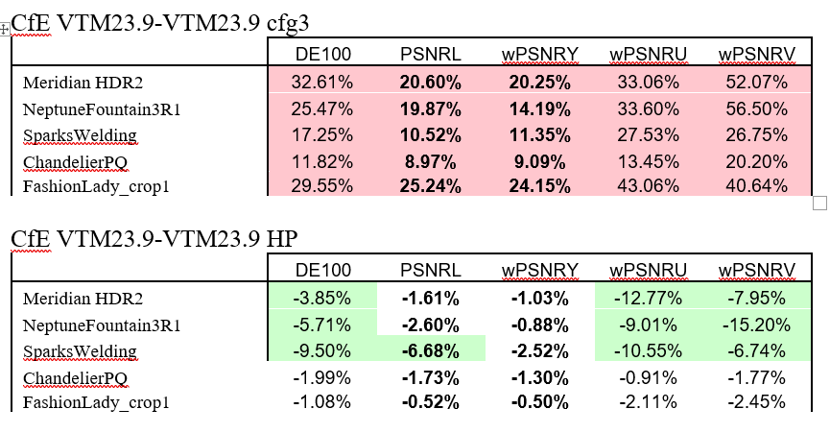
HDR Metrics comparisons

Slide 7
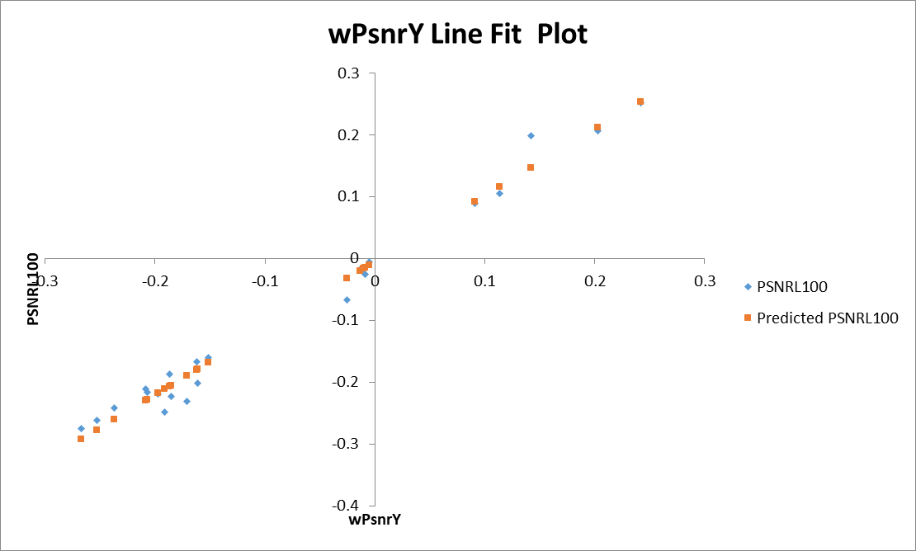
Correlation of wPSNR Y and PSNR L100
PSNRL = a + b*wPSNRY
Multiple R = 0.991665932

Slide 8
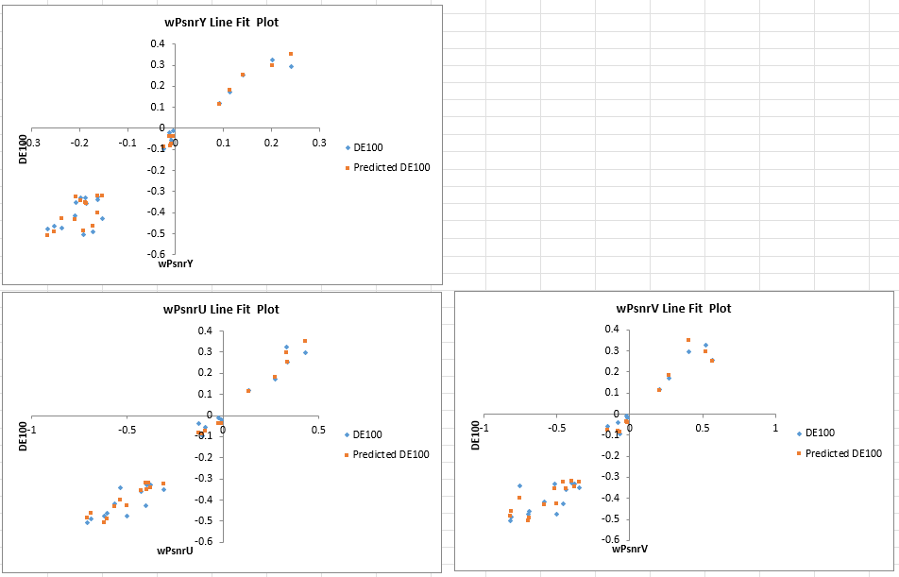
Correlation of wPSNR Y,U,V and Delta E100
DE100 = a + b*wPSNRY + c*wPSNRU + d*wPSNRV
Multiple R = 0.991473965

Slide 9
JVET-AM0287: Conclusion
Contributions proposes:
  Change HDR tests categorization from resolution (4K/8K) to transfer characteristics (PQ/HLG).
  Incorporate in CfE clarification text on compile and run-time settings for deriving of HDR metrics.
  Evaluate need for L100/DE100 HDR metrics reporting in the view of observed redundancy in additional to the weighted PSNR.
  Document in CfE document the HDR metrics used for CfE

