Slide 1
Full VTM tool set in ultra-low latency test scenario
JVET-AM0203
Vyacheslav Khamidullin, Ivan Gribushin, Sergey Ikonin, Elena Alshina (Huawei)

Slide 2
Introduction
Ultra-low latency simulation software of AHG18 is currently using simplified encoding configuration with reduced coding tools set.
The contribution proposes to enable back full set of VTM coding tools and reports its performance under ultra-low latency test scenario using fast encoding configuration VTM-Reduced-runtime-3 (JVET-AL0055, used in the draft CfE Section 3 (fast encoding) of JVET-АМ0041).
Bug fix concerning retransmission packets ordering.

Slide 3
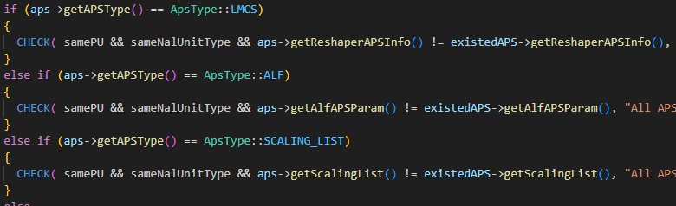
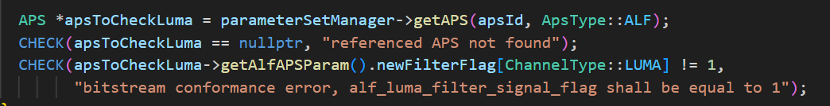
Problem description
Adaptive Parameter Set (APS) section of slice header (or picture header) is used for signalling adaptive parameters of in-loop filters such as ALF, CC ALF and etc. These parameters can be lost during transmission.
The problems as a decoder process interruption arises due to lost some APS while transmission. In the parsing header APS identifiers (like LUMA APS ALF identifier), some identifier could refer to non-existent (in case of loses under the AhG18 testing scenario) APS, that leads to stop decoding process.
The another problem is that decoder interrupts due to existed APS with same ID as parsed APS ID, and these APS have different data (different flags, attributes and coefficient s, etc.)
Stop decoding reason

Slide 4
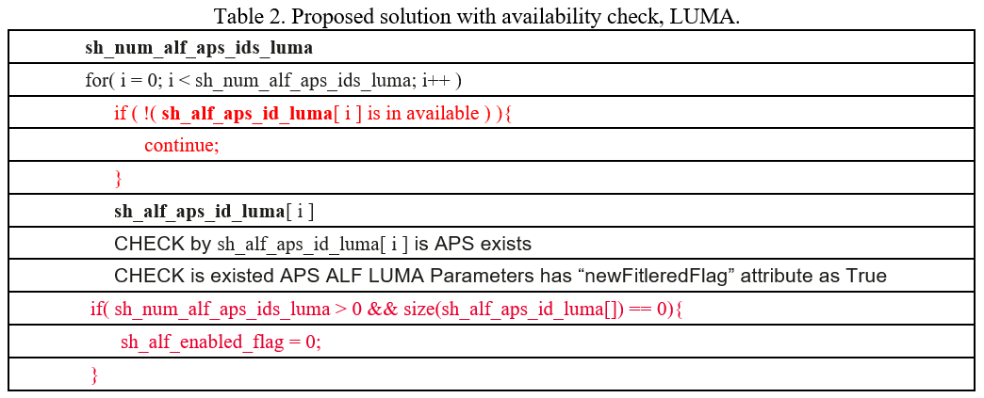
Proposed solution 1/2
ALF parsing
Check on the availability APS before software CHECK:
  If the APS exists (non-null pointer) and APS Parameters set is new one (new flag is True), then the APS is “available”.
  The APS Parameters can be used.
  Otherwise, the APS Parameters set enabling flag will set as False.

Slide 5
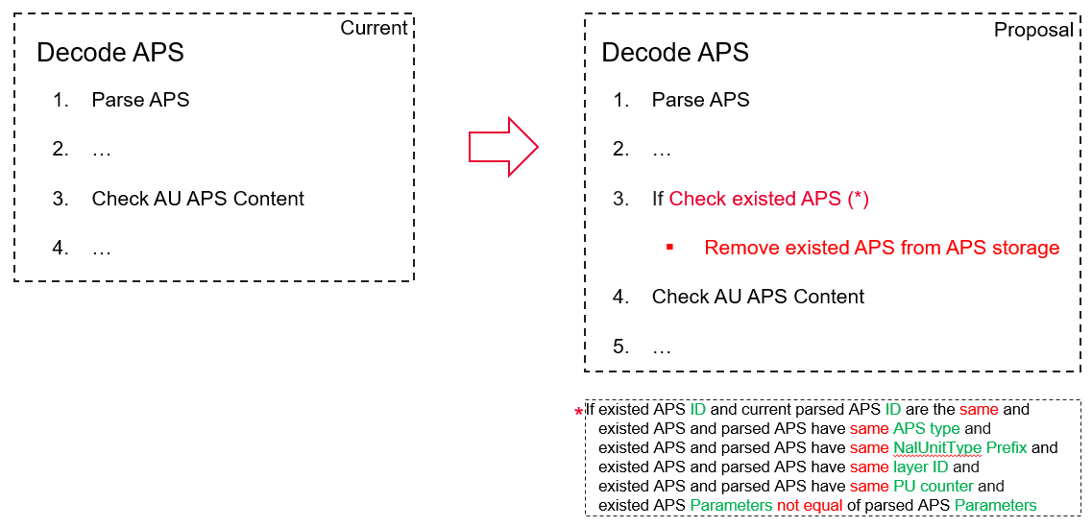
Proposed solution 2/2
APS decoding
The additional condition for checking existed APS in the “xDecodeAPS” method:
  - If identifiers of both existed and new parsed APS are the same (same APS type, same layer ID and same prefix NAL unit), then remove existed APS from APS storage.

Slide 6
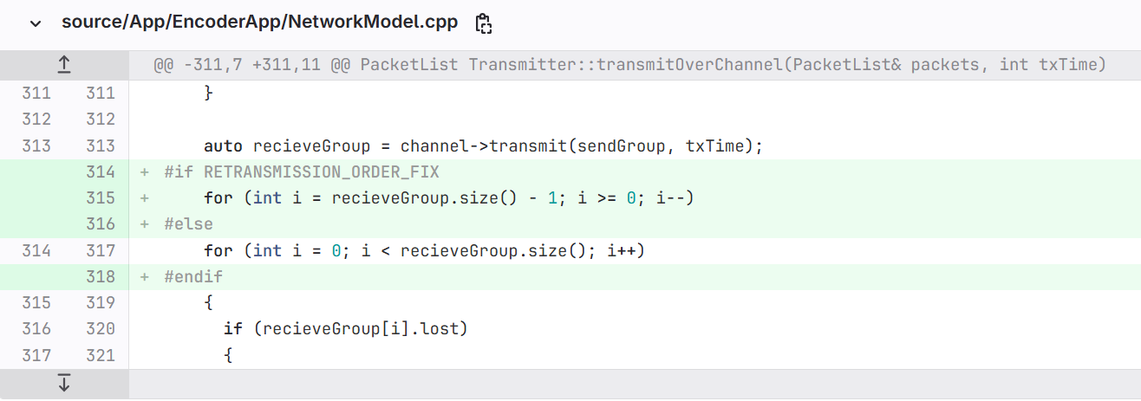
Retransmission ordering bug fix
In the current version of AHG18 simulation software the bug related to Wi-Fi retransmission logic was identified. The problem is the following:
- The order of all packets for sending was reversed before each retransmission (for example, the packets with numbers 1, 2, 3 were reordered to 3, 2, 1). The transmission time of retransmitted packets is violated. That affects the delivery status of late packets.
Fix:

Slide 7
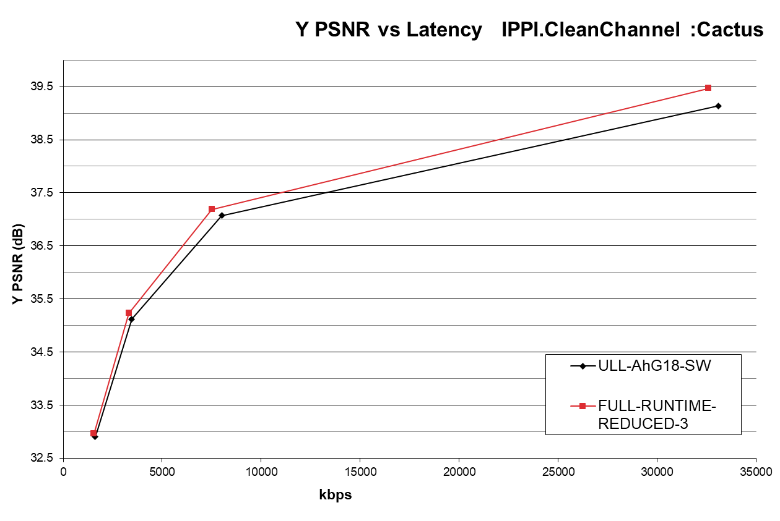
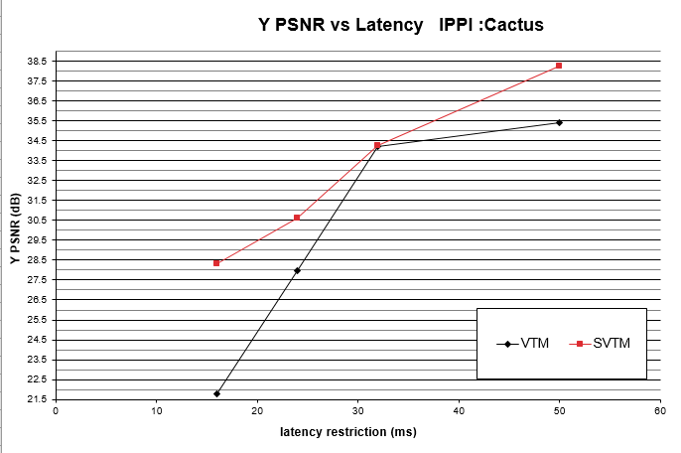
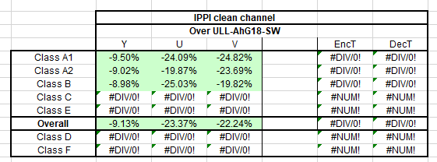
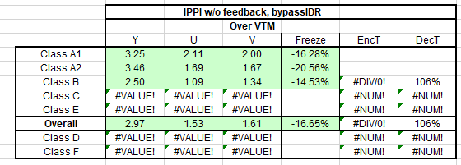
Results
BD-Rate summary,
VTM-ULL-AhG18-SW vs. VTM-Reduced-Runtime-3.
BD-PSNR summary, Reduced-Runtime-3
VTM vs. SVTM.

Slide 8
Conclusion
This contribution enables back the full set of VTM coding tools, describes software modification required to stability of APS logic in case of packet loss.
The performance under ultra-low latency test scenario is reported:
  The full VTM coding tools set + fast encoding configuration VTM-Reduced-runtime-3 (JVET-AL0055 and currently used in draft CfE Section 3 (fast encoding) of JVET-АМ0041).
The software bug of Wi-Fi retransmission logic was identified and fixed.
It is proposed to adopt described modifications to AHG18 simulation software.

Slide 9
Thank you.

