Slide 1

JVET-AM0185
AhG11: Decomposed Content-adaptive VLOP
Zhuowei Xu, Jacek Konieczny, Alexey Filippov, Christopher Hollmann, Vasily Rufitskiy, Tianyu Dong, Hongdong Qin (TCL)

Slide 2
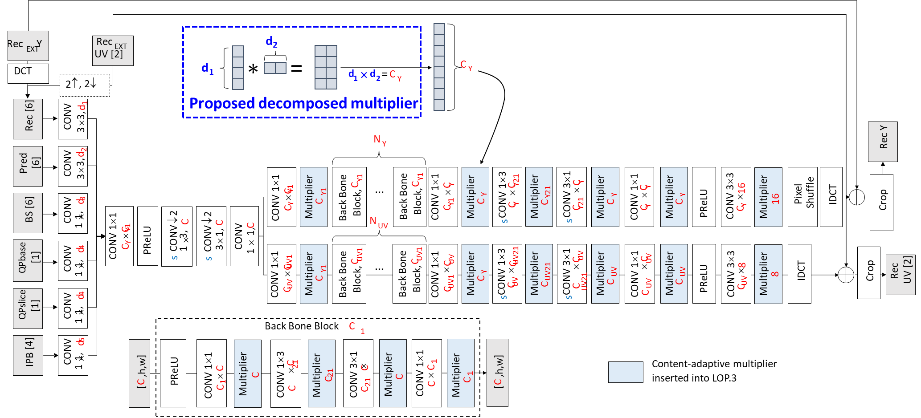
Introduction
In JVET-AL0169, a dimension-wise decomposed representation of content-adaptive multipliers is tested in LOP.4 and adopted in NNVC-13.

Slide 3
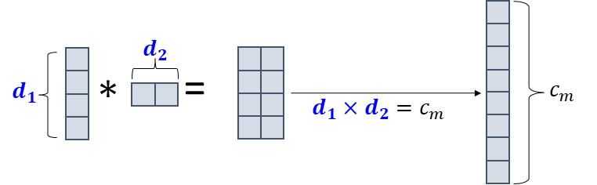
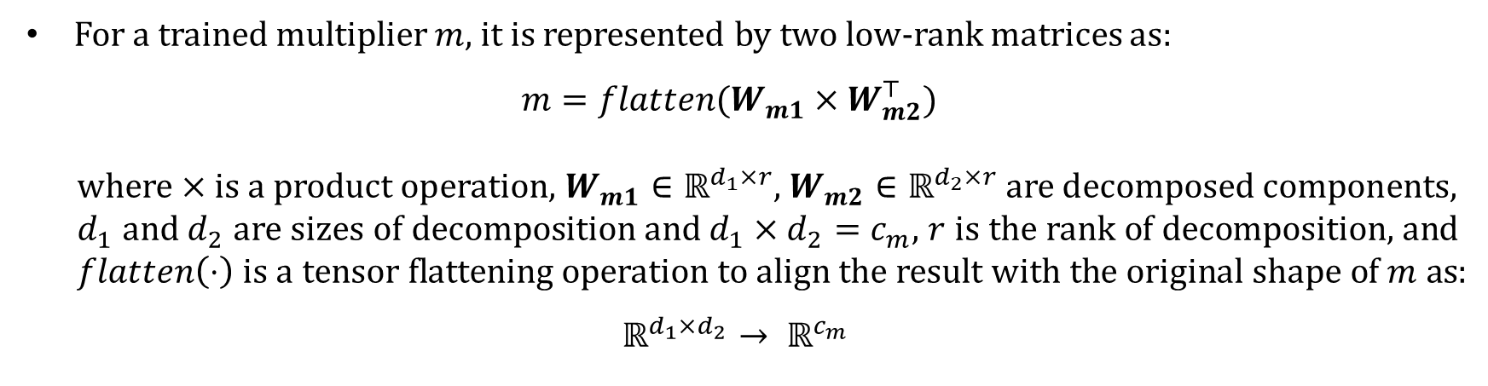
Introduction
For a trained multiplier $m$, it is represented by two low-rank matrices as:
$$m=flatten(W_{m1}×W_{m2}^{⊤})$$
  where $×$ is a product operation, $W_{m1}∈ℝ^{d_{1}×r}$, $W_{m2}∈ℝ^{d_{2}×r}$ are decomposed components, $d_{1}$ and $d_{2}$ are sizes of decomposition and $d_{1}×d_{2}=c_{m}$, $r$ is the rank of decomposition, and $flatten\left(⋅\right)$ is a tensor flattening operation to align the result with the original shape of $m$ as:
$$ℝ^{d_{1}×d_{2}}→ ℝ^{c_{m}}$$
Architecture of neural network is exactly the same as the original content-adaptive model.

Slide 4
Proposal
The decomposed multiplier is applied to content-adaptive VLOPs (as DCAVLOP)
Configurations are the same as JVET-AI0157.
  Training settings e.g., number of layers being overfitted
  Signalling settings e.g. multiplexed as NNR stream in APS
Experimental results are reported.

Slide 5
Experimental results
Results compared with CAVLOP
RA, NNVC-13
 | Y | U | V
Class A1 | -0.06% | 0.16% | -0.55%
Class A2 | -0.18% | -0.69% | -0.31%
Class B | -0.04% | -0.75% | -0.43%
Class C | -0.10% | -0.17% | -0.02%
Overall | -0.09% | -0.40% | -0.32%
Class D | -0.03% | -0.19% | -0.19%
Class F | -0.33% | -1.11% | -0.88%

Slide 6
Conclusion
This contribution proposes to:
  apply decomposed representation of layer multipliers in content-adaptive VLOP
The proposal brings about the following gains, compared with existing tool:
  Y: -0.09% U: -0.40% V: -0.32%
It is recommended that the proposed methods be studied in the next round of EE.
Thank you!

