Slide 1

JVET-AM0167: On long-tap interpolation filtering for angular modes
Tianyu Dong, Vasily Rufitskiy, Alexey Filippov
39th Meeting: Daejeon, Korea
26 June–4 JULY 2025

Slide 2

INTRODUCTION
Intra smoothing decision-making in ECM-17.0
Aspects of JVET-AM0140
1
Do not use smoothing in both TIMD and DIMD fusion process
2
Select interpolation filtering in unwrapping in accordance with the prediction filtering
Aspects of JVET-AM0149
1
Improved unwrapping for reference sample before prediction
2
6tap/8tap filter switch for template generation in TIMD
Longer-tap filter selection in DIMD:
Weight | [1,7] | [8,24] | [25,31] | [32,48] | >48
Filter length | 6 | 8 | 8 | 16 | 16

Slide 3
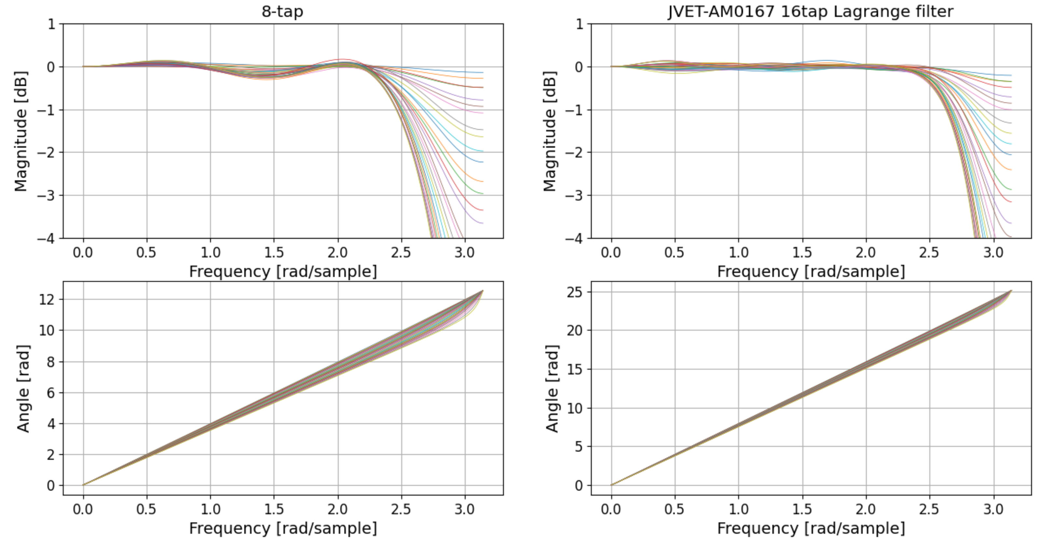
Proposal: Frequency response of the 16-tap filter
No smoothing for blended predictors

Slide 4
RESULTS for All Intra configuratoin
Results for AI configuration
 | All Intra Main 10
 | Over ECM-17.0
 | Y | U | V | EncT | DecT | EncVmPeak | DecVmPeak
Class A1 | -0.01% | 0.00% | 0.13% | 99.4% | 100.0% | 100.0% | 99.9%
Class A2 | -0.05% | -0.01% | -0.10% | 99.7% | 100.0% | 100.1% | 100.0%
Class B | -0.04% | -0.02% | 0.04% | 99.4% | 100.4% | 100.0% | 100.0%
Class C | -0.14% | -0.07% | -0.18% | 99.9% | 100.4% | 100.0% | 100.0%
Class E | -0.03% | -0.07% | -0.12% | 99.8% | 99.8% | 99.9% | 100.1%
Overall | -0.06% | -0.04% | -0.04% | 99.6% | 100.2% | 100.0% | 100.0%
Class D | -0.04% | -0.07% | 0.00% | 100.1% | 100.8% | 99.9% | 100.0%
Class F | -0.01% | 0.00% | 0.13% | 99.4% | 100.0% | 100.0% | 99.9%

