Slide 1
Non-EE2: On ALF coefficient coding
JVET-AM0159
Ikram Jumakulyyev, Döne Buğdaycı Şanslı, Jani Lainema

Slide 2
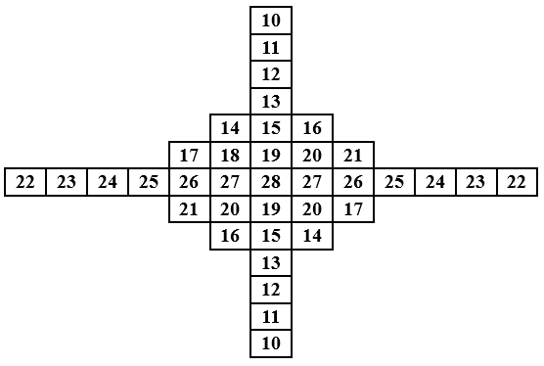
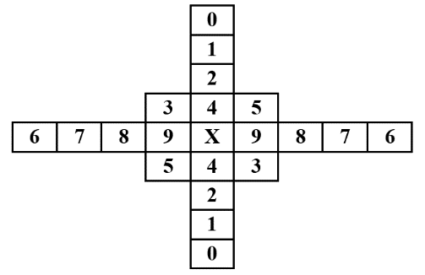
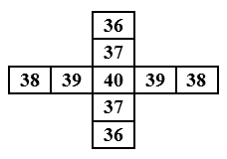
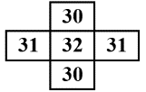



ALF filter shapes in ECM 17.0
ALF coefficient filter taps for online training:
#33 - #34:
Residual based Taps
#36 - #40:
Laplacian Info
Taps
#0 - #9:
Spatial Taps
#10 - #29:
Fixed Filter Output-based Taps
#30 - #32:
Reconstruction Before DBF Taps
#35:
Gaussian Smoothing
based Tap

Slide 3
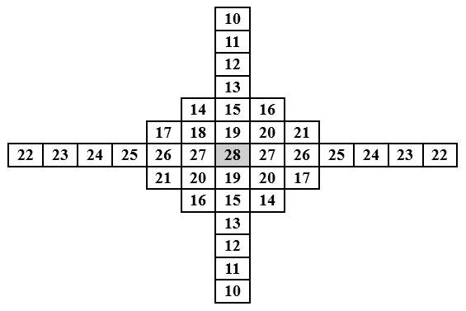
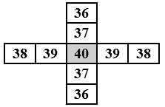




ALF coefficient coding in ECM 17.0
ALF coefficient Huffman coding in two groups:
Group 1: For center coefficients (grey colored).
Group 0: For the rest of all coefficients (white colored).
#33 - #34:
Residual based Taps
#36 - #40:
Laplacian Info
Taps
#0 - #9:
Spatial Taps
#10 - #29:
Fixed Filter Output-based Taps
#30 - #32:
Reconstruction Before DBF Taps
#35:
Gaussian Smoothing
based Tap

Slide 4
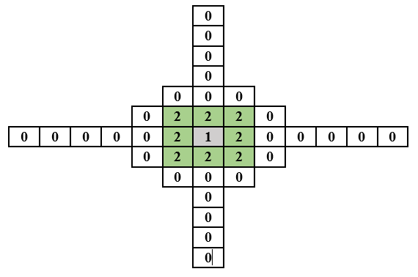
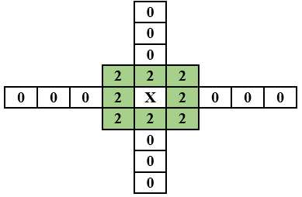
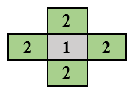
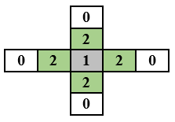


Proposed Method 1: ALF coefficient coding group extension
Anchor codes direct neighboring coefficients within the same group as farther coefficients.
Motivation: Direct neighboring coefficients have more significance than farther coefficients and coding them in the separate group can enhance redundancy exploitation.
Method 1 proposes to code center, direct neighboring and farther coefficients separately in different groups:
  Group 2: For center coefficients (green colored).
  Group 1: For center coefficients (grey colored).
  Group 0: For the rest of all coefficients (white colored).
  The frequency table extended and re-trained.

Slide 5
Experimental Results
 | All Intra Main 10
 | Over ECM-17.0 + HuffmanFrequencyTableRetrained
 | Y | U | V | EncT | DecT | EncVmPeak | DecVmPeak
Class A1 | 0.00% | 0.05% | 0.00% | 100.0% | 99.6% | 100.0% | 100.0%
Class A2 | 0.00% | 0.02% | -0.02% | 99.7% | 100.2% | 100.0% | 100.0%
Class B | 0.00% | 0.02% | -0.03% | 100.1% | 99.7% | 100.0% | 100.0%
Class C | 0.00% | 0.01% | 0.00% | 100.0% | 99.4% | 100.4% | 100.0%
Class E | -0.01% | 0.02% | -0.03% | 100.2% | 100.1% | 99.0% | 100.0%
Overall | -0.01% | 0.02% | -0.02% | 100.0% | 99.8% | 99.9% | 100.0%
Class D | -0.01% | 0.01% | -0.02% | 100.0% | 100.4% | 100.0% | 100.0%
Class F | 0.00% | -0.02% | 0.00% | 99.6% | 100.2% | 98.9% | 100.1%
 | Random Access Main 10
 | Over ECM-17.0 + HuffmanFrequencyTableRetrained
 | Y | U | V | EncT | DecT | EncVmPeak | DecVmPeak
Class A1 | -0.03% | -0.01% | -0.11% | 99.7% | 99.9% | 100.0% | 100.2%
Class A2 | 0.01% | -0.17% | 0.00% | 99.7% | 99.6% | 99.4% | 100.0%
Class B | -0.01% | 0.03% | -0.01% | 99.8% | 99.7% | 100.0% | 100.1%
Class C | -0.03% | 0.07% | 0.02% | 99.8% | 99.6% | 100.0% | 100.0%
Class E
Overall | -0.01% | -0.01% | -0.02% | 99.8% | 99.7% | 99.9% | 100.1%
Class D | 0.02% | -0.15% | 0.17% | 99.8% | 99.7% | 100.0% | 100.1%
Class F | 0.00% | -0.15% | 0.02% | 99.8% | 100.8% | 100.0% | 100.0%
Low delay B Main 10
Over ECM-17.0 + HuffmanFrequencyTableRetrained
Y | U | V | EncT | DecT | EncVmPeak | DecVmPeak
-0.03% | -0.08% | 0.46% | 99.9% | 99.9% | 100.2% | 100.2%
-0.06% | 0.01% | -0.17% | 99.7% | 100.0% | 100.0% | 100.1%
0.04% | -0.48% | 0.15% | 99.8% | 99.6% | 99.9% | 100.2%
-0.02% | -0.15% | 0.17% | 99.8% | 99.8% | 100.0% | 100.2%
0.05% | 0.03% | -1.11% | 100.0% | 99.5% | 99.9% | 100.0%
0.18% | 1.16% | 0.11% | 100.2% | 98.3% | 100.0% | 100.0%

Slide 6
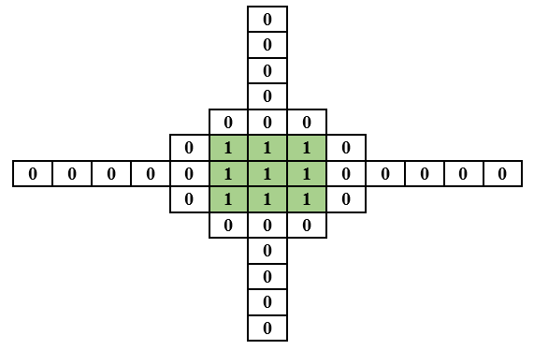
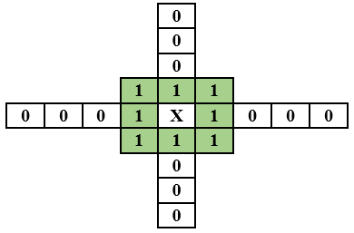
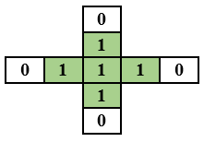



Proposed Method 2: ALF coefficient coding group reassignment
Anchor codes direct neighboring coefficients within the same group as farther coefficients and codes center coefficients in another group.
Motivation: Direct neighboring coefficients have more significance than farther coefficients and their significance is rather closer to center coefficients.
Method 2 proposes to code center and direct neighboring in one group and farther coefficients separately in a different group:
  Group 1: For center coefficients (green colored).
  Group 0: For the rest of all coefficients (white colored).
  The frequency table re-trained to adapt to new way of grouping.

Slide 7
Experimental Results
 | All Intra Main 10
 | Over ECM-17.0 + HuffmanFrequencyTableRetrained
 | Y | U | V | EncT | DecT | EncVmPeak | DecVmPeak
Class A1 | 0.00% | 0.01% | 0.01% | 99.7% | 99.1% | 100.0% | 100.0%
Class A2 | 0.00% | 0.00% | 0.00% | 99.7% | 99.6% | 100.0% | 100.0%
Class B | 0.00% | 0.03% | -0.02% | 100.1% | 99.3% | 100.0% | 100.1%
Class C | 0.00% | 0.00% | 0.01% | 99.9% | 98.9% | 100.4% | 100.0%
Class E | -0.01% | 0.01% | -0.02% | 99.6% | 99.7% | 99.0% | 100.0%
Overall | 0.00% | 0.01% | -0.01% | 99.8% | 99.3% | 99.9% | 100.0%
Class D | 0.01% | 0.03% | 0.01% | 99.9% | 99.4% | 100.0% | 100.0%
Class F | 0.00% | 0.01% | 0.02% | 99.5% | 99.7% | 98.4% | 100.0%
 | Random Access Main 10
 | Over ECM-17.0 + HuffmanFrequencyTableRetrained
 | Y | U | V | EncT | DecT | EncVmPeak | DecVmPeak
Class A1 | -0.02% | 0.08% | 0.07% | 99.7% | 99.9% | 100.0% | 100.1%
Class A2 | -0.01% | -0.16% | -0.07% | 99.8% | 100.1% | 99.4% | 100.1%
Class B | 0.00% | 0.08% | 0.04% | 99.8% | 100.2% | 100.0% | 100.0%
Class C | -0.03% | 0.08% | 0.04% | 99.6% | 100.4% | 99.9% | 100.0%
Class E
Overall | -0.01% | 0.03% | 0.02% | 99.7% | 100.2% | 99.9% | 100.0%
Class D | 0.00% | -0.03% | 0.18% | 100.0% | 100.5% | 100.0% | 100.0%
Class F | -0.02% | -0.11% | 0.03% | 100.1% | 100.5% | 100.0% | 100.2%
Low delay B Main 10
Over ECM-17.0 + HuffmanFrequencyTableRetrained
Y | U | V | EncT | DecT | EncVmPeak | DecVmPeak
-0.04% | -0.11% | -0.09% | 99.5% | 99.5% | 100.0% | 100.0%
-0.06% | 0.01% | -0.48% | 99.2% | 100.1% | 100.0% | 100.1%
-0.01% | -0.54% | 0.41% | 100.0% | 99.6% | 100.3% | 100.1%
-0.04% | -0.18% | -0.10% | 99.5% | 99.7% | 100.1% | 100.1%
0.06% | 0.36% | -0.41% | 100.1% | 99.3% | 100.0% | 100.0%
-0.01% | 1.02% | 0.77% | 99.6% | 98.7% | 100.1% | 99.8%

Slide 8
Summary
Two methods proposed on ALF coefficient coding improvement.
Achieved coding gains:
Method 1: [AI: -0.01%, RA: -0.01%, LDB: -0.02%] with no encT/decT impact
[AI: 100.0% / 99.8%, RA: 99.8% / 99.7%, LDB: 99,8% / 99,8%]
Method 2: [AI: 0.00%, RA: -0.01%, LDB: -0.04%] with no encT/decT impact
[AI: 99.8% / 99.3%, RA: 99.7% / 100.2%, LDB: 99,5% / 99,7%]
Proposed to study the methods in the next round of EEs.
Thanks to Ericsson for the cross-check!

