Slide 1

JVET-AM0150
Non-EE2: Extension of reconstructed area types for EIP
Weihong Niu, Shaowei Xie, Menghu Jia, Yaxian Bai, Cheng Huang
(ZTE)

Slide 2
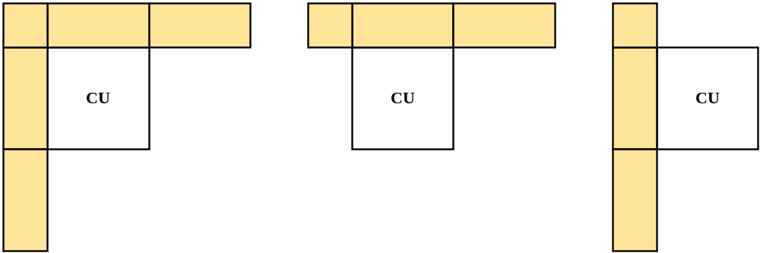
Introduction
There are three types of reconstructed areas for EIP mode in ECM17.0.
And these three reconstructed areas are combined with three EIP filter shapes for prediction.

Slide 3
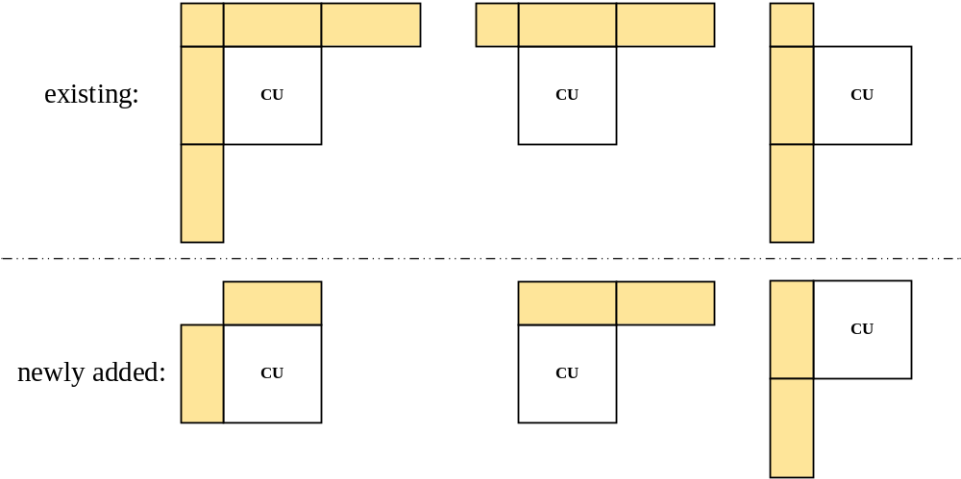
Proposed
To provide more choices of reconstructed area types for the EIP filter and enrich the diversity of reconstructed areas, this proposal extends the number of EIP reconstructed area types from three to six.

Slide 4
Simulation results
The proposed method is implemented on top of ECM-17.0.
 | All Intra Main 10
 | Over ECM-17.0
 | Y | U | V | EncT | DecT | EncVmPeak | DecVmPeak
Class A1 | -0.01% | -0.12% | 0.13% | 101.5% | 100.0% | 100.0% | 99.9%
Class A2 | -0.02% | 0.06% | -0.01% | 102.9% | 100.6% | 100.0% | 99.9%
Class B | -0.01% | -0.04% | 0.01% | 101.9% | 98.8% | 100.9% | 100.0%
Class C | -0.01% | -0.12% | 0.02% | 101.7% | 100.1% | 99.6% | 100.0%
Class E | -0.03% | -0.09% | -0.08% | 102.0% | 99.6% | 102.0% | 100.0%
Overall | -0.02% | -0.06% | 0.01% | 101.9% | 99.7% | 100.5% | 100.0%
Class D | 0.00% | 0.03% | -0.10% | 102.1% | 98.9% | 100.0% | 100.0%
Class F | -0.02% | 0.02% | 0.02% | 101.1% | 97.7% | 99.6% | 100.0%
Class TGM | -0.03% | 0.01% | -0.04% | 101.0% | 97.9% | 96.6% | 100.0%

Slide 5
Conclusions
The proposed methods can improve the coding efficiency of ECM with minor complexity increases.
It is suggested to further study in EE2.
Thanks to Vivo for cross-checking!

Slide 6
Thank you！

