Slide 1
JVET-AM0127
EE2-related: Advanced Budget Control for TSRC

Slide 2
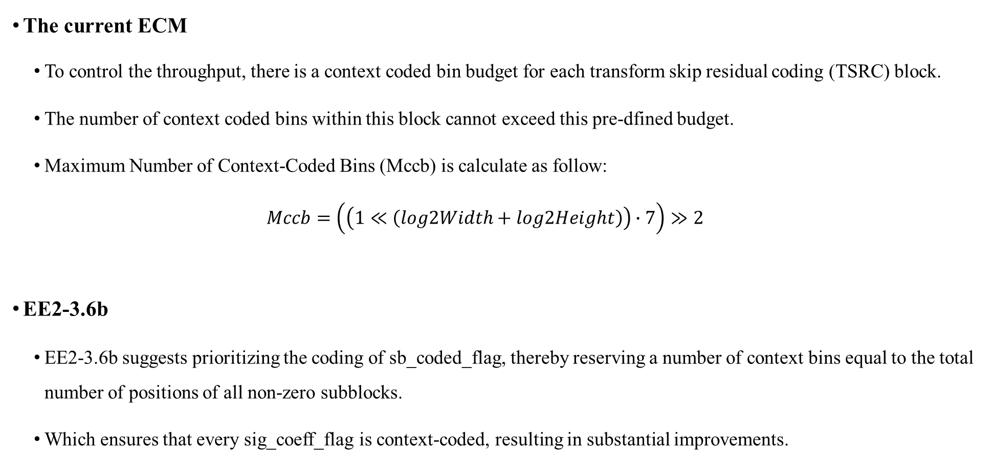
Background
The current ECM
  To control the throughput, there is a context coded bin budget for each transform skip residual coding (TSRC) block.
    The number of context coded bins within this block cannot exceed this pre-dfined budget.
    Maximum Number of Context-Coded Bins (Mccb) is calculate as follow:
    $$Mccb=\left(\left(1≪\left(log2Width+log2Height\right)\right)∙7\right)≫2$$
  EE2-3.6b
    EE2-3.6b suggests prioritizing the coding of sb_coded_flag, thereby reserving a number of context bins equal to the total number of positions of all non-zero subblocks.
    Which ensures that every sig_coeff_flag is context-coded, resulting in substantial improvements.

Slide 3
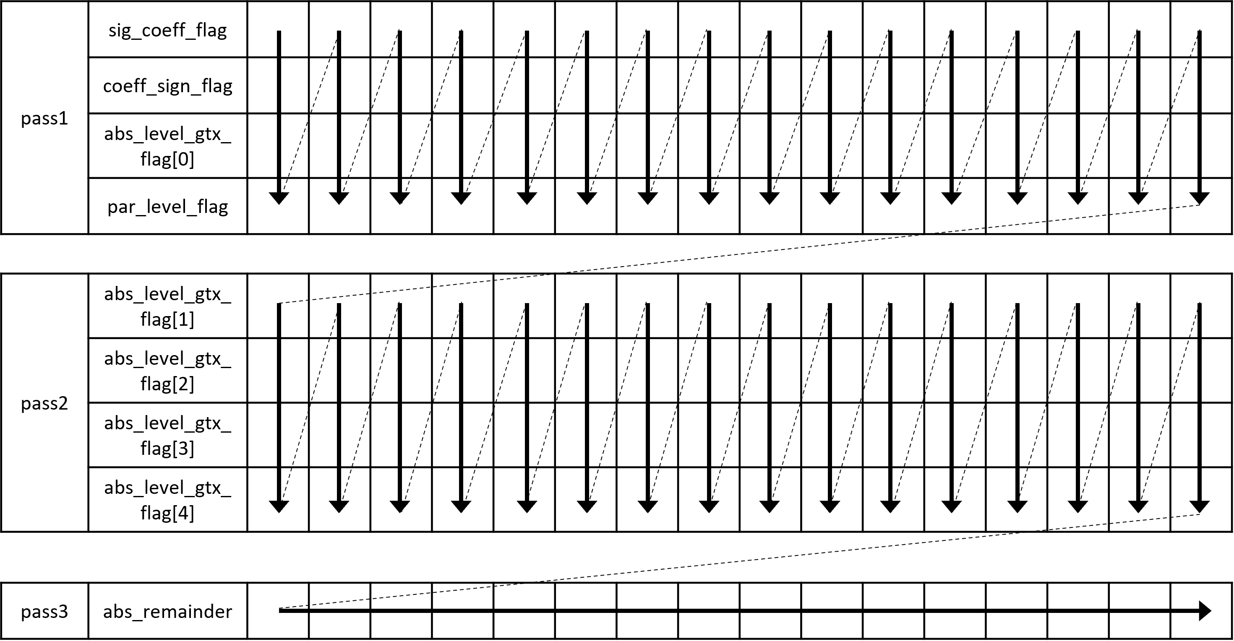
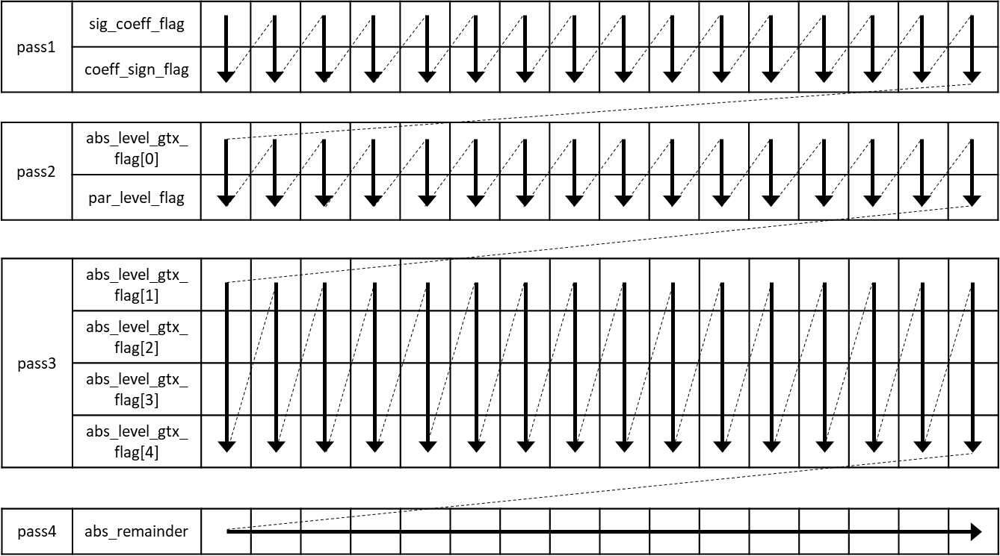
Proposed method
ECM Implementation
Proposed method
Coding coefficients in the CG
Coding coefficients in the CG
    In this contribution, we propose a method to increase the priority of coeff_sign_flag at the CG level.
    The coeff_sign_flag is granted higher priority at CGs once the context budget has been exhausted.

Slide 4
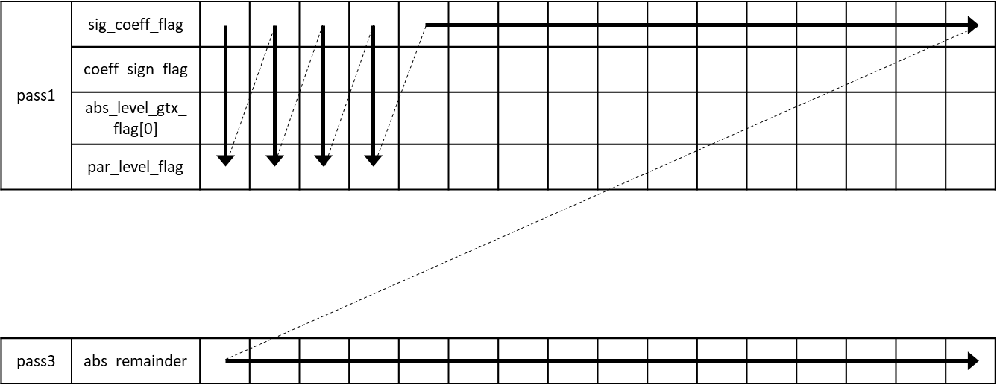
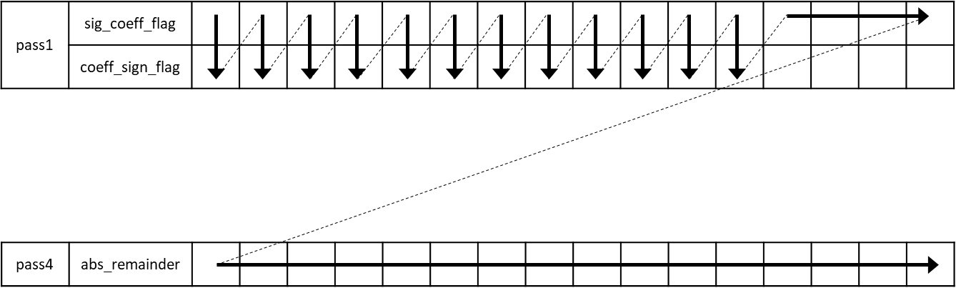
Proposed method
ECM Implementation
Proposed method
Coding coefficients in the CG
Coding coefficients in the CG
    For example, we have a remaining budget of 12 context bins for the current CG after accounting for significant flags.
    In the previous approach, these 12 bins would be consumed sequentially by coeff_sign_flag, level flag and parity flag.
    With our proposed method, we give higher priority to the coeff_sign_flag. The budget originally allocated for level_flag and parity_flag has been reallocated to coeff_sign_flag

Slide 5
Experimental results
Proposed method + EE2-3.6b over ECM-17.0
 | All Intra Main 10
 | Over ECM-17.0
 | Y | U | V | EncT | DecT
Class F | -0.12% | -0.01% | -0.10% | xx.x% | xx.x%
Class TGM | -0.23% | -0.29% | -0.28% | xx.x% | xx.x%
Proposed method + EE2-3.6b over EE2-3.6b
 | All Intra Main 10
 | Over EE2-3.6b
 | Y | U | V | EncT | DecT
Class F | -0.01% | 0.03% | 0.19% | xx.x% | xx.x%
Class TGM | -0.04% | -0.03% | -0.02% | xx.x% | xx.x%

Slide 6
Conclusion
A coding gain can be observed for SCC sequences
  Proposed method + EE2-3.6b over ECM-17.0
    AI: F: { -0.12 %, -0.01 %, -0.10 %, xx.x%, xx.x%} TGM : { -0.23 %, -0.29 %, -0.28 %, xx.x%, xx.x%}
Simple and straightforward
Recommend to investigate in EE.

Slide 7
Thank you

