Slide 1

JVET-AM0073: [AHG11] Comparison of execution time of NN on different devices
Image and Video codec standardization team in Huawei
A. Karabutov, E. Alshina, F. Brand

Slide 2
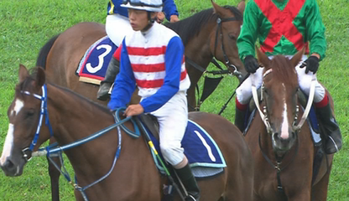
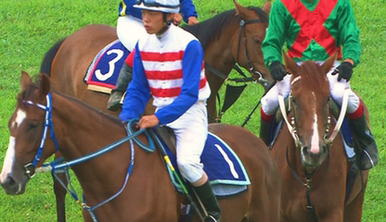












JPEG AI: single stream multiple decodes
160+96
Rec. Im. 0
Simple
8kMAC/pxl
common
Decoder ID=0
Encoder ID=0
Latent Prediction
$$\hat{r}$$
CDF-z
$$\hat{r}$$
Latent Prediction
Decoder ID=1
Rec. Im. 1
Orig. Image
Base
22 kMAC/pxl
y
AE
stream-z
AD
$$\hat{y}$$
Decoder (attention)
ID=2
Entropy Enc.
stream-r
Entropy Dec.
Encoder ID=1
$$\hat{z}$$
CDF-r
$$\hat{z}$$
$$σ$$
Rec. Im. 2
High
224 kMAC/pxl
Sender Reciever

Slide 3
Experiments set-up
Same stream decoded with different decoders:
  Simple ~7 kMAC/pxl
  Base ~20 kMAC/pxl
  High ~200 kMAC/pxl
Image sizes from 64x121 to 1856x3520
Latent tiles size / image partitioning
  256x256
  512x512
  1024x1024
What is measured?
  CPU execution time of PC
  GPU execution time on PC
  NPU execution time on Smartphone
Output
  CPU/GPU run time ratio
160+96
CPU or GPU / NPU
Decoder ID=0
Rec. Im. 0
Simple
Encoder ID=0
Latent Prediction
$$\hat{r}$$
CDF-z
$$\hat{r}$$
Latent Prediction
Decoder ID=1
Rec. Im. 1
Orig. Image
Base
y
AE
stream-z
AD
$$\hat{y}$$
Decoder (attention)
ID=2
Entropy Enc.
stream-r
Entropy Dec.
Encoder ID=1
$$\hat{z}$$
CDF-r
$$\hat{z}$$
$$σ$$
Rec. Im. 2
High
Sender Reciever

Slide 4
Experiments set-up
Huawei Mate50 pro:
  Processor: Snapdragon 8+ Gen 1 4G Mobile Platform.
  NPU: 7th Gen Qualcomm AI Engine.
  RAM: 8 GB.
  Framework: C++ implementation of JPEG-AI (DIS version of the reference SW) with SNPE library.
PC with GPU:
  Processor: AMD Ryzen 9 5950X 16-Core Processor.
  GPU: Nvidia Geforce RTX 3090, 24 GB.
  RAM: 64 GB DDR4 2133 MHz.
  Framework: python implementation of JPEG-AI (DIS version of the reference SW) based on PyTorch.

Slide 5
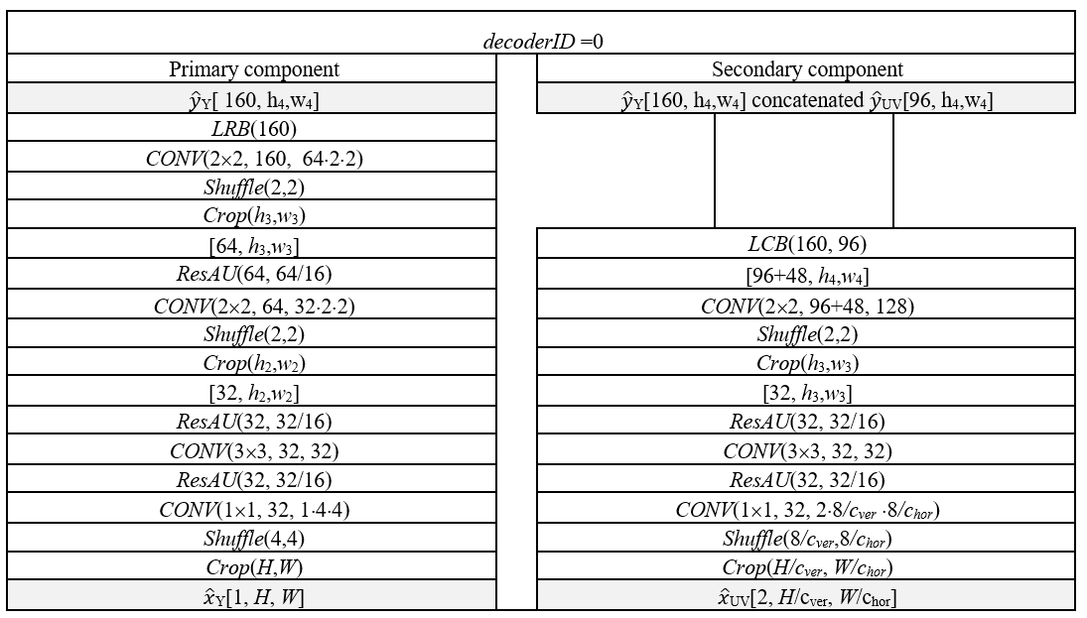
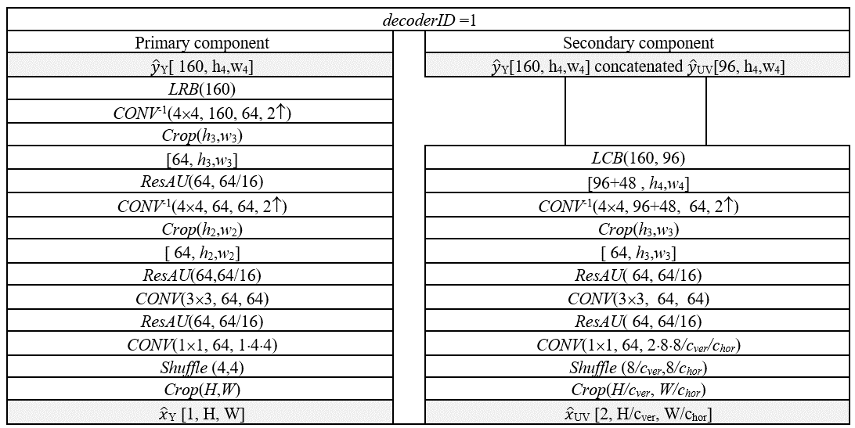
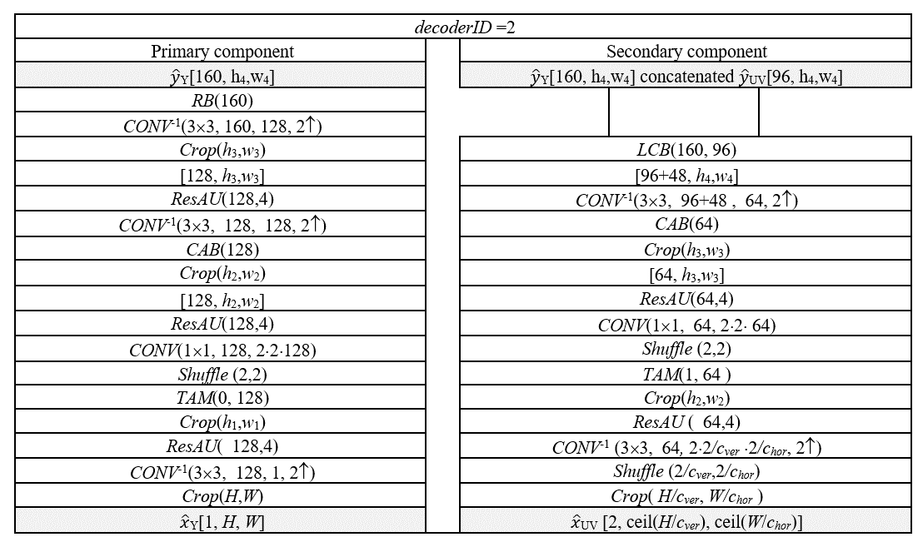
Different decoders
Simple:
8 kMAC/pxl
no attention
max sequential 12 CONV layers
w/o inverse convolutions
Base:
22kMAC/pxl
no attention
max sequential 12 CONV layers
w/ inverse convolutions
High:
224 kMAC/pxl
with attention
30+ sequential CONV layers
w/ inverse convolutions

Slide 6
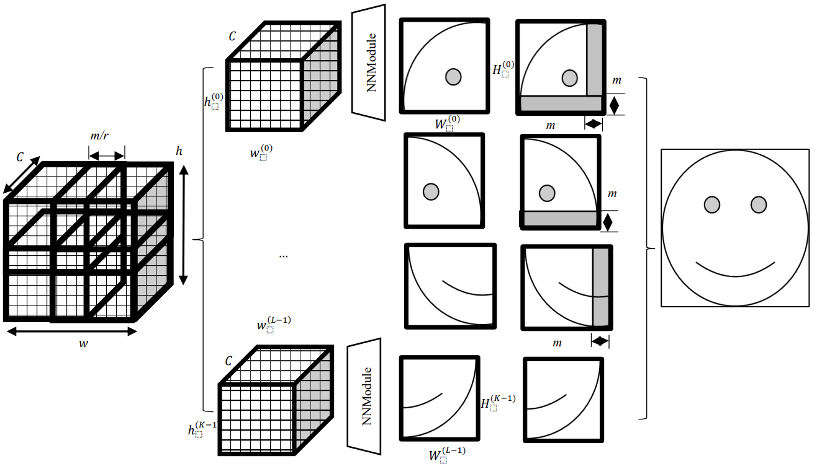
Tiles in the latent space
Computational complexity kMAC/pxl depends on latent tile size and size of overlap m (also the case for AhG11)

Slide 7

Experiment #1: Decoding of the same stream on the mobile phone and PC
 | Action | Time on CPU, ms | Time on NPU or GPU, ms | Ratio T_{CPU}/T_{NPU or GPU}
Huawei Mate 50 pro | Data loading | 29±4 ms | 33±2 ms
 | Model inference | (46±8)·100 ms | 114±4 ms | 40
 | All above | (46±8)·100 ms | 147±4 ms | 31
PC + GPU | Data loading + Model inference | (354±6)·10 ms | 162±2 ms | 21
Parameter | Value
Width | 1856
Height | 3520
Decoding complexity | 23.16 KMac / pxl

Slide 8
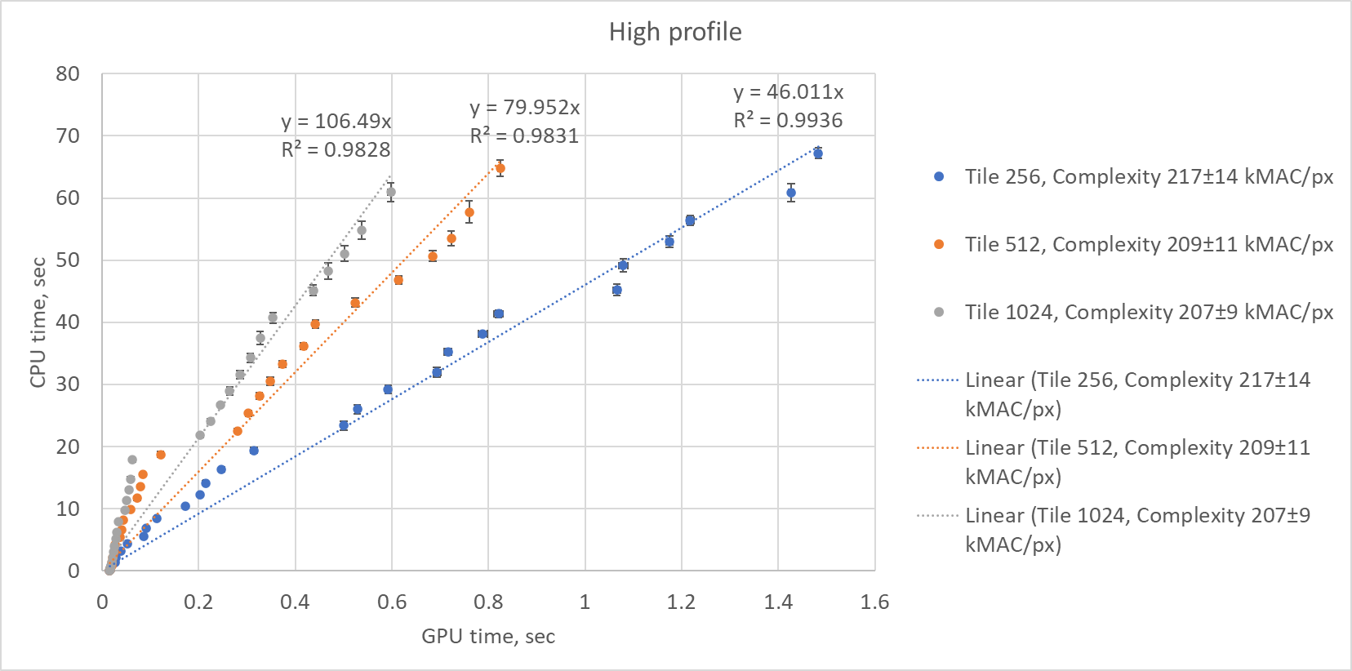
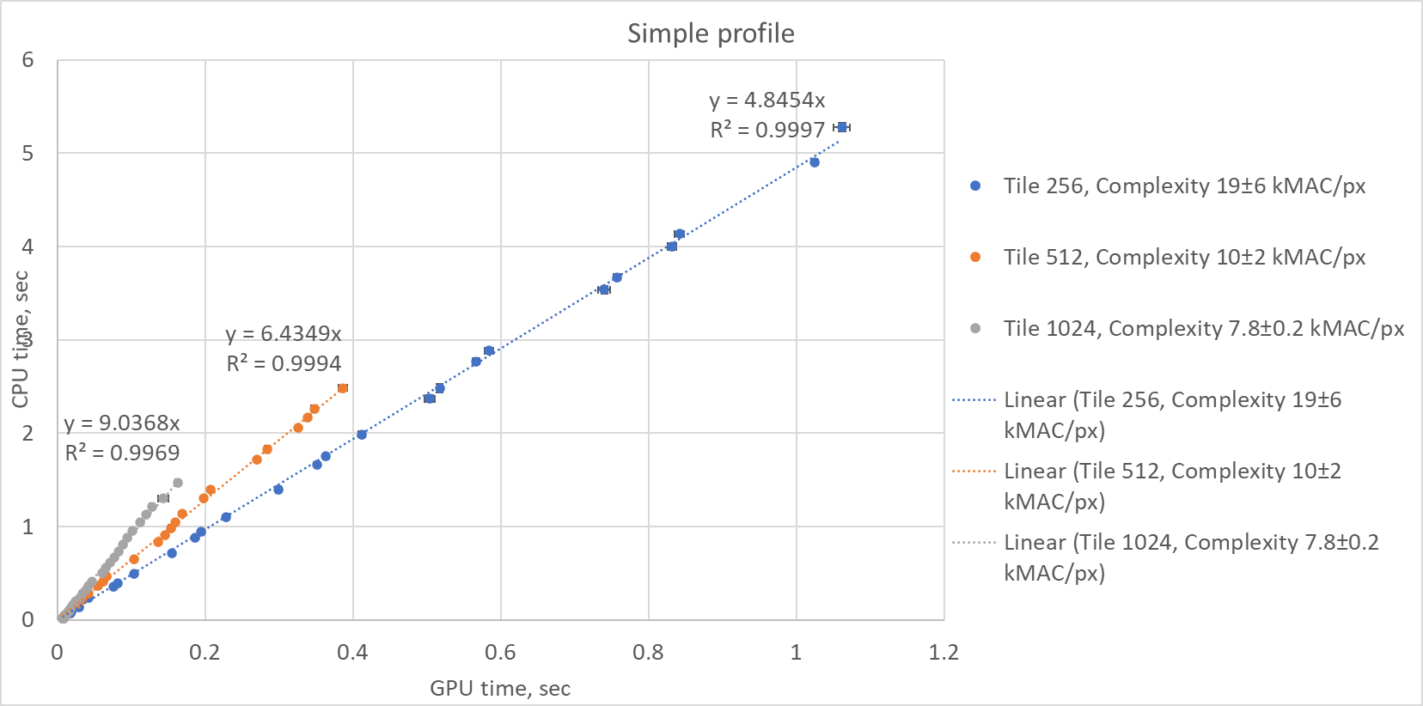
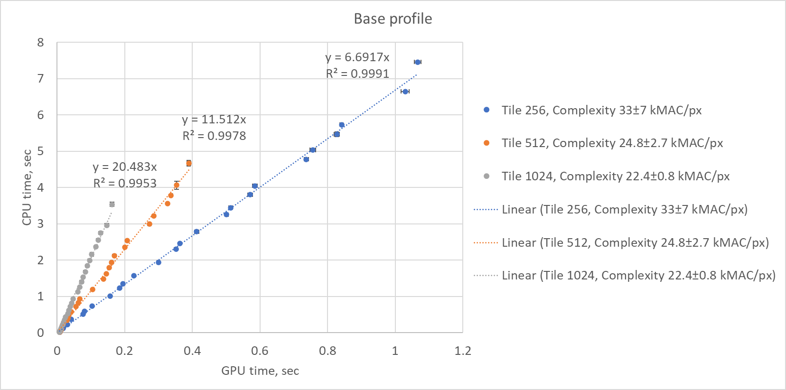
Experimental results

Slide 9
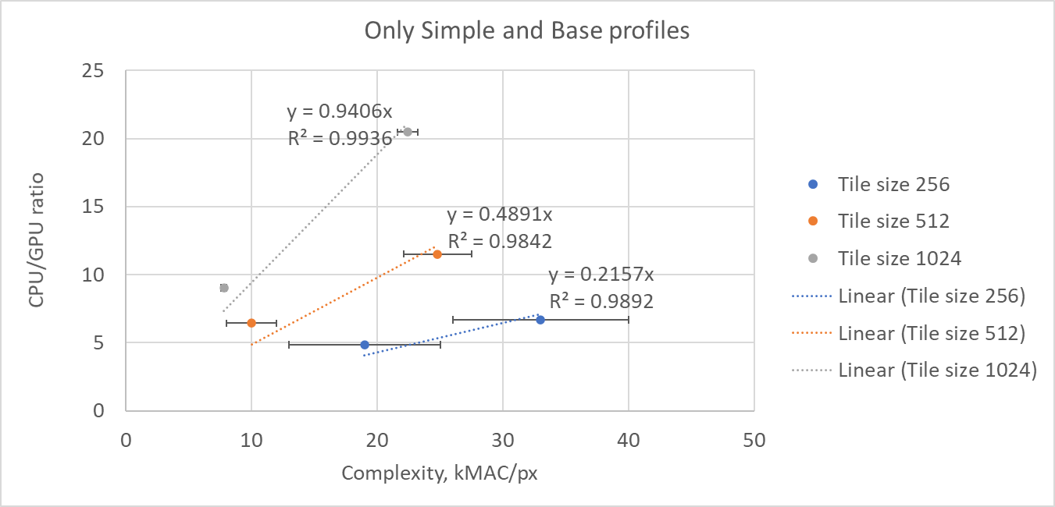

Experimental results
$$T_{GPU}=\frac{256}{0.236}∙\frac{T_{CPU}}{C∙TS}$$
where TS is the size of the tiles, C is the complexity in kMAC/px

Slide 10
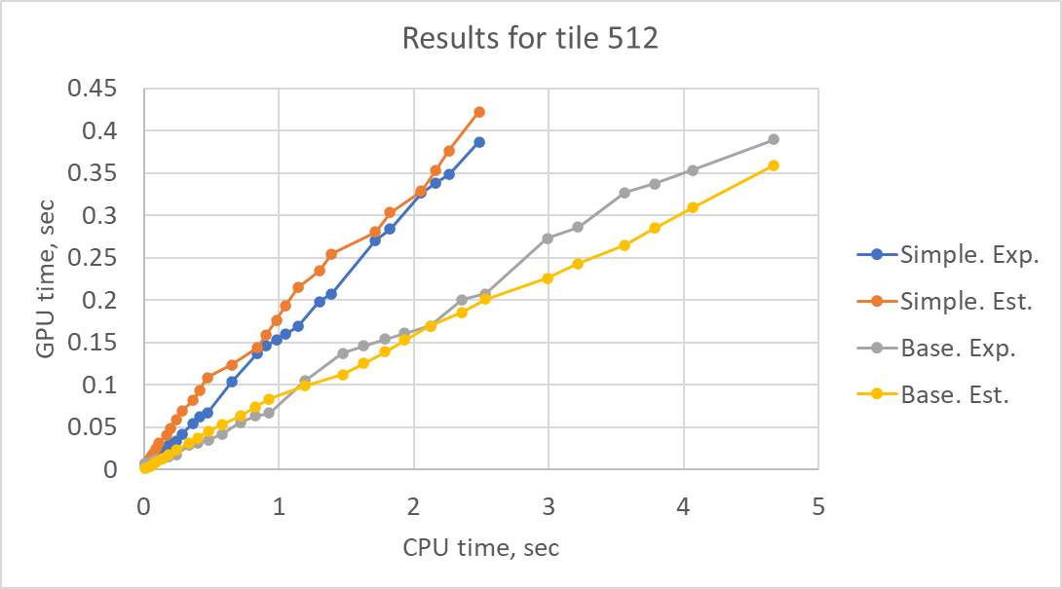
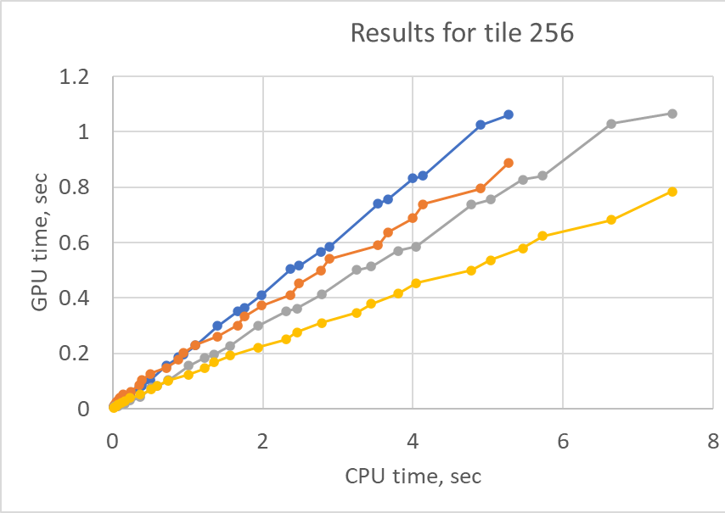
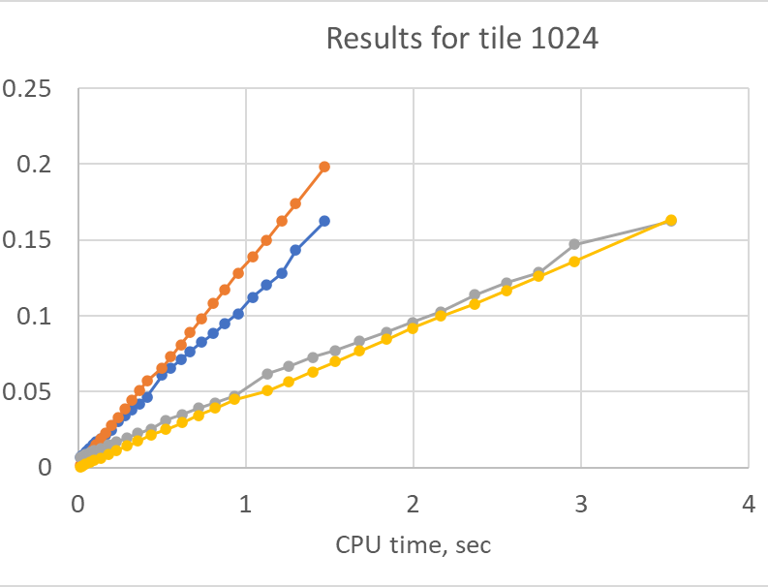
Limits of the applicability of the formula

Slide 11


Experimental results
$$T_{GPU}=T_{CPU}$$
$${TS}_{min}=256/(0.236∙C)$$
GPU is faster
66
54
CPU is faster

Slide 12
Conclusions
CPU vs GPU run time dependency is linear for simple network structure (w/o attention)
Only kMAC/pxl and CPU run time is not enough to predict actual run time in a product with powerful processors designed for AI tasks like GPU/NPU
It is suggested to study further a relationship between CPU and GPU/NPU run time targeting to work out GPU/NPU run time modelling (based on tile size, network structure, kMAC/pxl) which would simplify comparison of AI based methods with classical coding algorithms based on CPU run time

Slide 13
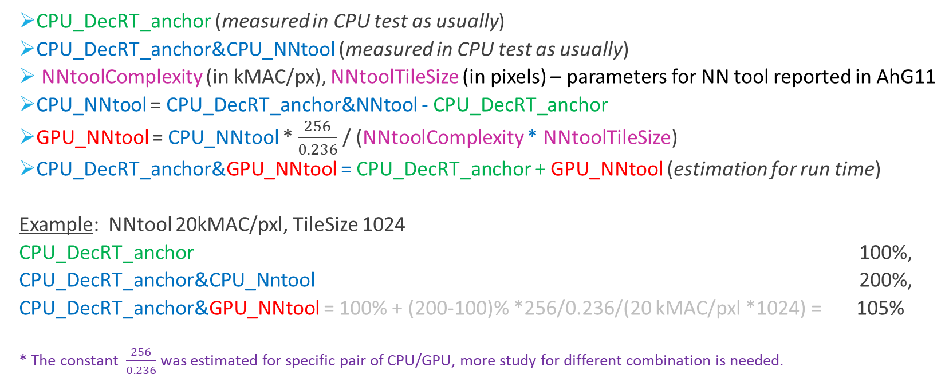
How to interpret CPU run time for NNVC
  CPU_DecRT_anchor (measured in CPU test as usually)
  CPU_DecRT_anchor&CPU_NNtool (measured in CPU test as usually)
  NNtoolComplexity (in kMAC/px), NNtoolTileSize (in pixels) – parameters for NN tool reported in AhG11
  CPU_NNtool = CPU_DecRT_anchor&NNtool - CPU_DecRT_anchor
  GPU_NNtool = CPU_NNtool * $\frac{256}{0.236}$ / (NNtoolComplexity * NNtoolTileSize)
  CPU_DecRT_anchor&GPU_NNtool = CPU_DecRT_anchor + GPU_NNtool (estimation for run time)
  Example: NNtool 20kMAC/pxl, TileSize 1024
  CPU_DecRT_anchor 100%,
  CPU_DecRT_anchor&CPU_Nntool 200%,
  CPU_DecRT_anchor&GPU_NNtool = 100% + (200-100)% *256/0.236/(20 kMAC/pxl *1024) = 105%
  * The constant $\frac{256}{0.236}$ was estimated for specific pair of CPU/GPU, more study for different combination is needed.

