Slide 1
Non-EE2: On Sign Prediction
JVET-AM0069
Yuhuai Zhang, Luhang Xu, Yue Yu, Jonathan Gan, Haoping Yu, Dong Wang (OPPO)

Slide 2
Background
Current sign prediction design
  Signs of up to N non-zero coefficients within a specified sign prediction (SP) area can be predicted
    e.g., N = 8 in ECM17.0
  Combining the contributions from all coefficients in 2^N hypothesis residual blocks
    Each SP coefficient: calculate two hypotheses of its contribution to the residual through inverse transform it with either a + or - sign
  Determine the most likely hypothesis
    Each of the hypothesis residual blocks is assessed for boundary continuity
  Derive the predicted signs of the SP coefficients

Slide 3
Example
As shown in the right figure, there are 15 non-zero coefficients
  SP coefficient: Associated with the largest coefficient magnitude, inside the SP area
    8 signs (x) will be predicted
  Other non-zero coefficients inside SP area
    4 signs (○) will not be predicted
  Non-zero coefficients outside the SP area
    3 signs (□) will not be predicted
SP Area
SP applied TU

Slide 4
Proposal
The concept of linked sign prediction (LSP) coefficients
  Link non-sign predicted (non-SP) coefficients to an LSP coefficient
    Add the residual contribution from non-SP to an LSP when assessing boundary continuity
  Up to two SP coefficients with the lowest magnitude are converted to LSPs
The proposed method
  Non-SP coefficients linking process
  The residual hypothesis of the linked coefficient group
  Sign correction of non-SP coefficients

Slide 5
Non-SP coefficients linking process
Non-SP coefficients classification
  Type A (○): The non-SP coefficients inside the SP area.
  Type B (□): The non-SP coefficients outside the SP area.
If neither type A nor type B coefficients exist
  The proposed method is not used.
If only type A or B coefficients exists
  These coefficients will be linked to the SP coefficient with the smallest coefficient magnitude
If both type A and B coefficients exist
  Type A coefficients will be linked to the SP coefficient with the smallest coefficient magnitude
  Type B coefficients will be linked to the SP coefficient with the second-smallest coefficient magnitude
The linked coefficients constitute a linked coefficient group (LCG)
  Each LCG will be used to calculate two hypotheses respectively for their combined contribution to the residual.
SP coeff
LSP coeff
Type A coeff
Type B coeff

Slide 6
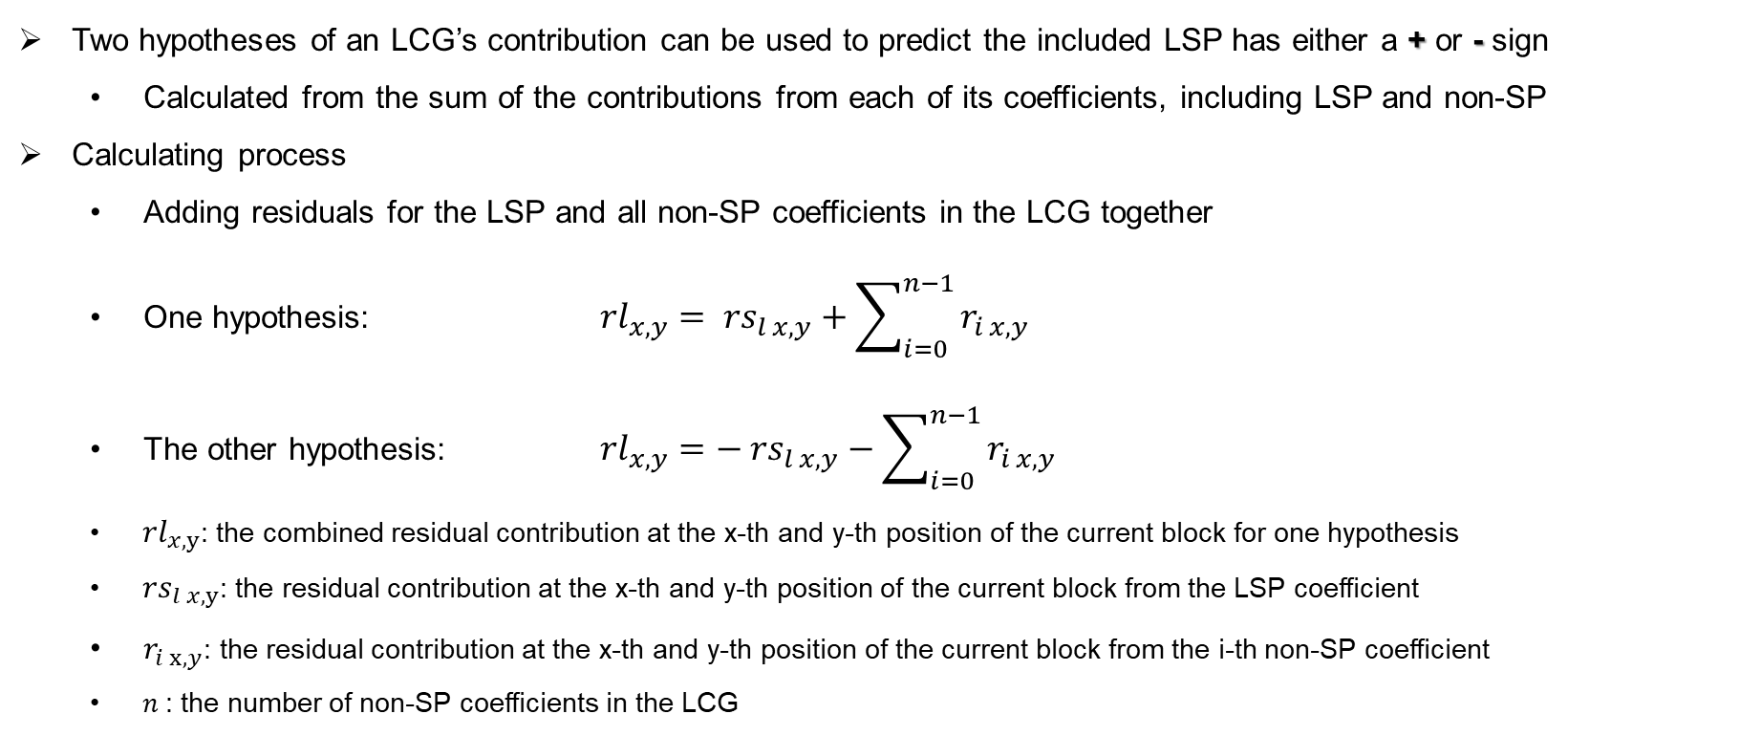
The residual hypothesis of the linked coefficient group
Two hypotheses of an LCG’s contribution can be used to predict the included LSP has either a + or - sign
  Calculated from the sum of the contributions from each of its coefficients, including LSP and non-SP
Calculating process
  Adding residuals for the LSP and all non-SP coefficients in the LCG together
  One hypothesis: ${rl}_{x,y}= {rs}_{l x,y}+\sum_{i=0}^{n−1}{r_{i x,y}}$
  The other hypothesis: ${rl}_{x,y}=− {rs}_{l x,y}−\sum_{i=0}^{n−1}{r_{i x,y}}$
  ${rl}_{x,y}$: the combined residual contribution at the x-th and y-th position of the current block for one hypothesis
  ${rs}_{l x,y}$: the residual contribution at the x-th and y-th position of the current block from the LSP coefficient
  $r_{i x,y}$: the residual contribution at the x-th and y-th position of the current block from the i-th non-SP coefficient
  $n$: the number of non-SP coefficients in the LCG

Slide 7
Sign correction of non-SP coefficients
Calculating process
  If the LSP predicted result is correct
    The signs of its linked non-SP coefficients are the same as indicated by their decoded sign bits
  If the LSP predicted result is incorrect
    The signs of its linked non-SP coefficients are interpreted as the reverse of their decoded sign bits

Slide 8
Experimental results
The proposed method is implemented on top of the ECM-17.0 software
 | All Intra Main 10
 | Over ECM17.0
 | Y | U | V | EncT | DecT
Class A1 | -0.01% | -0.05% | 0.06% | 100.8% | 100.2%
Class A2 | -0.02% | 0.00% | -0.04% | 101.0% | 100.0%
Class B | -0.02% | 0.02% | 0.07% | 101.0% | 100.2%
Class C | 0.01% | -0.05% | -0.06% | 101.1% | 100.5%
Class E | 0.00% | 0.02% | 0.01% | 101.0% | 100.3%
Overall | -0.01% | -0.01% | 0.01% | 101.0% | 100.3%
Class D | 0.00% | 0.14% | -0.06% | 101.1% | 100.9%
Class F | 0.06% | 0.10% | -0.12% | 101.6% | 100.1%
Class TGM | #VALUE! | #VALUE! | #VALUE! | #NUM! | #NUM!
 | Random Access Main 10
 | Over ECM17.0
 | Y | U | V | EncT | DecT
Class A1 | -0.05% | -0.06% | 0.07% | 100.1% | 100.7%
Class A2 | -0.01% | 0.15% | -0.07% | #NUM! | #NUM!
Class B | 0.00% | 0.02% | -0.07% | 100.3% | 100.6%
Class C | -0.02% | -0.01% | 0.33% | 100.4% | 100.4%
Class E
Overall | -0.02% | 0.02% | 0.06% | #NUM! | #NUM!
Class D | -0.02% | 0.18% | -0.59% | 100.3% | 100.1%
Class F | -0.02% | 0.10% | 0.59% | 100.4% | 101.3%
Class TGM | #VALUE! | #VALUE! | #VALUE! | #NUM! | #NUM!
 | Low delay B Main 10
 | Over ECM17.0
 | Y | U | V | EncT | DecT
Class A1
Class A2
Class B | -0.02% | -0.01% | -0.14% | 100.2% | 100.6%
Class C | -0.12% | 0.25% | 0.13% | 100.5% | 100.1%
Class E | -0.16% | 0.94% | 1.09% | 101.1% | 99.6%
Overall | -0.09% | 0.32% | 0.26% | 100.5% | 100.2%
Class D | 0.07% | -1.39% | 0.80% | 99.5% | 98.2%
Class F | -0.14% | 0.69% | 1.01% | 100.2% | 99.8%
Class TGM | #VALUE! | #VALUE! | #VALUE! | #NUM! | #NUM!

Slide 9
Conclusions
The method proposes to include non-SP coefficients in the calculation of hypotheses for linked sign prediction coefficients
It brings -0.01%/-0.02%/-0.09% BD-rates performance for AI/RA/LD on top of ECM-17.0
It is suggested to further study the proposed method in EE2
Thanks to Alibaba for crosschecking!

