Slide 1
JVET-AM0068: AHG12: On Shifting Quantization Center
Yue Yu
Haoping Yu, Jonathan Gan, Luhang Xu, Hang Huang, Fan Wang, Zhihuang Xie, Dong Wang
JVET-AM0068

Slide 2
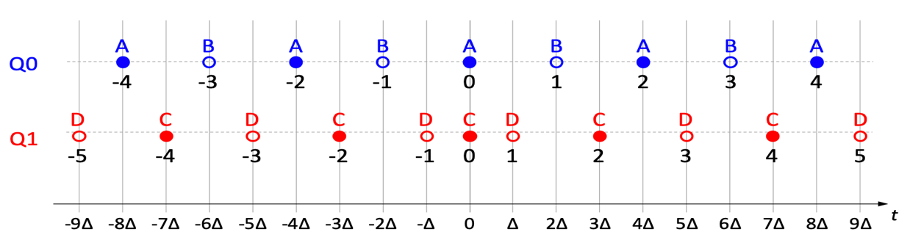
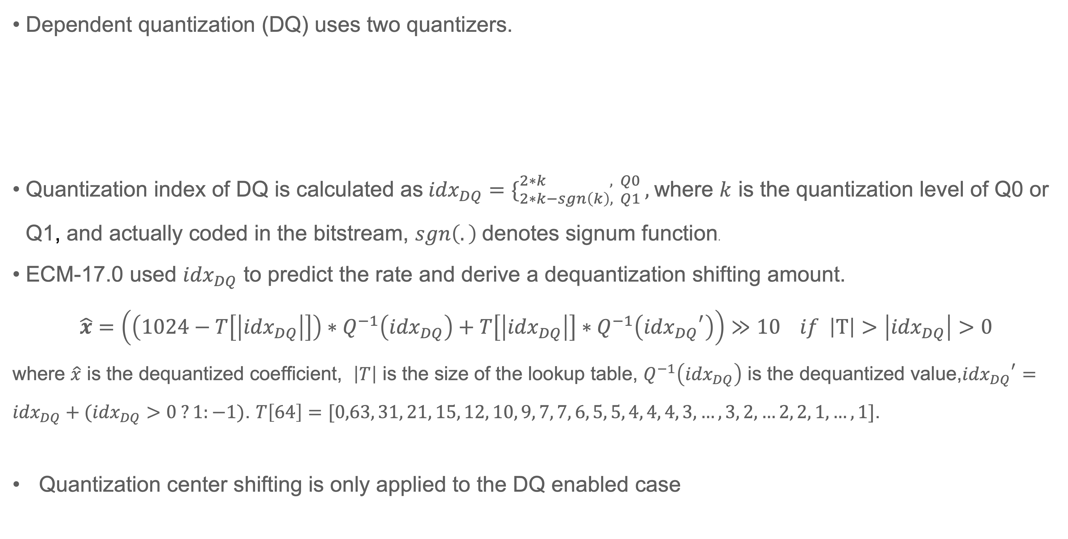
Background
Dependent quantization (DQ) uses two quantizers.
Quantization index of DQ is calculated as${idx}_{DQ}=\{_{2∗k−sgn\left(k\right), Q1 }^{2∗k , Q0},$where $k$ is the quantization level of Q0 or Q1, and actually coded in the bitstream, $sgn\left(.\right)$denotes signum function.
ECM-17.0 used ${idx}_{DQ}$ to predict the rate and derive a dequantization shifting amount.
$$\hat{x}=\left(\left(1024−T\left[\left|{idx}_{DQ}\right|\right]\right)∗Q^{−1}\left({idx}_{DQ}\right)+T\left[\left|{idx}_{DQ}\right|\right]∗Q^{−1}\left({{idx}_{DQ}}^{′}\right)\right)≫10 if \left|T\right|>\left|{idx}_{DQ}\right|>0$$
where $\hat{x}$ is the dequantized coefficient, $\left|T\right|$ is the size of the lookup table, $Q^{−1}\left({idx}_{DQ}\right)$ is the dequantized value,${{idx}_{DQ}}^{′}={idx}_{DQ}+({idx}_{DQ}>0 ?1:−1)$. $T\left[64\right]=[0,63, 31, 21, 15, 12, 10, 9, 7, 7, 6, 5, 5, 4, 4, 4, 3, …, 3, 2, …2, 2, 1,…,1]$.
Quantization center shifting is only applied to the DQ enabled case
JVET-AM0068

Slide 3
Proposal for non-CTC
Non-CTC: DQ is disabled and sign prediction is disabled
Applying the quantization center shifting for both RRC and TSRC, the same table with the current ECM-17.0 is used
JVET-AM0068

Slide 4
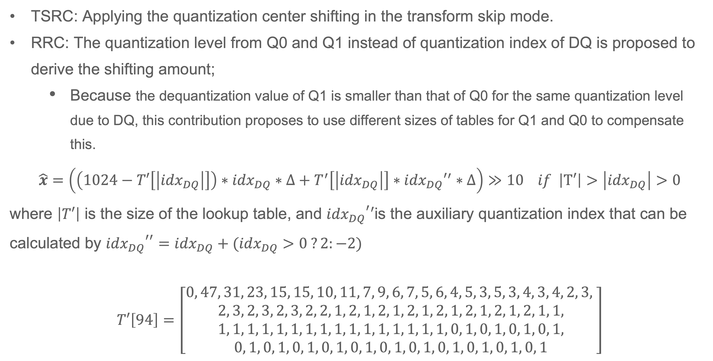
Proposal for CTC
TSRC: Applying the quantization center shifting in the transform skip mode.
RRC: The quantization level from Q0 and Q1 instead of quantization index of DQ is proposed to derive the shifting amount;
  Because the dequantization value of Q1 is smaller than that of Q0 for the same quantization level due to DQ, this contribution proposes to use different sizes of tables for Q1 and Q0 to compensate this.
$$\hat{x}=\left(\left(1024−T′\left[\left|{idx}_{DQ}\right|\right]\right)∗{idx}_{DQ}∗Δ+T^{′}\left[\left|{idx}_{DQ}\right|\right]∗{{idx}_{DQ}′}^{′}∗Δ\right)≫10 if \left|T′\right|>\left|{idx}_{DQ}\right|>0$$
where $\left|T′\right|$ is the size of the lookup table, and ${{idx}_{DQ}}^{′}′$is the auxiliary quantization index that can be calculated by ${{idx}_{DQ}}^{′′}={idx}_{DQ}+({idx}_{DQ}>0 ?2:−2)$
$T′\left[94\right]=\left[\begin{aligned}0, 47, 31, 23, 15, 15, 10, 11, 7, 9, 6, 7, 5, 6, 4, 5, 3, 5, 3, 4, 3, 4, 2, 3, \\ 2, 3, 2, 3, 2, 3, 2, 2, 1, 2, 1, 2, 1, 2, 1, 2, 1, 2, 1, 2, 1, 2, 1, 1, \\ 1, 1, 1, 1, 1, 1, 1, 1, 1, 1, 1, 1, 1, 1, 1, 1, 0, 1, 0, 1, 0, 1, 0, 1, \\ 0, 1, 0, 1, 0, 1, 0, 1, 0, 1, 0, 1, 0, 1, 0, 1, 0, 1, 0, 1, 0, 1\end{aligned}\right]$
JVET-AM0068

Slide 5
Simulation results (non-CTC)
 | All Intra Main 10
 | Over NonCTC
 | Y | U | V | EncT | DecT | EncVmPeak | DecVmPeak
Class A1 | -0.39% | -0.70% | -0.82% | 100.8% | 101.5% | 100.0% | 100.3%
Class A2 | -0.41% | -0.68% | -0.63% | 100.9% | 101.7% | 100.1% | 100.2%
Class B | -0.43% | -0.71% | -0.76% | 101.1% | 100.7% | 99.1% | 100.0%
Class C | -0.42% | -0.54% | -0.65% | 101.8% | 101.2% | 100.0% | 100.0%
Class E | -0.48% | -0.52% | -0.72% | 101.2% | 101.1% | 100.0% | 100.0%
Overall | -0.42% | -0.63% | -0.72% | 101.2% | 101.2% | 99.8% | 100.1%
Class D | -0.40% | -0.65% | -0.55% | 101.0% | 99.5% | 100.2% | 100.1%
Class F | -0.36% | -0.65% | -0.52% | 99.4% | 98.9% | 98.4% | 99.9%
Class TGM | -0.21% | -0.19% | -0.19% | 100.5% | 100.2% | 101.1% | 99.9%
JVET-AM0068

Slide 6
non-CTC with AE0102 and AG0100
 | Random Access Main 10
 | Over nonCTC
 | Y | U | V | EncT | DecT | EncVmPeak | DecVmPeak
Class A1 | -0.14% | -0.61% | -0.61% | 100.3% | 101.1% | 100.2% | 99.9%
Class A2 | -0.08% | -0.44% | -0.59% | 100.4% | 100.5% | 100.0% | 99.0%
Class B | -0.13% | -0.46% | -0.56% | 100.3% | 100.7% | 100.1% | 100.2%
Class C | -0.17% | -0.54% | -0.25% | 100.2% | 100.8% | 100.1% | 100.1%
Class E
Overall | -0.13% | -0.51% | -0.50% | 100.3% | 100.8% | 100.1% | 99.9%
Class D | -0.08% | -0.51% | -0.01% | 100.1% | 101.0% | 100.0% | 100.1%
Class F | -0.13% | -0.08% | 0.10% | 100.3% | 99.3% | 100.3% | 100.2%
Class TGM | 0.03% | -0.13% | -0.07% | 99.7% | 99.5% | 100.0% | 100.0%
 | All Intra Main 10
 | Over nonCTC
 | Y | U | V | EncT | DecT | EncVmPeak | DecVmPeak
Class A1 | -0.24% | -0.55% | -0.81% | 101.2% | 101.8% | 100.1% | 100.5%
Class A2 | -0.16% | -0.42% | -0.41% | 100.9% | 101.6% | 100.1% | 100.6%
Class B | -0.20% | -0.51% | -0.69% | 101.2% | 100.9% | 100.0% | 100.3%
Class C | -0.20% | -0.28% | -0.35% | 100.7% | 99.8% | 99.2% | 100.1%
Class E | -0.30% | -0.52% | -0.59% | 100.9% | 100.3% | 100.0% | 100.1%
Overall | -0.22% | -0.45% | -0.57% | 101.0% | 100.8% | 99.8% | 100.3%
Class D | -0.19% | -0.30% | -0.59% | 100.7% | 99.6% | 100.3% | 100.0%
Class F | -0.21% | -0.30% | -0.13% | 98.6% | 100.1% | 101.6% | 100.0%
Class TGM | -0.16% | -0.13% | -0.13% | 98.8% | 100.1% | 102.2% | 99.9%
 | Low delay B Main 10
 | Over nonCTC
 | Y | U | V | EncT | DecT | EncVmPeak | DecVmPeak
Class A1
Class A2
Class B | -0.12% | 0.33% | -0.58% | 99.9% | 101.2% | 100.1% | 100.4%
Class C | -0.14% | -0.15% | -0.14% | 99.7% | 101.0% | 100.5% | 99.9%
Class E | 0.02% | 0.73% | 0.18% | 100.0% | 100.2% | 100.1% | 100.0%
Overall | -0.09% | 0.27% | -0.25% | 99.8% | 100.9% | 100.2% | 100.1%
Class D | -0.22% | 0.09% | -1.00% | 99.2% | 101.0% | 99.9% | 100.0%
Class F | -0.26% | 0.30% | 0.72% | 99.3% | 100.1% | 100.1% | 100.2%
Class TGM | -0.15% | -0.08% | -0.13% | 99.8% | 96.4% | 100.0% | 100.4%
JVET-AM0068

Slide 7
CTC
 | All Intra Main 10
 | Over CTC
 | Y | U | V | EncT | DecT | EncVmPeak | DecVmPeak
Class A1 | -0.01% | -0.24% | -0.03% | 100.0% | 99.2% | 100.0% | 100.0%
Class A2 | -0.02% | -0.14% | -0.03% | 100.2% | 99.6% | 100.0% | 100.0%
Class B | -0.03% | -0.05% | -0.01% | 100.3% | 99.5% | 99.1% | 100.1%
Class C | -0.01% | 0.02% | -0.12% | 100.3% | 99.7% | 100.5% | 100.0%
Class E | -0.04% | -0.10% | -0.07% | 100.1% | 99.7% | 98.0% | 100.0%
Overall | -0.02% | -0.09% | -0.05% | 100.2% | 99.6% | 99.5% | 100.0%
Class D | 0.02% | 0.04% | -0.33% | 99.6% | 99.7% | 99.7% | 100.0%
Class F | -0.07% | -0.04% | -0.11% | 99.4% | 100.6% | 98.2% | 100.0%
Class TGM | -0.11% | -0.04% | -0.10% | 98.4% | 99.7% | 101.1% | 100.0%
 | Random Access Main 10
 | Over CTC
 | Y | U | V | EncT | DecT | EncVmPeak | DecVmPeak
Class A1 | -0.01% | 0.02% | -0.11% | 99.6% | 100.3% | 100.0% | 100.1%
Class A2 | 0.00% | -0.04% | -0.17% | 99.9% | 100.6% | 100.3% | 100.1%
Class B | 0.00% | -0.23% | -0.01% | 99.9% | 100.2% | 100.0% | 99.9%
Class C | 0.00% | 0.01% | 0.04% | 99.7% | 100.1% | 100.0% | 99.9%
Class E
Overall | 0.00% | -0.08% | -0.05% | 99.8% | 100.3% | 100.1% | 100.0%
Class D | 0.00% | 0.09% | -0.24% | 99.8% | 99.9% | 100.0% | 99.9%
Class F | -0.05% | -0.03% | 0.21% | 99.9% | 100.6% | 100.1% | 100.0%
Class TGM | 0.02% | -0.01% | -0.12% | 99.8% | 99.6% | 100.0% | 100.0%
 | Low delay B Main 10
 | Over CTC
 | Y | U | V | EncT | DecT | EncVmPeak | DecVmPeak
Class A1
Class A2
Class B | 0.01% | 0.28% | 0.20% | #DIV/0! | #DIV/0! | 100.1% | 98.9%
Class C | -0.05% | -0.47% | 0.24% | #DIV/0! | #DIV/0! | 99.8% | 99.0%
Class E | -0.14% | 1.39% | 1.34% | #DIV/0! | #DIV/0! | 100.0% | 98.4%
Overall | -0.05% | 0.30% | 0.50% | #DIV/0! | #DIV/0! | 100.0% | 98.8%
Class D | 0.07% | -1.27% | 0.89% | #DIV/0! | #DIV/0! | 99.8% | 99.0%
Class F | 0.06% | 0.75% | 1.94% | #DIV/0! | #DIV/0! | 99.7% | 99.0%
Class TGM | -0.18% | -0.33% | -0.21% | #DIV/0! | #DIV/0! | 103.3% | 99.8%
JVET-AM0068

Slide 8
Conclusions
This contribution proposes to apply quantization center shifting to non-CTC case (DQ off)
This contribution also proposes to apply quantization center shifting in transform skip mode;
This contribution further proposes to use different size of tables to derive the shifting amount of Q0 and Q1
The simulation results show noticeable coding gain for all the classes of test content while no increase in complexity.
It is proposed to study this in the next round of EE
Thank Qualcomm and Interdigital for crosschecking this proposal.
JVET-AM0068

