Slide 1
JVET-AL0055
AhG10: On constrained encoder configuration of VTM
Timofey Solovyev
Johannes Sauer
Johan Esprit Francis Pardo
Elena Alshina
Huawei Technologies

Slide 2
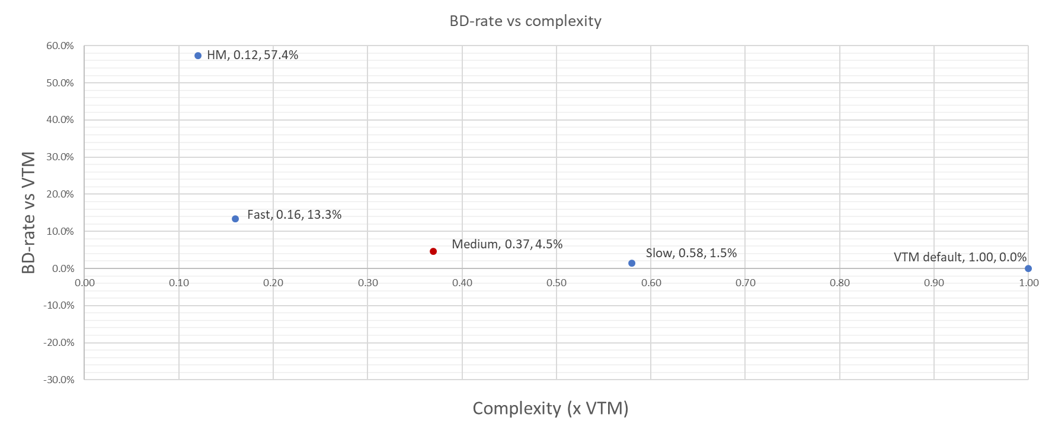
Possible VTM configurations (full length results)
RA
Full CTC
Anchor: VTM 23.5, default RA configuration
Notes:
Fast should be HM runtime with ~7% loss

Slide 3
Configuration “medium”, full length results
--MaxMTTHierarchyDepth=1 --MaxMTTHierarchyDepthISliceL=2 --MaxMTTHierarchyDepthISliceC=2 (default value 3)
--MTS=0 --MTSImplicit=1
--MaxNumMergeCand=5 (default value 6)
 | Random Access Main 10
 | VTM23.5_medium_conf Over VTM23.5
 | Y | U | V | EncT | DecT
Class A1 | 3.65% | 4.54% | 5.52% | 38.3% | 92.9%
Class A2 | 5.03% | 6.06% | 5.79% | 38.5% | 93.3%
Class B | 4.24% | 5.95% | 5.99% | 38.2% | 97.8%
Class C | 4.96% | 6.08% | 6.37% | 33.8% | 91.1%
Class E
Overall (Ref) | 4.47% | 5.72% | 5.96% | 37.1% | 94.1%
Class D | 4.21% | 5.86% | 5.56% | 41.2% | 101.6%
Class F | 5.66% | 6.13% | 6.24% | 47.1% | 97.9%
 | All Intra Main10
 | VTM23.5_medium_conf Over VTM23.5
 | Y | U | V | EncT | DecT
Class A1 | 1.02% | 1.00% | 1.04% | 54.7% | 92.3%
Class A2 | 1.21% | 1.72% | 1.55% | 46.8% | 94.7%
Class B | 1.56% | 1.52% | 1.74% | 44.9% | 99.4%
Class C | 1.70% | 1.62% | 1.88% | 40.1% | 97.4%
Class E | 1.86% | 1.58% | 1.42% | 46.5% | 107.8%
Overall | 1.49% | 1.50% | 1.57% | 45.8% | 98.3%
Class D | 1.48% | 1.51% | 1.58% | 41.5% | 110.8%
Class F | 2.18% | 2.48% | 2.78% | 49.9% | 96.2%
 | Low delay B Main10
 | VTM23.5_medium_conf Over VTM23.5
 | Y | U | V | EncT | DecT
Class A1
Class A2
Class B | 3.91% | 6.30% | 7.12% | 39.5% | 95.1%
Class C | 4.53% | 6.63% | 6.83% | 38.8% | 100.9%
Class E | 4.14% | 4.94% | 5.06% | 59.8% | 105.4%
Overall (Ref) | 4.17% | 6.07% | 6.51% | 43.6% | 99.5%
Class D | 4.20% | 7.10% | 7.16% | 45.3% | 100.4%
Class F | 8.66% | 11.20% | 11.49% | 50.6% | 98.4%
 | Low delay P Main10
 | VTM23.5_medium_conf Over VTM23.5
 | Y | U | V | EncT | DecT
Class A1
Class A2
Class B | 4.05% | 7.24% | 7.81% | 37.2% | 94.8%
Class C | 4.60% | 6.94% | 7.11% | 38.4% | 98.3%
Class E | 4.46% | 6.04% | 5.91% | 60.9% | 107.6%
Overall (Ref) | 4.34% | 6.84% | 7.10% | 42.5% | 99.0%
Class D | 4.23% | 6.55% | 7.15% | 46.4% | 108.8%
Class F | 8.94% | 11.54% | 11.96% | 52.1% | 104.8%
Tested by Huawei, RA results xchecked by InterDigital
Notes:
Default MTT depth is 3
Default MaxNumMergeCand 6
More fancy MTT depth configuration can be done in ECM_as_VTM configuring MTT depth for different temporal layers (less depth for higher layers)

Slide 4
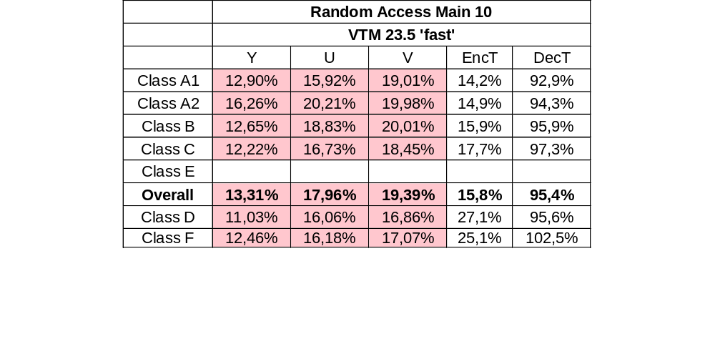
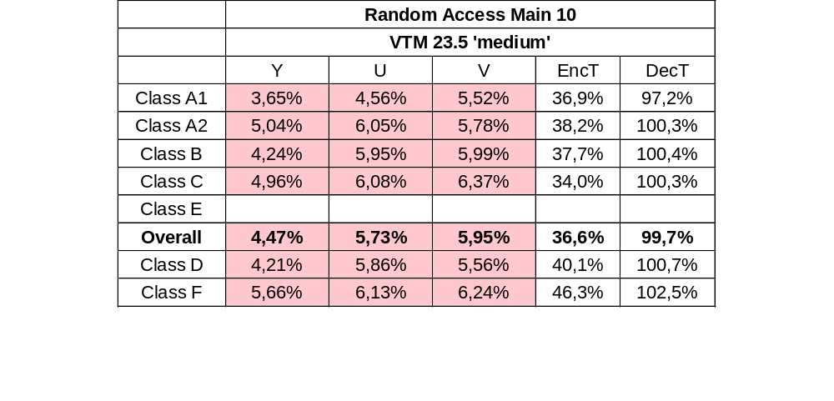
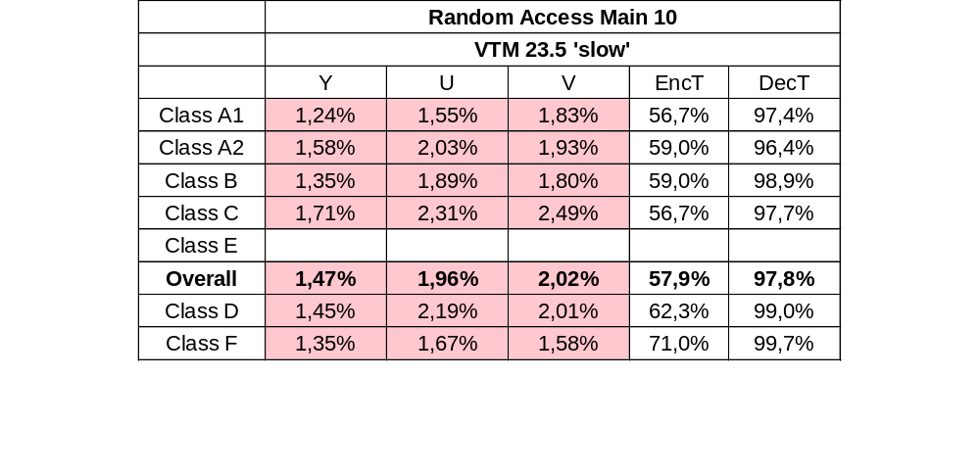
Summary (fast, medium, slow)
These full length results provided by InterDigital in crosscheck contribution JVET-AL0263

Slide 5
Possible VTM configurations (full length results)
RA
Full CTC
Anchor: VTM 23.5, default RA configuration
Notes:
Fast should be HM runtime with ~7% loss

