Slide 1
JVET-AL0053
DCR MOS over rate plots
Preliminary compilation of results.
17 viewers
Played 24/25fps sequences with 30fps
Non-normalized z-score threshold 2.5, no other processing

Slide 2
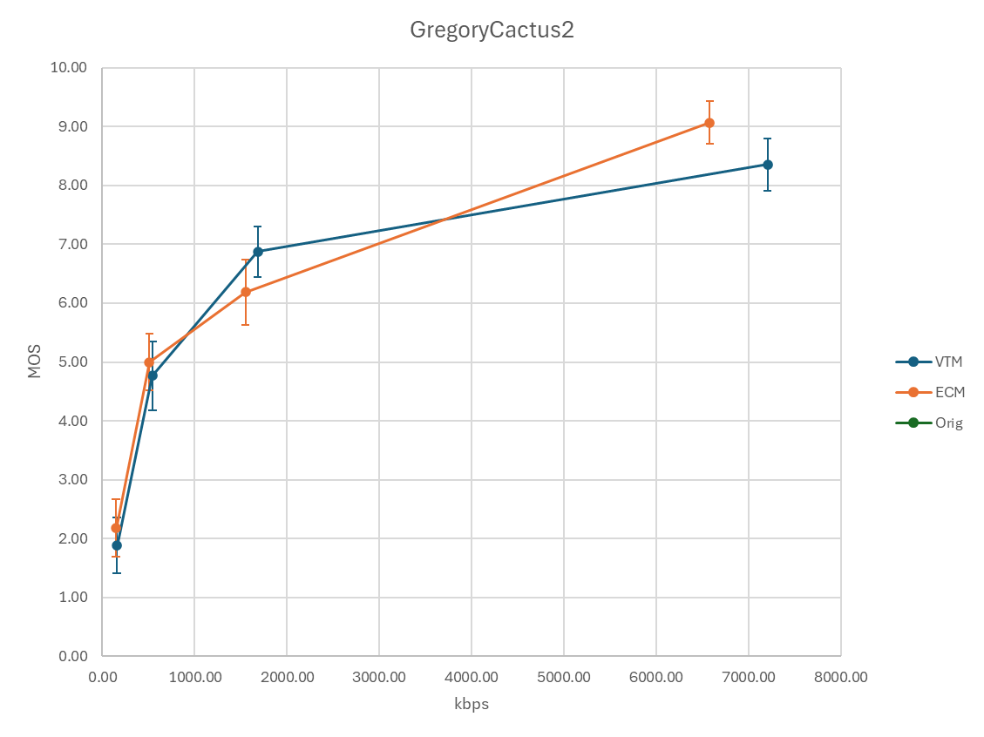

Slide 3
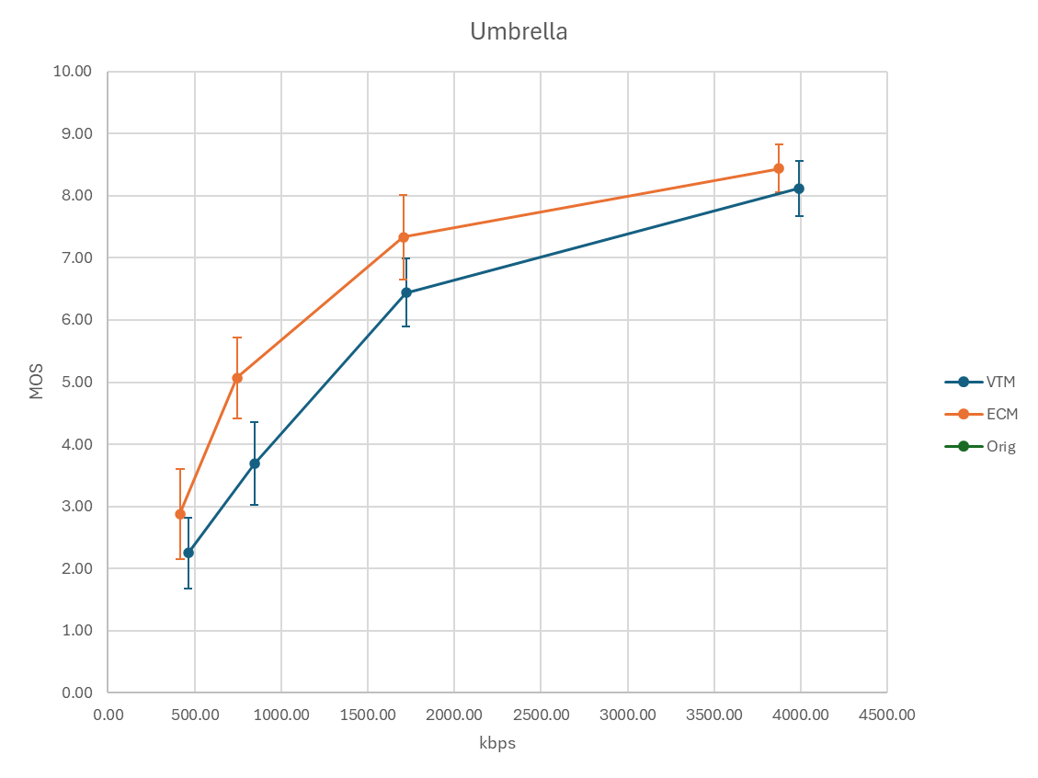

Slide 4
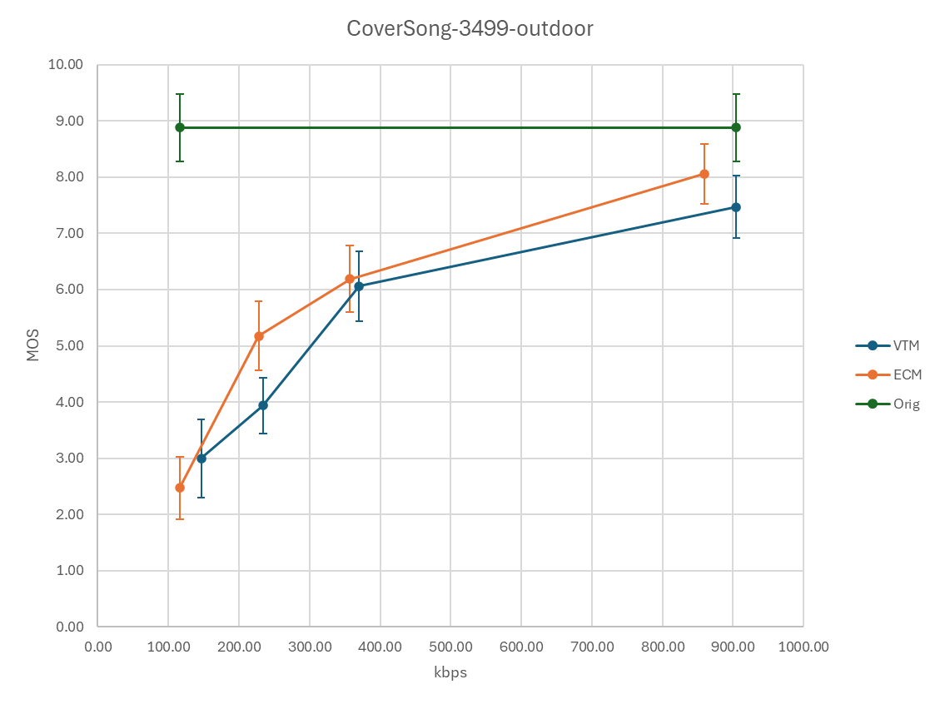

Slide 5
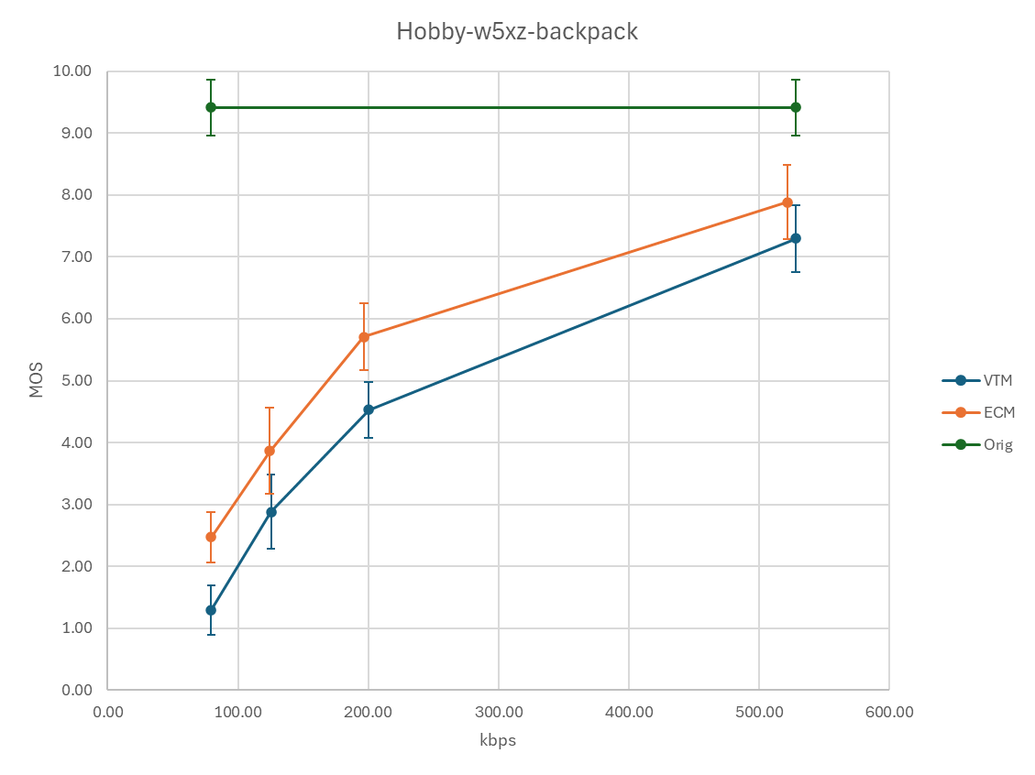

Slide 6
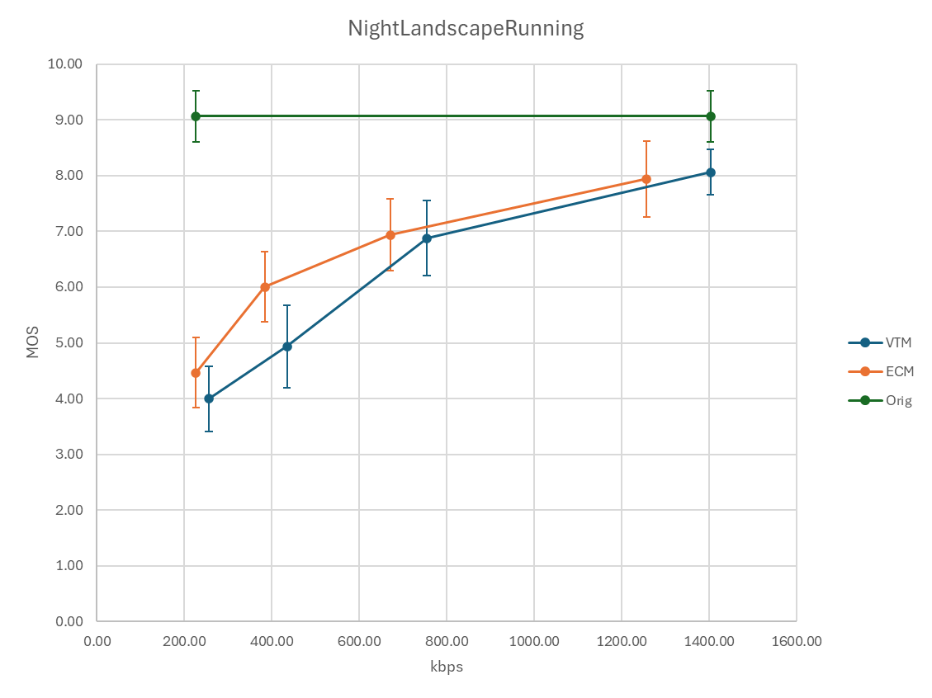

Slide 7
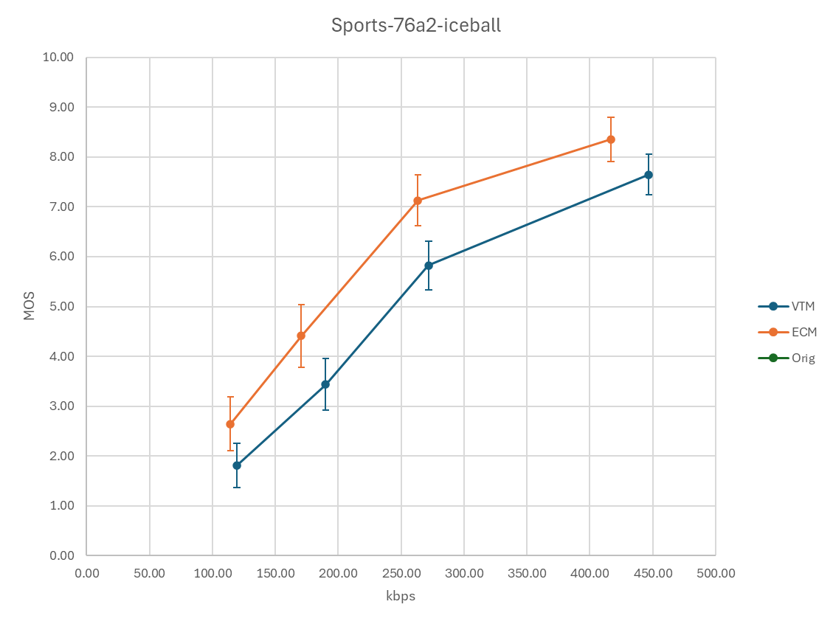

Slide 8
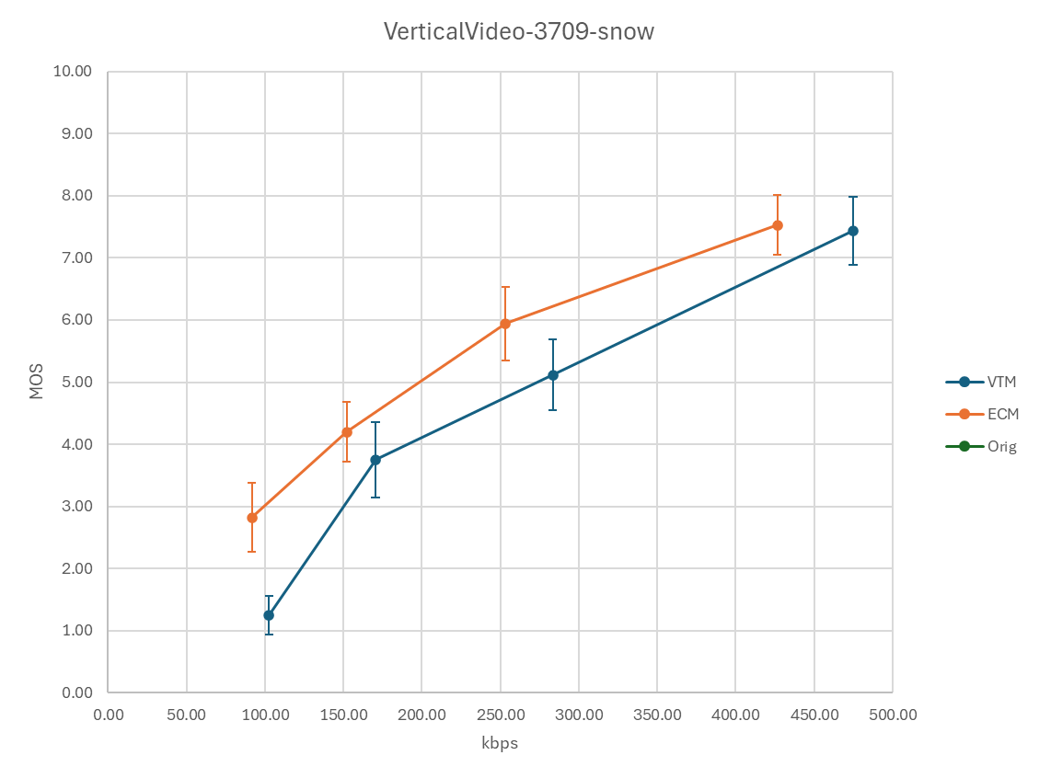

Slide 9
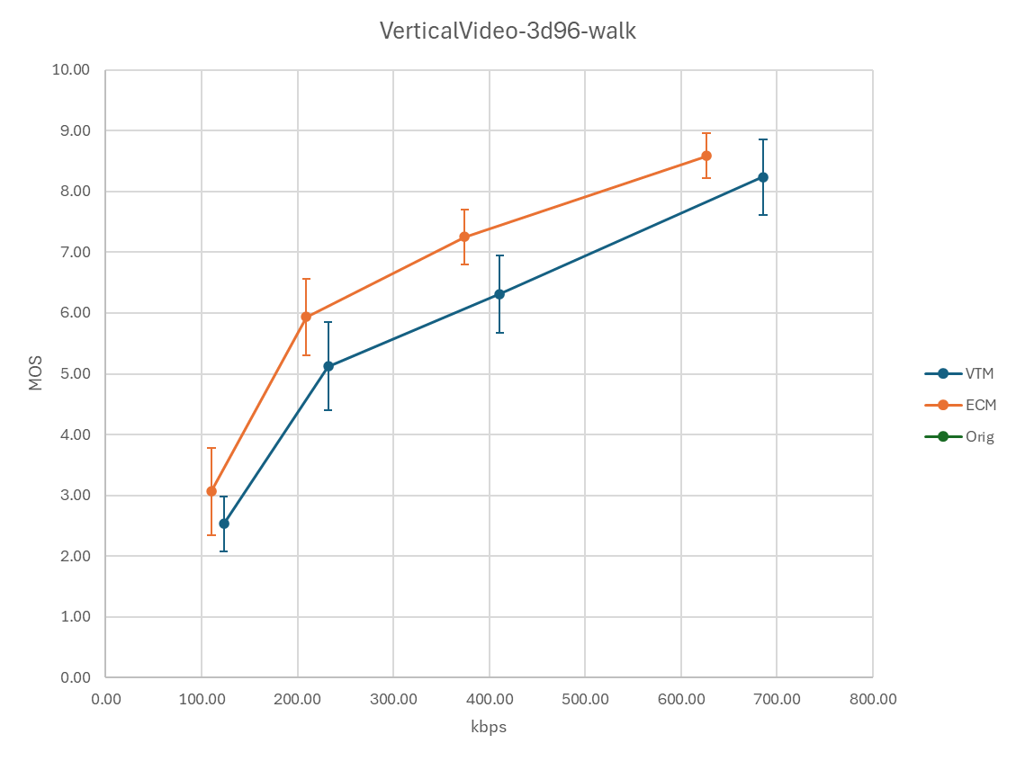

Slide 10
