Slide 1
JVET-AL0052: AhG17: Comments on proposed draft text: Call for Evidence on video compression with capability beyond existing standards
E. Alshina, T. Solovyev, Huawei Technologies

Slide 2
What kind of evidence needs to be demonstrated?
Group is ready to perform visual tests
  There are test materials and rate points visual benefits can be observed
  Visual testing procedure agreed
The industry needs can be addressed by potential future coding standard and JVET has good understanding how to demonstrate this
  Video materials cover wide range of use cases important for industry
  Video material are challenging enough (rate reduction required)
  User experience gets improved in ultra-low transmission latency scenario
  Compression benefits can be observed in constrained encoder scenario
    JVET group has agreed testing procedure which allows to drive conclusion on codec performance in this scenario (‘fast encoder’ category in JVET-AL0047)

Slide 3
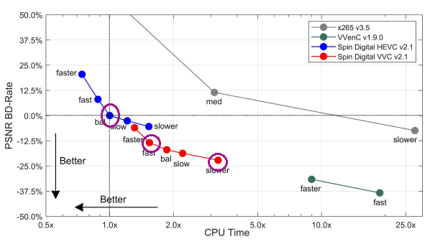
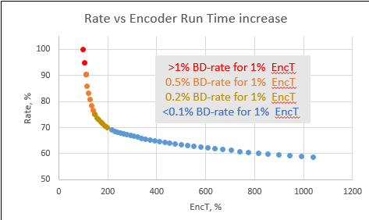
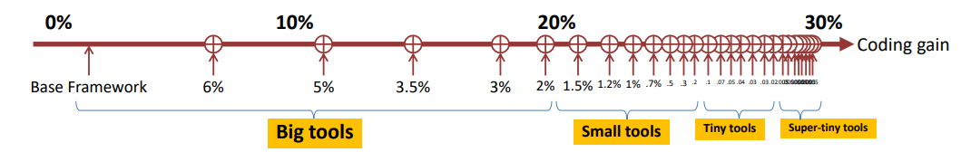
Motivation
ITU and ISO/IEC JTC 1 SC 29 Joint ​ Workshop on “Future video coding – advanced signal processing, AI and standards
Spin Digital
Samsung
‘Big tools’ needed
4K encoder from Spin Digital over ‘realtime’ HEVC
13% compression gain with ×1.5 EncT. ↑
25% compression gain with × 3 EncT. ↑
How to demonstrate an evidence of video compression capability beyond existing standards in constrained encoder configuration?

Slide 4
General comments
Difficulties in designing constrained encoder test conditions:
  It is impossible to realistically emulate ‘real time’ encoding during standard development
    Encoder constrains are highly dependent on platform, use case, device.
  Standard development shall not become a competition of product level optimized encoders
  Run time cross-check for both encoder and decoder will be required
Quality evaluation
  Major criteria: visual quality (MOS)
  It is not safe to rely on PSNR only
  Suggestion: compute extra metrics: MS-SSIM, VMAF, … several other widely used Q-metrics
    Share implementation for Q-metrics
    Benefit: contribution to AG5 study for correlation between MOS and quality metrics
Ensure against overfitting?
  Several (2-3) extra sequences to be announced AFTER submission decoder executables

Slide 5
How to check run time?
Cross-check for both encoder and decoder.
  Decoder executables are submitted as always
  Encoder executables are submitted as part of responses in ‘constrained encoder category’
  Encoder cross-check is slow? Check just few cases (for example, the lowest and the highest rate for several selected sequences)
  Useful to submit executables generated with same settings /optimization level for anchor
What if submission (or anchor) can benefit from usage GPU?
  Allow to use GPU under conditions:
    bit-exact reconstruction on cross-checker device, device interoperability (similar to SADL)
  Would it be unfair? Not really!
    CPU – GPU data transfer very costly, time consuming
    VTM, ECM are full of SMID optimization
  Encoder time (ET) and decoder time (DT) for CfE response (test) are measured as observable time (GPU or/and CPU or mix)

Slide 6
Variant 1.1: minimal changes compared to other categories
Anchor:
  Encoder/decoder: VTM23.x, default random access (RA) and low-delay-B (LDB) configurations (same as in other categories).
  Run time for encoder (ET_anchor) and decoder (DT_anchor) are measured on CPU, single thread.
Constrains 1.1:
  DT_test <= 2.0 * DT_anchor,
  ET_test <= ET_anchor.
Which kind of evidence is demonstrated:
  Compression benefits compared to reference implementation of previous standard w/o increment encoder complexity and affordable decoder complexity increase.
All factors here and in the rest of this proposal are just initial suggestion, subject for discussion

Slide 7
Variant 1.2: minimal changes compared to other categories
Anchor:
  Encoder/decoder: VTM23.x, default random access (RA) and low-delay-B (LDB) configurations (same as in other categories).
  Run time for encoder (ET_anchor) and decoder (DT_anchor) are measured on CPU, single thread.
Constrains 1.2:
  DT_test <= 2.0 * DT_anchor,
  ET_test <= 1.5 * ET_anchor.
Which kind of evidence is demonstrated:
  Compression benefits compared to reference implementation of previous standard with limited increment encoder complexity and affordable decoder complexity increase.

Slide 8
Variant 1.3: minimal changes compared to other categories
Anchor:
  Encoder/decoder: VTM23.x, default random access (RA) and low-delay-B (LDB) configurations (same as in other categories).
  Run time for encoder (ET_anchor) and decoder (DT_anchor) are measured on CPU, single thread.
Constrains 1.3:
  DT_test <= 2.0 * DT_anchor,
  ET_test <= 0.5 * ET_anchor.
Which kind of evidence is demonstrated:
  Compression benefits compared to reference implementation of previous standard with lower encoder complexity and affordable decoder complexity increase.

Slide 9
Variant 2: constrained anchor
Anchor:
  Encoder/decoder: faster configuration of VTM (recommended by AhG3 or/and AhG10) analog of random access (RA) and low-delay-B (LDB) (anchor is different from other categories).
  Run time for encoder (ET_anchor) and decoder (DT_anchor) are measured on CPU, single thread.
Constrains 2:
  DT_test <= 2.0 * DT_anchor,
  ET_test <= 1.5 * ET_anchor.
Which kind of evidence is demonstrated:
  Compression benefits compared to recognized and agreed fast encoder implementation of previous standard with limited increment encoder complexity and affordable decoder complexity increase.

Slide 10
Variant 3: constrained anchor
Anchor:
  Encoder/decoder: VVenC/VVdeC (present recommended by developers) analog of random access (RA) and low-delay-B (LDB) (anchor is different from other categories).
  Run time for encoder (ET_anchor) and decoder (DT_anchor) are measured on CPU, single thread.
Constrains 3:
  DT_test <= 2.0 * DT_anchor,
  ET_test / DT_test <= ET_anchor / DT_anchor.
Which kind of evidence is demonstrated:
  Compression benefits compared to highly optimized fast encoder implementation of previous standard maintaining the same ratio between encoder and decoder run time.

Slide 11
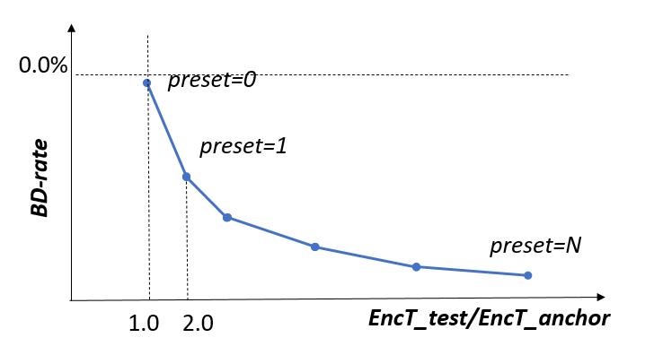
Variant 4: trade-off demonstration
Anchor:
  Encoder/decoder: VTM23.x, default random access (RA) and low-delay-B (LDB) configurations (same as in other categories).
Test:
  Encoder provided with several encoder presets: 0..N (0 - the fastest , N - the most powerful). Decoder is the same for all presents.
Constrains:
  ET_test[0] <= 1.0 * ET_anchor; DT_test[0] <= 2.0 * DT_anchor
    NOTE: Expected that visual quality for preset=0 is similar or better than anchor.
  ET_test[1] <= 2.0 * ET_anchor; DT_test[1] <= 2.0 * DT_anchor
  ...
  ET_test[N-1] <= 11 * ET_anchor; DT_test[N-1] <= 12* DT_anchor
    NOTE: Place holder for ECM (if needed)
  ET_test[N] unconstrained; DT_test[N] unconstrained
Which kind of evidence is demonstrated:
  Visual quality benefits compared to reference implementation of previous standard w/o increment encoder complexity (preset=0) and affordable decoder complexity increase and existence of coding tools with good coding efficiency / encoder complexity tradeoff. Information about performance for lower presets preset=0..1 can be very helpful for initial test model building (at collaborative phase).
ECM

Slide 12
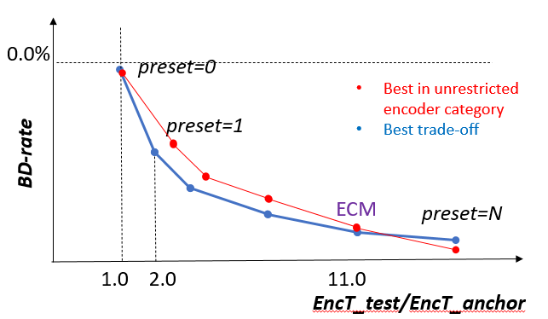
Variant 4: trade-off demonstration
Anchor:
  Encoder/decoder: VTM23.x, default random access (RA) and low-delay-B (LDB) configurations (same as in other categories).
Test:
  Encoder provided with several encoder presets: 0..N (0 - the fastest , N - the most powerful). Decoder is the same for all presents.
Constrains:
  ET_test[0] <= 1.0 * ET_anchor; DT_test[0] <= 2.0 * DT_anchor
    NOTE: Expected that visual quality for preset=0 is similar or better than anchor.
  ET_test[1] <= 2.0 * ET_anchor; DT_test[1] <= 2.0 * DT_anchor
  ...
  ET_test[N-1] <= 11 * ET_anchor; DT_test[N-1] <= 12* DT_anchor
    NOTE: Place holder for ECM (if needed)
  ET_test[N] unconstrained; DT_test[N] unconstrained
Which kind of evidence is demonstrated:
  Visual quality benefits compared to reference implementation of previous standard w/o increment encoder complexity (preset=0) and affordable decoder complexity increase and existence of coding tools with good coding efficiency / encoder complexity tradeoff. Information about performance for lower presets preset=0..1 can be very helpful for initial test model building (at collaborative phase).

Slide 13
Different combinations are available in JVET
Data from AhG14, AhG6, AhG7 reports
(run time not very reliable, just illustration)

Slide 14
Conclusion
Contribution strongly supports inclusion of constrained encoder category into potential CfE
Contribution provides initial suggestion on organization tests in this encoder category
It is suggested to discuss potential variants of tests in constrained encoder category include agreed variant into preliminary draft of CfE

Slide 15
0.0%
preset=0
Best in unrestricted encoder category
Best trade-off
preset=1
BD-rate
ECM
preset=N
1.0 2.0 11.0
EncT_test/EncT_anchor

