Slide 1
JVET-AK0201
On additional operation point for the exploration model
Timofey Solovyev, Johan Esprit Francis Pardo, Johannes Sauer, Zishan Li, Elena Alshina
Huawei Technologies

Slide 2
Outline
Motivation: why an additional operation point is needed?
Operating points (presets) in VVenC
Gain/complexity tradeoffs for tools included in ‘faster’ preset of VVenC
Tool flexibility
How to define new operation point?
Possible SW for the new operation point
Conclusion

Slide 3
1
Motivation
m70750 “Update on Preliminary draft of use cases and requirements for potential next-generation video coding standard beyond VVC capability” says:
The standard shall enable encoders to trade off complexity and coding efficiency in an economically viable way. Real-time encoding with adequate coding efficiency advantage over existing standards shall be feasible at the expected time of usage. Non-real-time encoding with further improvement of coding efficiency should be feasible at the expected time of usage.
[Section 3 Complexity]
Current CTC address “Non-real-time encoding” scenario (ET/RT*~100K for 1080p60), whereas “Real-time encoding” or at least close to that is not yet covered.
*ET – encoding time, RT – real-time

Slide 4
1
Motivation
Coding gain in ultimate performance scenario != coding gain in real-time scenario
# Spin Digital reported only 20% gain of VVC vs HEVC in real-time scenario (4K@60fps)
Currently implementers have to turn off some tools completely to meet complexity requirements (e.g. VVenC uses only 5 of 25 tools in ‘faster’ preset)
-> presence of a lightweight mode (2nd operation point) in the exploration model can help us better tune tools for this scenario and so make more tools useful for the constrained complexity scenario
Presence of the SW, demonstrating substantial coding gain for the constrained complexity scenario, is a good evidence of the standard applicability -> faster deployment

Slide 5
2
Tools used for different VVenC presets
 | Preset
Tools | faster | fast | medium | slow | slower
Affine | 0 | 5 | 4 | 3 | 1
ALF | 1 | 1 | 1 | 1 | 1
BCW | 0 | 0 | 0 | 2 | 2
BIO | 0 | 1 | 1 | 1 | 1
CCALF | 1 | 1 | 1 | 1 | 1
CIIP | 0 | 0 | 0 | 1 | 1
DepQuant | 0 | 1 | 1 | 1 | 1
DMVR | 1 | 1 | 1 | 1 | 1
GPM | 0 | 0 | 4 | 2 | 1
AMVR | 0 | 5 | 5 | 1 | 1
ISP | 0 | 0 | 3 | 3 | 1
JointCbCr | 0 | 1 | 1 | 1 | 1
LFNST | 0 | 1 | 1 | 1 | 1
CCLM | 1 | 1 | 1 | 1 | 1
LMCS | 0 | 2 | 2 | 2 | 2
MIP | 0 | 0 | 1 | 1 | 1
MMVD | 0 | 3 | 3 | 3 | 1
MRL | 0 | 1 | 1 | 1 | 1
MTS Explicit | 0 | 0 | 0 | 0 | 1
MTS Implicit | 1 | 1 | 1 | 1 | 0
PROF | 0 | 1 | 1 | 1 | 1
SBT | 0 | 0 | 0 | 1 | 1
SbTMVP | 0 | 1 | 1 | 1 | 1
SMVD | 0 | 0 | 3 | 3 | 1
NonLinearAlfChroma | 0 | 0 | 0 | 0 | 1
NonLinearAlfLuma | 0 | 0 | 0 | 0 | 1
Only 5 (from 25) VVC tools are used in ‘faster’ VVenC preset:
ALF
CCALF
DMVR
CCLM
MTS (implicit)
‘Faster’ preset speed is ~30fps on HD (qp 37, 8 threads)
Preset | PSNR BD-rate vs. HM | Speedup vs. HM | ET / RT | (ET / RT) * T | Runtime increase vs. prev preset | BD-rate difference with the prev preset (estimated)
faster | -11% | 350 | 1 | 8
fast | -26% | 150 | 2 | 19 | 2.3 | 16%
medium | -35% | 41 | 9 | 68 | 3.7 | 12%
slow | -39% | 12 | 29 | 233 | 3.4 | 6%
slower | -42% | 2.7 | 130 | 1037 | 4.4 | 5%
[bd-rate and runtime data from VVenC github]

Slide 6
3
Gain / complexity tradeoffs for tools in ‘faster’ preset
Tool off results for VVenC ‘faster’ preset (class B)
Tool name | PSNR BD-rate YUV | Encoder runtime | Runtime increase (%) per 1% gain
ALF | 7.65% | 92% | 1.1
CCALF | 4.67% | 98% | 0.4
DMVR | 2.72% | 94% | 2.2
CCLM | 3.07% | 99.9% | 0.03
MTS implicit | 0.97% | 99.9% | 0.1
All tools off | 15.65% | 87% | 1.0
For all tools in ‘faster’ preset runtime increase is smaller than 3% per 1% coding gain
5 tools included in ‘faster’ preset give ~15% gain with just 15% complexity increase

Slide 7
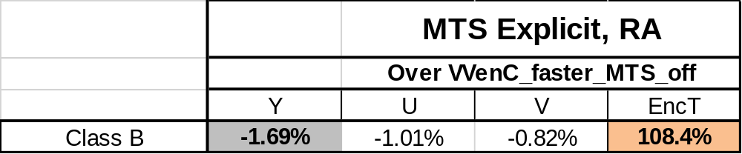
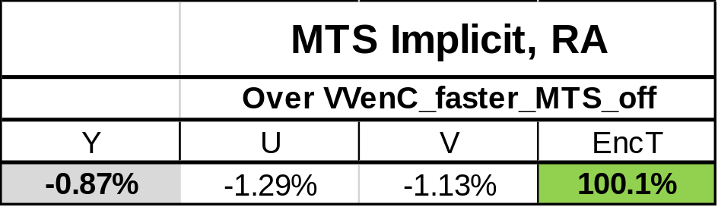
4
Example of tool flexibility: implicit and explicit MTS
During VVC development two variants of MTS were developed:
  Explicit MTS -> 1.69% gain with 8.4% encoder complexity increase
  Implicit MTS -> 0.87% gain with 0.1% encoder complexity increase
Explicit MTS is good for ultimate performance
Implicit MTS is good in case of constrained complexity
Gain/complexity tradeoff of implicit MTS would be barely achieved with just encoder optimization
of explicit MTS -> it’s a feature of standard design

Slide 8
5
How to define new operation point?
Option 1: Encoding / Decoding runtime ratio
VTM: ~1000-4000
Possible definition of the operation point: ‘Encoder runtime is x10 VTM decoder runtime’
Option 2: Encoding time / real-time (e.g for 1080p60)
VTM: ~20000
VVenC ‘faster’ 1 thread: ~15-20
Possible definition of the operation point: ‘Encoder runtime is x100 of the real-time’ (ET/RT=100)
Option 3: Encoding time in comparison with VTM (e.g x2 of specific VTM configuration)
Possible definition of the operation point: ‘Encoder runtime is x2 of the VTM encoder runtime’
Notes:
roughly corresponds to VVenC ‘medium’ preset

Slide 9
6
Possible SW for the new operation point
Option | Pro | Contra
VVenC (2nd codebase) | Realistic complexity/performance trade-off SW is ready, all fast decisions are there | 2nd codebase Difficult to port ECM tools Might not be suitable for research (SW-wise) No decoder (VVdeC is a separate project)
VTM + cfg change | Single codebase No SW changes needed, only extra config file Can be done relatively quickly using LLCC activity results (or JVET-AK0232) as a starting point | Difficult to reach (ET/RT=100) with a reasonable trade-off -> configuration can be far from realistic from the performance point of view (even for ET/RT=1000 losses were about 25% for VTM)
VTM + cfg change + fast decisions | Single codebase Realistic complexity/performance trade-off (realistic operation point) | Need to implement more fast decisions in VTM codebase (quite some effort)

Slide 10
Conclusion
We believe an additional operation point is needed for developing/tuning tools for the constrained complexity scenario
Three variants of defining new operation point were considered:
  Based on Encoding time / Decoding time ratio (e.g. 10/1)
  Based on Encoding time / Real-time ratio (e.g. 100/1 for 1080p60)
  Based on VTM runtime (e.g x2)
Three approaches to building the SW for the new operation point were considered
Proposed action – establish AhG with the following mandates:
  Solicit more information from practical encoder implementations
  Define new operation point, reflecting a constrained complexity scenario
  Design software/configuration for explorations in the constrained complexity scenario

