Slide 1
AHG12: temporal ALF
JVET-AJ0090
Luhang Xu, Yue Yu, Haoping Yu, Dong Wang (OPPO)

Slide 2
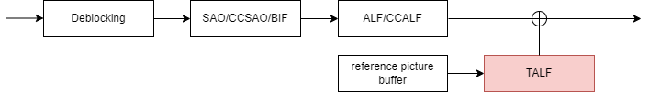
Proposed method (1/4)
The proposed TALF is placed at the last in the loop filters.
It uses temporal reconstructed information to improve the current picture’s quality.
Similar to ALF, the filter coefficients and related information are transmitted in the bitstream.
  Related information comprises coefficient precision, non-linear clip and reuse information.
Up to 8 sets of history TALFs are stored for uni/bi-filtering and can be reused in the current picture’s filtering.

Slide 3
Proposed method (2/4)
The temporal ALF has 6 filtering modes.
  The 1st filtering mode is an uni-filtering mode, it uses the rounded MV0 from the reference picture list 0 to locate the filter inputs.
  The 2nd filtering mode is an uni-filtering mode, it uses the rounded MV1 from the reference picture list 1 to locate the filter inputs.
  The 3rd filtering mode is a bi-filtering mode, it uses the rounded MV0 and MV1 from the reference picture list 0 and 1 to locate the filter inputs.
  The 4th filtering mode is an uni-filtering mode, it uses the collocated reconstructed samples in the closest reference picture as the filter inputs.
  The 5th filtering mode is an uni-filtering mode, it uses the collocated reconstructed samples in the second closest reference picture as the filter inputs.
  The 6th filtering mode is a bi-filtering mode, it uses the collocated reconstructed samples in the most two closest reference pictures as the filter inputs.

Slide 4
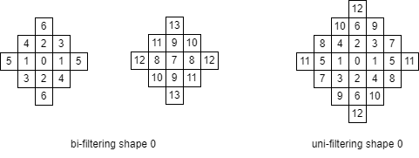
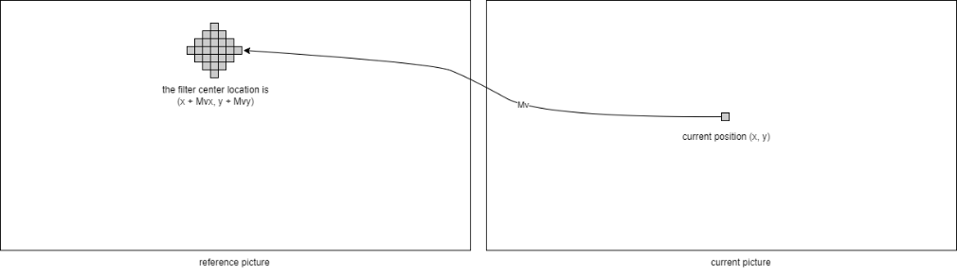
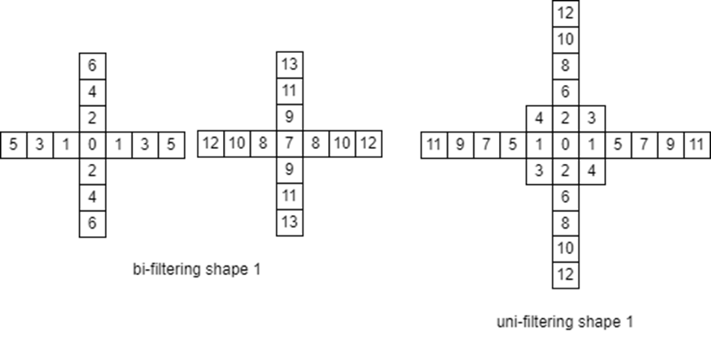
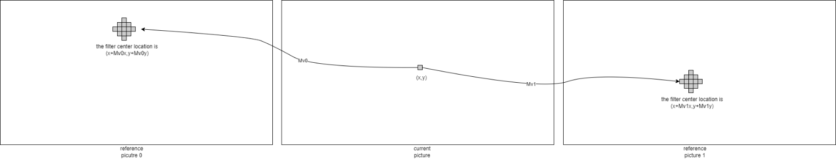
Proposed method (3/4)
Figure-1. The inputs of the uni-filtering
mode are located by the uni-MV
Figure-3. The filter shape0 for
bi-filtering and uni-filtering.
Figure-2. The inputs of the bi-filtering
mode are located by the MV0 and MV1
Figure-4. The filter shape1 for
bi-filtering and uni-filtering.

Slide 5
Proposed method (4/4)
slice_header() {
sh_talf_enabled_flag | u(1)
if(sh_talf_enabled_flag){
talf_reuse_flag // reuse history filters or not | u(1)
talf_mode // 6 filtering modes | ue(v)
if(talf_reuse_flag) {
num_talf_reuse_minus1 // number of reused history filter sets | u(3)
for (i=0; i<=num_talf_reuse_minus1; i++)
talf_reuse_id[ i ] | u(3)
}
else {
talf_signaled_filter_minus1 // num of new filters for this slice | ue(v)
talf_clip_enabled_flag // non-linear clip flag | u(1)
for ( fIdx = 0; fIdx <= talf_signaled_filter_minus1; fIdx++)
talf_shift_value[ fIdx ] // precision of filter coefficients | u(2)
for (i=0; i < (isBifilter ? 14 : 13); i++)
talf_coeff[ fIdx ][ i ] // filter coefficient | ue(v)
if (talf_coeff[ fIdx ][ i ] && talf_clip_enabled_flag)
talf_clip_index[ fIdx ][ i ] // non-linear clip index | u(2)
}
}
Coding_tree_syntax() {
if (sh_talf_enabled_flag) {
talf_ctb_enabled_flag[ ctuX ][ ctuY] // use talf or not | ae(v)
if (num_talf_reuse_minus1 > 0)
talf_set_idx[ ctuX ][ ctuY ] // use which set if multiple sets are reused | ae(v)
talf_filter_idx[ ctuX ][ ctuY ] // use which filter in the selected set | ae(v)
}
A summary of the proposed TALF
mode signaling is shown on this page

Slide 6
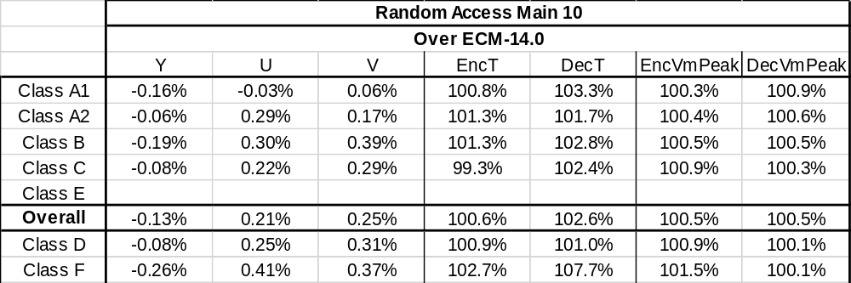
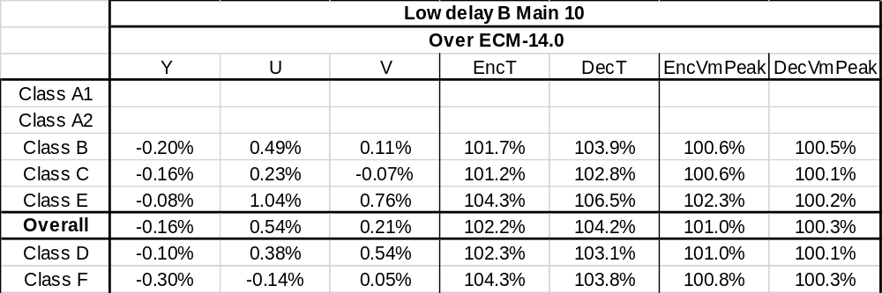
Summary
The proposed method brings 0.13% and 0.16% of coding gain for RA and LDB, respectively.
It is recommended to further study the proposed method in the next round of EE2.
Thanks to Alibaba for crosschecking this proposal.

