Slide 1
JVET-AI0226: Longer motion compensation interpolation filter
Ruoyang Yu, Han Huang, Vadim Seregin, Marta Karczewicz

Slide 2
Introduction
ECM uses 12-tap interpolation filter for luma motion compensation
In EE2 (3.10) of the previous meeting, sharp 12-tap interpolation filter for bi-prediction was proposed and has been adopted in this meeting

Slide 3
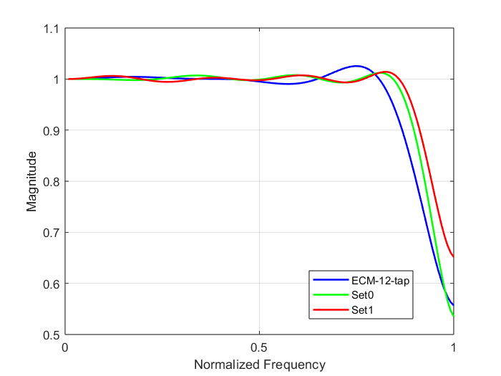
Proposal
Following the same spirit of the EE and with attempt to preserve more high frequencies for bi-prediction, it is proposed to use longer (16-tap) interpolation filter for luma motion compensation.
Two sets of 16-tap interpolation filter are proposed, set0 and set1.
  Both sets are used for bi-prediction, uni-prediction uses existing ECM 12-tap interpolation filter
  set0 ”boosts” less high frequency than set1, and is activated for blocks that have both side greater than 32, or has one side equals to 4 (i.e., 4xN or Nx4 blocks)
  Filters are designed based on cosine-windowed sinc function

Slide 4
Results
CTC RA and LDB (set0 and set1 used for bi-prediction only)
 | Random Access Main 10
 | Over ECM-13.0
 | Y | U | V | EncT | DecT | EncVmPeak | DecVmPeak
Class A1 | #VALUE! | #VALUE! | #VALUE! |  |  | #NUM! | #NUM!
Class A2 | #VALUE! | #VALUE! | #VALUE! |  |  | #NUM! | #NUM!
Class B | -0.01% | -0.01% | 0.03% |  |  | 100.1% | 100.0%
Class C | -0.31% | -0.16% | 0.09% | 103.8% | 104.7% | 99.9% | 100.0%
Class E
Overall | #VALUE! | #VALUE! | #VALUE! |  |  | #NUM! | #NUM!
Class D | -0.71% | -0.38% | -0.33% | 104.2% | 106.6% | 100.1% | 100.0%
 | Low delay B Main 10
 | Over ECM-13.0
 | Y | U | V | EncT | DecT | EncVmPeak | DecVmPeak
Class A1
Class A2
Class B | #VALUE! | #VALUE! | #VALUE! |  |  | #NUM! | #NUM!
Class C | -0.28% | -0.19% | -0.59% |  |  | 100.1% | 100.1%
Class E | -0.05% | 0.27% | -0.38% |  |  | 100.0% | 100.2%
Overall | #VALUE! | #VALUE! | #VALUE! |  |  | #NUM! | #NUM!
Class D | -0.47% | -0.75% | 0.21% | 105.4% | 105.7% | 100.2% | 100.0%

Slide 5
Results (Updated July 18)
CTC RA
 | Random Access Main 10
 | Over ECM-13.0
 | Y | U | V | EncT | DecT | EncVmPeak | DecVmPeak
Class A1 | #VALUE! | #VALUE! | #VALUE! |  |  | #NUM! | #NUM!
Class A2 | #VALUE! | #VALUE! | #VALUE! |  |  | #NUM! | #NUM!
Class B | -0.06% | 0.10% | -0.08% |  |  | 100.1% | 99.9%
Class C | -0.29% | -0.12% | 0.00% |  |  | 99.8% | 99.9%
Class E
Overall | #VALUE! | #VALUE! | #VALUE! |  |  | #NUM! | #NUM!
Class D | -0.62% | -0.09% | -0.30% |  |  | 100.1% | 100.0%
 | Random Access Main 10
 | Over ECM-13.0
 | Y | U | V | EncT | DecT | EncVmPeak | DecVmPeak
Class A1 (2 MISS) | 0.00% | -0.04% | -0.08% |  |  | #NUM! | #NUM!
Class A2 (4 MISS) | 0.02% | -0.11% | 0.16% |  |  | #NUM! | #NUM!
Class B | -0.01% | -0.01% | 0.03% |  |  | 100.1% | 100.0%
Class C | -0.31% | -0.16% | 0.09% | 103.8% | 104.7% | 99.9% | 100.0%
Class E
Overall | -0.08% | -0.07% | 0.05% |  |  | #NUM! | #NUM!
Class D | -0.71% | -0.38% | -0.33% | 104.2% | 106.6% | 100.1% | 100.0%
16-tap set0 and 16-tap set1 used for Bi-prediction only
(Missing points are with anchor results copied)
16-tap set0 for Uni-, switch to ECM 12 tap for 32xN or 4xN
16-tap set1 for Bi-, switch to sharp 12 tap for 32xN or 4xN

Slide 6
Supplimental results of using 16-tap for uni-prediction
CTC LDP (using 16-tap set0 filter for uni-prediction)
 | Low delay P Main 10
 | Over ECM-13.0
 | Y | U | V | EncT | DecT | EncVmPeak | DecVmPeak
Class A1
Class A2
Class B | #VALUE! | #VALUE! | #VALUE! | #NUM! | #NUM!
Class C* | -0.29% | -0.16% | 0.12% | 100.8% | 101.6%
Class E* | -0.16% | -0.78% | -0.33% | 101.0% | 100.8%
Overall | #VALUE! | #VALUE! | #VALUE! | #NUM! | #NUM!
Class D | -0.77% | 0.28% | 0.00% | 100.5% | 100.9%

Slide 7
Conclusion
16-tap interpolation filters are proposed for luma motion compensation
  Our original proposal was targeting for bi-prediction, but it is found that using 16-tap can also help with uni-prediction in the later process
Some evidence of BD-rate improvements have been demonstrated
It is proposed to study using 16-tap interpolation filters in the next round of EE

Slide 9
Appendix (Coefficients for filter set0 and set1)
Fractional sample position | Interpolation filter coefficients (set0)
0/16 | 0 | 0 | 0 | 0 | 0 | 0 | 0 | 256 | 0 | 0 | 0 | 0 | 0 | 0 | 0 | 0
1/16 | 0 | 0 | -1 | 2 | -3 | 6 | -14 | 254 | 16 | -7 | 4 | -2 | 1 | 0 | 0 | 0
2/16 | 0 | 1 | -2 | 4 | -7 | 12 | -26 | 249 | 35 | -15 | 8 | -5 | 3 | -2 | 1 | 0
3/16 | -1 | 2 | -4 | 7 | -11 | 19 | -38 | 242 | 54 | -22 | 13 | -8 | 5 | -3 | 2 | -1
4/16 | -1 | 3 | -5 | 8 | -13 | 22 | -44 | 230 | 76 | -31 | 18 | -11 | 7 | -4 | 2 | -1
5/16 | -1 | 3 | -5 | 9 | -15 | 25 | -49 | 216 | 98 | -38 | 21 | -13 | 8 | -5 | 3 | -1
6/16 | -2 | 4 | -7 | 11 | -17 | 28 | -53 | 201 | 119 | -43 | 24 | -15 | 9 | -5 | 3 | -1
7/16 | -1 | 3 | -6 | 11 | -17 | 28 | -53 | 182 | 141 | -48 | 26 | -16 | 10 | -6 | 3 | -1
8/16 | -1 | 3 | -6 | 10 | -17 | 28 | -51 | 162 | 162 | -51 | 28 | -17 | 10 | -6 | 3 | -1
9/16 | -1 | 3 | -6 | 10 | -16 | 26 | -48 | 141 | 182 | -53 | 28 | -17 | 11 | -6 | 3 | -1
10/16 | -1 | 3 | -5 | 9 | -15 | 24 | -43 | 119 | 201 | -53 | 28 | -17 | 11 | -7 | 4 | -2
11/16 | -1 | 3 | -5 | 8 | -13 | 21 | -38 | 98 | 216 | -49 | 25 | -15 | 9 | -5 | 3 | -1
12/16 | -1 | 2 | -4 | 7 | -11 | 18 | -31 | 76 | 230 | -44 | 22 | -13 | 8 | -5 | 3 | -1
13/16 | -1 | 2 | -3 | 5 | -8 | 13 | -22 | 54 | 242 | -38 | 19 | -11 | 7 | -4 | 2 | -1
14/16 | 0 | 1 | -2 | 3 | -5 | 8 | -15 | 35 | 249 | -26 | 12 | -7 | 4 | -2 | 1 | 0
15/16 | 0 | 0 | 0 | 1 | -2 | 4 | -7 | 16 | 254 | -14 | 6 | -3 | 2 | -1 | 0 | 0
Fractional sample position | Interpolation filter coefficients (set1)
0/16 | 0 | 0 | 0 | 0 | 0 | 0 | 0 | 256 | 0 | 0 | 0 | 0 | 0 | 0 | 0 | 0
1/16 | -1 | 2 | -4 | 5 | -7 | 11 | -19 | 259 | 12 | -3 | 0 | 1 | -1 | 1 | -1 | 1
2/16 | -2 | 3 | -5 | 7 | -11 | 17 | -31 | 254 | 31 | -11 | 5 | -2 | 1 | 0 | 0 | 0
3/16 | -2 | 4 | -6 | 9 | -14 | 22 | -41 | 245 | 51 | -19 | 10 | -5 | 3 | -1 | 0 | 0
4/16 | -2 | 4 | -7 | 11 | -16 | 26 | -48 | 234 | 72 | -27 | 14 | -8 | 4 | -2 | 1 | 0
5/16 | -2 | 4 | -7 | 11 | -17 | 28 | -52 | 219 | 95 | -35 | 19 | -11 | 7 | -4 | 2 | -1
6/16 | -2 | 4 | -7 | 12 | -18 | 29 | -54 | 202 | 117 | -41 | 22 | -13 | 8 | -4 | 2 | -1
7/16 | -2 | 4 | -7 | 11 | -18 | 29 | -53 | 183 | 140 | -47 | 25 | -15 | 9 | -5 | 3 | -1
8/16 | -1 | 3 | -6 | 10 | -17 | 28 | -51 | 162 | 162 | -51 | 28 | -17 | 10 | -6 | 3 | -1
9/16 | -1 | 3 | -5 | 9 | -15 | 25 | -47 | 140 | 183 | -53 | 29 | -18 | 11 | -7 | 4 | -2
10/16 | -1 | 2 | -4 | 8 | -13 | 22 | -41 | 117 | 202 | -54 | 29 | -18 | 12 | -7 | 4 | -2
11/16 | -1 | 2 | -4 | 7 | -11 | 19 | -35 | 95 | 219 | -52 | 28 | -17 | 11 | -7 | 4 | -2
12/16 | 0 | 1 | -2 | 4 | -8 | 14 | -27 | 72 | 234 | -48 | 26 | -16 | 11 | -7 | 4 | -2
13/16 | 0 | 0 | -1 | 3 | -5 | 10 | -19 | 51 | 245 | -41 | 22 | -14 | 9 | -6 | 4 | -2
14/16 | 0 | 0 | 0 | 1 | -2 | 5 | -11 | 31 | 254 | -31 | 17 | -11 | 7 | -5 | 3 | -2
15/16 | 1 | -1 | 1 | -1 | 1 | 0 | -3 | 12 | 259 | -19 | 11 | -7 | 5 | -4 | 2 | -1

Slide 10
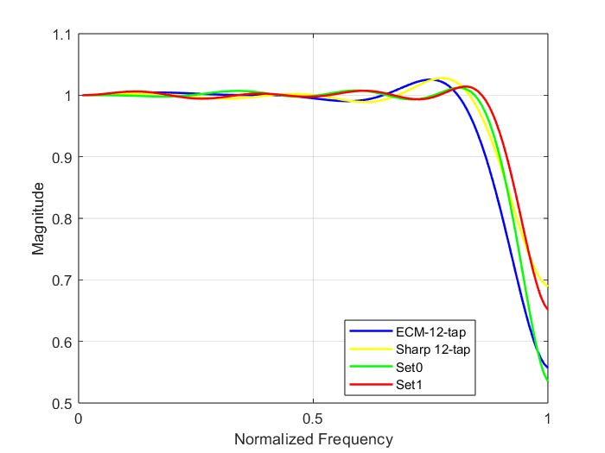
Appendix (example of magnitude response)

Slide 11
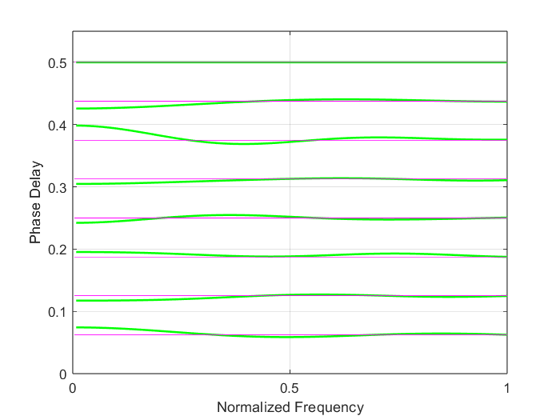
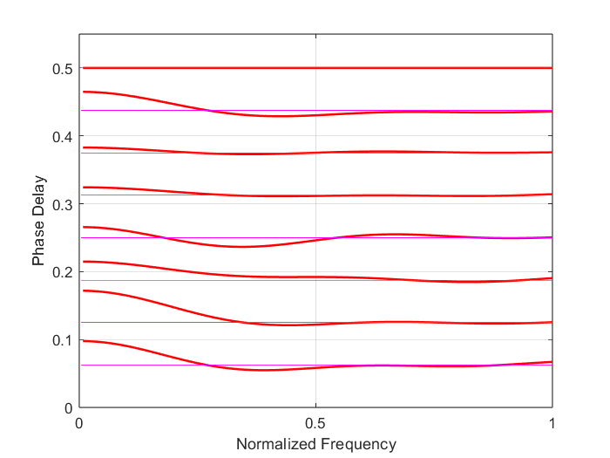
Appendix (phase delay of set0 and set1)

Slide 12
Appendix (Results vs. EE2-3.10 testb)
CTC RA and LDB
 | Random Access Main 10
 | Over ECM-13.0
 | Y | U | V | EncT | DecT | EncVmPeak | DecVmPeak
Class A1 | #VALUE! | #VALUE! | #VALUE! |  |  | #NUM! | #NUM!
Class A2 | #VALUE! | #VALUE! | #VALUE! |  |  | #NUM! | #NUM!
Class B | -0.01% | -0.01% | 0.03% |  |  | 100.1% | 100.0%
Class C | -0.31% | -0.16% | 0.09% | 103.8% | 104.7% | 99.9% | 100.0%
Class E
Overall | #VALUE! | #VALUE! | #VALUE! |  |  | #NUM! | #NUM!
Class D | -0.71% | -0.38% | -0.33% | 104.2% | 106.6% | 100.1% | 100.0%
 | RA (EE2-3.10 TEST B)
 | Over ECM-13.0
 | Y | U | V
Class A1 | -0.03% | 0.00% | 0.05%
Class A2 | 0.00% | -0.04% | 0.03%
Class B | -0.04% | 0.10% | -0.13%
Class C | -0.17% | -0.11% | 0.07%
Class E
Overall | -0.07% | 0.00% | -0.01%
Class D | -0.38% | -0.18% | -0.04%
 | RA (EE2-1.10 TESA)
 | Over ECM-13.0
 | Y | U | V
Class A1 | -0.01% | -0.08% | -0.12%
Class A2 | 0.03% | -0.05% | 0.03%
Class B | -0.04% | -0.05% | -0.09%
Class C | -0.20% | 0.10% | 0.00%
Class E
Overall | -0.06% | -0.02% | -0.05%
Class D | -0.43% | -0.11% | -0.20%
 | Low delay B Main 10
 | Over ECM-13.0
 | Y | U | V | EncT | DecT | EncVmPeak | DecVmPeak
Class A1
Class A2
Class B | #VALUE! | #VALUE! | #VALUE! |  |  | #NUM! | #NUM!
Class C | -0.28% | -0.19% | -0.59% |  |  | 100.1% | 100.1%
Class E | -0.05% | 0.27% | -0.38% |  |  | 100.0% | 100.2%
Overall | #VALUE! | #VALUE! | #VALUE! |  |  | #NUM! | #NUM!
Class D | -0.47% | -0.75% | 0.21% | 105.4% | 105.7% | 100.2% | 100.0%
 | LDB (EE2-3.10)
 | Over ECM-13.0
 | Y | U | V
Class A1
Class A2
Class B | -0.10% | -0.19% | -0.27%
Class C | -0.09% | -0.05% | -0.19%
Class E | -0.12% | -0.08% | 0.06%
Overall | -0.10% | -0.11% | -0.16%
Class D | -0.06% | -0.36% | 0.26%

