Slide 1

EE2-related: Block Vector-Guided Chain Motion Vector Prediction
JVET-AI0088
Menghu Jia,
Ying Gao,
Yaxian Bai,
Shaowei Xie,
Weihong Niu,
Cheng Huang，
(ZTE Corporation)

Slide 2
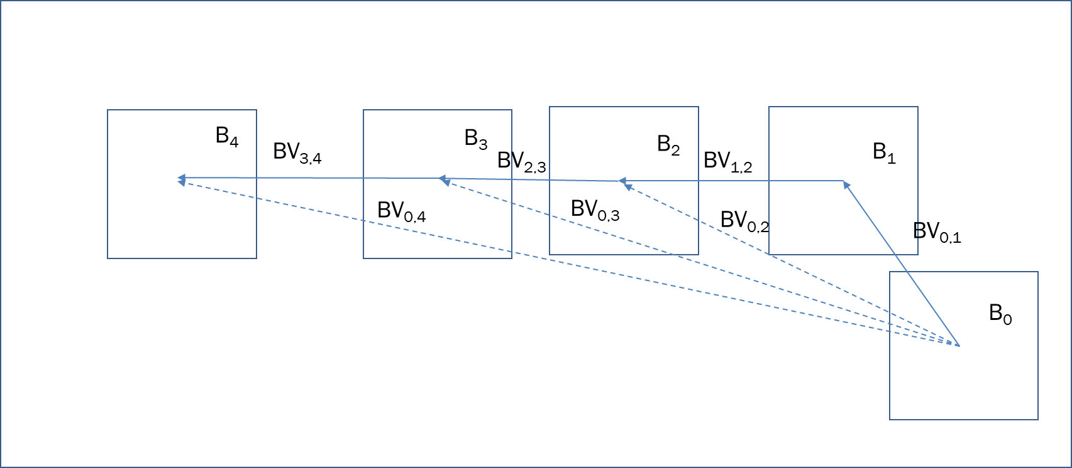
Intruduction
AR-BVP(AF0129) : an auto relocated block vector prediction
  AR-BVP can be derived as a guiding BV plus a BV of reference block, allocated by the guiding BV.
  The guided BV comes from the previously constructed IBC merge/AMVP list.

Slide 3
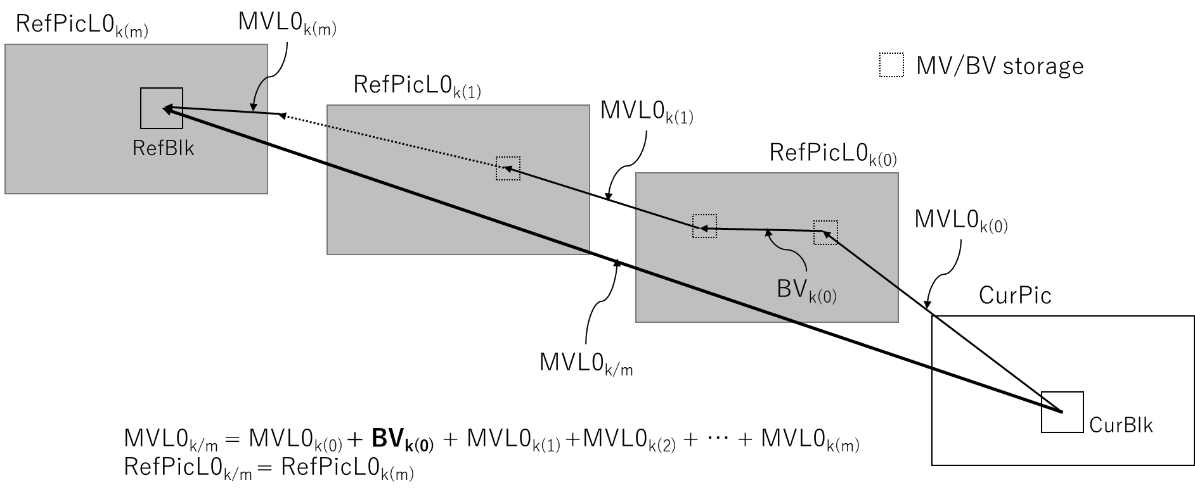
Intruduction
CMVP(AG0073) : a chained motion vector prediction
  CMVP candidates can be derived as the accumulation of the recursively traced MVs and BVs based on the pre-derived MVs for the inter merge candidate list.
  the pre-derived MVs comes from the previously constructed inter merge list.

Slide 4
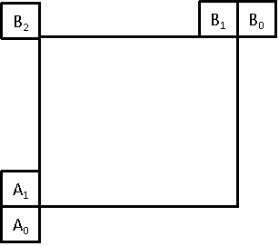
Proposed Method
BVG-CMVP: a block vector guided chain motion vector prediction
    BVG-CMVP candidates can be derived as the accumulation of the recursively traced MVs and BVs based on the pre-derived BVs
1. Derive a set of BV candidates.
BV candidates come from spatially adjacent blocks.
The scanning order is: B1->A1->A0->B0->B2. The maximum size of BV candidates is 10.
Figure 1 the position of spatially adjacent blocks.

Slide 5
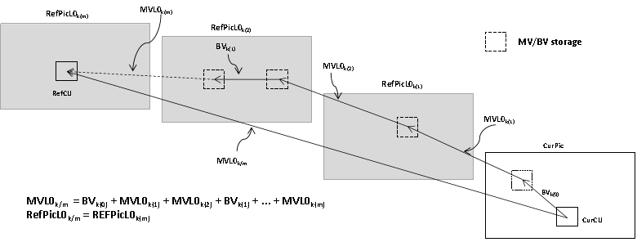
Proposed Method
2. Using the derived BVs as the guiding vector, derive BVG-CMVP candidates.
Similar to CMVP, but with the difference of using pre-derived BV as the guiding vector.
In this contribution, the recursive depth is only 1.
Specifically, a BVG-CMVP is obtained by adding an guiding BV and a MV of reference block, allocated by the guiding BV.
Figure 2 An example of derivation of CMVP candidate.

Slide 6
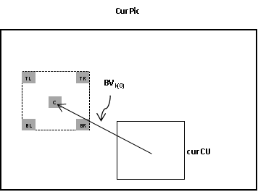
Proposed Method
2. Using the derived BVs as the guiding vector, derive BVG-CMVP candidates.
When deriving BVG-CMVP, the existence of MV all five positions corresponding to the current block pointed by the guided BV will be checked.
Figure 3 An example of Reference source of tracing MVs relocated by guided BV.
3. Insert BVG-CMVP candidates after CMVP candidate in inter merge candidate list.

Slide 7
Results
Anchor: ECM13.0
Test : AI0088
 | Random Access Main 10
 | Over ECM13.0
 | Y | U | V | EncT | DecT | EncVmPeak | DecVmPeak
Class A1 | #VALUE! | #VALUE! | #VALUE! | #DIV/0! | #DIV/0! | #DIV/0! | #DIV/0!
Class A2 | #VALUE! | #VALUE! | #VALUE! | #DIV/0! | #DIV/0! | #DIV/0! | #DIV/0!
Class B | 0.00% | -0.03% | -0.08% | 99.7% | 99.8% | 100.0% | 100.0%
Class C | -0.01% | 0.02% | 0.12% | 100.2% | 99.7% | 100.0% | 107.8%
Class E
Overall | #VALUE! | #VALUE! | #VALUE! | #DIV/0! | #DIV/0! | #DIV/0! | #DIV/0!
Class D | 0.01% | -0.02% | 0.04% | 100.2% | 99.5% | 100.1% | 100.7%
Class F | 0.00% | -0.05% | -0.03% | 100.2% | 97.7% | 99.8% | 99.9%
Class TGM | -0.03% | -0.02% | -0.02% | 99.5% | 96.7% | 99.5% | 99.8%
It should be noted that after crosscheck by KDDI, it was found that in RA mode, there is inconsistency in the encoding and decoding of QP22 and 27 in the slide show sequence.
With the help of KDDI, the bug has been fixed.
Based on current testing, AI0088+bugfix will not affect the results of other LDB sequences.
 | Low delay B Main 10
 | Over ECM13.0
 | Y | U | V | EncT | DecT | EncVmPeak | DecVmPeak
Class A1
Class A2
Class B | -0.06% | -0.31% | 0.17% | 100.2% | 99.1% | 100.0% | 100.0%
Class C | -0.04% | -0.12% | -0.50% | 99.7% | 99.8% | 100.0% | 100.0%
Class E | -0.05% | 0.27% | 0.39% | 101.1% | 100.7% | 99.8% | 100.1%
Overall | -0.05% | -0.10% | 0.00% | 100.3% | 99.7% | 99.9% | 100.0%
Class D | -0.04% | -0.89% | -0.64% | 99.8% | 103.4% | 99.8% | 100.0%
Class F | -0.23% | 0.35% | -0.23% | 100.6% | 100.2% | 99.8% | 99.9%
Class TGM | -0.20% | -0.07% | 0.02% | 100.6% | 99.0% | 99.9% | 101.5%

Slide 8
Conclusion
It is proposed that a block vector guided chain motion vector prediction(BVG-CMVP).
It is suggested to investigate in the next round of EE2.
Thanks KDDI and Peking University for cross-checking.

Slide 9
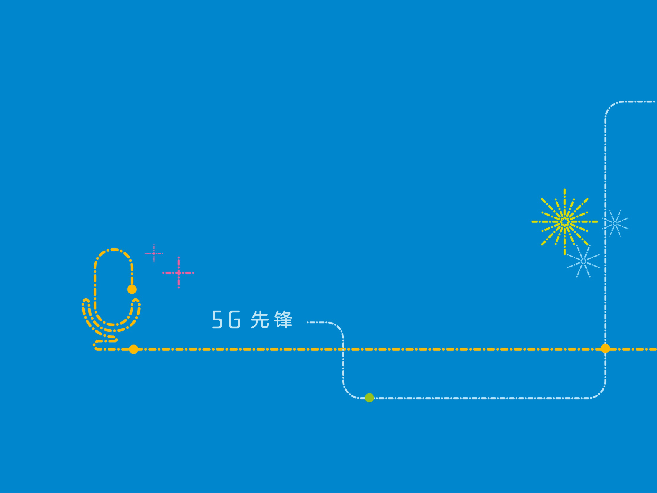
THANK YOU！

