Slide 1
Film grain synthesis demos
JVET 34th meeting / MPEG146

Slide 2
Contents
Introduction
  What is film grain, encoding issues, grain synthesis
VFGS
  A hardware-friendly film grain synthesizer
  Low HW cost, reference model in C
  Supports different grain models
Demos
  Grain model and tuning tool
  VVC web player (live decode) with grain synthesis
    Rate savings by using grain synthesis instead of attempting to code the grain natively: ~90% off !
    Includes hiding some coding defects

Slide 3


Introduction
What is film grain
Is is hard to compress
Film grain synthesis
Stakes and current actions

Slide 4



What is film grain ?
1mm
100
μm
10 μm
4000 dpi scanner output
1 pix = 6.4 μm
Fuji S400 film (still picture)
Raw negative
150x microscope view
1 pix = 0.6 μm
Raw negative
500x microscope view
1 pix = 0.16 μm

Slide 5
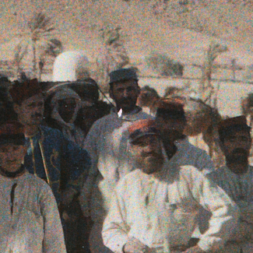
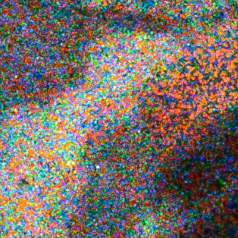
What is film grain ?
Image formation (microscopic grains)
→ « film grain » macroscopic texture
Part of original look of films. Artists like it and now add synthetic grain to digital footage: that became an « artistic intent ».
1916 autochrome (13x18 cm glass plate), A. Samama, RMN-GP (France)
24x24 mm crop
2.2x2.2 mm crop

Slide 6
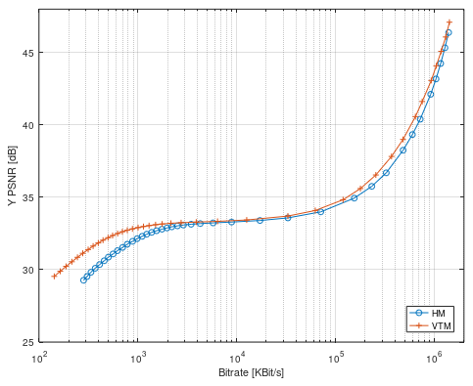
Problem: encoding removes grain
Grain
Video

Slide 7
Film grain synthesis
Film grain is removed before/by video compression and film grain characteristics are generated
  Grain / noise is spatially & temporally uncorrelated = costly to encode
  Recent codecs are very efficient denoisers, gains come at that price
Synthesis at decoder side (post-processing) helpful:
  To restore artistic intent, if grain was present in the source video
  To hide compression defects (blurring, blocks, etc)
→ subjective quality improvement
  Synthesis follows a defined model, with parameters embedded in the bitstream (metadata = SEI message). Available since AVC

Slide 8
System architecture
Source video
Bitstream
with SEI
Output video
Denoise
Encode
Decode
Add grain
Grain model fitting
Model parameters =
Film Grain Characteristics
SEI message
FGC

Slide 9
System architecture (option 2)
Source video
Bitstream
with SEI
Output video
Encode
Decode
Add grain
Grain model fitting
Model parameters =
Film Grain Characteristics
SEI message
FGC

Slide 10



Synthesis example #1
original
decoded
+ synthetic grain

Slide 11
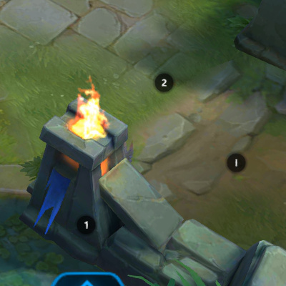


Synthesis example #2
original
decoded
+ synthetic grain

Slide 12
Enablers & current actions
Technical report (ISO 23002-9)
  Explains how it works and how to use it
Synthesis implementation
  HW model more flexible + reduced cost vs RDD-5: VFGS (InterDigital)
  Android: libFGS (Ittiam/Dolby)
  Real-time SW needed (SIMD/GPU)
Interoperability
  Translate model parameters
  Graceful degradation (no shape adaptation)
Parameter estimation / tuning
  Should be easy and reliable, to quiclky assess to potential of the technology
Studies / specs in applicative standards
  3GPP: concluding (HEVC + SEI)
  DVB: starting(VVC + SEI)
  SCTE related discussions
Demos + Visual tests
  JVET: started formal visual test of VVC+SEI. Rate savings, grain similarity. Needs more test content.
  DVB: demos by InterDigital in ‘23 and ‘24
  NAB, IBC: demos and test reports by various companies
Publications

Slide 13
VFGS
Film grain synthesis implementation
A hardware model in C
Interoperable
Good quality and low cost

Slide 14
Synthesis architecture overview
cfg
Get a set of film grain patterns
Offline / firmware
64x64
Split image into blocks
Randomization
Generate random block offset
Need
deblock
Select pattern
Content-adpatation
Apply scaling factor
Deblock
Blend with target picture

Slide 15
VFGS
vfgs_fw.c / .h
Firmware
Model parameters
(e.g. FGC SEI)
Pat-terns
Gain LUT
Pattern LUT
Hardware
Pixel stream (in)
vfgs_hw.c / .h
Generic hardware interface, pixel-based process suitable for display pipeline (no line buffer)
https://github.com/InterDigitalInc/VersatileFilmGrain
https://vcgit.hhi.fraunhofer.de/jvet-ahg-fgt/vfgs

Slide 16
Film grain demos
Grain model, tuning tool
Live VVC decode and grain synthesis.
  Savings at top quality: ~90% off !
Side-by-side comparisons

Slide 17
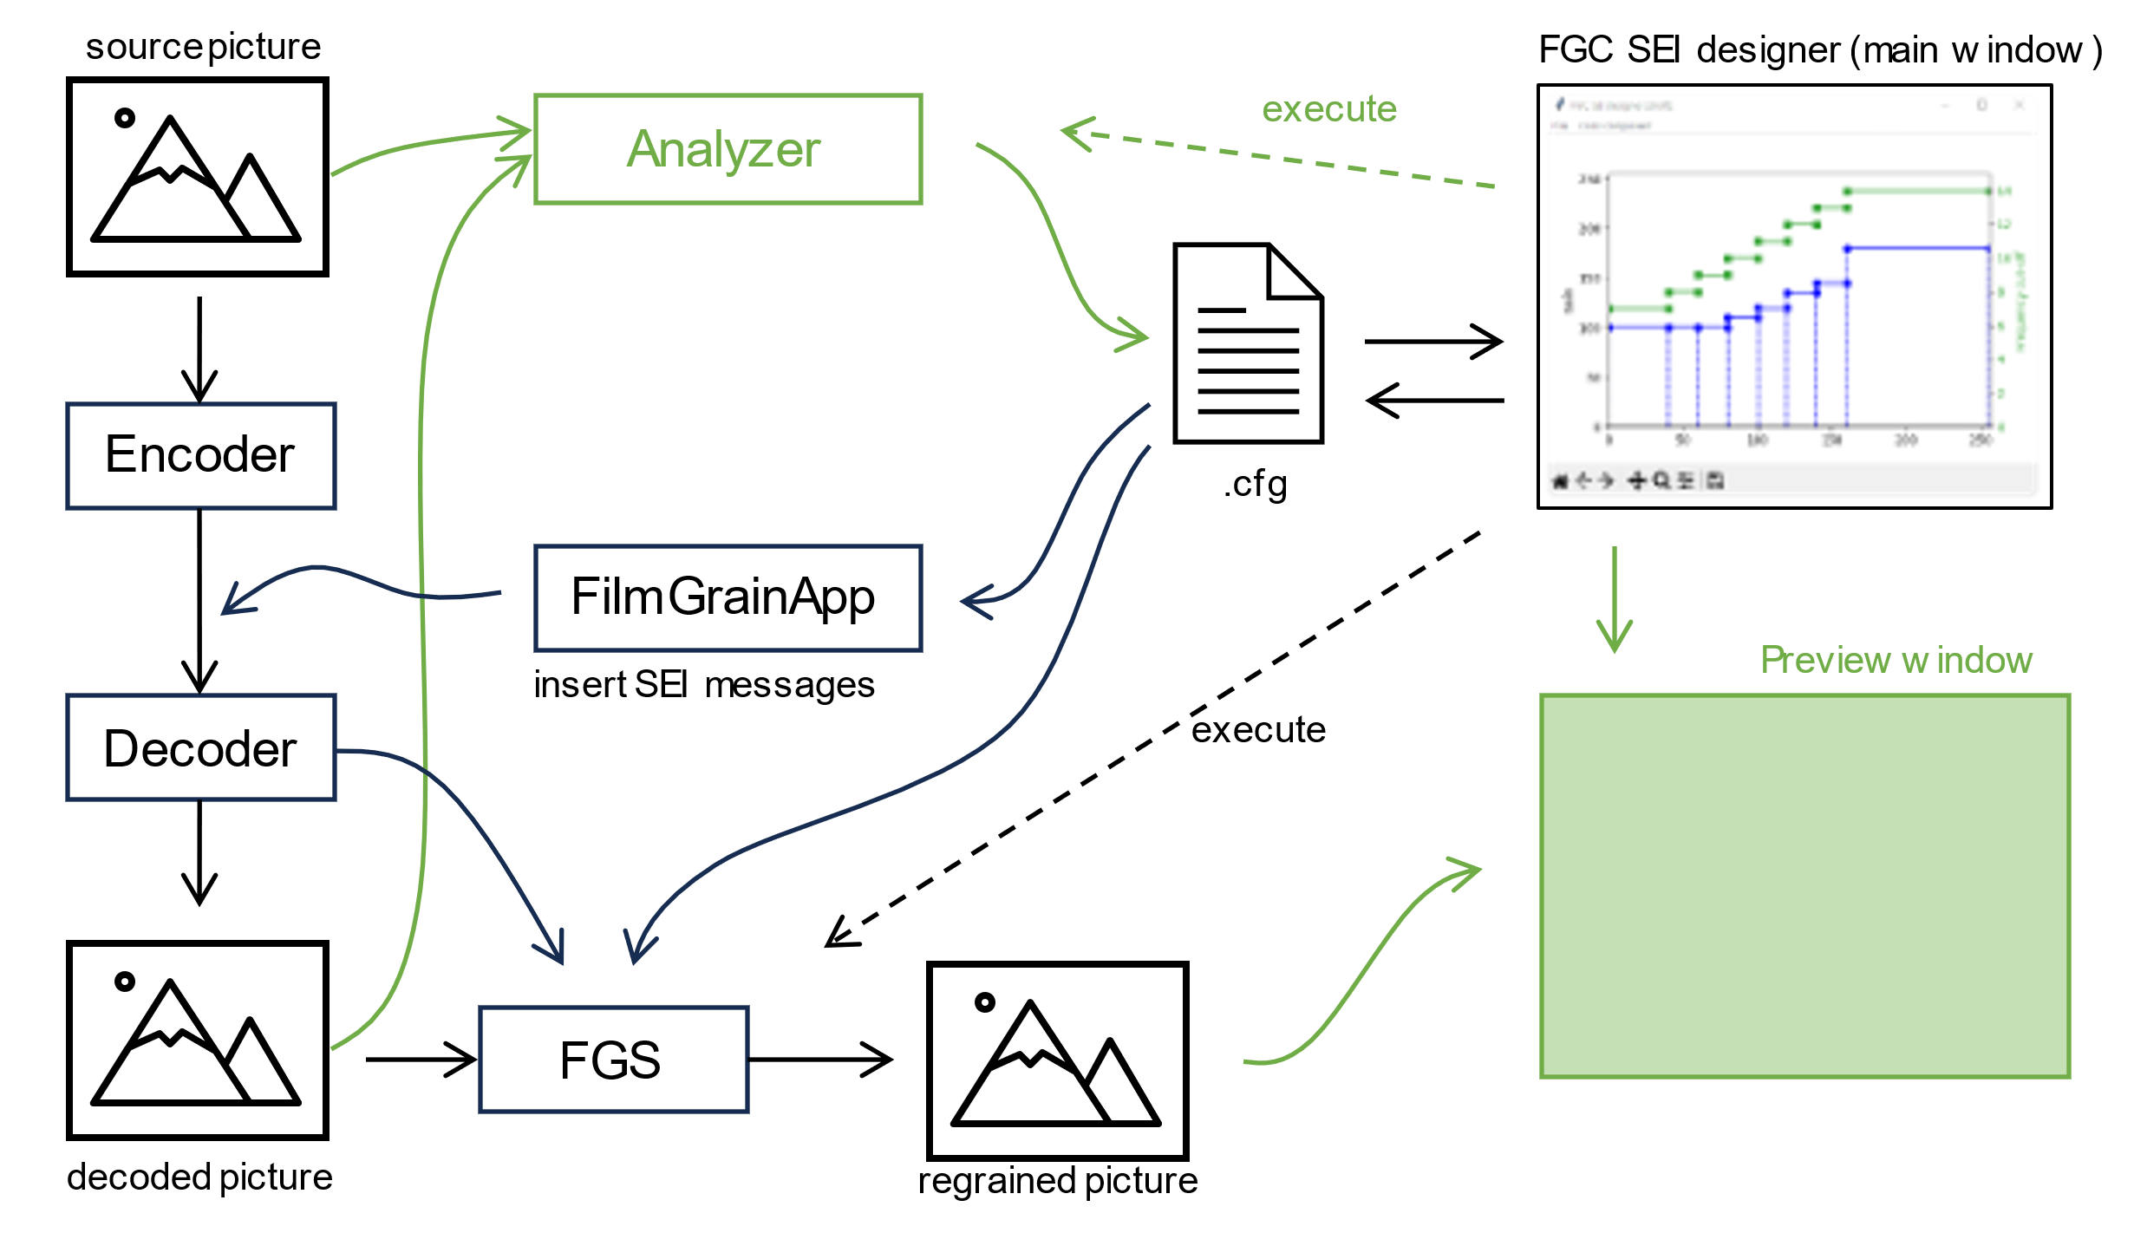
Film grain experimentation framework
(green = work in progress)

