Slide 1
JVET-AH0220
AHG15: Configurations for gaming sequences

Slide 2
Motivation
AHG15 mandates
  Propose test conditions appropriate for gaming applications
  Investigate possibilities to enhance compression capability for gaming content.
Take advantage of existing configurations used in CTC (per-class config)
ECM encoding time for LDB is still problematic for investigating new coding tools
  Reach for encoding time reduction

Slide 3
Current Proposal – Part 1
1. Directly use the AI/RA per-class configurations from JVET CTC
  AI
    Affects only 4k sequences by increasing maximum CTU size to 256
      CTUSize: 256
  RA
    Use class A configuration for 4k sequences (not tested)
    Use class B configuration for full-HD sequences
      classB_randomaccess.cfg
  LDB
    Use class B configuration for full-HD sequences
      MaxMTTHierarchyDepthByTidOverrideByQP: 22 332222
    No 4k sequence is tested under LDB/LDP for AHG15

Slide 4
Current Proposal – Part 2
Proposed variations of LDB configs
LDB tests | MaxMTTHierarchyDepthByTidOverrideByQP
Default | 22 332222
Test 1 | 22 322222
Test 2 | 22 322111
Test 3 | 22 332222 27 332222
Test 4 | 22 322222 27 322222
Test 5 | 22 322111 27 322222
Test 6 | 22 322111 27 322111

Slide 5
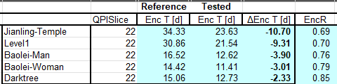
Results – Part 1
Overall
Example in RA
In Summary
  For AI, encoding gain of 0.02% and encoding time reduction of 3%.
  For RA, encoding gain of 0.24% and encoding time increase of only 2%.
    Up to more than 10 days encoding time reduction for QP22
  For LDB, encoding loss of 0.16% and encoding time reduction of 7%.
 |  |  | BD-rate5 q12345 (piecewise cubic) |  |  | BD-rate4 q2345 (piecewise cubic) |  |  | BD-rate4 q1234 (piecewise cubic)
 | EncR | DecR | Y-PSNR | U-PSNR | V-PSNR | Y-PSNR | U-PSNR | V-PSNR | Y-PSNR | U-PSNR | V-PSNR
AI | 96.64% | 101.05% | -0.02% | -0.17% | -0.33% | 0.00% | -0.36% | -0.60% | -0.04% | -0.12% | -0.20%
RA | 102.01% | 100.06% | -0.24% | -0.22% | 0.00% | -0.61% | -0.15% | 0.04% | 0.11% | 0.02% | 0.04%
LDB | 92.79% | 99.41% | 0.16% | 0.20% | 0.22% | 0.00% | 0.00% | 0.00% | 0.21% | 0.25% | 0.28%

Slide 6
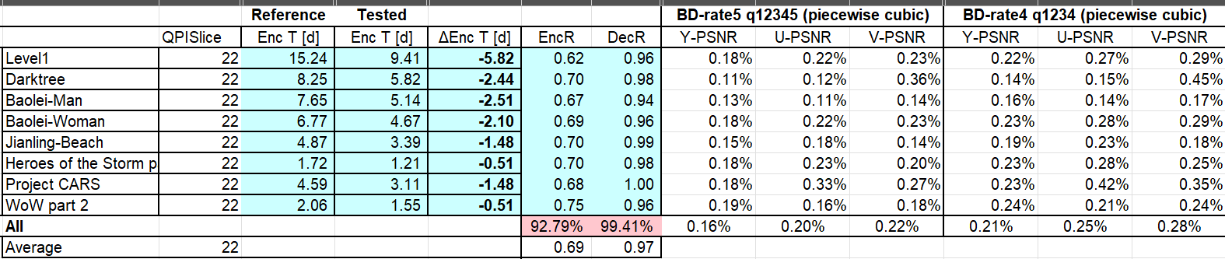
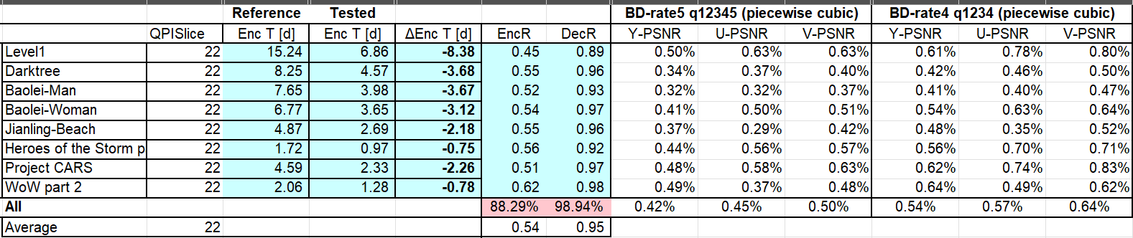
Results – Part 2
Some examples for QP 22 only (BD-rate for q2345 is 0%)
  Default CTC
  Test #2 (MaxMTTHierarchyDepthByTidOverrideByQP: 22 322111)

Slide 7
Results – Part 2
Comparative results
Config | EncR QP22 | Worst-case reduction [days] | EncR QP27 | Worst-case reduction [days] | EncR Mean (%) | BD-rate (Y) Q12345 (%) | BD-rate (Y) Q2345 (%) | BD-rate (Y) Q1234 (%)
Default | 0.69 | -5.82 | - |  | 92.8 | 0.16 | - | 0.21
Test 1 | 0.63 | -6.86 | - |  | 91.2 | 0.19 | - | 0.24
Test 2 | 0.54 | -8.38 | - |  | 88.3 | 0.42 | - | 0.54
Test 3 | 0.69 | -5.82 | 0.77 | -2.83 | 88.7 | 0.48 | 0.13 | 0.60
Test 4 | 0.63 | -6.86 | 0.71 | -3.43 | 86.0 | 0.60 | 0.17 | 0.75
Test 5 | 0.54 | -8.38 | 0.71 | -3.43 | 83.5 | 0.83 | 0.17 | 1.05
Test 6 | 0.54 | -8.38 | 0.63 | -4.43 | 81.6 | 1.33 | 0.38 | 1.67
QP 22
only
QP 22 &
27
*
* Possibly best trade-off

Slide 8
Conclusion
Use CTC per-class configurations is proposed to improve encoding gain and/or encoding time.
  For AI, the gains are minor, but consistent.
  For RA, the gains are more expressive, with minor encoding time increase.
For LDB, besides the CTC configuration, other configuration variants are proposed.
  Worst-case encoder runtime (in this presentation Level1 QP 22) can be reduced up to more than 8 days, hence more convenient to use in practice.
Propose to adopt (for continuation of investigations on gaming sequences):
  CTC configurations for AI and RA, according to frame size;
  Test 5 for LDB

Slide 10
Annex LDB (JVET-AE0163)
JVET-AE0163 proposed slight modification on LDB/LDP encoder configuration
  Reduce maximum MTT hierarchy depth in slices with slice temporal depth >= 2
    MaxMTTHierarchyDepthByTidOverrideByQP: 22 332222
Drawbacks on MaxMTTHierarchyDepthByTidOverrideByQP: 22 332222
  Frames with temporal depth of 1 and 2 have the same QP
    Why not also set the max. MTT hierarchy depth with the same value?
  Frames with temporal depth of 3 (highest QP) has a large amount of encoding time
    Represent half of all encoded frames

