Slide 1
JVET-AH0195
EE1-related: Complexity reduction of NN in-loop filters through early cropping
J. Ström, M. Damghanian, D. Liu, P. Wennersten (Ericsson)

Slide 2
Background
Current LOP.2 structure
picture
144x144
final
output
128x128
+
128x128
144x144
Neural
network
128x128
Crop to
128x128
128x128
NN output

Slide 3
Background
Current LOP.2 structure
picture
Calculated but
never used
144x144
final
output
128x128
+
128x128
144x144
Neural
network
128x128
Crop to
128x128
128x128
NN output

Slide 4
Proposed structure in JVET-AH0195
picture
144x144
final
output
128x128
+
128x128
Neural
network
128x128
NN output

Slide 5
Proposed structure in JVET-AH0195
Neural network outputs
the correct size from
the start
picture
144x144
final
output
128x128
+
128x128
Neural
network
128x128
NN output

Slide 6
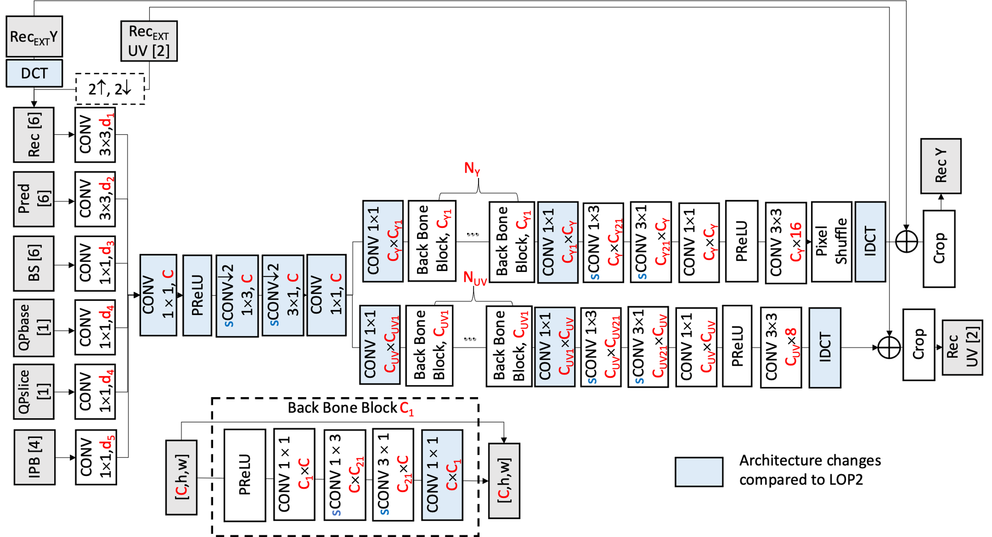
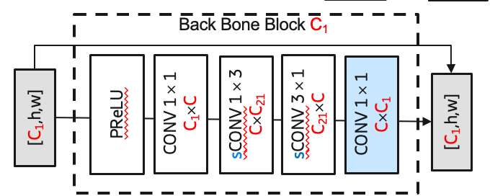
(a)
144x144
Current EE1-1.2 (and EE1-1.3) architecture
(l)
128x128
(b)
72x72
(f)
36x36
36x36
(i)
36x36
(j)
72x72
(k)
144x144
(c)
72x72
(d)
72x36
(e)
36x36

Slide 7
Current
Proposed
In: 36x36 samples
Out: 36x36 samples
In: 36x36 samples
Out: 34x34 samples
0
0
0
0
0
0
0
0
0
0
0
0
0
0
0
0
0
0
0
0
0
0
0
0
0
0
0
0
0
0
0
0
0
0
0
0
CONV 3x3 using padding=(1,1)
CONV 3x3 using padding=(0,0)

Slide 8
Current
Proposed
In: 36x36 samples
Out: 36x36 samples
In: 36x36 samples
Out: 34x34 samples
0
0
0
0
0
0
0
0
0
0
0
0
0
0
0
0
0
0
0
0
0
0
0
0
0
0
0
0
0
0
0
0
0
0
0
0
CONV 3x3 using padding=(1,1)
CONV 3x3 using padding=(0,0)
Same 3x3 weights and biases can be used.

Slide 9
(a)
144x144
Proposed architecture
crop
crop
(l)
128x128
(b)
72x72
(f)
36x36
(g)
36x34
(h)
34x34
(i)
32x32
(j)
64x64
(k)
128x128
(c)
72x72
(d)
72x36
(e)
36x36

Slide 10
(a)
144x144
Proposed architecture
crop
crop
(l)
128x128
(b)
72x72
(f)
36x36
(g)
36x34
(h)
34x34
(i)
32x32
(j)
64x64
(k)
128x128
(c)
72x72
(d)
72x36
(e)
36x36

Slide 11
Changes done
We converted existing checkpoints for LOP.2 and EE1-1.3 to new SADL-int16 models
  Exactly the same weight- and bias values
  Padding (1,1) exchanged with (0,0) in strategic places
We changed the NNVC software so that it does not do cropping of the NN output
We changed SADL so that it can handle padding=(0,0)

Slide 12
Results
Bit exact results
  Matching md5sums when decoding bitstreams created using the original EE1-1.3 or LOP.2 models.
Some lowered decoder runtime in the LOP.2 case
Proposed on top of EE1-1.3 over EE1-1.3
Proposed on top of LOP.2 over NNVC8.0
 | Random access Main10
 | BD-rate Over VTM-11.0_nnvc-1.0
 | Y-PSNR | U-PSNR | V-PSNR | EncT | DecT
Class A1 | 0.00% | 0.00% | 0.00% | 100% | 100%
Class A2 | 0.00% | 0.00% | 0.00% | 100% | 100%
Class B | 0.00% | 0.00% | 0.00% | 100% | 99%
Class C | 0.00% | 0.00% | 0.00% | 100% | 99%
Class E
Overall | 0.00% | 0.00% | 0.00% | 100% | 99%
Class D | 0.00% | 0.00% | 0.00% | 100% | 99%
Class F | 0.00% | 0.00% | 0.00% | 100% | 98%
 | Random access Main10
 | BD-rate Over VTM-11.0_nnvc-1.0
 | Y-PSNR | U-PSNR | V-PSNR | EncT | DecT
Class A1 | 0.00% | 0.00% | 0.00% | 100% | 93%
Class A2 | 0.00% | 0.00% | 0.00% | 100% | 93%
Class B | 0.00% | 0.00% | 0.00% | 100% | 96%
Class C | 0.00% | 0.00% | 0.00% | 100% | 97%
Class E
Overall | 0.00% | 0.00% | 0.00% | 100% | 95%
Class D | 0.00% | 0.00% | 0.00% | 100% | 98%
Class F | 0.00% | 0.00% | 0.00% | 100% | 97%
 | All Intra Main10
 | BD-rate Over VTM-11.0_nnvc-1.0
 | Y-PSNR | U-PSNR | V-PSNR | EncT | DecT
Class A1 | 0.00% | 0.00% | 0.00% | 100% | 100%
Class A2 | 0.00% | 0.00% | 0.00% | 100% | 99%
Class B | 0.00% | 0.00% | 0.00% | 100% | 99%
Class C | 0.00% | 0.00% | 0.00% | 100% | 100%
Class E | 0.00% | 0.00% | 0.00% | 100% | 101%
Overall | 0.00% | 0.00% | 0.00% | 100% | 100%
Class D | 0.00% | 0.00% | 0.00% | 100% | 99%
Class F | 0.00% | 0.00% | 0.00% | 100% | 99%
 | All Intra Main10
 | BD-rate Over VTM-11.0_nnvc-1.0
 | Y-PSNR | U-PSNR | V-PSNR | EncT | DecT
Class A1 | 0.00% | 0.00% | 0.00% | 100% | 96%
Class A2 | 0.00% | 0.00% | 0.00% | 100% | 97%
Class B | 0.00% | 0.00% | 0.00% | 100% | 98%
Class C | 0.00% | 0.00% | 0.00% | 100% | 98%
Class E | 0.00% | 0.00% | 0.00% | 100% | 95%
Overall | 0.00% | 0.00% | 0.00% | 100% | 97%
Class D | 0.00% | 0.00% | 0.00% | 100% | 97%
Class F | 0.00% | 0.00% | 0.00% | 100% | 98%

Slide 13
Results
Complexity in kMAC/pixel
  EE1-1.3-version: 16.76 kMAC/pixel, (down from 16.90 kMAC/pixel): -0.8%
  LOP.2 version: 16.86 kMAC/pixel, (down from 17.80 kMAC/pixel): -1.1%

Slide 14
Summary
Uses padding = (0,0) to avoid unnecessary calculations
Weights from existing models can be reused – no retraining needed.
Bit-exact identical results obtained
Complexity reduction in kMAC/sample:
  A reduction of 0.8% (when applied on top of EE1-1.2 or EE1-1.3 model)
  A reduction of 1.1% (when applied on top of LOP.2 model)
We propose to adopt this into LOP.3.
Thanks to Interdigital for crosschecking (JVET-AH0334)

