Slide 1
JVET-AH0180
AHG12: Modified CTC for encoding time reduction under low-delay configuration

Slide 2
Motivation
Revisit JVET-AE0163 with slight modification on LDB/LDP encoder configuration
  Reduce maximum MTT hierarchy depth in slices with slice temporal depth >= 2
    MaxMTTHierarchyDepthByTidOverrideByQP: 22 332222
ECM-12.0 encoding time has increased by an average compared to ECM-11.0
  19.0% in LDB
  21.4% in LDP
ECM encoding time for LDB is still problematic for investigating new coding tools
Worst case LDB (BQ Terrace QP22) takes approx. 15 days in ECM-12.0 to complete

Slide 3
Proposal in JVET-AE0163
Drawbacks on MaxMTTHierarchyDepthByTidOverrideByQP: 22 332222
  Frames with temporal depth of 1 and 2 have the same QP
    Why not also set the max. MTT hierarchy depth with the same value?
  Frames with temporal depth of 3 (highest QP) has a large amount of encoding time
    Represent half of all encoded frames

Slide 4
Current Proposal
Test #1:
  Reduce max MTT depth in slices with slice temporal depth = 1
    MaxMTTHierarchyDepthByTidOverrideByQP: 22 322222
    Apply only for class B, QP 22
Test #2:
  Reduce max MTT depth in slices with slice temporal depth 1 and 3
    MaxMTTHierarchyDepthByTidOverrideByQP: 22 322111
    Apply only for class B, QP 22
Test #3 and #4:
  Also provide additional tests on QP 27 for both cases in 1 and 2
    With the reduce max MTT depth in slices with slice temporal depth = 3
    MaxMTTHierarchyDepthByTidOverrideByQP: 27 333222

Slide 5
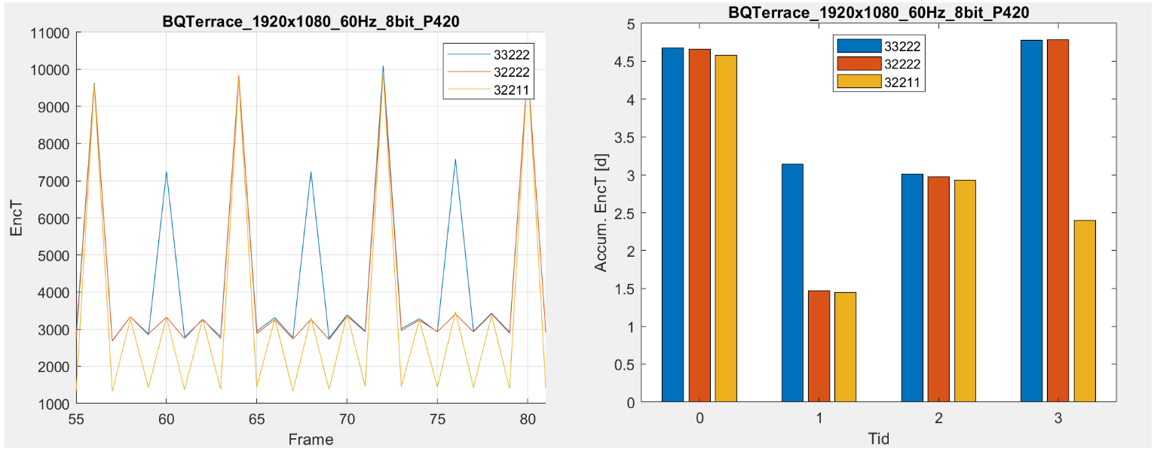
Example of encoding time for BQTerrace, QP22
JVET-AE0163
Test #1
Test #2
JVET-AE0163
Test #1
Test #2
(a) per frame for three GOPs
(b) accumulated per temporal depth for the entire sequence

Slide 6
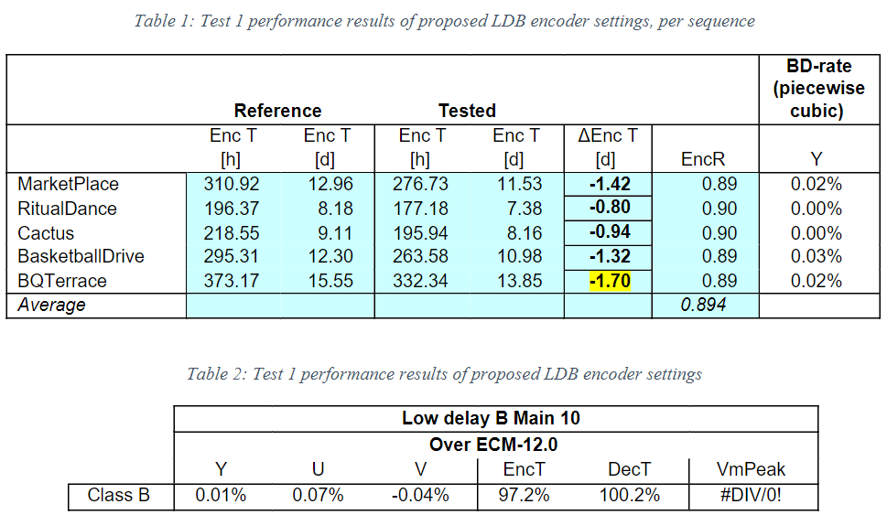
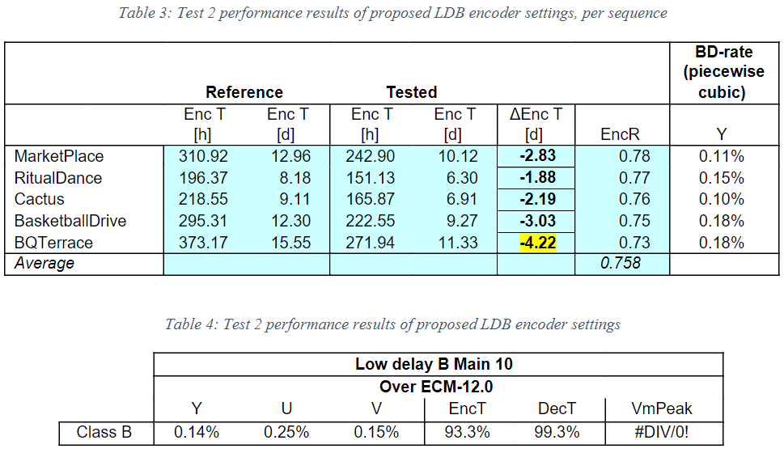
Results (1/2)
Test #1 Test #2
±10%
±24%
Under LDP: Similar results are observed in Test #1
Under LDP: Time reduction is similar in Test #2, but with an average BD-rate loss of 0.22%

Slide 7
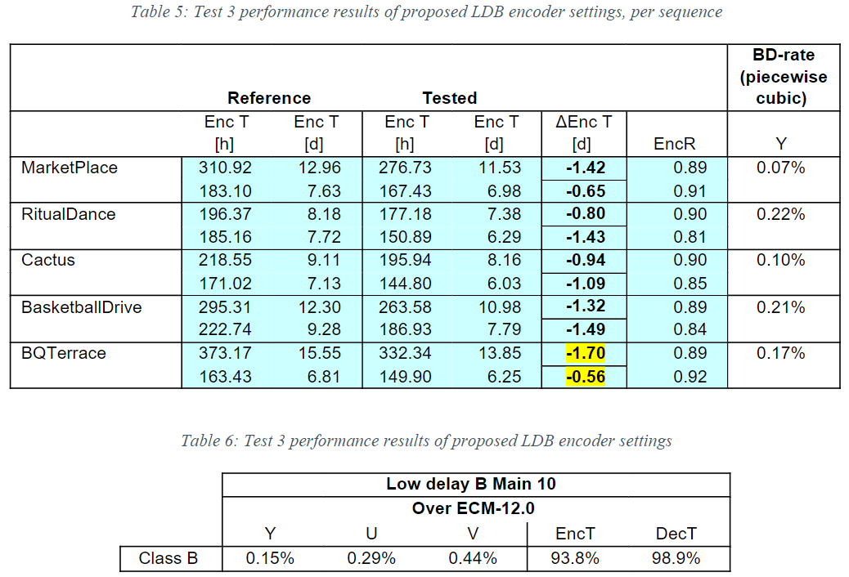
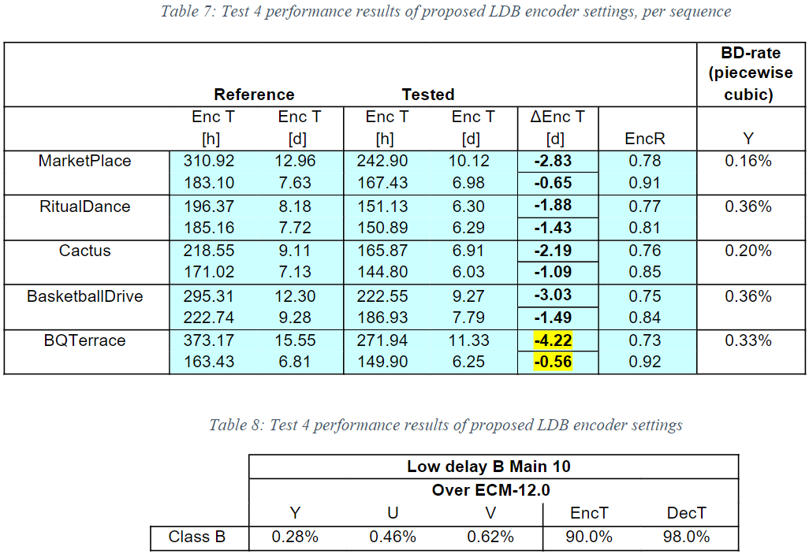
Results (2/2)
Test #3 Test #4

Slide 8
Conclusion
Modification to CTCs is proposed to reduce worst-case encoding time of ECM for both LDB and LDP.
Worst-case encoder runtime (BQTerrace QP 22) is reduced by more than 4 days, hence more convenient to use in practice
Performance impact of the proposed modifications compared to ECM-12.0 may be acceptable
No impact on visual quality (flickering or pumping)
Propose to adopt Test 2 CTC modifications for next JVET cycle

