Slide 1

AHG12: Temporal BV for IBC list construction
JVET-AH0059
Luhang Xu, Yue Yu, Haoping Yu, Dong Wang (OPPO)
N. Zhang, K. Zhang, L. Zhang (ByteDance)

Slide 2
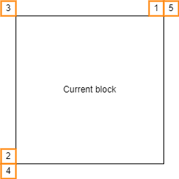
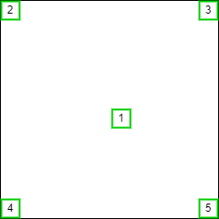
Introduction
It is proposed to use BVs in the collocated pictures as additional candidates for IBC/AMVP merge list construction.
The BVs can be obtained from the five collocated positions in the collocated pictures,
The BVs can be obtained from shifted collocated five positions in the collocated pictures. The shifting offset is obtained from the MVs of the neighboring locations as shown in red in the figure:
  MVs pointing to the collocated pictures,
  Scaled MVs from MVs pointing to the reference pictures,
  Mirrored MVs from the collocated picture to the other collocated picture.
Five collocated positions
Five neighboring positions
for obtaining MVs

Slide 3
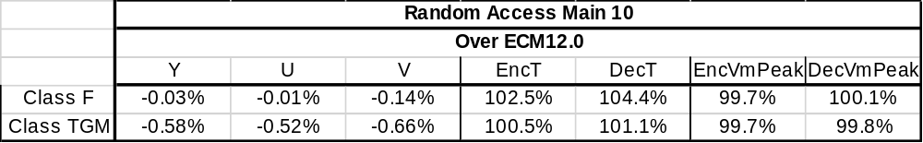
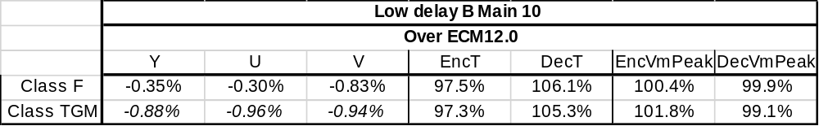
Simulation results
The proposed method is implemented on the ECM-12.0. The simulation time are not accurate and 1 QP point in LDB are copied from the anchor.
Thanks to Alibaba for crosschecking this proposal.

