Slide 1
JVET-AG0216
AHG8: Multi-layer VVC for hybrid machine-human consumption
J. Laitinen, T. Partanen, A. Mercat, J. Vanne
Tampere University, Tampere, Finland
A. Aminlou, M. M. Hannuksela, F. Cricri, H. Zhang
Nokia Technologies, Tampere, Finland

Slide 2
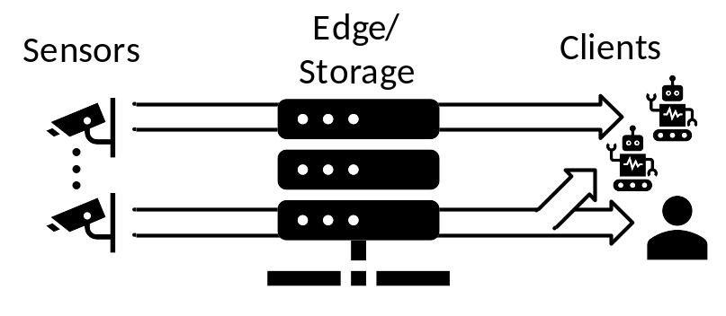
Introduction
Hybrid human-machine video consumption (quality metric)
  Continuous monitoring by machine
  On-demand monitoring by human
Use cases
  Intelligent traffic, assembly line, and security monitoring systems
Machine
Human

Slide 3
Investigated coding schemes
  VVC only (Anchor)
Machine
Human
  Simulcast VVC
Machine-optimized
Machine
Human
  Multi-layered VVC
Machine-optimized
Machine
Human

Slide 4
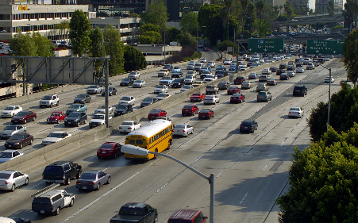
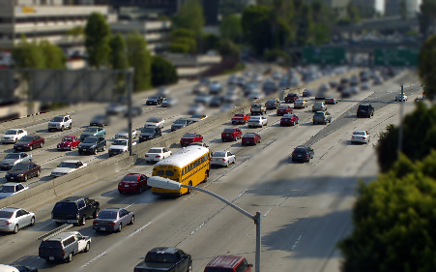
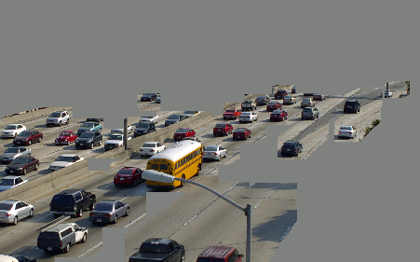
Machine-optimized video content
Object detection by YOLOv8x [4] → Generate the ROI map
ROI maps are aggregated inside GOP → more stable saliency map for frames inside a GOP
Background processing:
  Blurred (Gaussian filter)
  Removed (greyed-out)
Spatial scaling: 1x, 0.75x, 0.5x, and 0.25x
  Original
  Blurred background
  Removed background

Slide 5
Test condition
JVET-MVC CTC JVET-AF2031
Data set: SFU-HW, class A, B and C
  ROI is less efficient in other low-resolution test sequences
VTM20.1
Random access (RA)
Default multi-layer configuration
Same QP as CTC for both BL and EL
Evaluation
  mAP when analyzing machine consumption
  PSNR when analyzing human consumption
  BD-rate (using mAP or PSNR)
Break-even point: Fraction of the time that human consumption is needed
Machine
Human
Scheme | Bitrate | Quality | Bitrate | Quality
VVC only | R_{VVC} | mAP | R_{VVC} | PSNR
Simulcast | R_{M} | mAP | R_{M} + R_{VVC} | PSNR
Multi-layer | R_{M} (= R_{BL}) | mAP | R_{M} + R_{EL} | PSNR

Slide 6
Results: Multi-layer vs. Simulcast
Machine consumption: Multi-layer = Simulcast
Human consumption: Multi-layer is better than Simulcast (because of inter layer prediction)
Human
Seq. | Blurred Background |  |  |  | Greyed Background
BL ratio | 1× | 0.75× | 0.5× | 0.25× | 1× | 0.75× | 0.5× | 0.25×
A1 | -21.8% | -11.9% | -6.1% | -1.3% | -20.1% | -11.7% | -5.7% | -1.5%
B1 | -14.5% | -8.5% | -4.0% | -0.7% | -14.7% | -9.3% | -3.9% | -0.5%
B2 | -33.0% | -19.4% | -7.9% | -1.7% | -32.7% | -19.3% | -7.6% | -1.4%
B3 | -39.9% | -21.4% | -8.0% | -1.1% | -39.7% | -21.5% | -8.0% | -1.0%
B4 | -23.6% | -13.1% | -4.1% | -0.6% | -23.6% | -13.2% | -3.7% | -1.1%
Avg. | -26.5% | -14.9% | -6.0% | -1.1% | -26.2% | -15.0% | -5.8% | -1.1%
C1 | -46.1% | -18.0% | -5.3% | 0.4% | -45.2% | -18.2% | -5.1% | 0.3%
C2 | -43.2% | -15.9% | -4.4% | 0.6% | -44.4% | -15.9% | -4.3% | 0.7%
C3 | -37.1% | -15.4% | -4.0% | 0.5% | -36.0% | -15.4% | -3.8% | 0.6%
C4 | -47.7% | -17.9% | -4.8% | 0.0% | -47.6% | -17.8% | -4.9% | 0.2%
Avg. | -43.5% | -16.8% | -4.6% | 0.4% | -43.3% | -16.8% | -4.5% | 0.5%

Slide 7
Results: Multi-layer vs. VVC-only
Machine consumption: Multi-layer is better than VVC-only
Human consumption: Multi-layer is worse than VVC-only
Machine
Human
Seq. | Blurred Background |  |  |  | Greyed Background
BL ratio | 1× | 0.75× | 0.5× | 0.25× | 1× | 0.75× | 0.5× | 0.25×
A1 | -18.3% | -25.9% | -16.4% | -43.0% | -12.2% | -24.8% | -32.3% | -40.0%
B1 | -22.9% | -30.8% | -40.8% | -44.1% | -64.0% | -68.2% | -68.4% | -59.0%
B2 | -13.1% | -33.1% | -51.4% | -69.1% | -20.5% | -37.3% | -59.0% | -75.3%
B3 | -3.3% | -17.6% | -21.6% | -29.7% | -7.9% | -19.3% | -16.3% | -35.3%
B4 | -13.9% | -24.8% | -33.6% | -56.6% | -18.8% | -28.1% | -39.3% | -49.1%
Avg. | -14.3% | -26.4% | -32.8% | -48.5% | -24.7% | -35.5% | -43.1% | -51.7%
C1 | 4.8% | -13.6% | -12.9% | -9.6% | 1.9% | -13.2% | -14.4% | -20.2%
C2 | 5.3% | -3.9% | -7.6% | -12.8% | 3.7% | -9.1% | -1.9% | -8.6%
C3 | -16.5% | 3.3% | -7.9% | -26.3% | -10.8% | -26.9% | -18.0% | -30.9%
C4 | -0.8% | -19.9% | -27.3% | -9.1% | 4.9% | -21.1% | -25.3% | -9.9%
Avg. | -1.8% | -8.5% | -13.9% | -14.5% | -0.1% | -17.6% | -14.9% | -17.4%
Seq. | Blurred Background |  |  |  | Greyed Background
BL ratio | 1× | 0.75× | 0.5× | 0.25× | 1× | 0.75× | 0.5× | 0.25×
A1 | 20.5% | 24.4% | 18.4% | 10.8% | 12.6% | 17.7% | 14.1% | 08.0%
B1 | 15.4% | 18.7% | 14.3% | 8.7% | 08.4% | 12.4% | 10.4% | 06.8%
B2 | 24.4% | 37.7% | 30.9% | 17.5% | 19.3% | 32.0% | 27.3% | 16.0%
B3 | 15.1% | 33.6% | 28.5% | 14.5% | 15.0% | 33.2% | 28.4% | 14.5%
B4 | 25.4% | 31.8% | 25.1% | 13.2% | 23.2% | 28.4% | 23.4% | 11.8%
Avg. | 20.1% | 29.2% | 23.5% | 12.9% | 15.7% | 24.7% | 20.7% | 11.4%
C1 | 7.4% | 42.2% | 35.7% | 18.5% | 9.5% | 41.9% | 35.9% | 18.3%
C2 | 11.5% | 45.0% | 37.0% | 19.7% | 10.3% | 44.8% | 36.9% | 19.6%
C3 | 13.3% | 31.8% | 26.1% | 13.4% | 15.0% | 31.6% | 26.2% | 13.7%
C4 | 4.7% | 44.6% | 38.0% | 18.7% | 05.0% | 44.9% | 38.0% | 18.9%
Avg. | 9.2% | 40.9% | 34.2% | 17.6% | 09.9% | 40.8% | 34.2% | 17.6%

Slide 8
Results: Break-even point
If (Share of the time (%) of human consumption < Break-even point)
➔ multi-layered is better than VVC-only
Seq. | Blurred Background |  |  |  | Greyed Background
BL ratio | 1× | 0.75× | 0.5× | 0.25× | 1× | 0.75× | 0.5× | 0.25×
A1 | 47.2% | 51.5% | 47.0% | 80.0% | 49.1% | 58.4% | 69.6% | 83.3%
B1 | 59.8% | 62.2% | 74.1% | 83.6% | 88.4% | 84.6% | 86.8% | 89.7%
B2 | 35.0% | 46.8% | 62.5% | 79.8% | 51.4% | 53.9% | 68.4% | 82.5%
B3 | 18.1% | 34.4% | 43.1% | 67.2% | 34.5% | 36.8% | 36.5% | 71.0%
B4 | 35.3% | 43.8% | 57.2% | 81.1% | 44.7% | 49.8% | 62.7% | 80.7%
Avg. | 39.1% | 47.7% | 56.8% | 78.3% | 53.6% | 56.7% | 64.8% | 81.4%
C1 | 00.0% | 24.4% | 26.5% | 34.3% | 00.0% | 23.9% | 28.6% | 52.5%
C2 | 00.0% | 07.9% | 17.1% | 39.5% | 00.0% | 16.8% | 04.8% | 30.5%
C3 | 55.3% | 00.0% | 23.2% | 66.2% | 41.7% | 46.0% | 40.7% | 69.3%
C4 | 13.8% | 30.9% | 41.8% | 32.7% | 00.0% | 32.0% | 39.9% | 34.4%
Avg. | 17.3% | 15.8% | 27.2% | 43.2% | 10.4% | 29.7% | 28.5% | 46.6%

Slide 9
Summary
Multi-layered VVC has about 30% lower bitrate than Simulcast.
Multi-layered VVC is better than VVC-only
  if time of human consumption is less than about 50%.
It is recommended to include simulcast and multi-layer VVC encoding methods in the next version of the technical report on a description of optimization of encoders and receiving systems for machine analysis of coded video content.

