Slide 1
AHG12: On context modeling in chroma coefficient coding
JVET-AG0064
Luhang Xu, Haoping Yu, Yue Yu, Dong Wang
JVET-AG0064

Slide 2
Introduction
In the current ECM, two different derivation methods for context model index and Rice parameter are used for coding transform coefficients. It is found that the new derivation method proposed in AE0102 for coding the LFNST and NSPT coded transform blocks is also applied to the chroma blocks not coded by LFNST and NSPT in single tree partition.

Slide 3
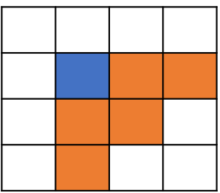
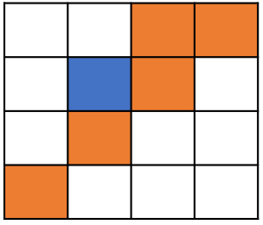
Proposal
It is proposed to use the same context derivation pattern shown on the left to code all the blocks that are not coded with LFNST/NSPT transforms, including those non-LFNST/NSPT coded chroma blocks whose corresponding luma blocks in single tree partition are coded with LFNST/NSPT
  i.e., only use the pattern shown on the right to code LFNST/NSPT blocks, as proposed in AE0102.
Left pattern for non-LFNST/NSPT, right pattern for LFNST/NSPT
JVET-AG0064

Slide 4
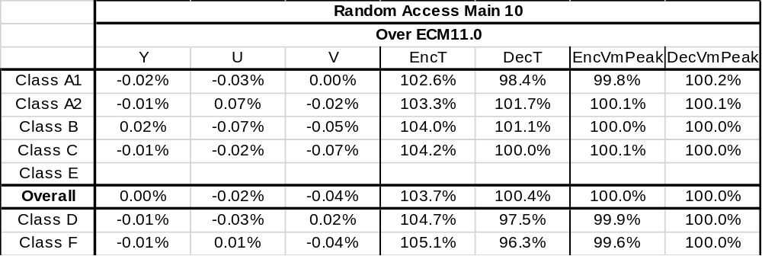
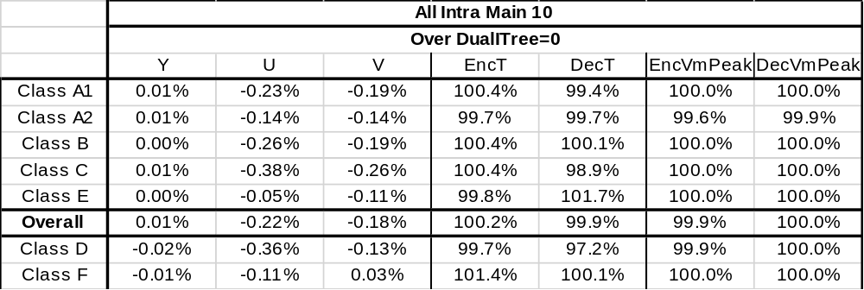
Simulation results
The encoding and decoding time are not accurate.
JVET-AG0064

Slide 5
Conclusions
This contribution proposes to use same process for context modeling and Rice parameter derivation to code all the blocks not coded with LFNST/NSPT, including those non-LFNST/NSPT coded chroma blocks whose luma blocks are coded with LFNST/NSPT in single tree partition, which means the process of context modeling and Rice parameter derivation will be consistent among all the non-directional transform coded blocks.
The simulation results are:
  0.00%(Y)/-0.02%(U)/-0.04%(V) for CTC RA
  0.01%(Y)/-0.22%(U)/-0.18%(V) for AI with DualITree=0
It is proposed to adopt this change into next version of ECM.
Thanks Qualcomm for crosschecking this proposal.
JVET-AG0064

