Slide 1

JVET-AF0161
AHG12: Harmonized IBC/ITMP search area with adaptive sampling factor
D. Ruiz Coll, B. Chen (Ofinno)
K. Naser, F. Le Léannec, P. Bordes, F. Galpin (InterDigital)

Slide 2
Summary
Proposals
  Enhancement of JVET-AE0166 and JVET-AE0198 contributions: IBC and TMP search area harmonization using adaptive sampling factor for SCC
Experimental Results
  Test-1: Sampling rate based on the searching distance.
    AI: Class F + TGM: {-0.57%, -0.54%, -0.51%, 101.2%, 106.7%},
    RA: Class F + TGM: {-0.29%, -0.27%, -0.28%, 100.4%, 101.1%},
  Test-2: Sampling rate based on the IntraTMP regions dimension.
    AI: Class F + TGM: {-0.37%, -0.35%, -0.32%, 101.0%, 103.2%},
  Test-3: Combination of Test-1 and Test-2
    AI: Class F + TGM: {-0.32%, -0.32%, -0.30%, 100.9%, 101.1%},

Slide 3
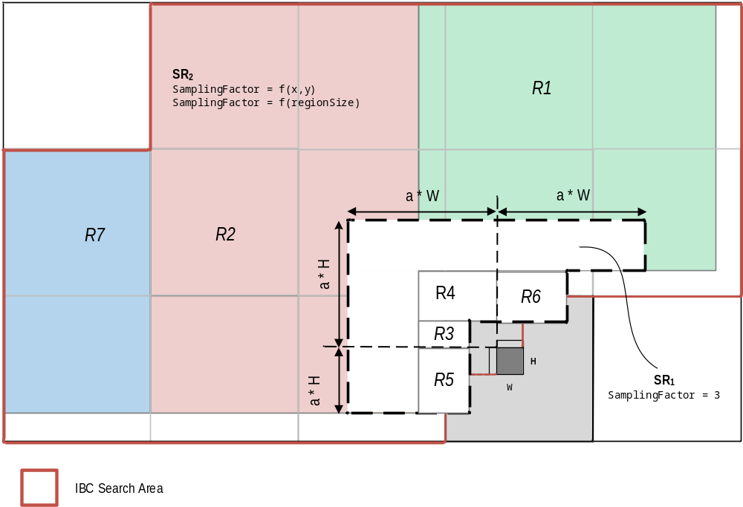
AHG12: Harmonized IBC/ITMP search area with adaptive sampling factor
IntraTMP search area extension to the IBC search region
  The boundaries of the closer regions (R3, R4, R5, R6) are adapted to the IBC region.
  One new region (R7) is added to the 6 regions in the ECM-10
  Region (R7) is pruned if the normalized TMP cost of the last BV candidate in the sparse list is less than a threshold:
    CostThreshold= -32*(W*H)+236
  The multifactor parameter ‘a’ is set to 4 for block sizes of 64 samples in order to not exceed the IBC boundaries
Notes:
Along with the RR-IBC, the template of the current block is flipped according to flip type which is horizontal or vertical flip.
AND With the flipped templates, the current block search for the most similar template in a defined search region.
Also, RR-TMP BV is stored to be used as IBC BV candidates for the following blocks.

Slide 4
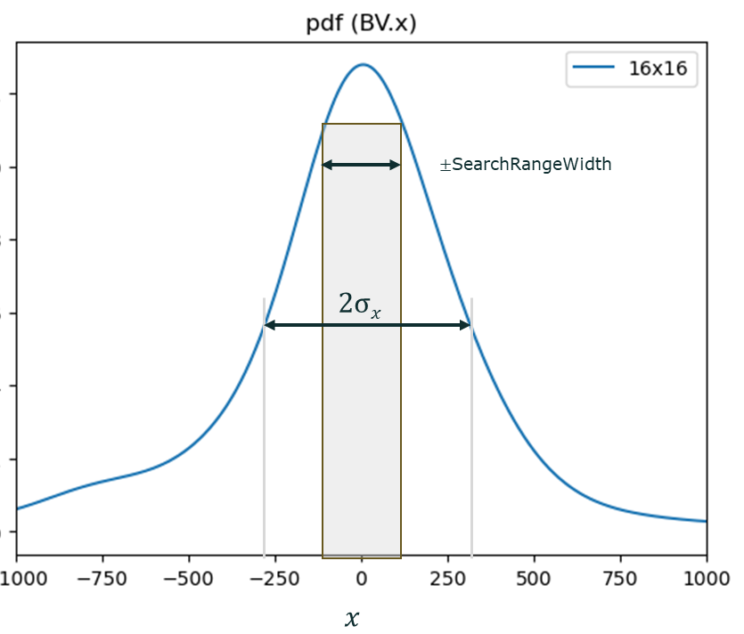
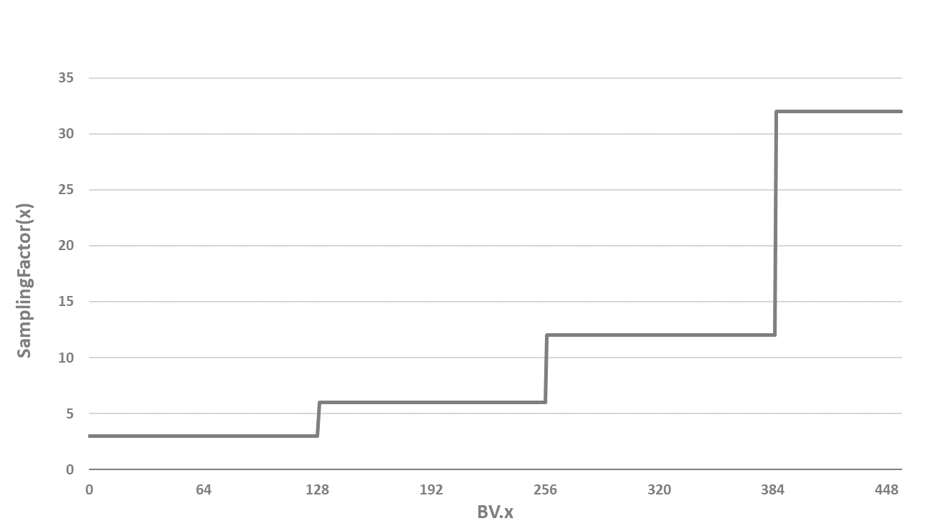
AHG12: Harmonized IBC/ITMP search area with adaptive sampling factor
Test-1: Sampling rate based on the searching distance
  Statistically, the probability of finding a BV in the search region follows a standard distribution.
  Using a constant sampling factor for farther locations to the current block is inefficient from the complexity point of view.
  Proposal:
    Regular search region: use the same SamplingFactor (SR=3).
    Extended search region: use a stepwise adjustment of the sampling rate, inversely proportional to the probability. SamplingFactor is pre-computed and storage in a LUT.
Notes:
Along with the RR-IBC, the template of the current block is flipped according to flip type which is horizontal or vertical flip.
AND With the flipped templates, the current block search for the most similar template in a defined search region.
Also, RR-TMP BV is stored to be used as IBC BV candidates for the following blocks.

Slide 5
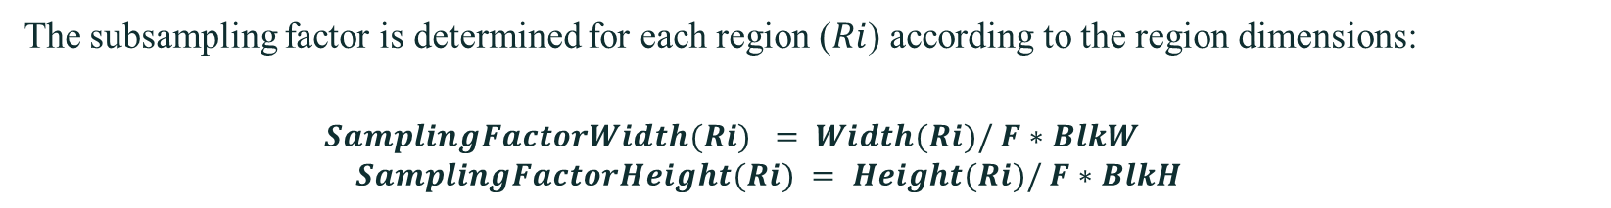
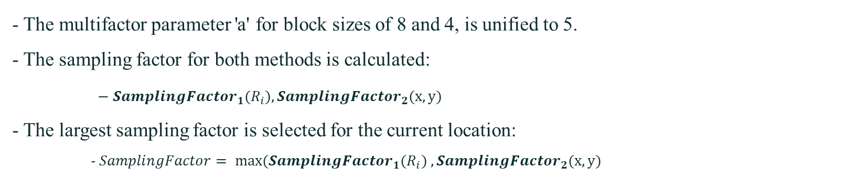
AHG12: Harmonized IBC/ITMP search area with adaptive sampling factor
Test-2: Sampling rate based on the IntraTMP regions dimension
The subsampling factor is determined for each region ($Ri$) according to the region dimensions:
$$SamplingFactorWidth(Ri) = Width(Ri)/ F∗BlkW$$
$$SamplingFactorHeight(Ri) = Height(Ri)/ F∗BlkH$$
Test-3: Combination of Test-1 and Test-2
- The multifactor parameter 'a' for block sizes of 8 and 4, is unified to 5.
- The sampling factor for both methods is calculated:
$− {SamplingFactor}_{1}(R_{i}),{SamplingFactor}_{2}(x,y)$
- The largest sampling factor is selected for the current location:
- $SamplingFactor= {max⁡(SamplingFactor}_{1}(R_{i}) ,{SamplingFactor}_{2}(x,y)$
Notes:
Along with the RR-IBC, the template of the current block is flipped according to flip type which is horizontal or vertical flip.
AND With the flipped templates, the current block search for the most similar template in a defined search region.
Also, RR-TMP BV is stored to be used as IBC BV candidates for the following blocks.

Slide 6
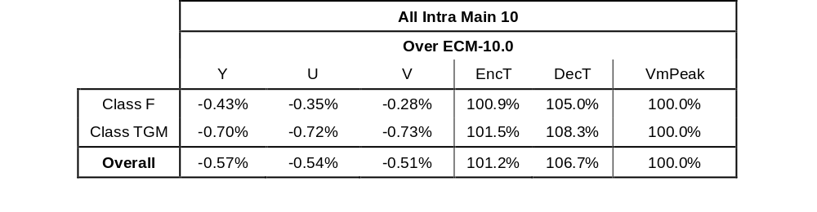
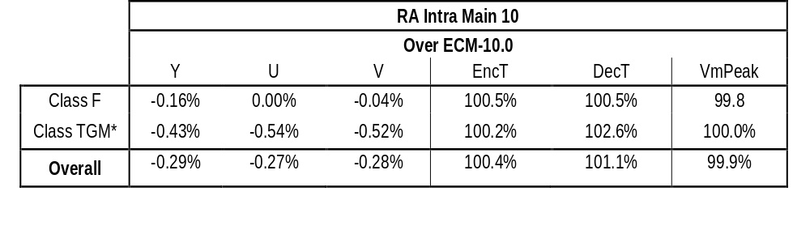
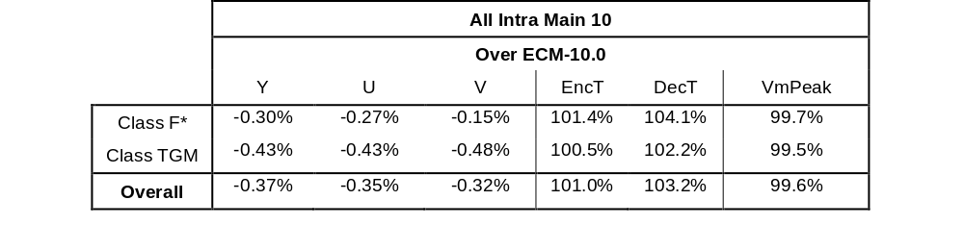
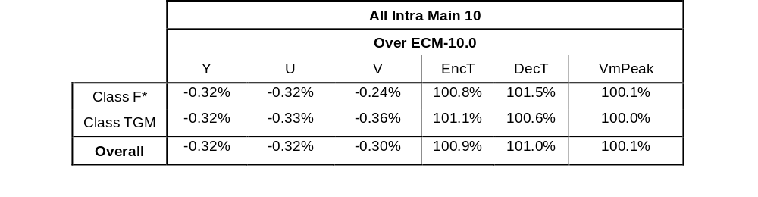
Results
  Test-1: Sampling rate based on the searching distance.
  Test-2: Sampling rate based on the IntraTMP regions dimension.
  Test-3: Combination of Test-1 and Tes-2.

Slide 7
Conclusion
Efficient use of the IBC and IntraTMP reference area
Require very small additional logic to compute the sampling factor
Luma gains ranging from -0.70% to -0.32% in AI
Slight encoder run time increase ≈ 101%
Propose for study in the next round of EE2
Notes:
As a conclusion, the proposal explores the RRTMP for screen content coding,
and support RR-IBC by using RR-TMP BV.
It shows -.25% of coding gain with neglectable encoding and decoding time.
So we recommend it to be included in the next EE2 for further study.
And Thank you Qualcomm for the crosschecking

