Slide 1
JVET-AF0056
EE1-1.2.2: Content-adaptive LOP filter
R. Yang, M. Santamaria, F. Cricri, H. Zhang, J. Lainema, M. M. Hannuksela, A. Hallapuro

Slide 2
Highlights
Content adaptation of NN LOP1 filter, via overfitting to input test sequence
The weight-update is coded with MPEG-NNR and considered in the bitrates
The weight-update is signaled within a new APS
  Neural network update adaptation parameter set
  One update is signaled per video sequence
Results with anchor NNVC-5.0 (NN intra and base NN LOP filters; same as NNVC 6.0):
    -1.19% (Y), -6.40% (Cb), -5.49% (Cr)

Slide 3
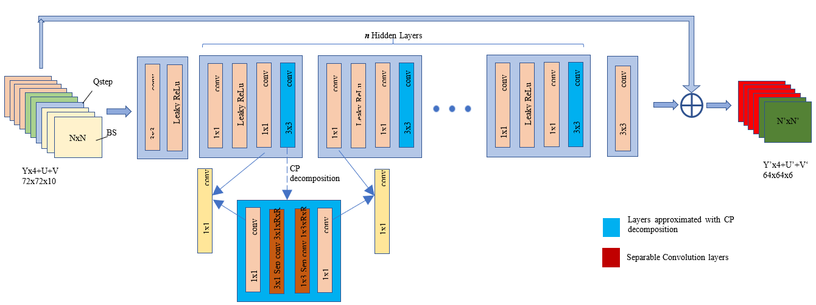
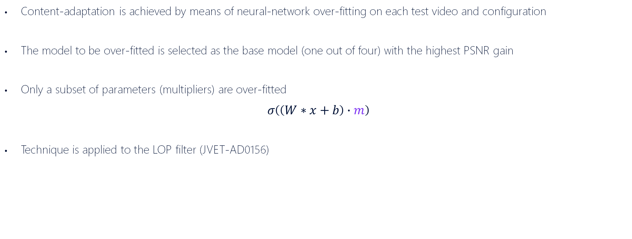
Over-fitting of LOP1 filter
Content-adaptation is achieved by means of neural-network over-fitting on each test video and configuration
The model to be over-fitted is selected as the base model (one out of four) with the highest PSNR gain
Only a subset of parameters (multipliers) are over-fitted
$$σ\left(\left(W∗x+b\right)∙m\right)$$
Technique is applied to the LOP filter (JVET-AD0156)

Slide 4
Weight-update signalling
adaptation_parameter_set_rbsp( ) { | Descriptor
aps_params_type | u(3)
aps_adaptation_parameter_set_id | u(5)
aps_chroma_present_flag | u(1)
if( aps_params_type = = ALF_APS )
alf_data( )
else if( aps_params_type = = LMCS_APS )
lmcs_data( )
else if( aps_params_type = = SCALING_APS )
scaling_list_data( )
else if( aps_params_type = = NN_UPDATE_APS )
nn_filter_update_data( )
aps_extension_flag | u(1)
if( aps_extension_flag )
while( more_rbsp_data( ) )
aps_extension_data_flag | u(1)
rbsp_trailing_bits( )
}
aps_params_type | Name of aps_params_type | Type of APS parameters
0 | ALF_APS | ALF parameters
1 | LMCS_APS | LMCS parameters
2 | SCALING_APS | Scaling list parameters
3 | NN_UPDATE_APS | Neural-network filter update
nn_filter_update_data( ) { | Descriptor
nnfu_bitstream_size_minus1 | u(15)
for( i = 0; i <= nnfu_bitstream_size_minus1; i++ )
nnfu_payload_byte[ i ] | u(8)
}
}
nnfu_payload_byte contains the byte sequence representing the size of the model QPs, the model QPs and the bitstream conforming to ISO/IEC 15938-17.

Slide 5
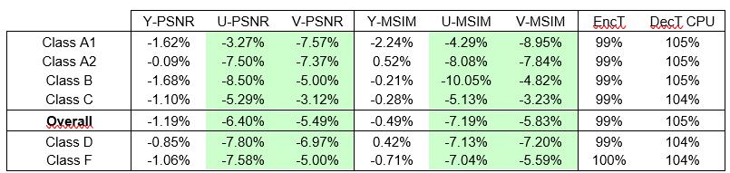
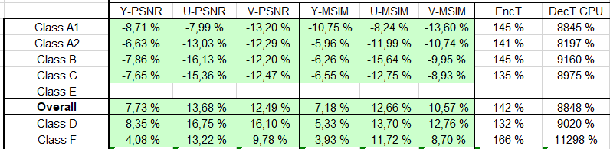
RA results
Over NNVC 5.0 anchor (NN intra pred and LOP1 ON)
Over NNVC 5.0 (NN tools OFF)

Slide 6
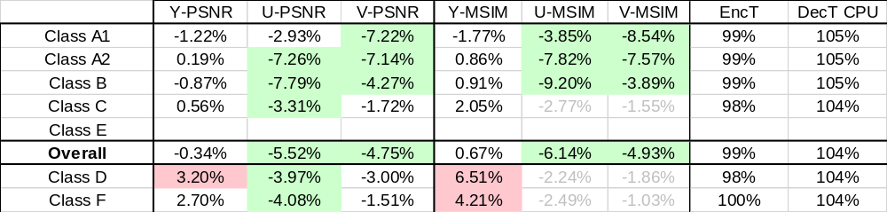
RA results (ii)
Signalling NNR weight-update for RA segment
Over NNVC 5.0 anchor (NN intra pred and LOP1 ON)
  Suboptimal results: NN update not optimised for RA segment

Slide 7
Summary
Content-adaptive LOP1 is proposed
RA gains over NNVC anchor: -1.19% (Y), -6.40% (Cb), -5.49% (Cr)
RA gains over NNVC with NN tools off: -7.73% (Y), -13.68% (Cb), -12.49 (Cr)
  Today, these are the highest gains provided by an LOP filter (+ NN intra).
No significant complexity added at decoder side
Successfully crosschecked in JVET-AF0119 and JVET-AF0216 (thanks Ittiam and OPPO!).
Recommendation: adopt JVET-AF0056 into the next version of NNVC software

Slide 9
Complexity details
Using max time, measured in seconds
Operation | Reference point | Time: OP / ref point
Multi-pass encoding | Single pass video encoding | 200,00%
Overfitting | Single pass video encoding | 3,09%
Weight-update encoding | Single pass video encoding | 0,28%
Determining NN quantisation params | Single pass video encoding | 0,04%
Weight-update decoding | Video decoding | 0,04%

