Slide 1
JVET-AD0239
Non-EE2:
Fixes for IntraTMP template availability
Gleb Verba, Zhi Zhang,
Vadim Seregin, Marta Karczewicz (Qualcomm)

Slide 2
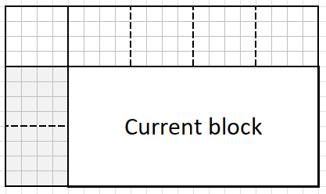
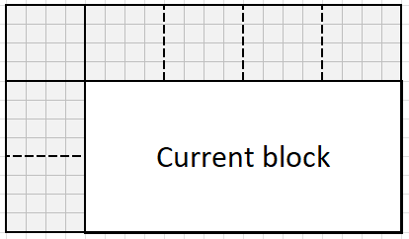
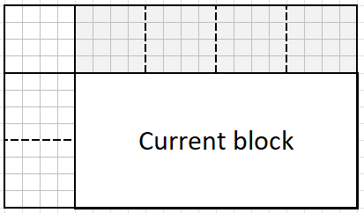
1. Fix the availability check for the left template choice
The left template check is inconsistent with the design.
Left template check:
Current:
L-shape template check
Above template check
Proposed:
Stands for the block availability check
Notes:
The type is chosen based on neighboring blocks availability near the current block

Slide 3
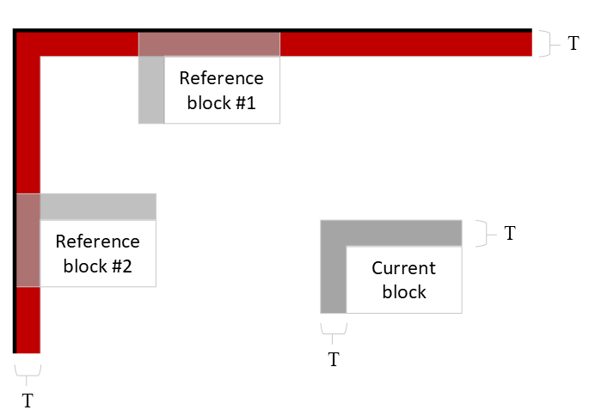
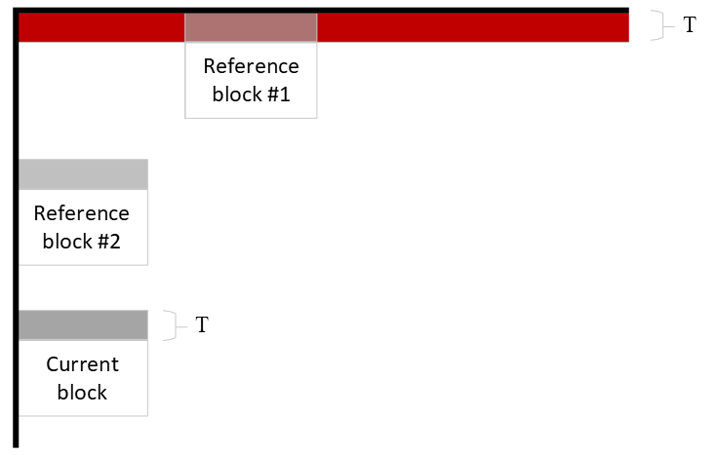
2. Reference block search area for left/above template
Current design: requiring full L-shape template availability for a reference block even when left/above only template type is used in IntraTMP.
Proposed design: requiring only left/above template availability for the left/above template type.
Proposed picture boundary handling in dependency from template type:
left: L-shape, right: above template
Notes:
In current design the reference block cannot approach the picture boundary, which is fixed by us

Slide 4
Results over ECM-8.0
Only fix #1
Fixes #1 and #2
 | All Intra Main 10
 | Over ECM-8.0
 | Y | U | V | EncT | DecT
Class A1 | 0.00% | -0.09% | 0.08% | 100% | 101%
Class A2 | -0.01% | -0.02% | 0.03% | 101% | 101%
Class B | 0.00% | 0.04% | 0.02% | 101% | 100%
Class C | -0.01% | -0.04% | 0.06% | 101% | 100%
Class E | 0.00% | 0.02% | 0.15% | 101% | 100%
Overall | 0.00% | -0.01% | 0.06% | 101% | 100%
Class D | 0.01% | 0.06% | -0.09% | 101% | 99%
Class F | -0.01% | 0.03% | -0.02% | 103% | 103%
Class TGM | -0.01% | 0.00% | 0.00% | 103% | 103%
 | All Intra Main 10
 | Over ECM-8.0
 | Y | U | V | EncT | DecT
Class A1 | 0.00% | -0.08% | 0.06% | 99% | 101%
Class A2 | -0.01% | -0.01% | 0.02% | 100% | 101%
Class B | 0.00% | -0.02% | 0.00% | 99% | 99%
Class C | -0.01% | -0.03% | 0.07% | 99% | 99%
Class E | 0.00% | -0.06% | 0.09% | 99% | 99%
Overall | 0.00% | -0.04% | 0.05% | 99% | 100%
Class D | 0.01% | 0.03% | -0.11% | 99% | 98%
Class F | -0.01% | 0.00% | 0.00% | 107% | 104%
Class TGM | -0.01% | 0.02% | 0.03% | 105% | 103%
 | Random Access Main 10
 | Over ECM-8.0
 | Y | U | V | EncT | DecT
Class A1 | 0.00% | -0.06% | -0.10% | 101% | 99%
Class A2 | -0.05% | 0.00% | 0.09% | 100% | 98%
Class B | -0.01% | 0.12% | 0.09% | 100% | 100%
Class C | -0.03% | 0.04% | 0.16% | 100% | 100%
Class E
Overall | -0.02% | 0.04% | 0.07% | 100% | 99%
Class D | -0.02% | 0.06% | -0.33% | 99% | 99%
Class F | 0.02% | 0.04% | 0.06% | 105% | 105%
Class TGM | 0.00% | -0.01% | -0.01% | 103% | 103%
 | Random Access Main 10
 | Over ECM-8.0
 | Y | U | V | EncT | DecT
Class A1 | 0.00% | 0.01% | 0.01% | 100% | 99%
Class A2 | -0.01% | 0.08% | 0.14% | 101% | 98%
Class B | 0.00% | -0.01% | -0.02% | 101% | 99%
Class C | -0.01% | 0.05% | 0.11% | 101% | 100%
Class E
Overall | 0.00% | 0.03% | 0.05% | 101% | 99%
Class D | -0.03% | -0.09% | -0.31% | 101% | 100%
Class F | -0.01% | -0.05% | 0.06% | 105% | 105%
Class TGM | 0.00% | -0.04% | 0.00% | 103% | 102%

Slide 5
Results over EE2-1.20j
Fixes #1 and #2
 | All Intra Main 10
 | Over EE2-1.20j
 | Y | U | V | EncT | DecT
Class A1 | 0.00% | 0.01% | -0.13% | 99% | 98%
Class A2 | 0.00% | 0.03% | 0.03% | 98% | 100%
Class B | -0.04% | -0.07% | -0.06% | 99% | 100%
Class C | -0.01% | -0.20% | -0.04% | 99% | 101%
Class E | -0.05% | 0.06% | -0.13% | 99% | 100%
Overall | -0.02% | -0.05% | -0.06% | 99% | 100%
Class D | -0.04% | -0.12% | -0.08% | 99% | 100%
Class F | 0.00% | 0.09% | 0.00% | 101% | 100%
Class TGM | -0.04% | -0.05% | -0.05% | 100% | 99%
 | Random Access Main 10
 | Over EE2-1.20j
 | Y | U | V | EncT | DecT
Class A1 | 0.03% | -0.36% | -0.08% | 100% | 100%
Class A2 | -0.03% | -0.01% | -0.01% | 101% | 99%
Class B | 0.00% | 0.02% | -0.03% | 100% | 100%
Class C | -0.03% | -0.07% | -0.07% | 100% | 100%
Class E
Overall | -0.01% | -0.08% | -0.05% | 100% | 100%
Class D | -0.01% | -0.20% | -0.06% | 100% | 100%
Class F | -0.02% | -0.07% | -0.13% | 101% | 100%
Class TGM | 0.02% | 0.01% | -0.03% | 100% | 99%

Slide 7
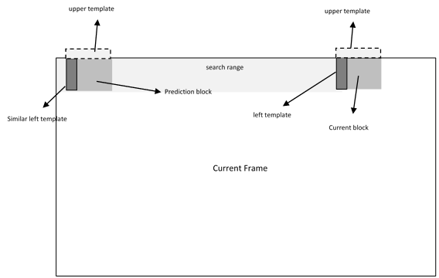
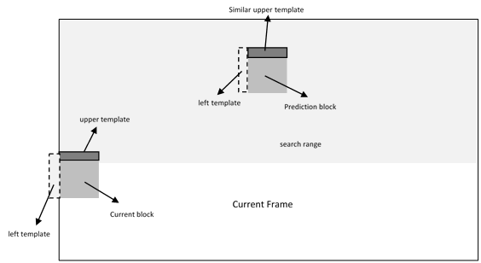
JVET-W0069 – On Intra TMP Boundary Conditions
Left and Above template are introduced to support IntraTMP in cases when only a part of L-shape is available.
Left template
Above template
Notes:
JVET-W0069 introduces the incomplete template types, but leaves at least two inconsistencies in the code

