Slide 1
JVET-AD0211
21-28 April 2023
EE1 Related : Combination test of EE1-1.3.5 and multi-scale component of EE1-1.6
Y. Li, S. Eadie, , D. Rusanovskyy, M. Karczewicz (Qualcomm)

Slide 2
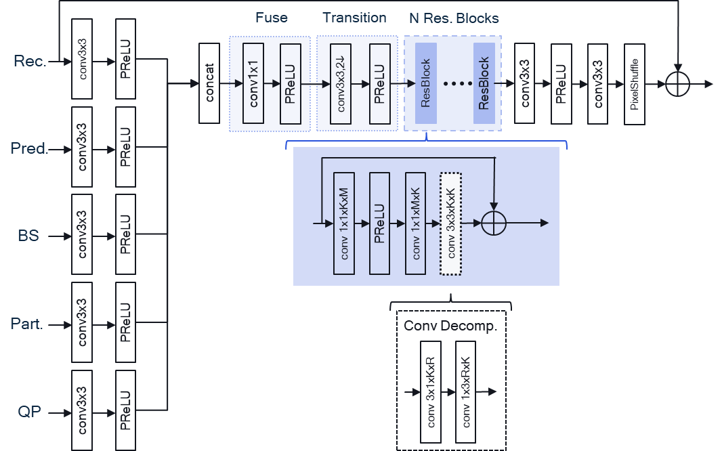
Overview
EE1-1.3.5a architecture:
  2 stage decomposition of 3x3 convolution
  ~32% complexity reduction vs FS1
  Compatible coding gain.
EE1-1.6 architecture:
  Multiscale component in similar architecture
Proposed:
  Combination of EE1-1.3.5 and
  EE1-1.6

Slide 3
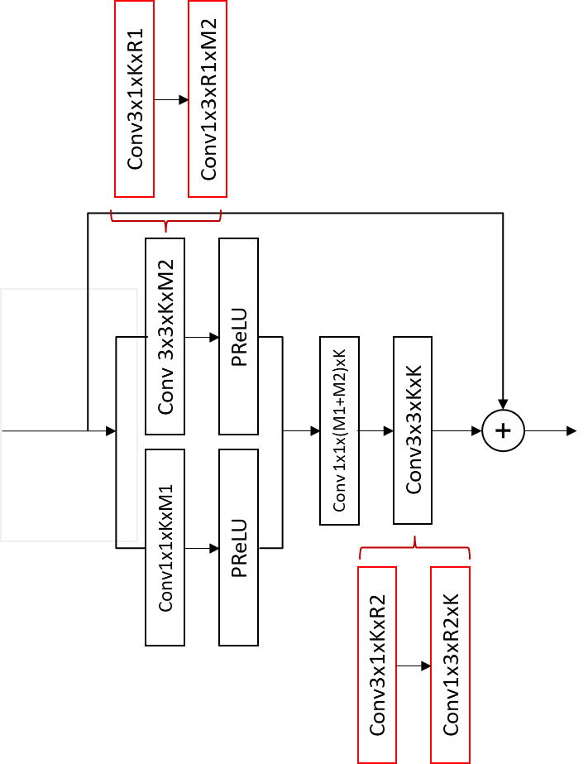
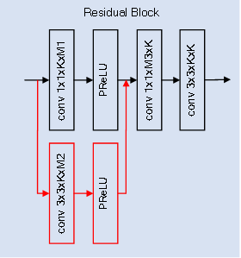
Proposed method
Added one branch with a 3x3 convolution to every backbone residual block of EE1-1.3.5
  Identical to JVET-AC0178
Two-component decomposition
K=64, R1=8, M1=160, M2=16, R2=44

Slide 4
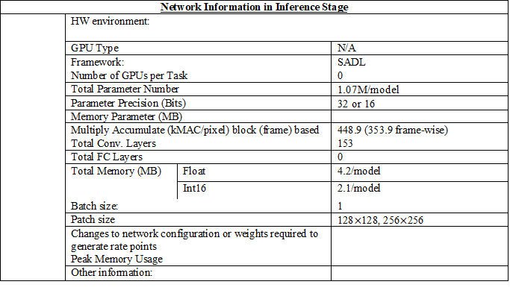
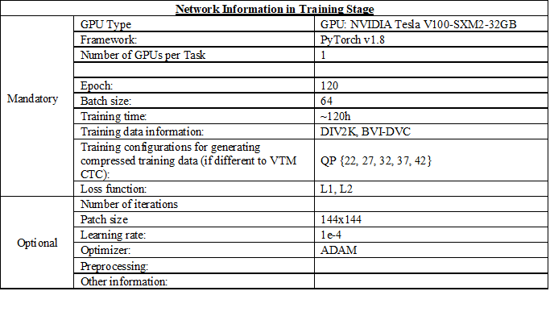
Network Information
No iterative training
Training data is smaller than 1TB, is much smaller comparing to competing proposal

Slide 5
Test Results (with SADL and 16-bit integer)
BD-Rate
Compared to NNVC-4.0
Compared to Filter set 1
 | AI |  |  | RA
 | Y-PSNR | U-PSNR | V-PSNR | Y-PSNR | U-PSNR | V-PSNR
Class A1 | -6.99% | -20.24% | -23.06% | -9.79% | -18.69% | -21.12%
Class A2 | -7.06% | -22.72% | -22.87% | -10.81% | -23.47% | -26.76%
Class B | -7.35% | -24.02% | -23.72% | -9.86% | -26.49% | -26.07%
Class C | -8.30% | -19.13% | -22.23% | -10.99% | -25.53% | -26.16%
Class E | -10.72% | -23.81% | -24.64%
Overall | -8.02% | -22.05% | -23.29% | -10.34% | -24.07% | -25.24%
Class D | -8.09% | -18.19% | -21.95% | -12.51% | -26.85% | -27.81%
Class F | -6.27% | -19.26% | -17.81% | -6.01% | -17.95% | -16.84%
AI |  |  | RA
Y-PSNR | U-PSNR | V-PSNR | Y-PSNR | U-PSNR | V-PSNR
-0.47% | -4.90% | -6.02% | -1.17% | -3.03% | -0.64%
-0.37% | -4.49% | -9.30% | -1.02% | -4.35% | -13.03%
-0.70% | -7.91% | -3.25% | -0.84% | -5.81% | -4.31%
-0.95% | -0.32% | -0.60% | -0.36% | -3.15% | -2.46%
-0.78% | -5.24% | -3.38%
-0.67% | -4.71% | -4.15% | -0.81% | -4.25% | -4.83%
-0.83% | 0.74% | 1.01% | 0.31% | -3.79% | -1.00%
-1.15% | -4.98% | -4.49% | -0.56% | -4.51% | -5.14%
Inference cross-check conducted by Ericsson, document JVET-AD0347
Complexity
  32 percent complexity reduction compared to Filter set 1

Slide 6
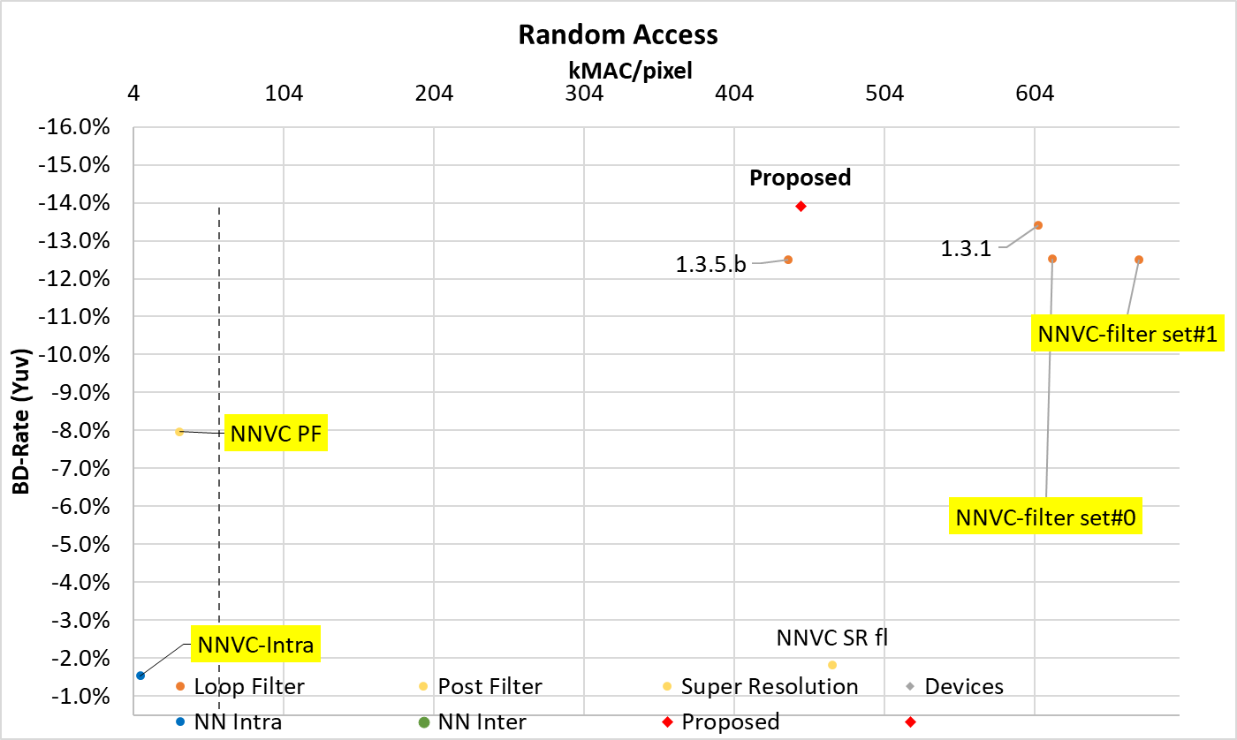
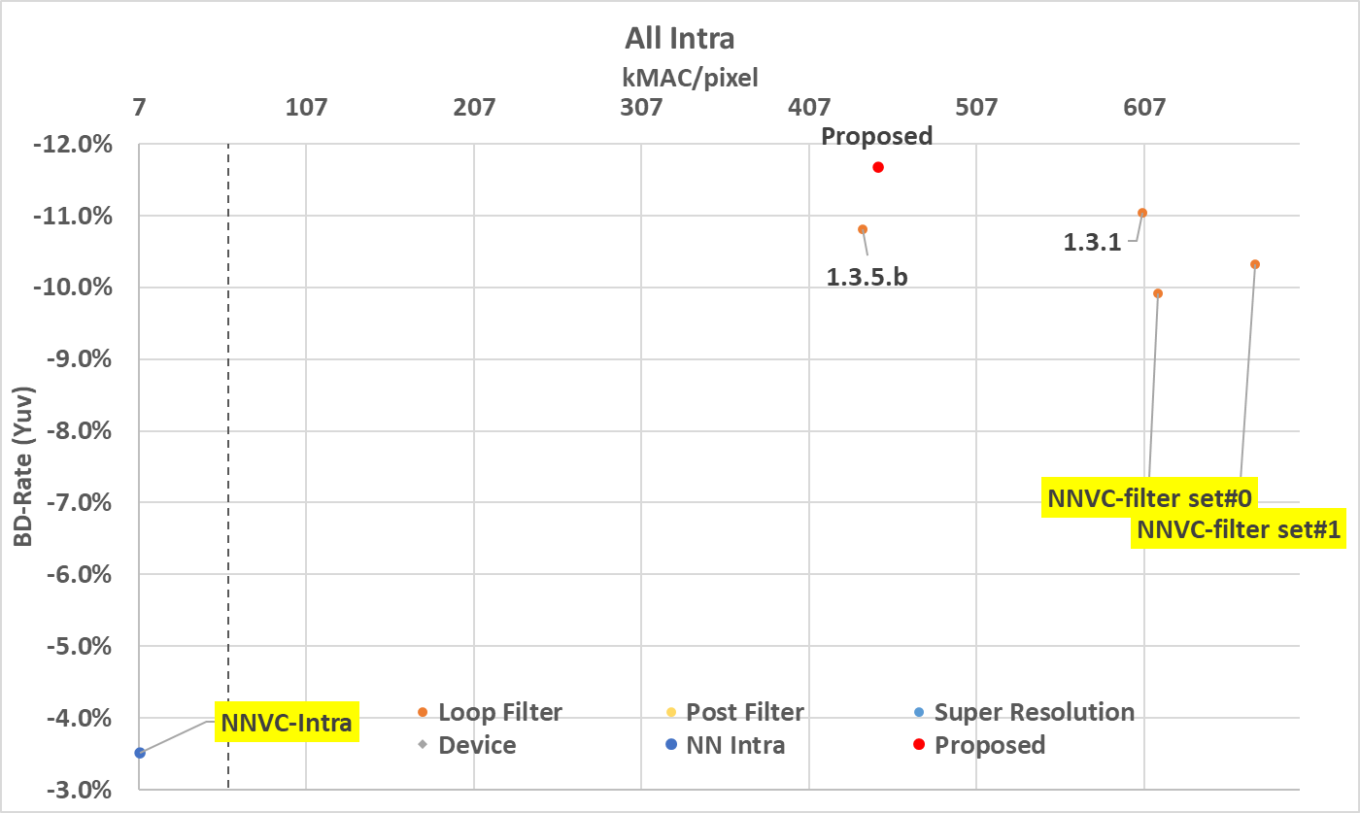
Test Results (with SADL and 16-bit integer)
Performance complexity trade off
  Proposal improves coding gain and reduce computational complexity

Slide 7
Conclusion
Combination of EE1-1.3.5 and EE1-1.6 is proposed.
Inference cross-check is conducted by Ericsson, JVET-AD0347.
The proposed method outperforms the Filter Set 1:
  RA: {-0.81%, -4.25%, -4.83%}
  AI: {-0.7%, --4.7%, -4.2%}
  Complexity: 32% lower computational comparing to Filter Set 1.
It is proposed to study the proposed method in the next round of EE.

Slide 8
Thank you to Ericsson for cross-checking

