Slide 1
JVET-AD0183
Non-EE2: SIF flag and BCW weight usage in OBMC
Antoine Robert, Franck Galpin, Tangi Poirier, Ya Chen

Slide 2
Proposal
Consider SIF flag and BCW index into OBMC to get more accurate predictions
  From neighboring blocks for top/left boundary blending
  From current CU for internal subblock blending
MVs + Refs
SIF + BCW
MVs + Refs
SIF + BCW
MVs + Refs
SIF + BCW

Slide 3
Complexity analysis
Modification of OBMC motion compensation
  One for each 4x4 neighboring block
  Using MVs and reference frames from neighboring block
  Using the default interpolation filter or half-pel one (simpler)
  For bidir case, both predictions are averaged or weighted averaged by applying BCW weights
Same number of MC with equivalent complexity

Slide 4
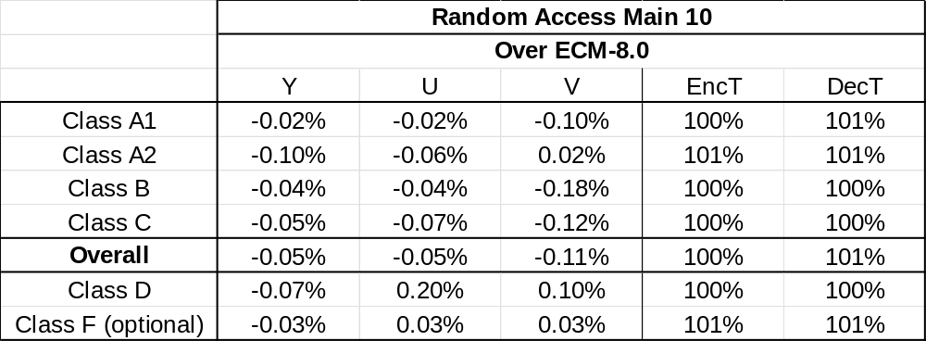
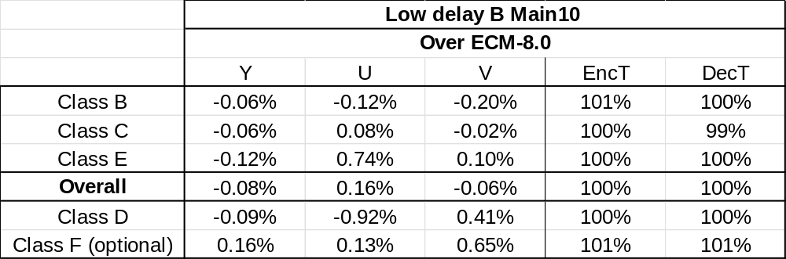
Results
Proposal results over ECM-8.0

Slide 5
Conclusion
Consider SIF flag and BCW index into OBMC
Results over ECM-8.0 show gain without any additional complexity
  RA: -0.05% average Y
  LDB: -0.08% average Y
Study JVET-AD0183 in the next EE2
Thanks to Bytedance for cross-checking

