Slide 1
JVET-AD0169
RPR filters for scale factors below 1.5x
J. Samuelsson-Allendes, S. Deshpande

Slide 2
Proposal summary
Proposed to define new set of RPR filters in ECM for scale factors 1.1x to 1.35x.
Proposed to use corresponding non-normative downsampling filter for 1.1x to 1.35x.
Average BD-Rate(Y-PSNR) gains in the range from 6% (RA 1.25x) to 12% (LD 1.33x).

Slide 3
Background
RPR in VVC and ECM supports downsampling with all scaling ratios between 1x and 2x.
However, only filters optimized for 1x, 1.5x and 2x are included in VVC.
This leads to suboptimal performance for downsampling factors such as 1.2x, 1.25x and 1.33x.

Slide 4
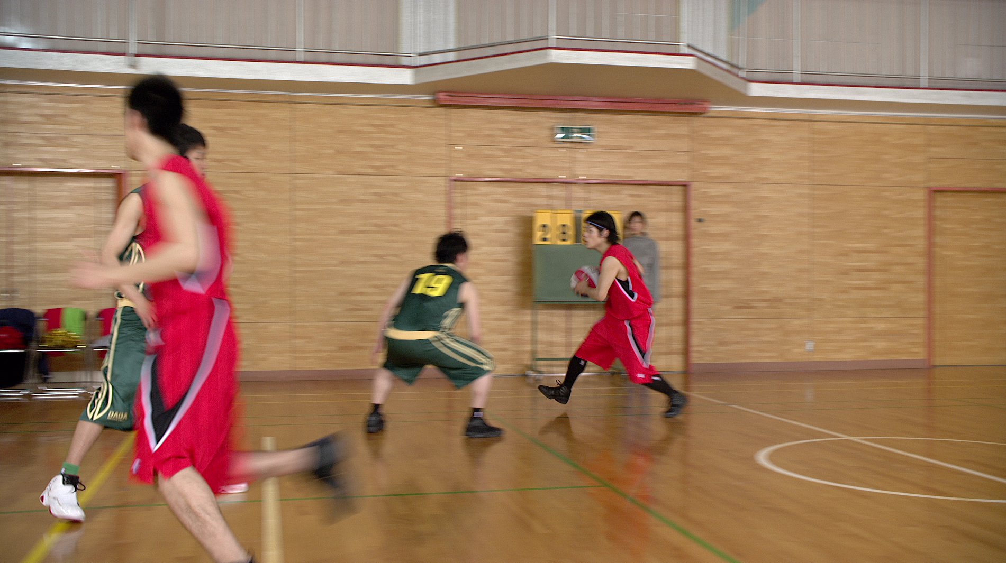
Background
1.5x
2x

Slide 5
Background
1.25x
1.33x
1.5x
2x

Slide 6
Filters used in RPR
1x
1.5x
1.5x
2x

Slide 7
Filters used in downsampling
1.5x
1.5x
1.5x
2x

Slide 8
Proposed filters for both downsampling and RPR
1.33x
1.33x
1.5x
2x

Slide 9

Proposed filters for both downsampling and RPR
Proposed filters for RPR (luma, chroma and affine) and for non-normative downsampling.
Visual investigation on various windowing functions to find good balance of blur, aliasing and ringing.
Filter derived from a kaiser-windowed-sinc-function with kaiser beta equal to 7 is proposed.
Detail from the BQTerrace sequence, frame 380.
Left: current 1.25x scaling, Right: proposed 1.25x scaling

Slide 10
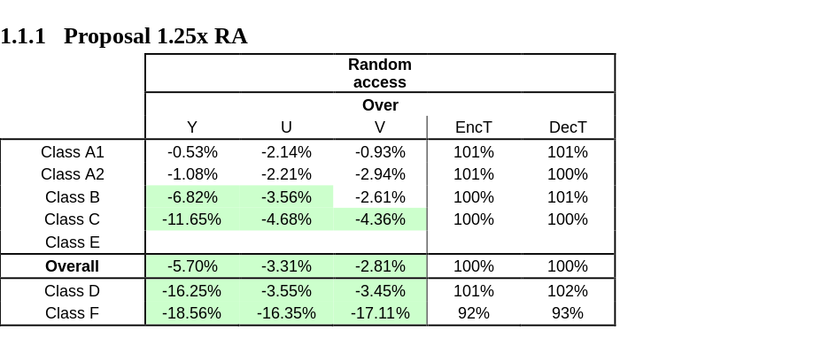
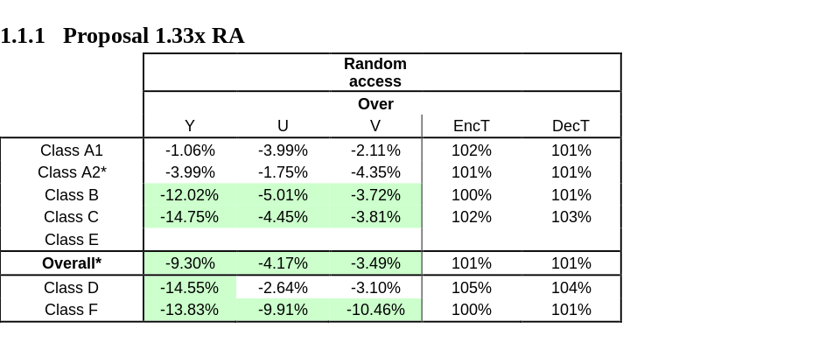
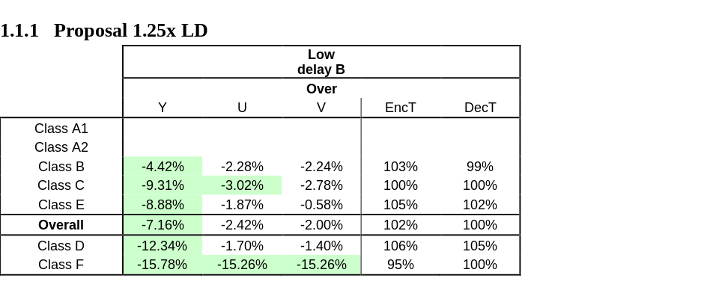
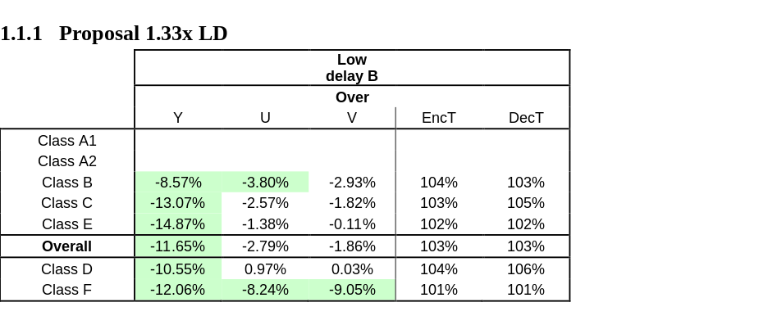
Results
For RA the test conditions from JVET-Z0062 are used.
For LD the test conditions from JVET-Q2015 are used.
*results for ParkRunning3 not completed

Slide 11
Proposal summary
Proposed to define new set of RPR filters in ECM for scale factors 1.1x to 1.35x.
Proposed to use corresponding non-normative downsampling filter for 1.1x to 1.35x.
Average BD-Rate(Y-PSNR) gains in the range from 6% (RA 1.25x) to 12% (LD 1.33x).

Slide 12
Crosscheck
Thanks Ericsson for crosschecking!
JVET-AD0345
Also includes supplementary results for VTM.

Slide 13
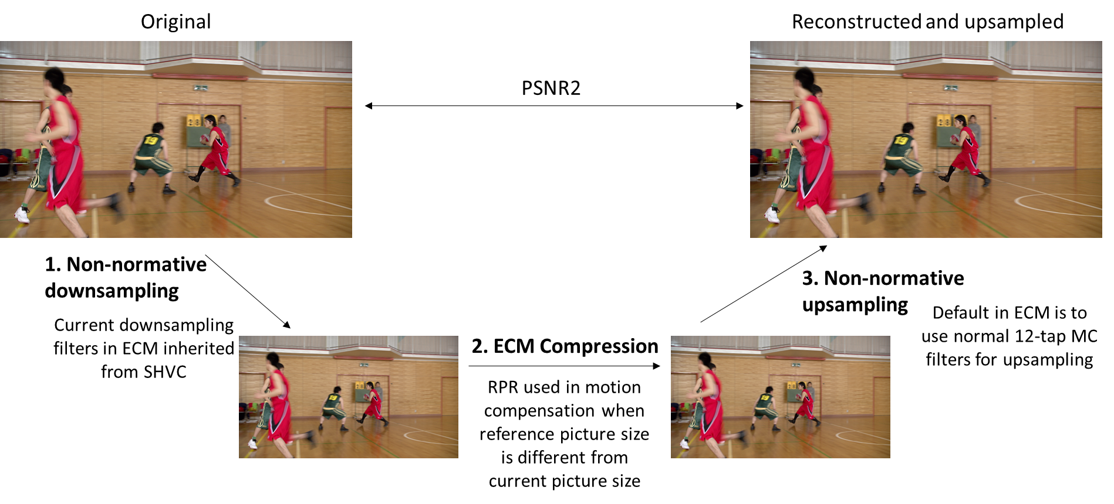
Proposal recap
Proposed to define new set of RPR filters in ECM for scale factors 1.1x to 1.35x.
Proposed to use corresponding non-normative downsampling filter for 1.1x to 1.35x.
Average BD-Rate(Y-PSNR) gains in the range from 6% (RA 1.25x) to 12% (LD 1.33x).

Slide 14
Updates for the revisit
Previous RPR CE, RPR EE, and RPR CTC always tested LD only – our results for RA goes beyond what was ever requested for RPR proposals.
PSNR1 results for LD (all classes) and RA (class B, C, D, and F) for normative aspect.
Non-normative results for VTM RA Class A added.
Non-normative results for ECM RA Class A still running.

Slide 15
PSNR1 and PSNR2
PSNR1

Slide 16
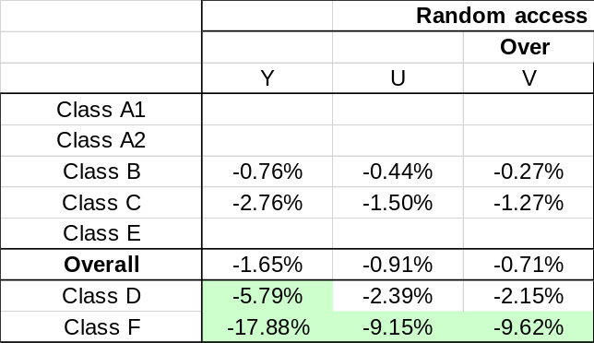
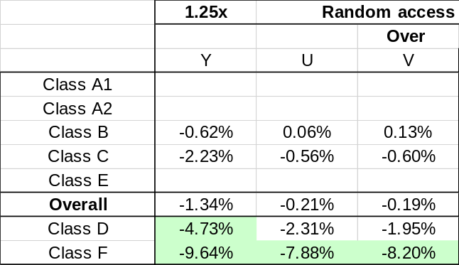
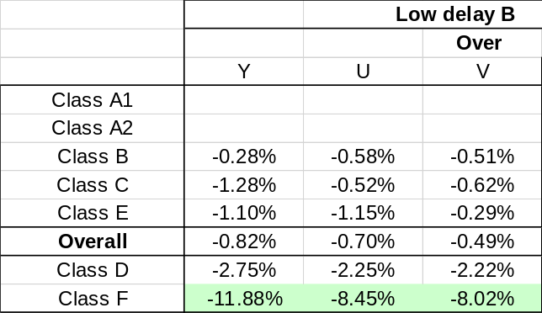
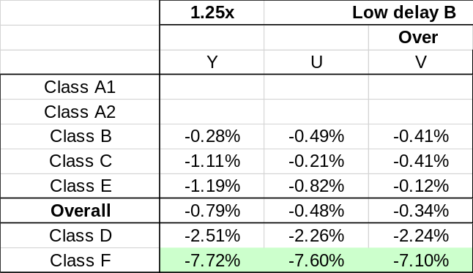
1.25x PSNR1 and PSNR2
PSNR1 RA
PSNR2 RA
PSNR1 LD
PSNR2 LD

Slide 17
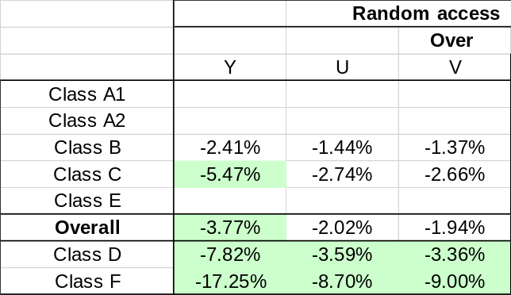
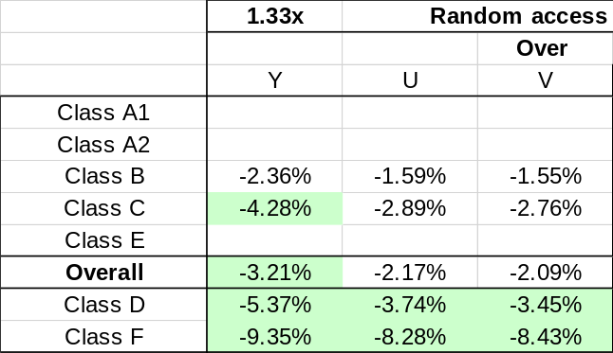
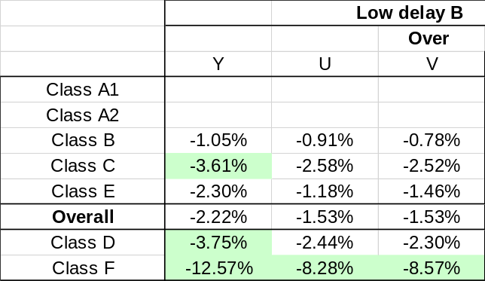
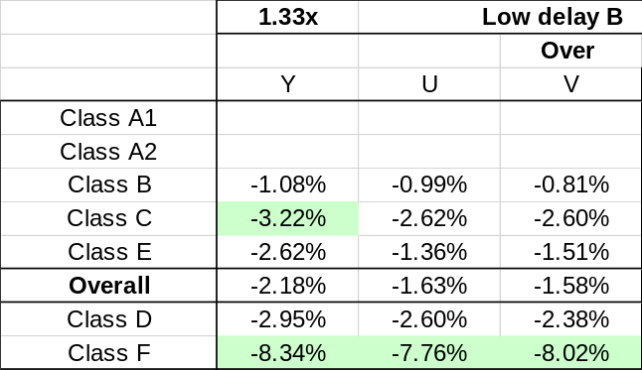
1.33x PSNR1 and PSNR2
PSNR1 RA
PSNR2 RA
PSNR1 LD
PSNR2 LD

Slide 18
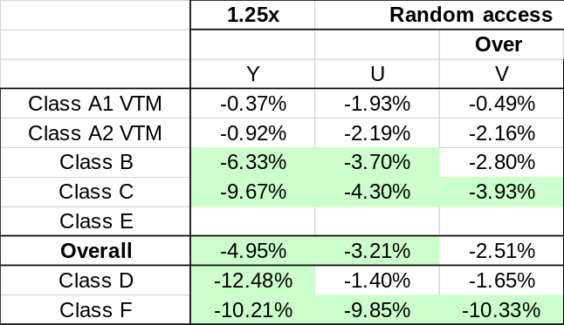
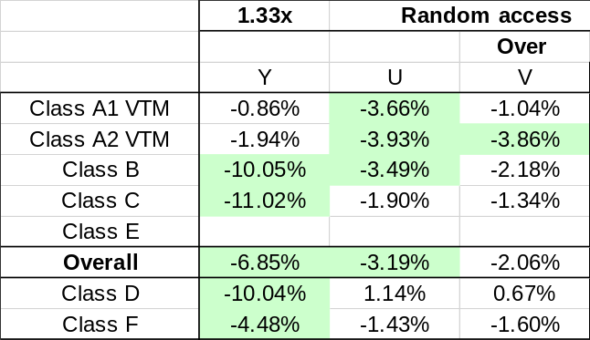
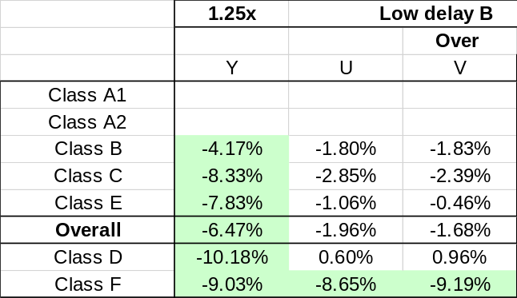
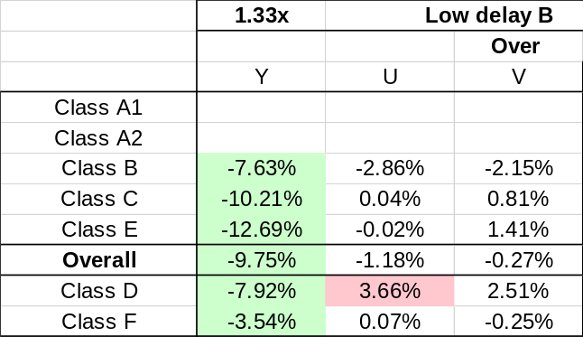
Additional results – gain for non-normative only

