Slide 1

[AHG8] SEI for encoder optimization information(JVET-AD0137)
Chulkeun Kim, Hendry, Dong-Gyu Gwak, Jaehyun Lim
LG Electronics

Slide 2
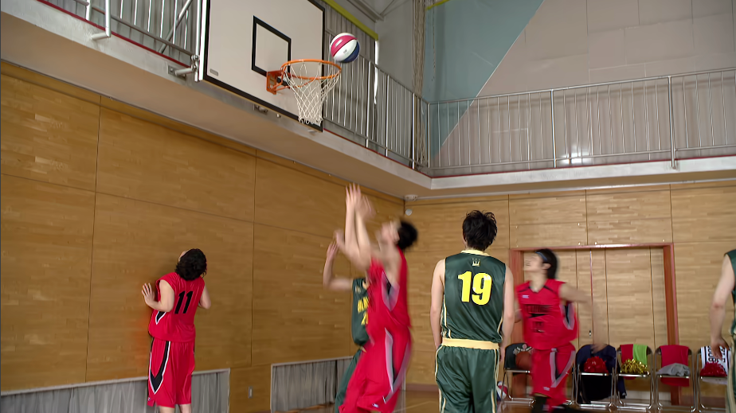
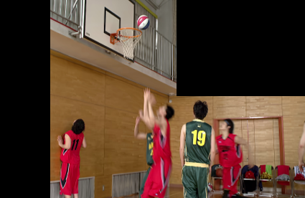
Problem description
The optimization methods may not align with the user’s or machine’s intention.
  The Encoding component and task component can be independently configured
  The encoded video can be used for various purposes
  The intended purpose can be changed by user or machine
For both user and machine to receive videos that meet their purposes,
  It would be helpful for them to identify the optimization method applied for encoding.
Optimized video
encoding component
Task component
Machine Task A
Encoder
Video
Optimization for machine analysis
Decoder
Machine Task B
Pre/Post-processing, encoding optimization
Human

Slide 3
Proposed solution
Table 1. SEI for encoder optimization
encoder_optimization_info(payloadSize ) { | Descriptor
optimization_cancel_flag | u(1)
if(!optimization_cancel_flag){
optimization_method | u(16)
optimization_persistence_flag | u(1)
}
}
optimization_cancel_flag equal to 1 specifies that the persistence of the previous applied optimization is cancelled. optimization_cancel_flag equal to 0 indicates that optimization_persistence_flag and optimization_method follow.
optimization_method indicates the optimization methods as specified in table 2.(The optimization methods specified in Table 2 are described in a draft technical report)
optimization_persistence_flag specifies the persistence of the optimization method that is indicated by the optimization_method. optimization_persistence_flag equal to 0 specifies that the optimization method identified by the optimization_method may be applied for the current picture only. optimization_persistence_flag equal to 1 specifies that the optimization method identified by the optimization_method may be applied for the current picture and all subsequent pictures.

Slide 4
Conclusion
This contribution proposes SEI to identify whether optimization has been applied, the applied optimization method, and the scope of optimization.
This can be helpful for users or machines to use a video that meets their purposes.
It is suggested to consider the proposed SEI for machine analysis of coded video content

Slide 5
Appendix. Definition of optimization_method
Table 2 – Definition of optimization_method
Value | Interpretation
optimization_method = = 0 | May be used as determined by the application
optimization_method > 0 && ( optimization_method & 0x01 ) = = 0 | No pre-processing methods of ROI
( optimization_method & 0x01 ) != 0 | With pre-processing methods of ROI
optimization_method > 0 && ( optimization_method & 0x02 ) = = 0 | No pre-processing methods of foreground and background
( optimization_method & 0x02 ) != 0 | With pre-processing methods of foreground and background
optimization_method > 0 && ( optimization_method & 0x04 ) = = 0 | No temporal subsampling
( optimization_method & 0x04 ) != 0 | With temporal subsampling
optimization_method > 0 && ( optimization_method & 0x08 ) = = 0 | No spatial subsampling
( optimization_method & 0x08 ) != 0 | With spatial subsampling
optimization_method > 0 && ( optimization_method & 0x10 ) = = 0 | No quantization parameter adaption for Region of Interest coding
( optimization_method & 0x10 ) != 0 | With quantization parameter adaption for Region of Interest coding
optimization_method > 0 && ( optimization_method & 0x20 ) = = 0 | No quantization step changes for temporal layers
( optimization_method & 0x20 ) != 0 | With quantization step changes for temporal layers

