Slide 1
JVET-AD0136
AhG10: Lagrange multiplier optimization for chroma ALF and CCALF
Wenjie Zou, Yi Zhou, Chengming Gu, Jiawei Fan (Xidian University)
Shaowei Xie, Ying Gao, Menghu Jia, Yali Hu, Cheng Huang (ZTE Corporation)
April 2023

Slide 2
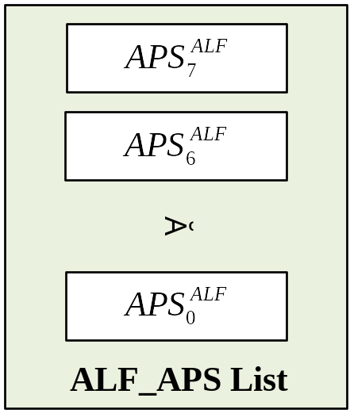
Introduction
ALF Adaptation Parameter Set (ALF APS): To transmit ALF filtering coefficients.
adaptation_parameter_set_rbsp( ) { | Descriptor
aps_params_type | u(3)
aps_adaptation_parameter_set_id | u(5)
aps_chroma_present_flag | u(1)
if( aps_params_type = = ALF_APS )
alf_data( )
Maximum 8 APSs in ALF_APS are listed in H.266/VVC.
When a new ALF APS (indexed by aps_adaptation_parameter_set_id) is received, the old ALF APS with the same ID number will be overwritten.
RA configuration: ALF_APS list will be initialized according to IntraPeriod.
LDB configuration: There is only one I frame. The ALF_APS list stores the history APS until a new APS having the same ID number is received.

Slide 3
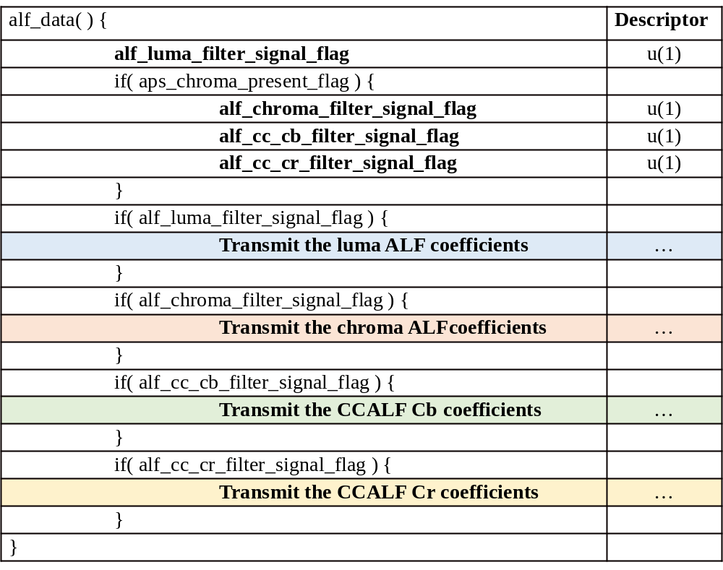
ALF APS
Four types of filtering coefficients
  Luma ALF coefficients
  Chroma ALF coefficients
  CCALF Cb coefficients
  CCALF Cr coefficients
Four individual ON/OFF flags
  alf_luma_filter_signal_flag
  alf_chroma_filter_signal_flag
  alf_cc_cb_filter_signal_flag
  alf_cc_cr_filter_signal_flag
Values of these flags are decided based on the RDO criterion.
A new ALF APS is transmitted if one of the four flags equal to 1.

Slide 4
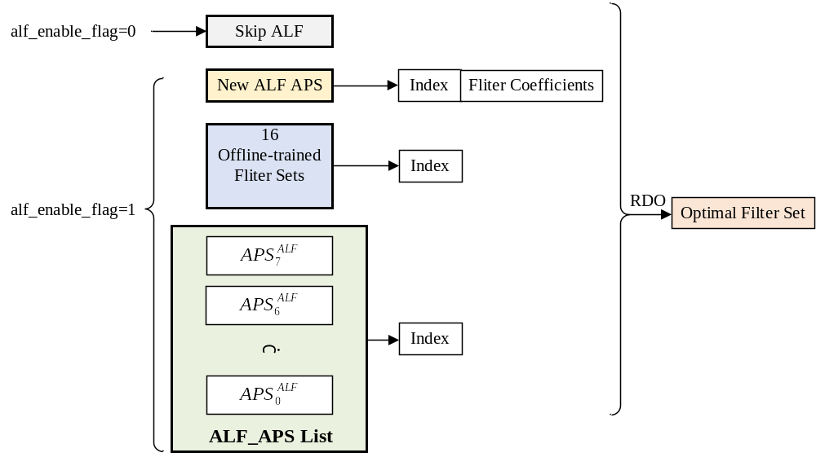

ALF RDO Decision (Luma)
The candidate ALF solutions:
Skip ALF
New ALF APS
Pre-defined fixed filter sets
ALF APS stored in the ALF_APS list
The RD costs of these luma ALF solutions are calculated as:
If the new ALF APS has a smallest RD cost, alf_luma_filter_signal_flag is set to 1. A new ALF APS will be transmitted.

Slide 5
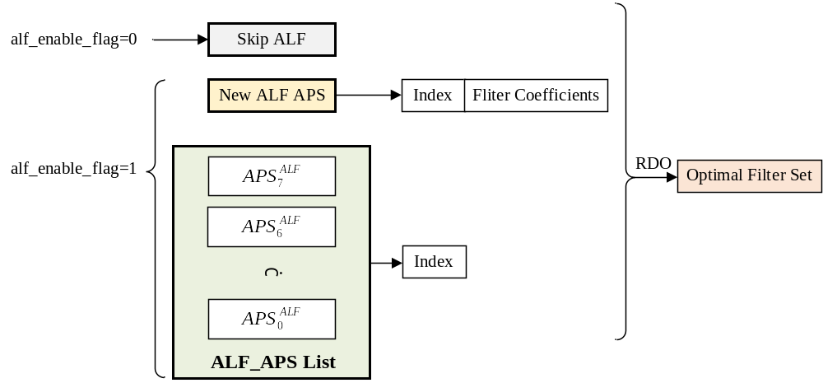

ALF RDO Decision (Chroma)
The candidate ALF solutions:
Skip ALF
New ALF APS
ALF APS in the ALF_APS list
The RD costs of these chroma ALF solutions are calculated as:
The RDO decisions for luma ALF, chroma ALF, CCALF Cb, and CCALF Cr are independent.

Slide 6
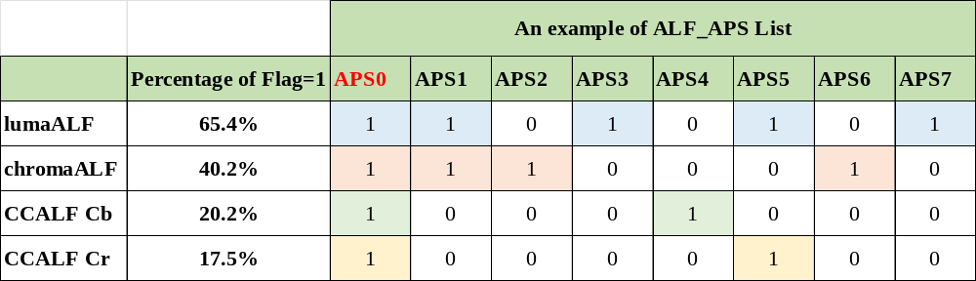
Problem Statement
A new APS will be transmitted if one of the following flags is equal to 1.
  alf_luma_filter_signal_flag
  alf_chroma_filter_signal_flag
  alf_cc_cb_filter_signal_flag
  alf_cc_cr_filter_signal_flag

Slide 7
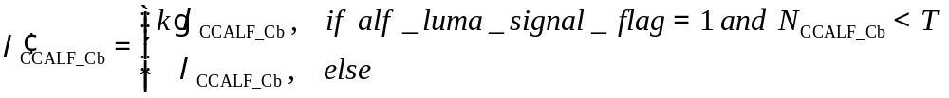
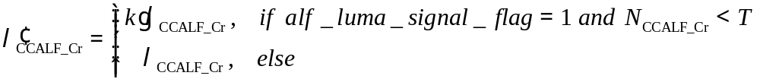
Proposed method
Encoder optimization
  Modify the Lagrange multiplier of chroma ALF, CCALF Cb, and CCALF Cr by introducing a scaling factor k (0.3 in the implementation) if the following conditions are met:
Chroma ALF:
CCALF Cb:
CCALF Cr:
alf_luma_filter_signal_flag = 1, which indicates that the luma ALF APS is transmitted.
The number of ALF flag = 1 of a channel in the ALF_APS list is lower than a threshold T, e.g., T = 4 in the implementation.

Slide 8
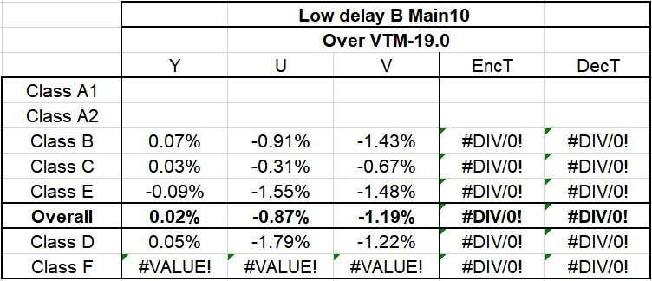
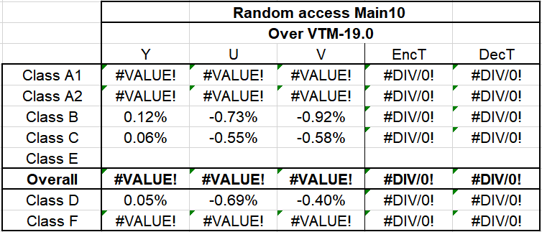
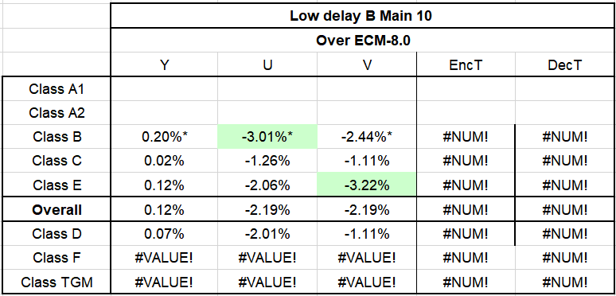
Experimental results
On VTM19.0
On ECM8.0
*The results of Class B are estimated due to that "MarketPlace_QP22, RitualDance_QP22, Cactus_QP22, BasketballDrive_QP22,BQTerrace_QP22" results are not completed and are replaced by ECM8.0 anchor result.

Slide 9
Conclusion
On VTM 19.0:
  LDB : 0.02%, -0.87%,-1.19%
On ECM 8.0:
  LDB : 0.12%*, -2.19%*, -2.19%*
The encoding and decoding time is expected to be similar as that of the anchor scheme due to the small modification.
Recommend to adopt this optimization into VTM under LDB configuration.

Slide 10
Thank you

