Slide 1
AHG10: Lambda-QP Relationship Fix for Slice-level Multi-QP Optimization
JVET-AD0133
Junqi Liao, Li Li, Dong Liu, Houqiang Li, Feng Wu
University of Science and Technology of China

Slide 2
Multi-QP optimization in VTM
Lambda and QP are usually assumed to have a fixed relationship in VTM.
However, the lambda-QP relationship is actually content-dependent. Frame-level multi-QP optimization is used to determine different QPs for frames with different content by applying RDO to the QPs used for each frame.

Slide 3
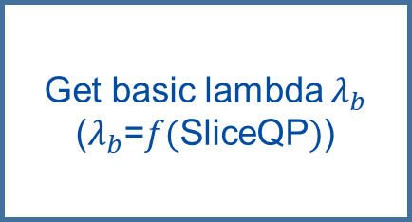
Framework of multi-QP optimization
Get the QP RDO range
(SliceQp±DeltaQpRD)
Get basic lambda $λ_{b}$
($λ_{b}$=$f(\text{SliceQP})$)
Encode the current frame using the QP being traversed
Calculate the RD-cost and update the best QP.
All QPs in RDO range are traversed?
N
Y
Return the best QP

Slide 4
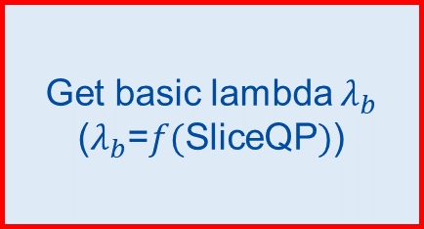
Problems in the original implementation
Get the QP RDO range
(SliceQp±DeltaQpRD)
Get basic lambda $λ_{b}$
($λ_{b}$=$f(\text{SliceQP})$)
Encode the current frame using the QP being traversed
Calculate the RD-cost and update the best QP.
The QP-lambda relationship used for calculating lambda here is not aligned with the QP-lambda relationship used in other parts of VTM, and an outdated version of the QP-lambda relationship is being used.
We propose to fix it.
All QPs in RDO range are traversed?
N
Y
Return the best QP

Slide 5
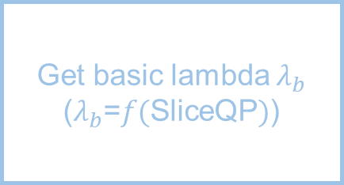
Problems in the original implementation
Get the QP RDO range
(SliceQp±DeltaQpRD)
Get basic lambda $λ_{b}$
($λ_{b}$=$f(\text{SliceQP})$)
Encode the current frame using the QP being traversed
Calculate the RD-cost and update the best QP.
Since we want to obtain an appropriate frame-level QP, lambda should not vary during the RDO process. However, in the current implementation, lambda varies with the traversed QP during the RDO process.
We propose to fix it.
All QPs in RDO range are traversed?
N
Y
Return the best QP

Slide 6
Our improvements to the frame-level multi-QP optimization.
We propose to align the QP-lambda relationship used in multi-QP optimization with the QP-lambda relationship used in other parts of VTM.
We propose that in the RDO process of frame-level multi-QP optimization, lambda should not vary with the traversed QP, but should be fixed using the lambda corresponding to SliceQp.
Since we have observed cache conflicts when frame-level multi-QP optimization and REUSE_CU_RESULTS are enabled at the same time, we propose to disable REUSE_CU_RESULTS when frame-level multi-QP optimization is being used.

Slide 7
Test results
All intra
Random access
 | Over VTM19.2 multiQP_anchor
 | Y | U | V | EncT | DecT
Class A1 | -9.18% | 2.85% | -1.59% | 100% | 99%
Class A2 | -9.38% | -4.13% | -4.38% | 100% | 101%
Class B | -8.31% | -7.76% | -6.98% | 100% | 100%
Class C | -7.20% | -9.09% | -8.54% | 99% | 101%
Class E | -7.51% | -7.77% | -7.03% | 100% | 101%
Overall | -8.25% | -5.68% | -6.00% | 100% | 100%
Class D | -7.61% | -8.35% | -8.60% | 100% | 101%
Class F (optional)
 | Over VTM19.2 multiQP_anchor
 | Y | U | V | EncT | DecT
Class A1 | #VALUE! | #VALUE! | #VALUE! | #DIV/0! | #DIV/0!
Class A2 | #VALUE! | #VALUE! | #VALUE! | #NUM! | #NUM!
Class B | -11.15% | -6.58% | -6.58% | 100% | 100%
Class C | -10.49% | -7.26% | -9.33% | 100% | 99%
Class E
Overall | #VALUE! | #VALUE! | #VALUE! | #DIV/0! | #DIV/0!
Class D | -10.20% | -7.54% | -7.61% | 99% | 101%
Class F (optional)
Low delay B
 | Over VTM19.2 multiQP_anchor
 | Y | U | V | EncT | DecT
Class A1
Class A2
Class B | -8.22% | -6.97% | -6.04% | 100% | 100%
Class C | -3.48% | -5.86% | -7.32% | 100% | 100%
Class E | -2.78% | 3.61% | 6.49% | 100% | 100%
Overall | -5.28% | -3.96% | -3.34% | 100% | 100%
Class D | -4.81% | -3.40% | -4.08% | 100% | 101%
Class F (optional)

Slide 8
Thank you!

