Slide 1
AHG12:
Cross-component residual model (CCRM)
JVET-AD0108
Pekka Astola, Jani Lainema

Slide 2
Overview of the proposed method
Cross-component residual model (CCRM) is a cross-component prediction tool for inter slices.
The cross-component filters are derived using the prediction signals of luma and chroma.
The derived filters are applied to the reconstructed luma signal producing the final chroma prediction.
resY
predY
+
Y
resCb
predCb
Derive filters
Apply filters
+
Cb
resCr
predCr
+
Cr
The proposed method on the decoder.

Slide 3
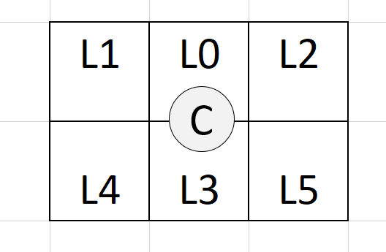
The cross-component filter
The proposed 8-tap filter consist of 6 spatial luma samples, a nonlinear term, and a bias term.
The 6 spatial luma samples (L0,…,L5) are obtained from the luma grid selecting the 6 luma samples closest to the chroma position C without down sampling and the prediction model becomes
  predChromaVal = c₀ L0+ c₁L1 + c₂L2 + c₃L3 + c₄L4 + c₅L5 + c₆ nonlinear((L0+L3+1) >> 1) + c₇ B,
  where nonlinear is CCCM’s nonlinear operator and B is bias.
Luma samples L0,..,L5 in relation to the chroma sample C.

Slide 4
The cross-component filter (continued)
The filter coefficients are derived using ECM’s division-free Gaussian elimination method and the necessary offsets are applied to samples prior to filter derivation.
Intra reference samples are used as additional input samples in filter derivation when the block has less than 64 chroma samples.
  CCCM’s design of at most 6 rows and columns of intra reference samples is used.
Blocks having 256 chroma samples or more are divided into subblocks that have at most 256 chroma samples.
  Subblocks containing zero luma residual are skipped.

Slide 5
Bitstream signalling and encoder operation
Usage of the mode is signalled with a CABAC coded TU level flag. One new CABAC context was included to support this.
The CCRM flag is only signalled if the TU’s luma Cbf is non-zero and the CU’s predMode is either MODE_INTER or MODE_IBC.
The encoder performs an RD decision in the transform selection loop for the chroma components when luma Cbf is non-zero and the CU’s predMode is either MODE_INTER or MODE_IBC.

Slide 6
Experimental results
 | Random Access Main 10
 | Over ECM-8.0
 | Y | U | V | EncT | DecT
Class A1 | -0.34 % | -2.07 % | -3.31 % | 106 % | 102 %
Class A2 | -0.56 % | -2.33 % | -2.94 % | 106 % | 100 %
Class B | 0.06 % | -0.89 % | -0.93 % | 104 % | 100 %
Class C | 0.04 % | -0.74 % | -0.69 % | 107 % | 100 %
Class E
Overall | -0.15 % | -1.37 % | -1.74 % | 106 % | 100 %
Class D | 0.09 % | -0.49 % | -0.45 % | 104 % | 101 %
Class F | -0.03 % | -0.72 % | -0.68 % | 105 % | 99 %
Class TGM | -0.31 % | -0.79 % | -0.86 % | 105 % | 101 %
Run times not accurate.
 | Low delay B Main10
 | Over ECM-8.0
 | Y | U | V | EncT | DecT
Class A1
Class A2
Class B | 0.07 % | -5.85 % | -4.85 % | 107 % | 100 %
Class C | -0.04 % | -2.20 % | -2.98 % | 107 % | 100 %
Class E | 0.05 % | -0.16 % | -0.75 % | 104 % | 98 %
Overall | 0.03 % | -3.21 % | -3.20 % | 106 % | 100 %
Class D | 0.09 % | -3.32 % | -3.47 % | 105 % | 100 %
Class F | -0.01 % | -4.76 % | -4.35 % | 106 % | 99 %
Class TGM | -0.58 % | -3.49 % | -4.49 % | 108 % | 100 %
 | Low delay P Main10
 | Over ECM-8.0
 | Y | U | V | EncT | DecT
Class A1
Class A2
Class B | 0.06 % | -5.80 % | -5.25 % | 108 % | 99 %
Class C | -0.02 % | -2.68 % | -3.30 % | 107 % | 100 %
Class E | 0.01 % | -1.36 % | -1.01 % | 105 % | 100 %
Overall | 0.02 % | -3.65 % | -3.54 % | 107 % | 100 %
Class D | 0.00 % | -3.14 % | -2.99 % | 105 % | 103 %
Class F | 0.07 % | -5.06 % | -5.13 % | 107 % | 102 %
Class TGM | -0.60 % | -4.04 % | -4.97 % | 108 % | 101 %

Slide 7
Summary
Proposing cross-component residual model for inter slices.
Provides improved coding efficiency for chroma coding.
It is suggested to include the method in the next round of EEs.

