Slide 1
Analysis for decoding time in EE2-1.21a

Slide 2
Introduction
The performance reported in EE2-1.21a, b, c, EE2-1.22 and EE2-1.24a are shown as follows,
Test | Descriptions | Y | U | V | EncT | DecT
1.21a | Additional 18 non-adjacent positions are added with intra prediction modes replacement by partitioning angles for SGPM/GPM | -0.05% | -0.09% | -0.02% | 100% | 102%
1.21b | Angular modes extension from 65 to 129 for TMRL | -0.05% | -0.05% | -0.08% | 99% | 99%
1.21c | Test 1.21a + Test 1.21b | -0.13% | -0.14% | -0.11% | 100% | 102%
1.22 | Template-based intra MPM list construction | -0.06% | -0.08% | -0.09% | 100% | 101%
1.24a | Test 1.21c + Test 1.22 | -0.19% | -0.20% | -0.19% | 100% | 102%

Slide 3
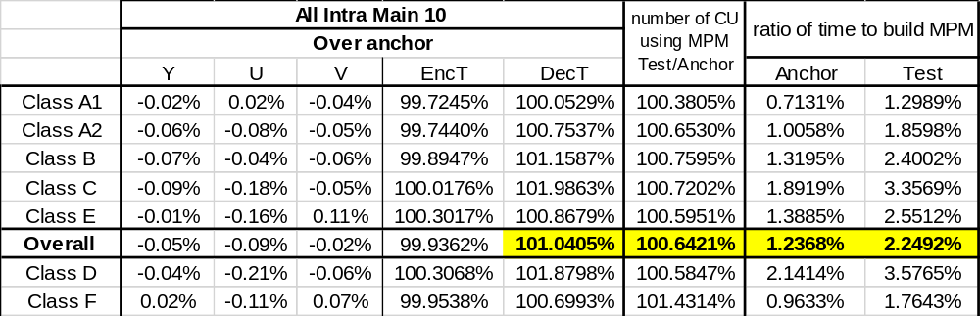
Analysis for decoding time in EE2-1.21a
DecT is the averaged time from 200 decodings.

Slide 4
Conclusions
It is proposed to adopt EE2-1.24a into the next version of ECM.

