Slide 1

EE2-related: Modifications of MTS and LFNST for IntraTMP
JVET-AC0205
Ramin G. Youvalari, Döne Bugdayci Sansli, Jani Lainema
Nokia

Slide 2
Transform Selection for IntraTMP
In ECM7.0
Transform selection for intraTMP tool in ECM-7.0 is done as follows:
Primary transform:
Default: {DCT2, DCT2}
If 4 <= width <= 16, trTypeHor is DST7
If 4 <= height <= 16, trTypeVer is DST7
Secondary transform:
LFNST transform set 0. If the current block is IntraTMP coded block, predModeIntra is mapped to planar mode.

Slide 3
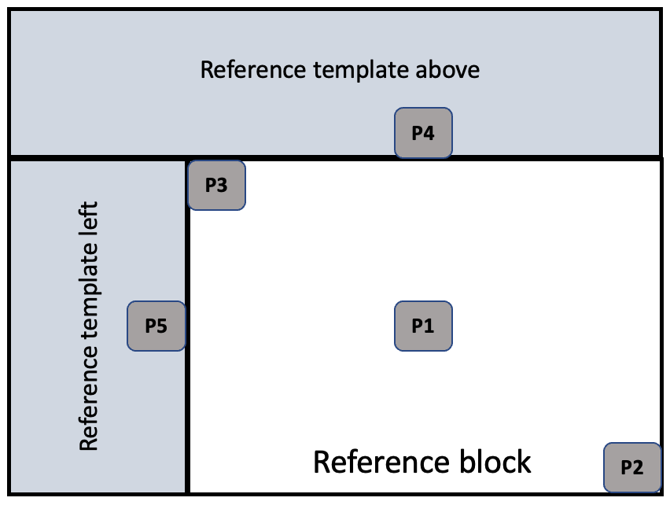
Transform Selection for IntraTMP
Proposed method in JVET-AC0205
This contribution proposes to inherit the intra prediction mode of an intraTMP block, from the prediction units in the reference area that the block is copied.
5 locations in the reference area are scanned sequentially and when an angular intra prediction is found then the scan is terminated, and that mode is used for the transform selection.
The scanning order is: P1 -> P2 -> P3 -> (P4, P5)
Scan order for locations in reference template:
If height <= width, P4 -> P5
Else, P5 -> P4

Slide 4
Further Details
JVET-AC0205
The first mode that is an angular intra prediction mode or planar/DC is selected and used, thus prediction units with following intra modes are skipped:
    MIP mode
    IntraTMP mode
    IBC mode
  If no candidate found in these 5 locations, then planar mode is assigned for the intraTMP block and is used for transform selection.
  Similar to EE2-4.1c, the inherited mode could be also stored and used in the MPM list of the neighbouring intra blocks.

Slide 5
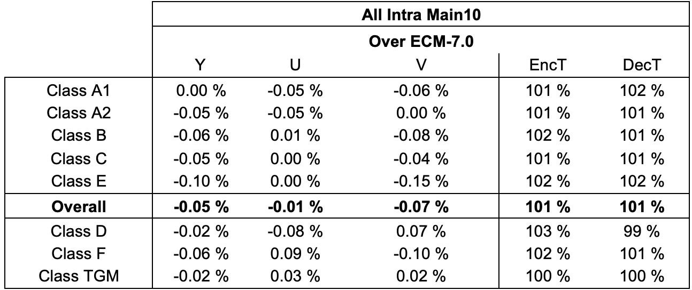
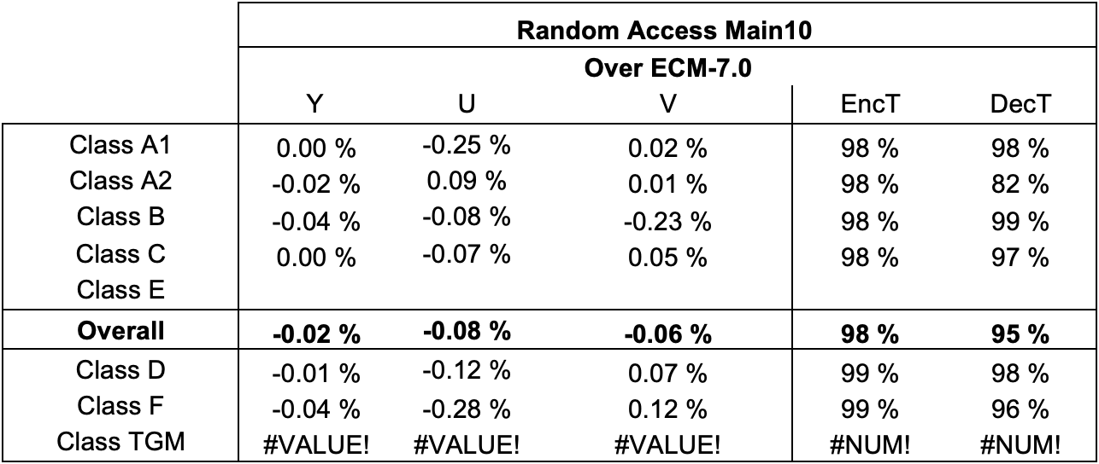
Experimental results
Test A: transform selection

Slide 6
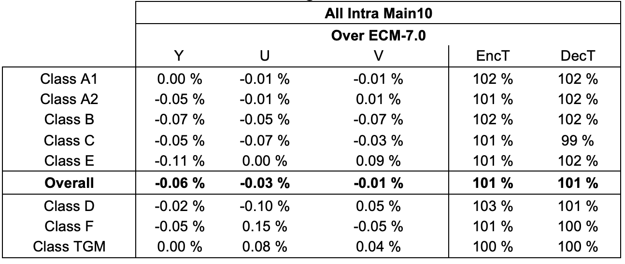
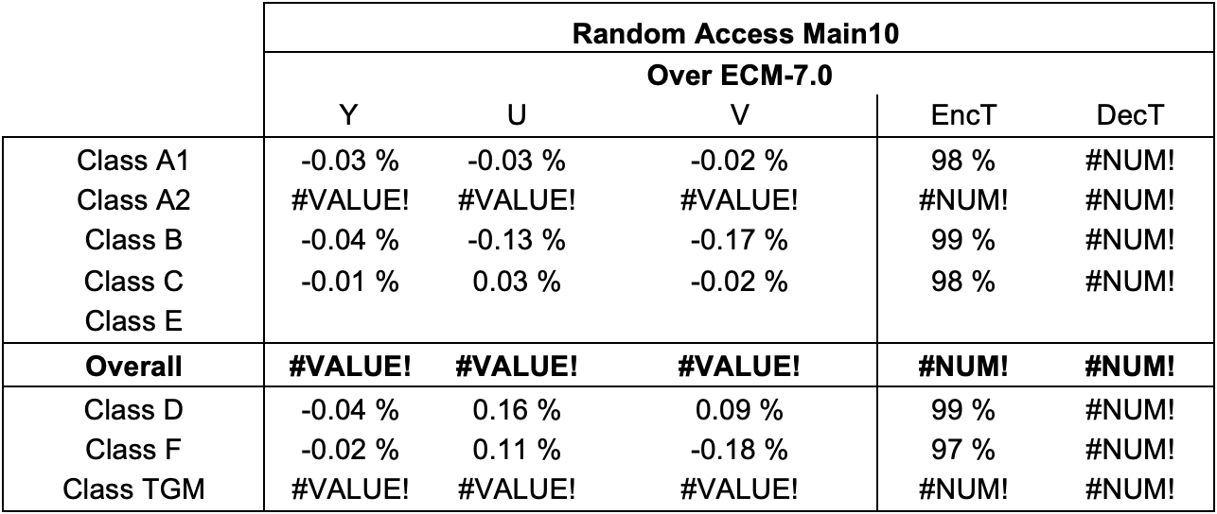
Experimental results
Test B: transform selection + use the mode in MPM list of future blocks

Slide 7
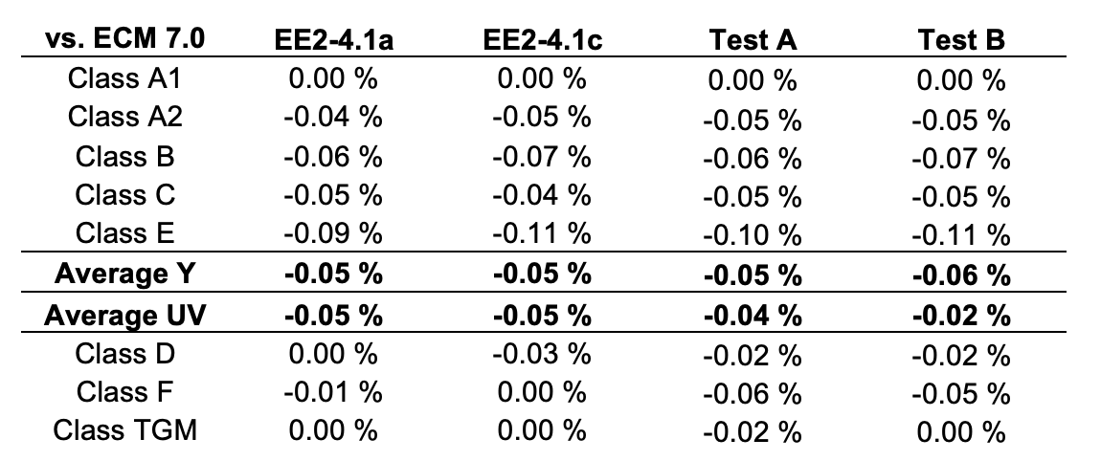
Additional Experimental Results in AI Configuration
Results compared to similar tests in EE2-4.1

Slide 8
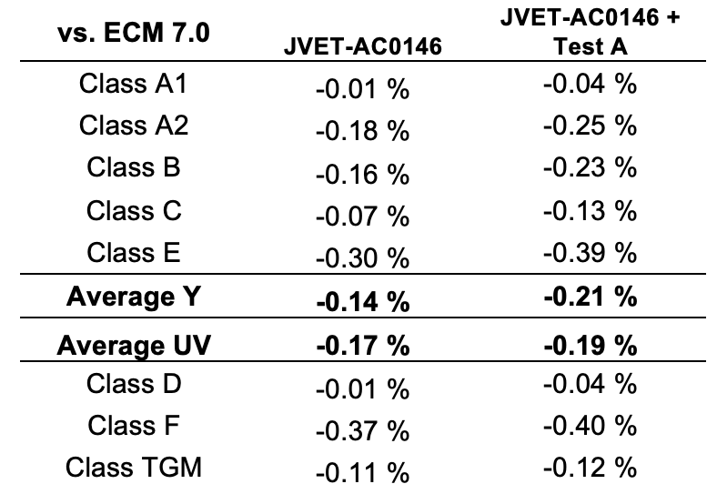
Additional Experimental Results in AI Configuration
Combination with JVET-AC0146 (FTMP)

Slide 9
Summary
JVET-AC0205
Proposing to inherit the intra prediction mode for transform selection in intraTMP from reference area
The proposed method is simpler than what has been proposed in EE2-4.1 and it provides slightly better coding efficiency
Provides further coding efficiency improvements over ECM-7.0
  Test A:
      AI: -0.05%, -0.01%, -0.07% for Y, U, V
  Test B:
      AI: -0.06%, -0.03%, -0.01% for Y, U, V
It is suggested to include the technique in the next round of EEs.

