Slide 1
JVET-AC0198
Non-EE2: IntraTMP with multiple modes
Po-Han Lin, Jian-Liang Lin,
Vadim Seregin, Marta Karczewicz (Qualcomm)

Slide 2
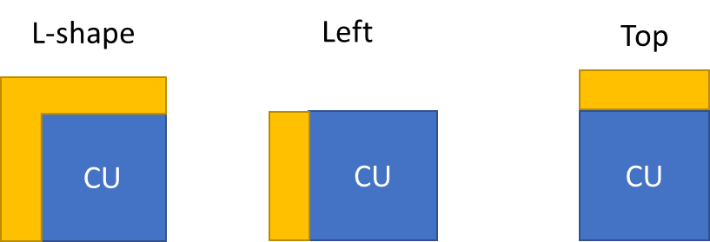

Proposed method
        The proposed method introduces three additional intraTMP modes: left template, above template and L-shape fusion modes
        Left and Above template modes use different template shape to do the template matching
        L-shape fusion mode derives 2 best candidates combined by the following formula:
        where P₀ and P₁ are the predictors from the two candidates, cost₀ and cost₁ are the TM costs of the candidates

Slide 3
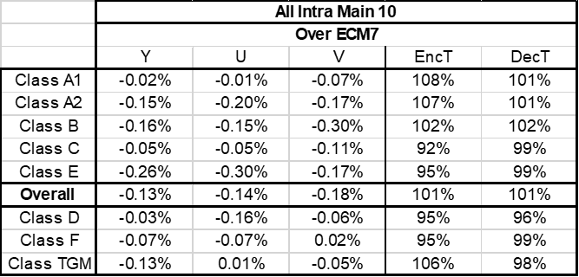
Simulation Results
        It is recommended to test in the next EE

