Slide 1
JVET-AC0167
AHG12: Using block vector derived from IntraTMP as an IBC candidate for the current block.
J.-K. Lee, D. Ruiz Coll, V. Warudkar
( Ofinno )

Slide 2
Summary
Proposals
  Employ the block vector (BV) from intra template matching prediction (IntraTMP) for the current block as a block vector predictor (BVP) for the AMVP IBC candidate list.
Experimental Results
  AI:
    Class F -0.07%, 0.10%, -0.12% (Enc/Dec:100%/97%)
    Class TGM -0.04%, -0.00%, -0.02% (Enc/Dec:98%/97%)
  RA:
    Class F -0.10%, -0.04%, -0.13%, (Enc/Dec:104%/102%)
    Class TGM 0.03%, -0.10%, 0.01% (Enc/Dec: 103%/103%)

Slide 3
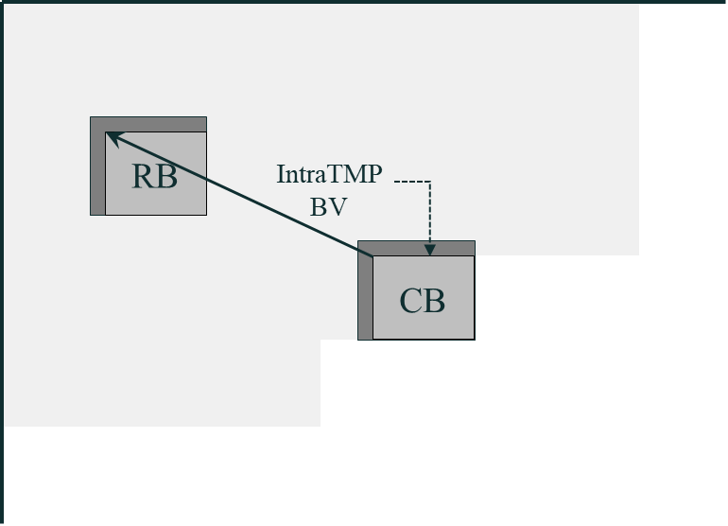
Using a TMP-BV of current block
Using the IntraTMP block vector (TMP-BV) of a current block as a BVP candidate in the AMVP IBC list.
  After the IntraTMP search is conducted, the TMP-BV is stored.
  The current block may use both the TMP-BV of the current block and the TMP-BVs of neighbouring blocks for the AMVP mode.
Figure 1. Storing IntraTMP block vector of current block for IBC candidate list.

Slide 4
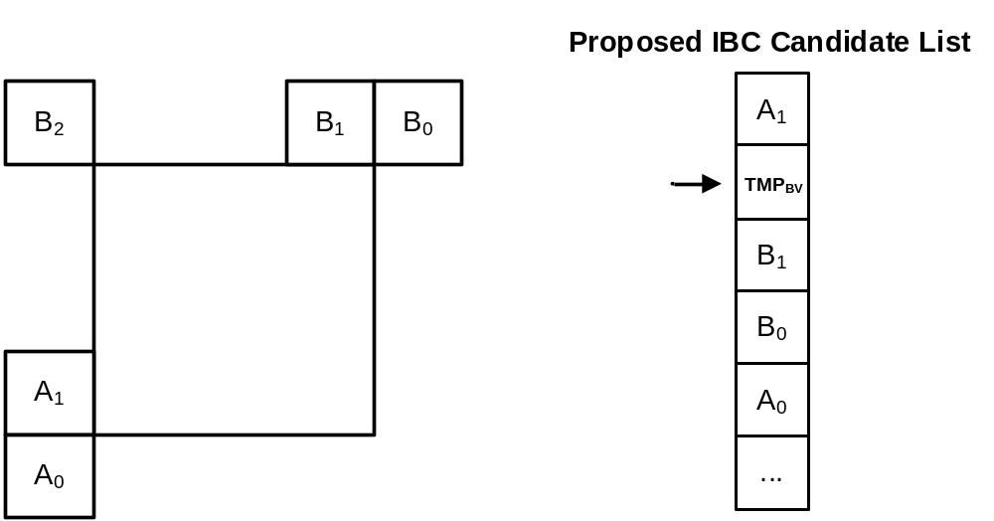
AMVP list construction using TMP-BV
AMVP list construction modification
  Using the TMP-BV of the current block in the second position of the BVPs candidate list among spatial candidates.
  Using the BVD in the AMVP IBC mode may refine the initial IntraTMP reference block location.
  TMP-BV is employed at index 1 of the IBC BV Candidate list to reduce the decoder complexity.
Figure 2. Proposed IBC candidate list modification using the IntraTMP BV for the current block.

Slide 5
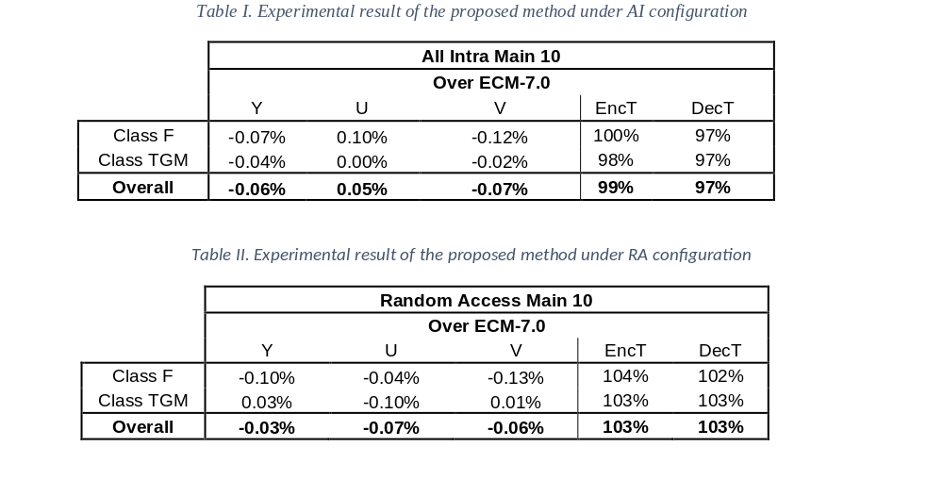
Results
On top of ECM-7.0:

Slide 6
Conclusion
Propose to use the TMP-BV of the current block in the BVPs candidate list.
AI/RA (-0.06%/-0.03%) average coding gain with negligible Enc/Dec run time (99%,97%).
Recommend including in the next EE2 for further study.
Thanks to WILUS for the crosschecking.

