Slide 1
JVET-AC0159
Non-EE2: IBC MBVD list derivation
Zhi Zhang, Pavel Nikitin, Han Huang,
Vadim Seregin, Marta Karczewicz (Qualcomm)

Slide 2
Introduction and Proposal
        In ECM, IBC MBVD list is derived as first 8 lowest TM cost candidates
        BVD candidates has an offset from the set { 1, 2, 4, 8, 12, 16, 24, 32, 40, 48, 56, 64, 72, 80, 88, 96, 104, 112, 120, 128 }-pel
        BVD candidates has a direction from the set { two horizontal and two vertical directions }.
        Local minimum TM cost search to derive MBVD list
        Check valid BVD candidates with interval M-pel along each direction not exceeding max offset N-pel. The K lowest TM cost candidates are kept in the list.
        For each candidate in the list, check two candidates with offset M=±M/2 along the direction.
        Repeat the local minimum TM cost search while reducing M by half until reach M=1.
        Max offset N={128, 256}-pel and start search interval M={4, 8}-pel are tested
        The amount of MBVD candidates K=8 and MBVD index signaling is kept the same as ECM-7.0

Slide 3
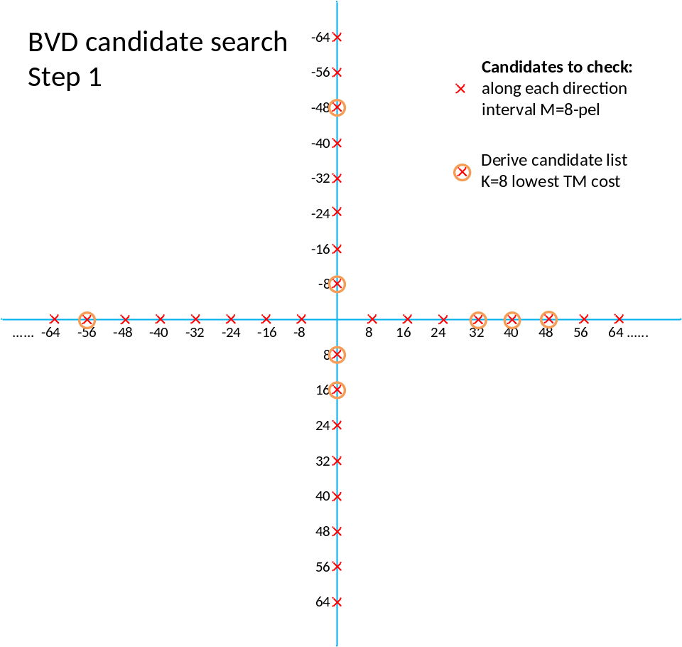
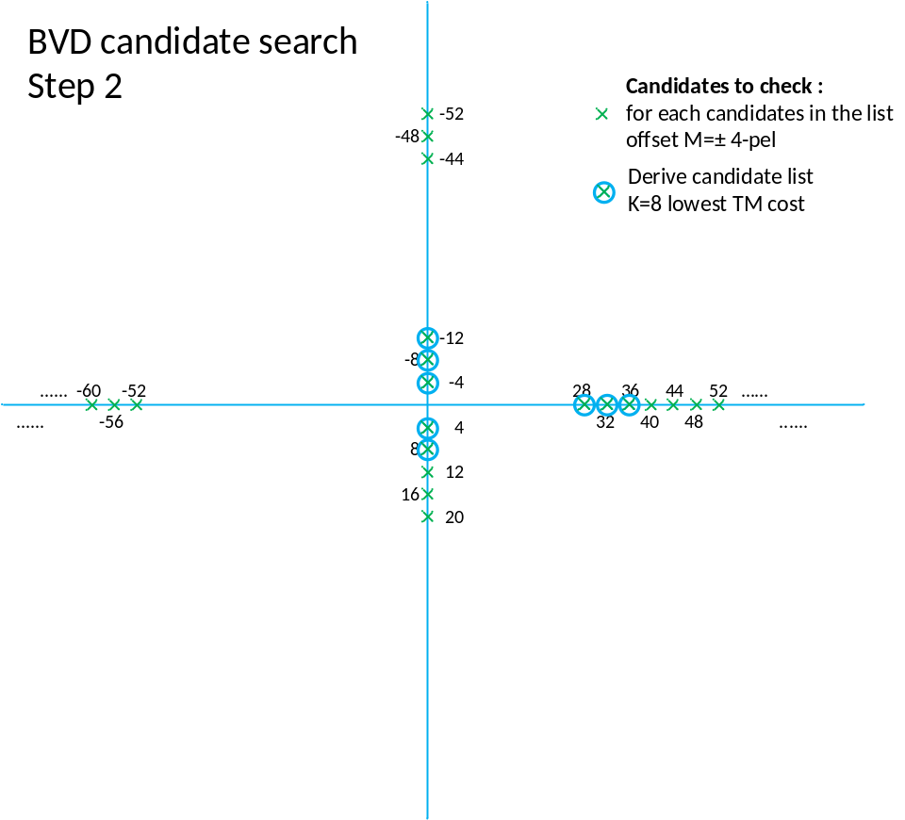
Local minimum TM cost search to derive MBVD list
Repeat until M=±1

Slide 4
Simulation Results
Thanks for Ericsson
Crosscheck JVET-AC0296
Max offset N=128-pel, direction D=4, starting search step M=8-pel (same MBVD configuration as in ECM-7.0)
 | All Intra Main10 |  |  |  |  | Random access Main10
 | Over ECM-7.0
 | Y | U | V | EncT | DecT | Y | U | V | EncT | DecT
Class F | -0.30% | -0.17% | -0.26% | 100% | 99% | -0.28% | -0.29% | -0.21% | 100% | 100%
Class TGM | -0.64% | -0.58% | -0.59% | 100% | 100% | -0.41% | -0.35% | -0.24% | 99% | 100%
Overall | -0.47% | -0.38% | -0.42% | 100% | 100% | -0.34% | -0.32% | -0.22% | 100% | 100%
Max offset N=256-pel, direction D=4, starting search step M=8-pel
 | All Intra Main10 |  |  |  |  | Random access Main10
 | Over ECM-7.0
 | Y | U | V | EncT | DecT | Y | U | V | EncT | DecT
Class F | -0.53% | -0.31% | -0.39% | 103% | 101% | -0.39% | -0.40% | -0.38% | 101% | 100%
Class TGM | -0.85% | -0.81% | -0.82% | 102% | 104% | -0.72% | -0.64% | -0.58% | 99% | 102%
Overall | -0.69% | -0.56% | -0.60% | 102% | 102% | -0.55% | -0.52% | -0.48% | 100% | 101%
Max offset N=256-pel, direction D=4, starting search step M=4-pel
 | All Intra Main10 |  |  |  |  | Random access Main10
 | Over ECM-7.0
 | Y | U | V | EncT | DecT | Y | U | V | EncT | DecT
Class F | -0.73% | -0.62% | -0.72% | 105% | 102% | -0.45% | -0.47% | -0.64% | 102% | 99%
Class TGM | -1.10% | -0.98% | -1.03% | 105% | 110% | -0.84% | -0.79% | -0.69% | 99% | 99%
Overall | -0.92% | -0.80% | -0.88% | 105% | 106% | -0.64% | -0.63% | -0.67% | 100% | 99%

