Slide 1
JVET-AC0148:
Non-EE2: CCCM using multiple downsampling filters
Yao-Jen Chang, Vadim Seregin, Marta Karczewicz

Slide 2
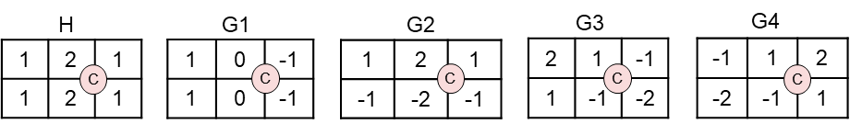
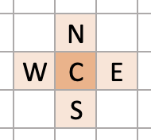
Current ECM
Convolutional cross-component mode (CCCM)
  Apply a downsampling filter to reconstructed luma samples
  The downsampled samples as well as a nonlinear term P and a bias term B are then combined together with filter coefficients to calculate the predicted chroma value
    predChroma = c0 * H(C) + c1 * H(N) + c2 * H(S) + c3 * H(E) + c4 * H(W) + c5 * P + c6 * B
  The filter coefficients ci are derived using LDL decomposition

Slide 3
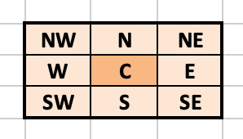
Proposed method
CCCM using multiple downsampling filters is proposed
  Apply multiple downsampling filters to a group of reconstructed luma samples in a CCCM
  The linear combination of these downsampled reconstructed samples is multiplied by derived filter coefficients to form the final chroma predictor
The proposed cross-component models shown below are tested as additional CCCM modes
  Model 1: predChroma = c0 * H(C) + c1 * G1(C) + c2 * G2(C) + c3 * G3(C) + c4 * G4(C) + c5 * P + c6 * B
  Model 2: predChroma = c0 * H(C) + c1 * H(W) + c2 * H(E) + c3 * G1(C) + c4 * G1(W) + c5 * G1(E) + c6 * B
  Model 3: predChroma = c0 * H(C) + c1 * H(N) + c2 * H(S) + c3 * G2(C) + c4 * G2(N) + c5 * G2(S) + c6 * B
  Model 4: predChroma = c0 * H(C) + c1 * H(NE) + c2 * H(SW) + c3 * G4(C) + c4 * G4(NE) + c5 * G4(SW) + c6 * B
  H(·), G1(·), G2(·), G3(·), G4(·) are various downsampling filters
  C denotes the current chroma sample position, and N, S, W, E, NE, SW are the positions around C
  c0, c1, …, c6 are filter coefficients (derived by same LDL decomposition)

Slide 4
Test results
Implemented on top of ECM-7.0
 | All Intra Main 10
 | Over ECM-7.0
 | Y | U | V | EncT | DecT
Class A1 | 0.00% | -1.12% | -1.09% | 105% | 101%
Class A2 | -0.04% | -1.09% | -1.08% | 106% | 103%
Class B | -0.01% | -1.25% | -1.01% | 102% | 99%
Class C | -0.04% | -0.90% | -0.81% | 103% | 98%
Class E | -0.01% | -0.77% | -0.39% | 103% | 99%
Overall | -0.02% | -1.05% | -0.89% | 104% | 100%
Class D | -0.02% | -0.97% | -0.63% | 103% | 99%
Class F | -0.19% | -1.07% | -0.98% | 100% | 100%
Class TGM | -0.75% | -1.14% | -1.37% | 101% | 100%
 | Random Access Main 10
 | Over ECM-7.0
 | Y | U | V | EncT | DecT
Class A1 | 0.03% | -0.59% | -0.40%
Class A2 | -0.01% | -0.56% | -0.50%
Class B | 0.01% | -0.99% | -0.84%
Class C | 0.00% | -0.50% | -0.43%
Class E
Overall | 0.01% | -0.69% | -0.57%
Class D | -0.02% | -0.32% | -0.59%
Class F | -0.28% | -1.15% | -0.95%
Class TGM | -0.20% | -0.44% | -0.39%

