Slide 1

AHG12: Filtered Template Matching based Intra Prediction (FTMP)
JVET-AC0146
Ramin G. Youvalari, Döne Bugdayci Sansli, Pekka Astola, Jani Lainema
Nokia

Slide 2
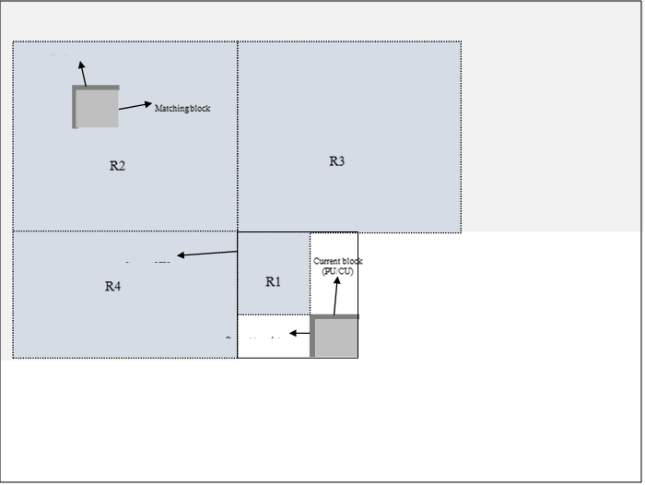
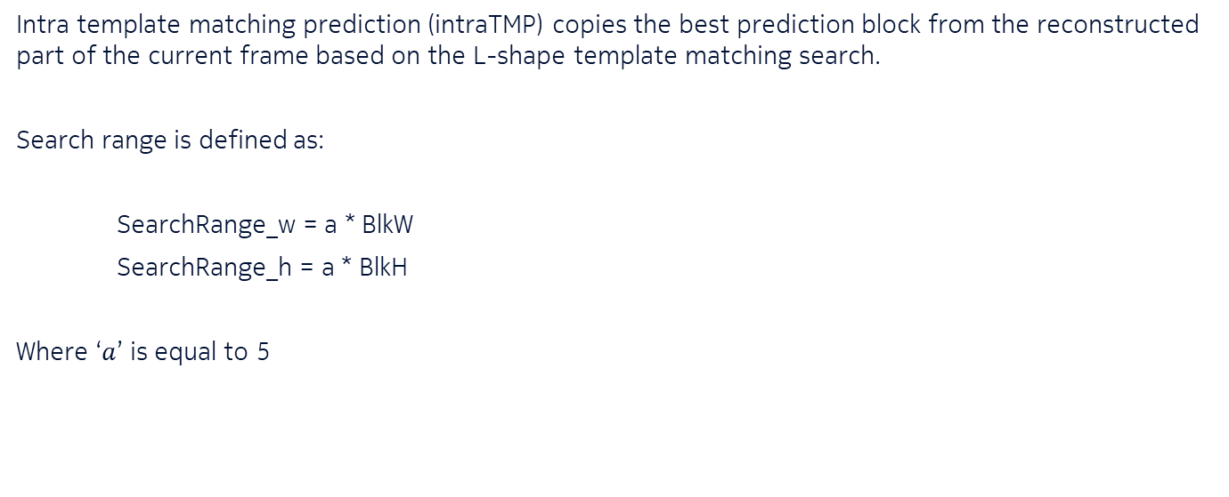
Intra Template Matching
In ECM7.0
Intra template matching prediction (intraTMP) copies the best prediction block from the reconstructed part of the current frame based on the L-shape template matching search.
Search range is defined as:
SearchRange_w = a * BlkW
SearchRange_h = a * BlkH
Where ‘$a$’ is equal to 5

Slide 3
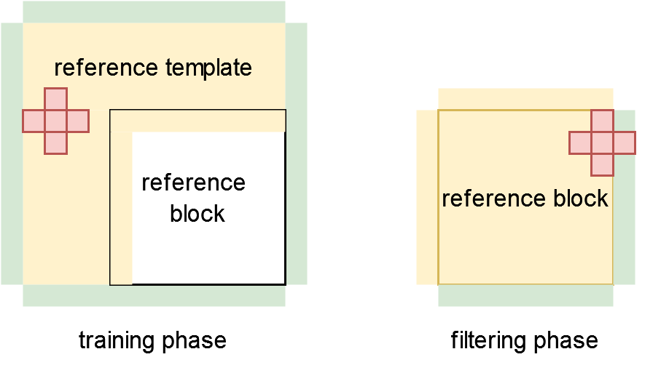
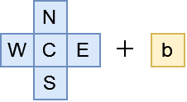
Filtered intraTMP - FTMP
Proposed method in JVET-AC0146
A 6-tap filter is trained using the samples in the template area of the intraTMP mode:
predVal = c₀C + c₁N + c₂S + c₃W + c₄E + c₅b
Filter inputs:
Center (C) sample
North (N) sample
South (S) sample
West (W) sample
East (E) sample
Bias term (b)
  set to be middle value of the operating range, e.g., 512 for 10-bit content)

Slide 4
Further Details
JVET-AC0146
LDL decomposition of ECM software is used for parameter calculation
The template area over which the filter parameters are calculated, is the same area as in intraTMP
Several (N) best candidates found through the SAD-based search of intraTMP method is used
Filter parameters are calculated for each of N best candidates and the best performing one in terms of template cost after filtering is selected as the final candidate
Signaled with a context coded flag as a sub-mode of intraTMP

Slide 5
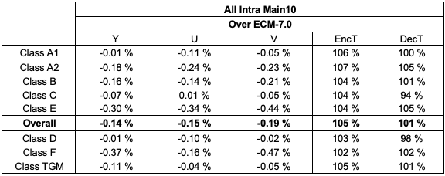
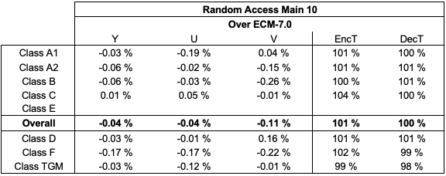
Experimental results
For N=8 candidates

Slide 6
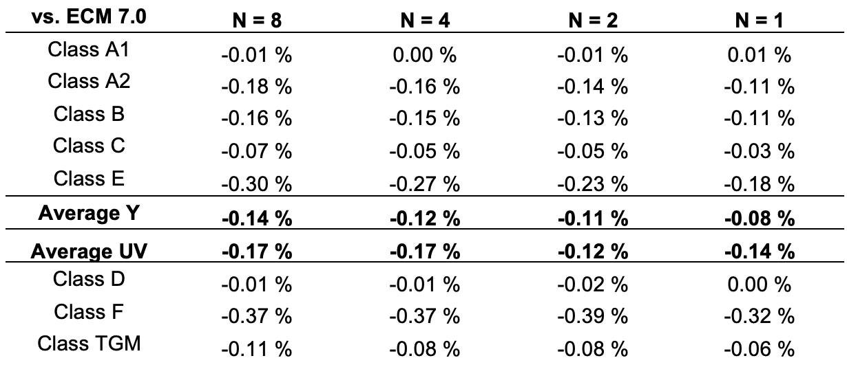
Additional Experimental Results in AI Configuration
For N=8, 4, 2 and 1 candidates

Slide 7
Summary
JVET-AC0146
Proposing a 6-tap filter for enhancing performance of intraTMP tool
Provides further coding efficiency improvements over ECM-7.0
  AI: -0.14%, -0.15%, -0.19% for Y, U, V
  RA: -0.04%, -0.04%, -0.11% for Y, U, V
It is suggested to include the technique in the next round of EEs.

