Slide 1
AHG12
Location-dependent
Decoder-side Intra Mode Derivation
JVET-AB0116
Saverio Blasi, Jani Lainema

Slide 2
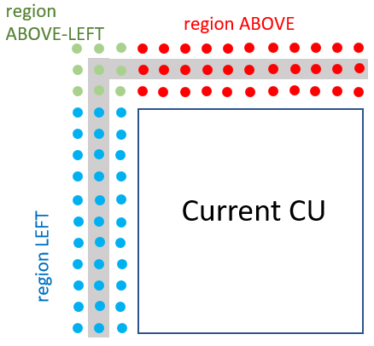
Proposed approach
It is proposed to allow sample-based blending for DIMD predictors.
The location of template samples may be used to infer the type of blending:
  e.g. If DIMD mode mostly derived from above, use higher weights at top of the block.
Three regions considered within the DIMD template:
Three “region histograms” separately computed.
Full histogram obtained adding the three histograms.

Slide 3
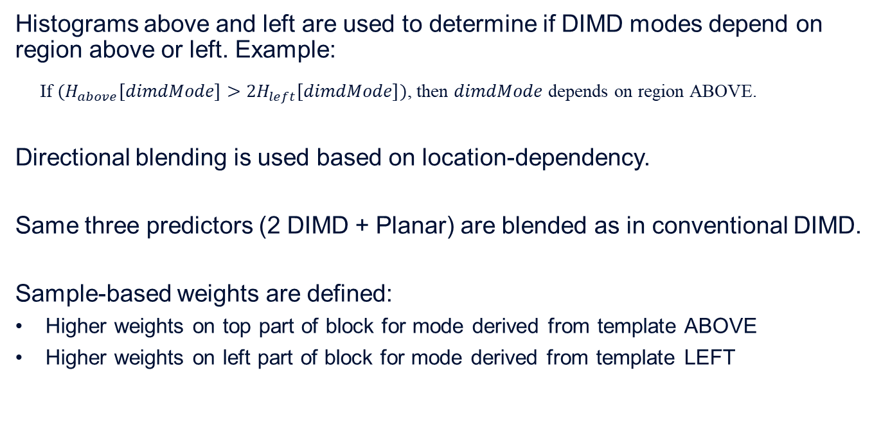
Proposed approach (2)
Histograms above and left are used to determine if DIMD modes depend on region above or left. Example:
If $(H_{above}\left[dimdMode\right]>2H_{left}\left[dimdMode\right])$, then $dimdMode$ depends on region ABOVE.
Directional blending is used based on location-dependency.
Same three predictors (2 DIMD + Planar) are blended as in conventional DIMD.
Sample-based weights are defined:
Higher weights on top part of block for mode derived from template ABOVE
Higher weights on left part of block for mode derived from template LEFT

Slide 4
Proposed approach (3)
Integration in ECM:
Conventional DIMD blending used if modes are not location-dependent
No new signalling required – usage is inferred during DIMD modes derivation
No new RD checks required at the encoder side

Slide 5
Experimental results
 | All Intra Main10
 | Over ECM-6.0
 | Y | U | V | EncT | DecT
Class A1 | -0.06% | -0.25% | -0.13% | 98% | 98%
Class A2 | -0.07% | -0.03% | -0.08% | 99% | 98%
Class B | -0.05% | -0.01% | -0.09% | 98% | 98%
Class C | -0.08% | -0.04% | -0.12% | 97% | 96%
Class E | -0.15% | -0.24% | -0.12% | 95% | 97%
Overall | -0.08% | -0.10% | -0.11% | 98% | 98%
Class D | -0.08% | -0.13% | -0.23% | 96% | 97%
Class F | -0.15% | -0.11% | -0.03% | 94% | 100%
 | Random Access Main 10
 | Over ECM-6.0
 | Y | U | V | EncT | DecT
Class A1 | -0.06% | 0.01% | -0.06% | 103% | 100%
Class A2 | -0.03% | -0.01% | -0.14% | 104% | 99%
Class B | -0.03% | 0.18% | -0.28% | 99% | 99%
Class C | -0.04% | 0.03% | 0.17% | 99% | 103%
Class E
Overall | -0.04% | 0.07% | -0.09% | 101% | 100%
Class D | -0.02% | -0.09% | -0.40% | 101% | 105%
Class F | -0.05% | -0.18% | 0.03% | 100% | 100%

Slide 6
Summary
We propose to allow sample-based blending for DIMD predictors
This is inferred during histogram computation
Approach provides -0.08% luma gains for AI and -0.04% luma gains for RA with no additional encoder or decoder complexity.
We propose to study this in the next round of the EE.

