Slide 1
JVET-AB0065
Non-EE2: Adaptive reference region DIMD
SHARP Corporation
Zheming Fan
Yukinobu Yasugi
Tomohiro Ikai

Slide 2
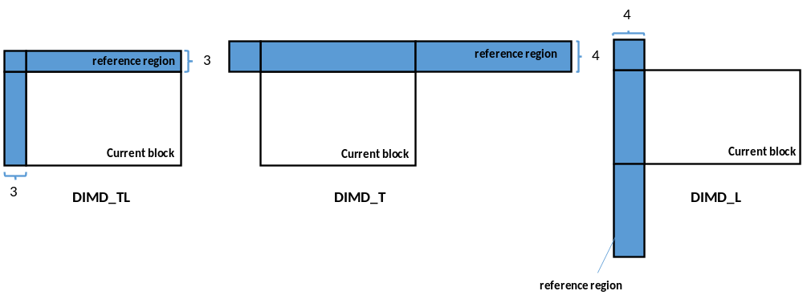
DIMD_T and DIMD_L
In this contribution, we add two new modes DIMD_T and DIMD_L to select different neighborhoods (reference region). In the DIMD_T we use top-left, top, and top-right neighborhoods as reference region, and in DIMD_L mode we use top-left, left, and left-bottom neighborhoods as reference region. Moreover, we set the number of lines in the reference area in DIMD_T and DIMD_L modes to 4.
Copyright © All rights reserved, SHARP CORPORATION

Slide 3
DIMD_T and DIMD_L
The proposed DIMD consists of DIMD_TL (top and left), DIMD_L (left) and DIMD_T (top) where a new syntax element is signalled to select neighboring reconstructed pixels (reference region) used to derive a prediction direction (DIMD intra mode). In each CU, a new flag named cu_dimd_mode is signalled after the DIMD enabled flag (cu_dimd_flag) to determine which DIMD mode is used.
cu_dimd_mode | Binarization | Name
0 | 0 | DIMD_TL
1 | 10 | DIMD_T
2 | 11 | DIMD_L
Copyright © All rights reserved, SHARP CORPORATION

Slide 4
Results
 | All Intra Main10
 | Over ECM-6.0
 | Y | U | V | EncT | DecT
Class A1 | -0.17% | -0.12% | -0.04% | 116% | 100%
Class A2 | -0.10% | -0.01% | 0.00% | 114% | 100%
Class B | -0.09% | 0.06% | 0.07% | 117% | 100%
Class C | -0.08% | 0.08% | 0.00% | 115% | 100%
Class E | -0.07% | 0.07% | -0.07% | 117% | 100%
Overall | -0.10% | 0.02% | 0.00% | 116% | 100%
Class D | -0.07% | 0.18% | -0.03% | 116% | 100%
Class F | -0.06% | 0.01% | 0.09% | 109% | 100%
Class TGM | #VALUE! | #VALUE! | #VALUE! | #DIV/0! | #DIV/0!
Copyright © All rights reserved, SHARP CORPORATION

Slide 5
Results
 | Random Access Main 10
 | Over ECM-6.0
 | Y | U | V | EncT | DecT
Class A1 | -0.10% | -0.03% | -0.04% | 104% | 104%
Class A2 | -0.06% | -0.01% | -0.05% | 104% | 110%
Class B | -0.06% | 0.14% | -0.29% | 102% | 100%
Class C | -0.04% | -0.03% | -0.10% | 98% | 94%
Class E
Overall | -0.06% | 0.03% | -0.14% | 101% | 101%
Class D | -0.05% | 0.12% | 0.05% | 114% | 103%
Class F | -0.05% | -0.03% | -0.41% | 101% | 79%
Class TGM | #VALUE! | #VALUE! | #VALUE! | #DIV/0! | #DIV/0!
Copyright © All rights reserved, SHARP CORPORATION

Slide 6
Conclusion
The experiment proves that the new DIMD proposed modes shows 0.1% Bd-rate gain on luma compared with the original DIMD mode. It is recommended to study this technique in EE.
Copyright © All rights reserved, SHARP CORPORATION

Slide 7
Acknowledgements
Thanks Alibaba for crosschecking. This is very helpful.
Copyright © All rights reserved, SHARP CORPORATION

Slide 8
Thank you for listening
Copyright © All rights reserved, SHARP CORPORATION

